Slide 1
LEAF COLOR CHART
Tool for real time N management
James Lasquites

Slide 2
LEAF COLOR CHART
-First developed in Japan in late ‘80s
-Further developed by:
University of California Cooperative Extension (UCCE)
International Rice Research Institute (IRRI)
Zejiang agricultural University (ZAU) and
Philippine Rice Research Institute (PhilRice)
-Released in 2003

Slide 3
Leaf Color Chart
Leaf color chart (LCC) is a reliable tool for real time N management
It can be used for rapid and reliable monitoring of relative greenness of the leaf as an indicator of leaf N status.

Slide 4
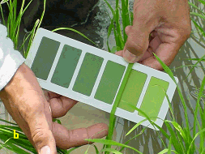
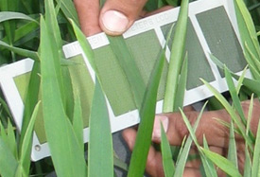
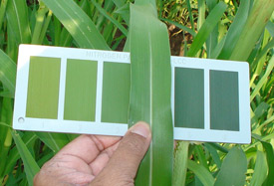
LEAF COLOR CHART
RICE
WHEAT
CORN

Slide 5
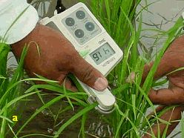
Chlorophyll meter vs Leaf Color Chart
Expensive
Battery operated
Active sensor (LED)
Low cost
Sunlight (light source)

Slide 6
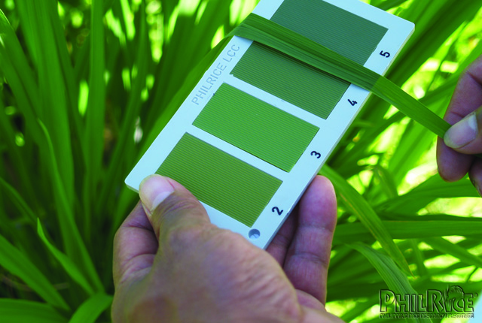
Leaf Color Chart
1
Standardized leaf color chart (developed by UCCE* in collaboration with IRRI**) released 2003
2
3

Slide 7
Buresh,R.J 2002

Slide 8
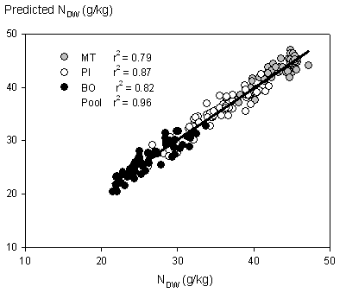
Data from 2001 Dry season (DS) and Wet Season (WS).
Predicted and measured leaf N content N_{dw} = leaf N per unit dry weight, MT = mid tillering, PI = panicle initiation, BO = booting.
Christian Witt^{1, 2}, Julie Mae Cabrera-Pasuquin² and Randall G. Mutters^{3,} 2004

Slide 9
Leaf Color Chart
Since its introduction in December 2003, more than 250,000 units of the 4-panel LCC have been produced and distributed to Asian rice farmers in Bangladesh, China, India, Indonesia, Myanmar, the Philippines

Slide 10
How to Use LCC
Select plants for testing
Randomly select at least 10 disease-free rice plants or hills in a field, where plant population is uniform.
Match the leaf to the chart
Select the topmost, youngest, fully expanded leaf from each hill or plant. This part best reflects the N status of the plants.
Place the middle part of the leaf on the LCC and compare its color with the color panels. Do not detach or destroy the leaf.

Slide 11
How to Use LCC
Measure the leaf color
  leaf color should be measured under the shade of your body. Direct sunlight affects leaf color readings.
  If possible, the same person should read the LCC at the same time of the day, every time.
  If the color of a rice leaf is in between two shades, take the average of the two values as the reading (ex. if the color is in between 3 and 4, the reading should be 3.5)

Slide 12
How to Use LCC
Determine the average LCC
Take the reading of the 10 leaves, and determine the average. If the color is 3.5 or less, N fertilizer top dressing is needed.

Slide 13
Using the LCC
Photos from Witt et al. (2002)

Slide 14
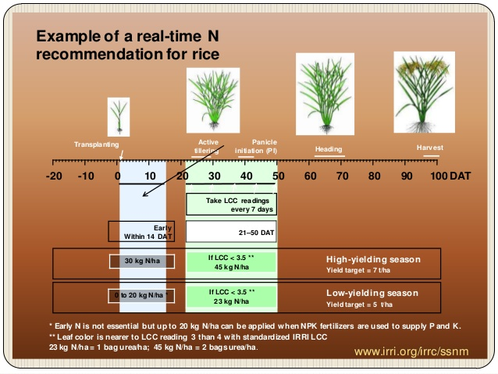

Slide 15
7 key sites in Asia (Irrigated rice)
Vietnam (2)
Philippines
Indonesia
India (2)
China
(Witt, J.M.C.A. Pasuquin, R. Mutters, and R.J. Buresh, 2005)

Slide 16
Benefit of using LCC
Saves 18-36lbs N/acres (39lbs-78lbs Urea/acre)
Average Grain Yield Increase of .669 tons/acre
Additional profit of US $ (20-56)/acre per season

Slide 17
Country | Irrigated rice area, '000 ha | Mean number of crops per year | Saving in urea per year*, '000 t
 |  |  | 25% farmers use LCC | 50% farmers use LCC | 75% farmers use LCC | 100% farmers use LCC
Bangladesh | 3,488 | 2 | 87.2 | 261.6 | 261.6 | 348.8
India | 22,250 | 1.5 | 417.2 | 834.4 | 1,251.6 | 1,668.8
Indonesia | 6,318 | 2 | 158.0 | 316.0 | 474 | 632.0
Philippines | 2,248 | 2 | 56.2 | 112.4 | 168.6 | 224.8
Thailand | 1,960 | 2 | 49.0 | 98.0 | 147.0 | 196.0
Vietnam | 3,978 | 2 | 99.5 | 199.0 | 297.7 | 398.0
Asia (- China) | -- | -- | 999.7 | 1,999.4 | 2,999.1 | 3,998.8
www.nitrogenparameters.com

Slide 18
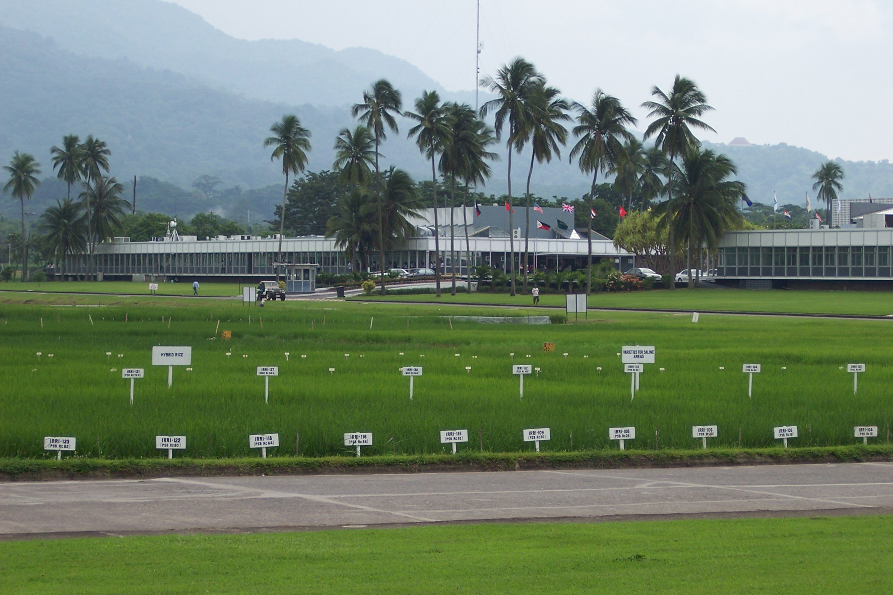
International Rice Research Institute

