Slide 1
Intro to Precision Agriculture
Soil 4213 Fall 2020

Slide 2

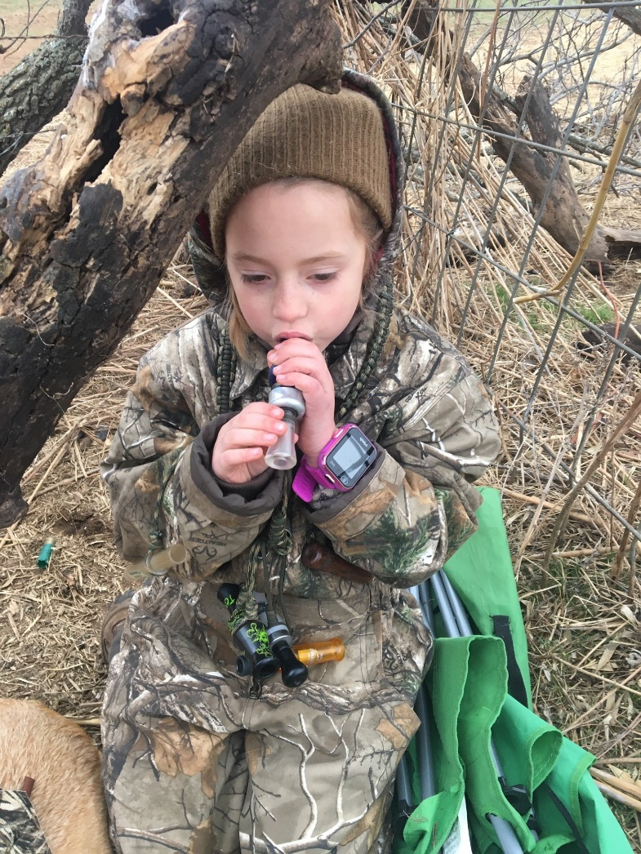
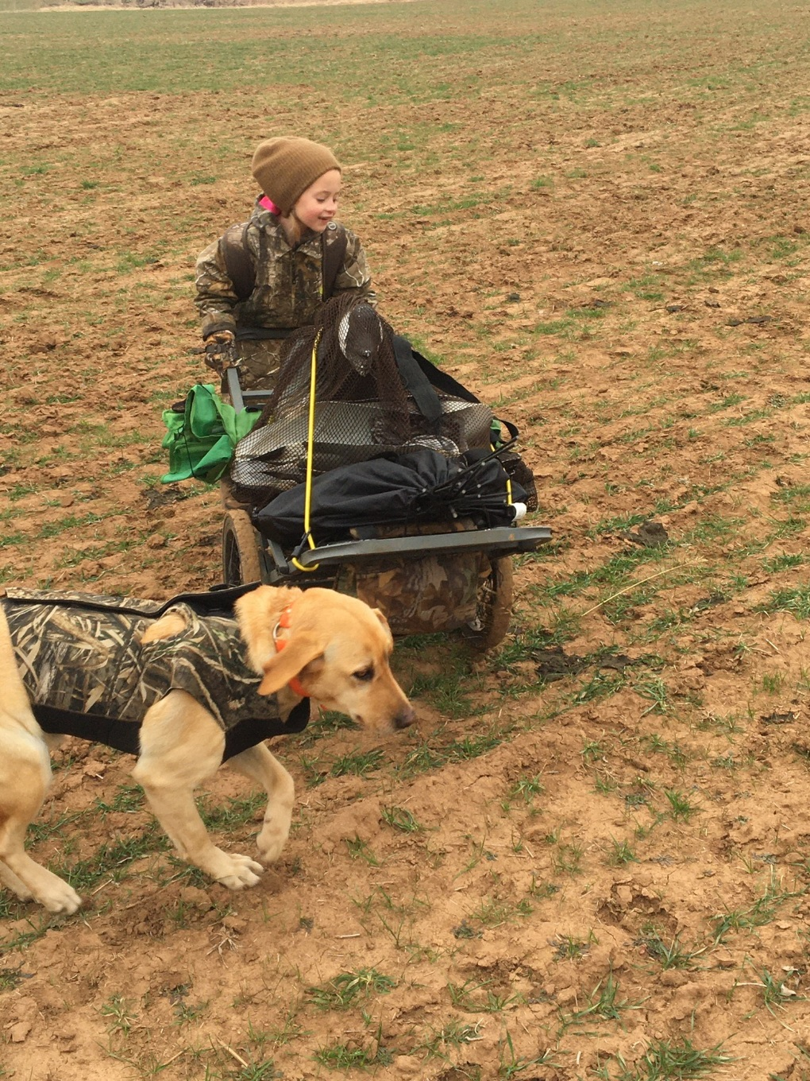


Slide 3
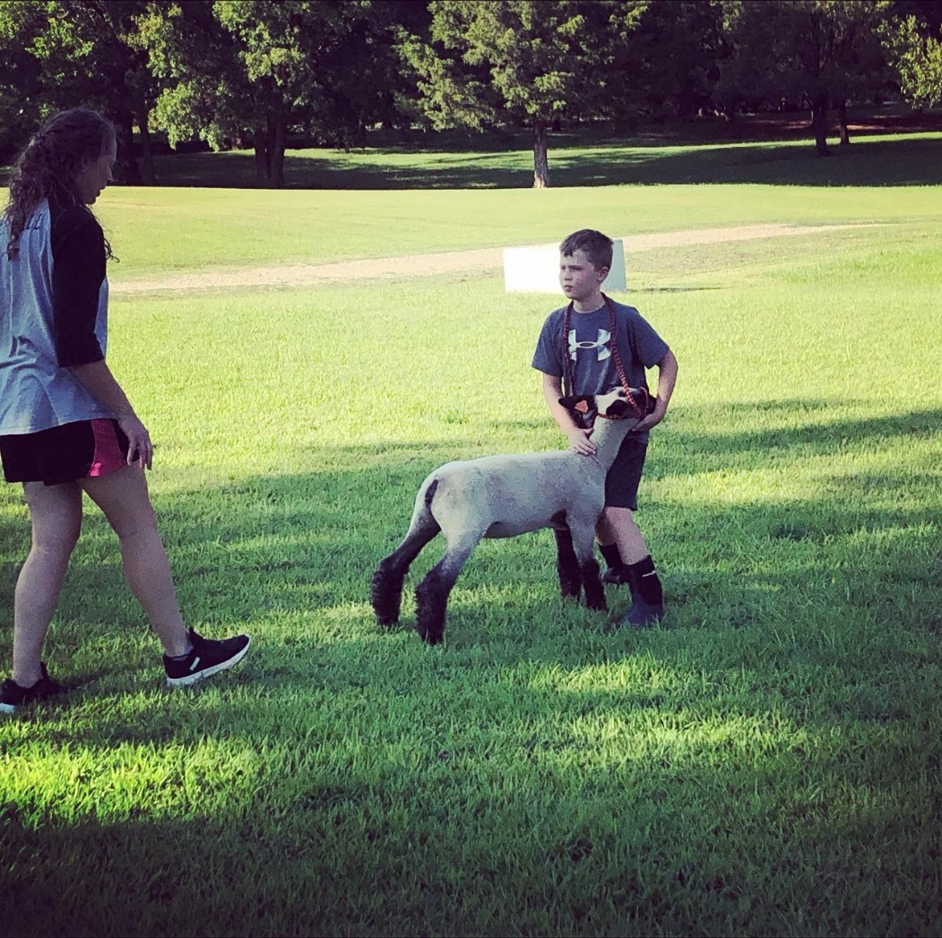
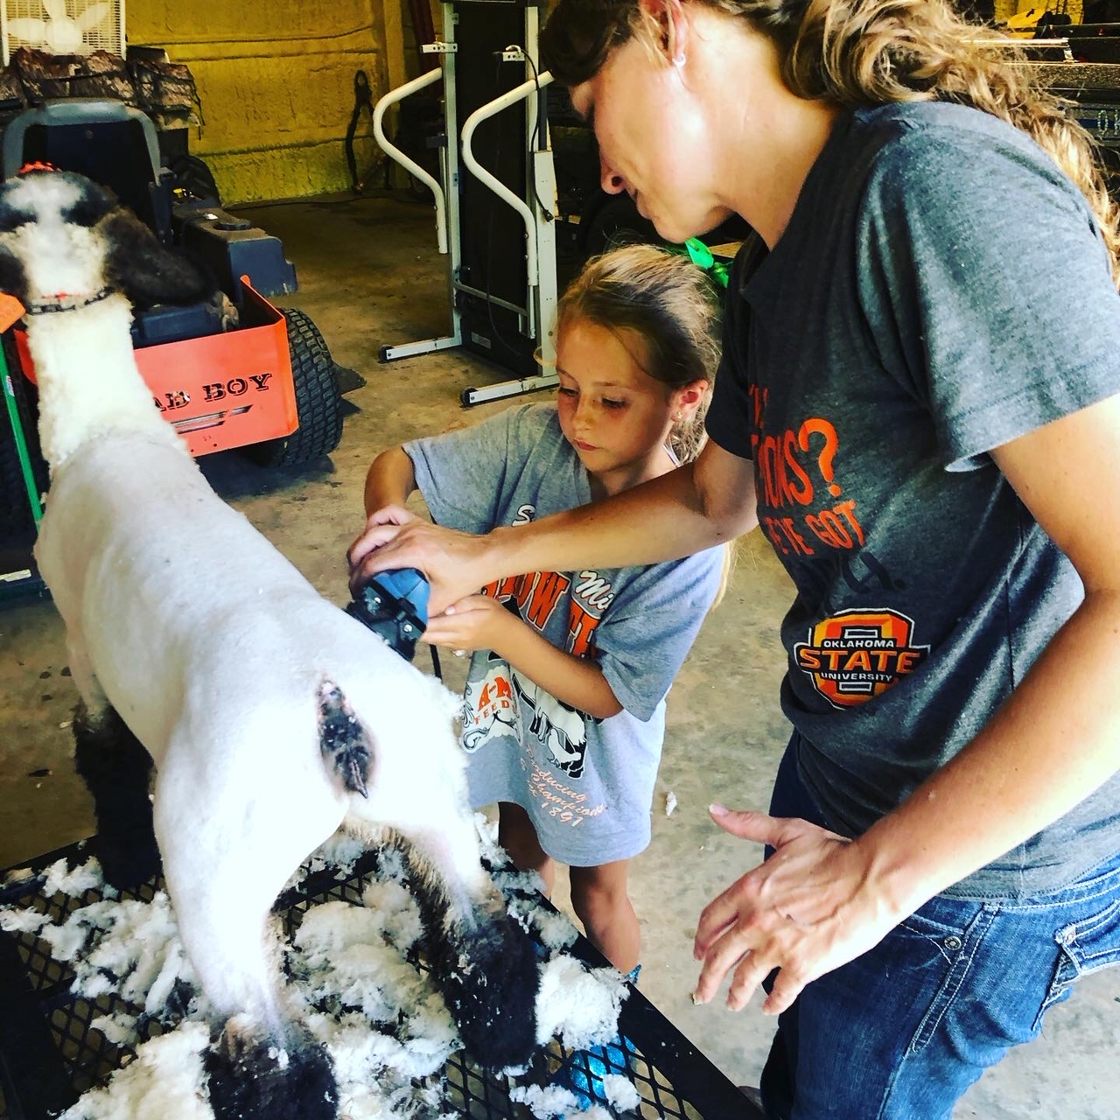

Slide 4

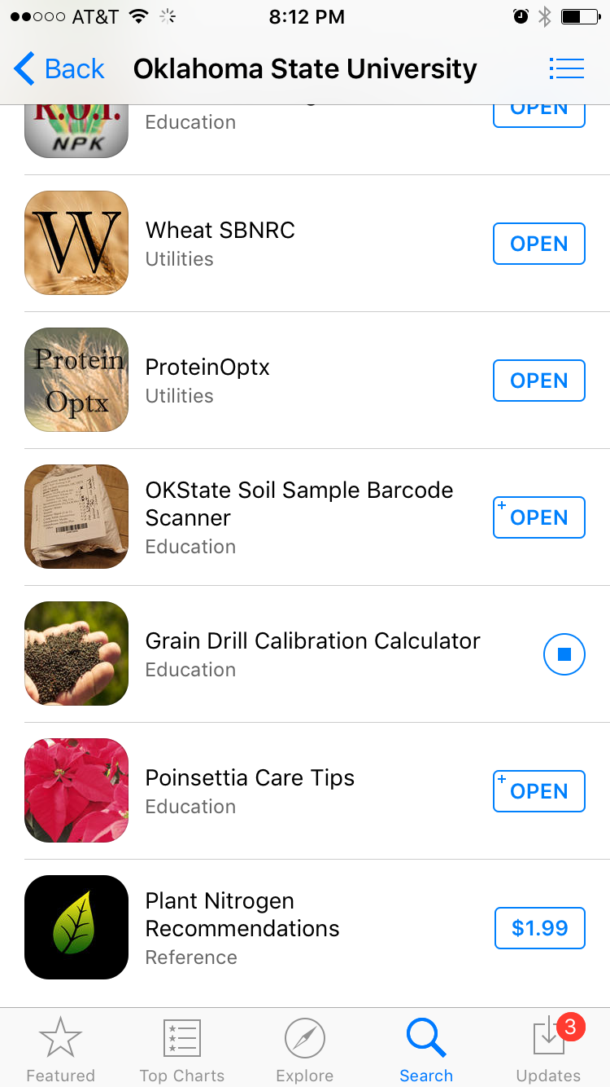
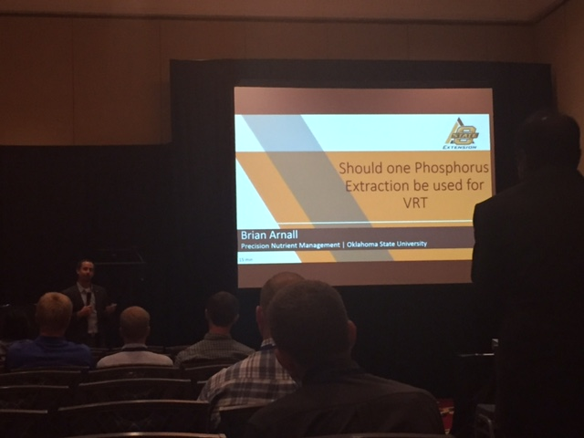

Slide 5
Quiz 1
On Canvas –
  Quizzes
    Quiz 1

Slide 6

Precision Ag (PA)
What is it?
What are examples of PA?
Is there a need for PA?
Is PA for everyone?
What are potential Benefits of PA?

Slide 7
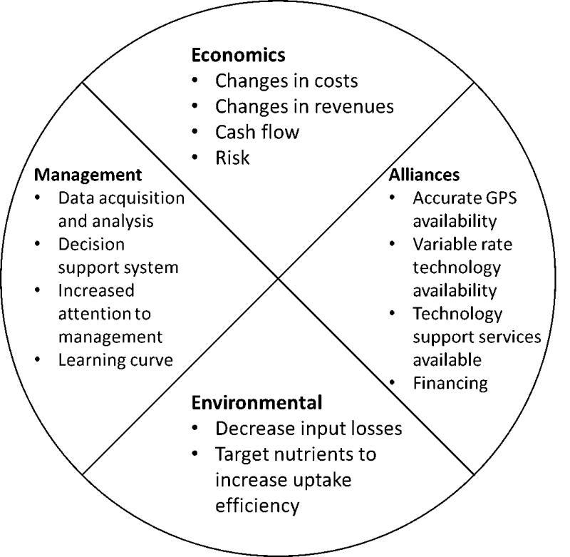
The Adoption of PA
$$$$$$
Management
Alliances: Green to Red, bankers
Mental
Environment
Fig. 1.1.
Issues affecting adoption of precision agriculture management.

Slide 8
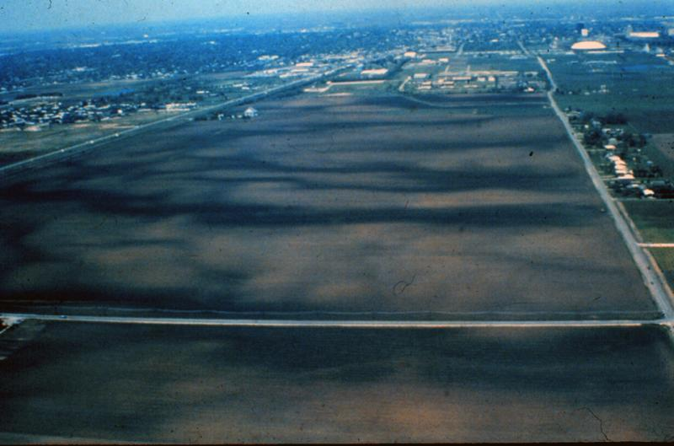
PA Need
What is needed for PA to be “Needed”????
  Variability
    Space
    Time
  Time/Mental Consuming Task
  Economics
    Profit to be made
      Decrease input maintain yield
      Increase input increase yield
      Decrease input increase yield
      Maintain input increase yield
    Product is worth varying
  Environmental
Fig. 1 2.
An aerial photo showing differences in organic matter

Slide 9
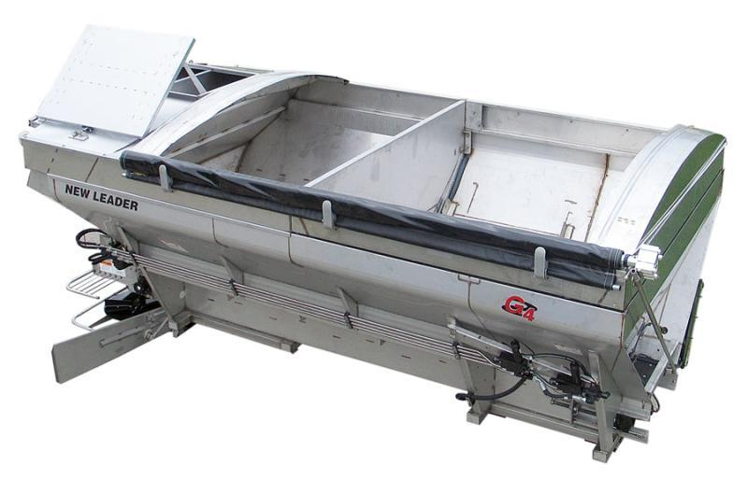
PA NEED
Appropriate Technology
Appropriate Management
Appropriate Tech Support
Fig. 1.3.
A multibin variable-rate fertilizer applicator body. Courtesy of Stahly. http://www.stahly.com/products/systems/L4000Gmultibin_spreader.htm

Slide 10
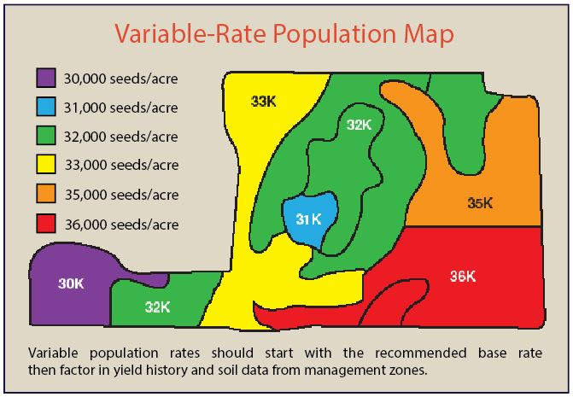
PA Inputs
Fertilizer
Pesticide
Seeds

Slide 11
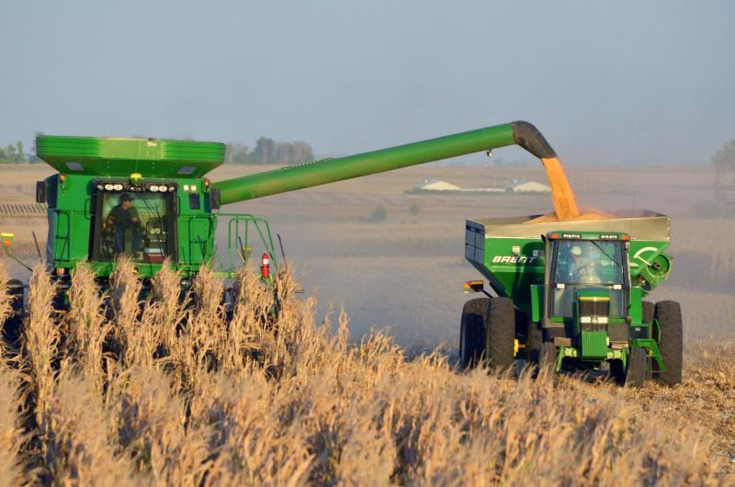
PA Tools
GNSS/GPS
  Global Navigation Satellite System
  Global Positioning System
Yield Monitors and Maps
Data Collection Devices
  In-cab
  On Equipment
Fig. 1.4.
GPS-equipped yield mapping combine. Courtesy of Kurt Lawton, Content Director, Corn and Soybean Digest. http://www.cornandsoybeandigest.com/node/12922/gallery?slide=19

Slide 12
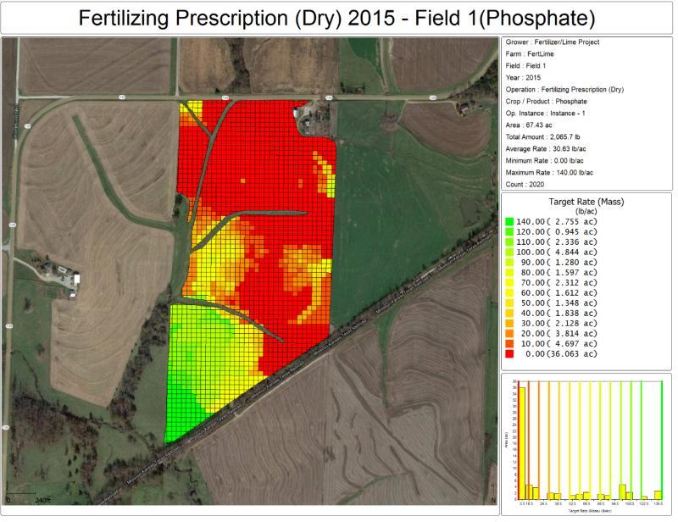
PA Tools
Sampling and Mapping
  Soil Sample
  EC Maps
  EM Maps
  Multi Spec
  By-row Planter
Remote Sensing and Imagery
  Ground Based
  Remote
Fig. 1.5.
A variable-rate fertilizer prescription map based on grid soil sampling values.

Slide 13
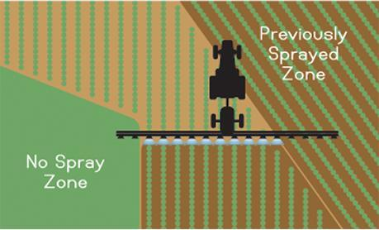
Implementation
Fig. 1.6. Illustration of automatic section control technology. Courtesy of Raven Industries, Inc. http://ravenprecision.com/assets/users/photo-gallery/15_accuboom-illustration.png

Slide 14
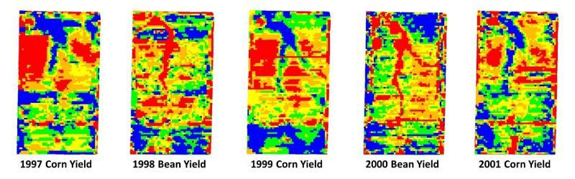
Implementation
Fig. 1.7.
Grain yields for five years (left, top to bottom: 1, 2, 3, 4, 5). Higher yielding areas are indicated by the color blue and lower yield areas are indicated by the color red. Courtesy of USDA-ARS Cropping Systems and Water Quality Research, Columbia, MO.

Slide 15
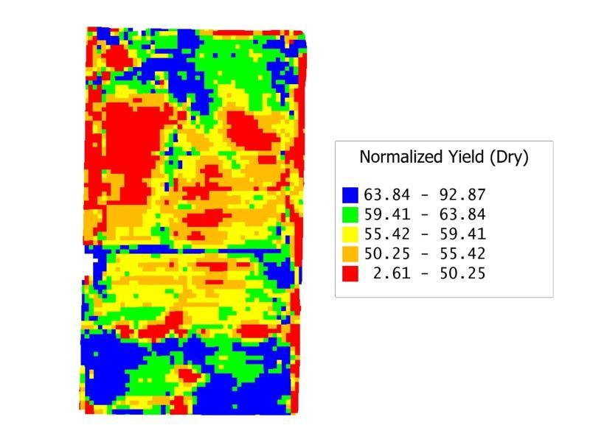
Implementation
What do you make of this?
What can you do with this data?
Fig. 1.8.
Standardized yield map for five years of yields on a scale from 0 to 100. Courtesy of USDA-ARS Cropping Systems and Water Quality Research, Columbia, MO.

Slide 16
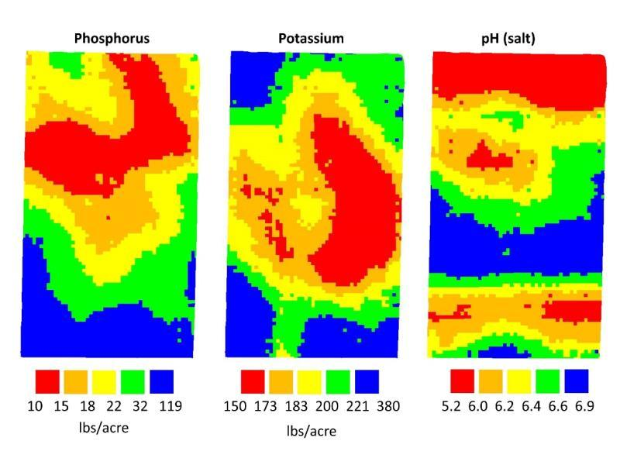
Implementation
Fig. 1.9.
Soil test phosphorous, potassium, and pH for a central Missouri farm. Courtesy of USDA-ARS Cropping Systems and Water Quality Research, Columbia, MO.

Slide 17
Implementation

Slide 18
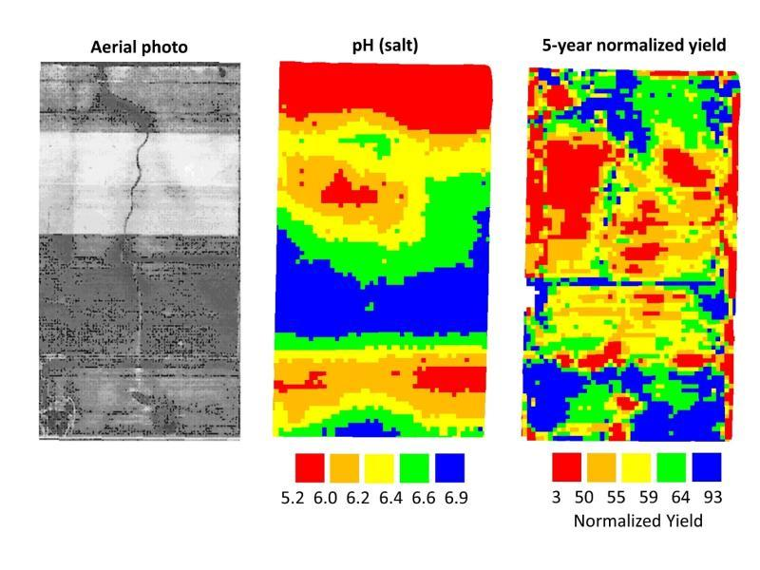
Implementation
Google Earth
Fig. 1.10.
Aerial photograph, soil pH, and 5-year average grain yields for central Missouri farm. Courtesy of USDA-ARS Cropping Systems and Water Quality Research, Columbia, MO.

Slide 19
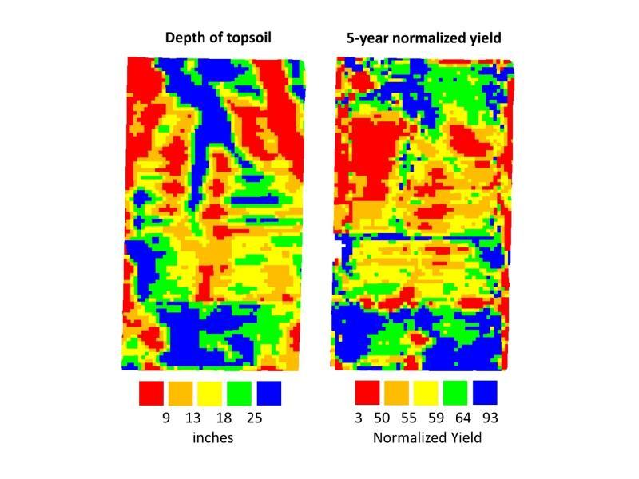

Implementation
Only 1 controlling variable??
Fig. 1.11.
Depth of topsoil in inches and five-year normalized yield for a central Missouri Farm (Courtesy of USDA-ARS Cropping Systems and Water Quality Research, Columbia, MO).

Slide 20
Questions
In this chapter, it was discussed that precision agriculture has the potential to affect crop production input costs and revenues. What are two site-specific management strategies that can be implemented with the goal of increasing profit?
What are the three questions a farmer must answer before adopting precision farming?
What are six primary tools of precision farming?
Define spatial variability.
Define temporal variability.
Develop a strategy to determine the yield limiting factor.

