Slide 1
Understanding and Identifying Variability
Soil 4213 Fall 2018

Slide 2
Precision Agriculture
What is it?
Precision n. The quality or state of being precise.
Used or intended for precise measurement.
Made for the least variation from a set standard. (Webster, 1995)
Precise adj. Capable of, caused by, or designating an action,
performance, or process carried out or successively repeated
within close specified limits (Webster, 1995).

Slide 3
PA
What is it?
Management of production inputs in relation to more
precisely delineated needs (Johnson, 1/18/01).
Recognizes spatial variability of production needs within a population
of production units, where production units are smaller than they used to be.

Slide 4
Key Terms
Spatial variability refers to quantitative or quali-tative diff erences found when comparing two or more locations.
Temporal variability is the change that occurs over time.
The change may have a short timeframe (e.g., nitrification of applied fertilizer, ammonia volatiliza-tion, C sequestration, or gully formation after a single large rainfall event) or a very long timeframe [e.g., gla-cial melt or a change in soil texture (e.g., from sand to clay)].
Abiotic stress is the negative impact of nonliving factors on an organism.
Biotic stress to crops is caused by living organisms, and they are often referred to as pests.

Slide 5
Spatial variability among production units.
What is the size of a production unit?
Depends on the enterprise.
  Small dairy = single dairy animal.
  Wagoner Ranch, TX = 7,000 – 8,000 acre wheat field.
Agronomic units = “fields” “zones”

Slide 6
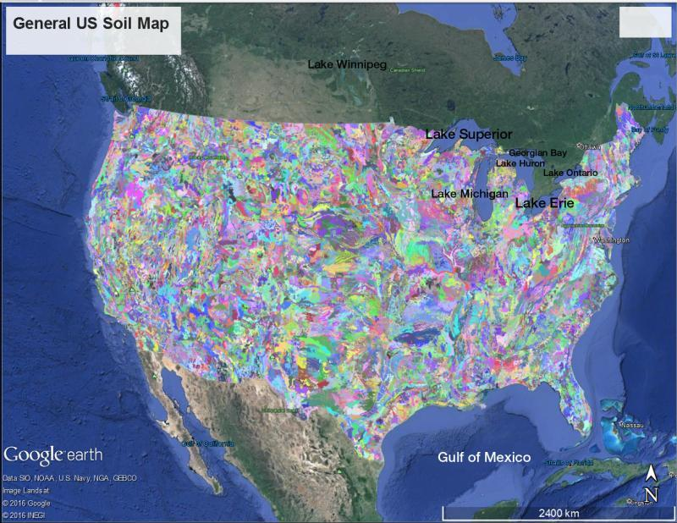
Fig. 2.1.
Classified U.S. soils by soil association, which is an aggregate of similar mapped soils. (Courtesy of Google Earth).

Slide 8
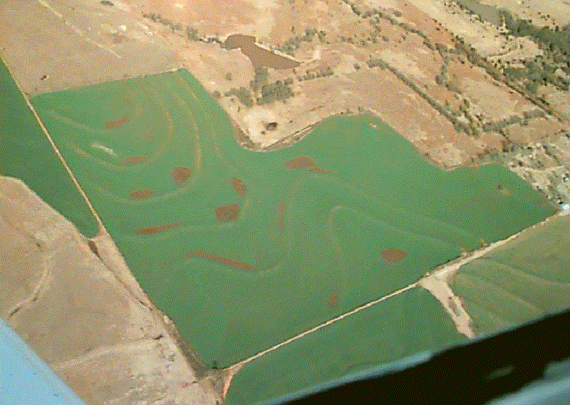
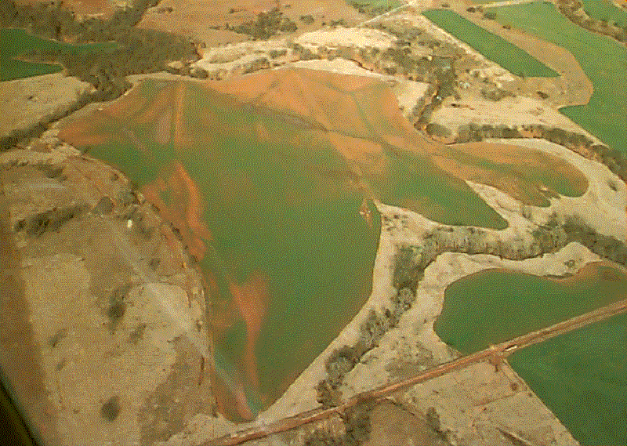
Production Unit Size?
By Farm?

Slide 9
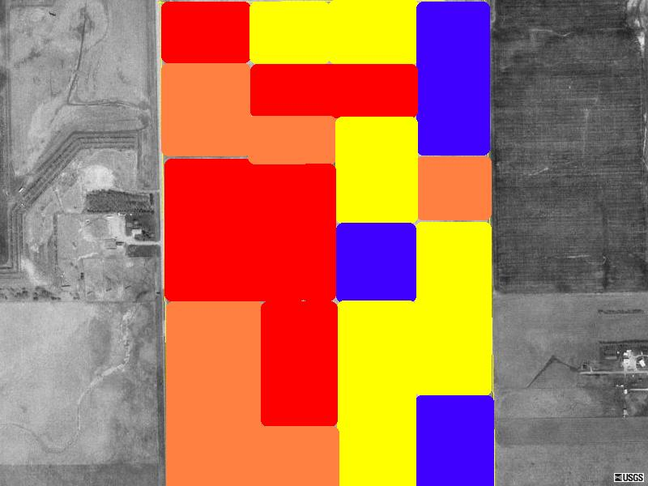
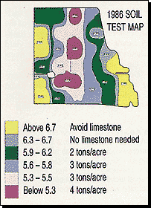
Production Unit Size?
2-4 acre grids?

Slide 10
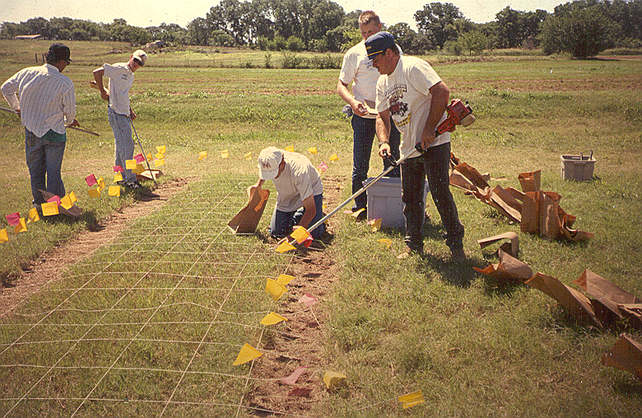
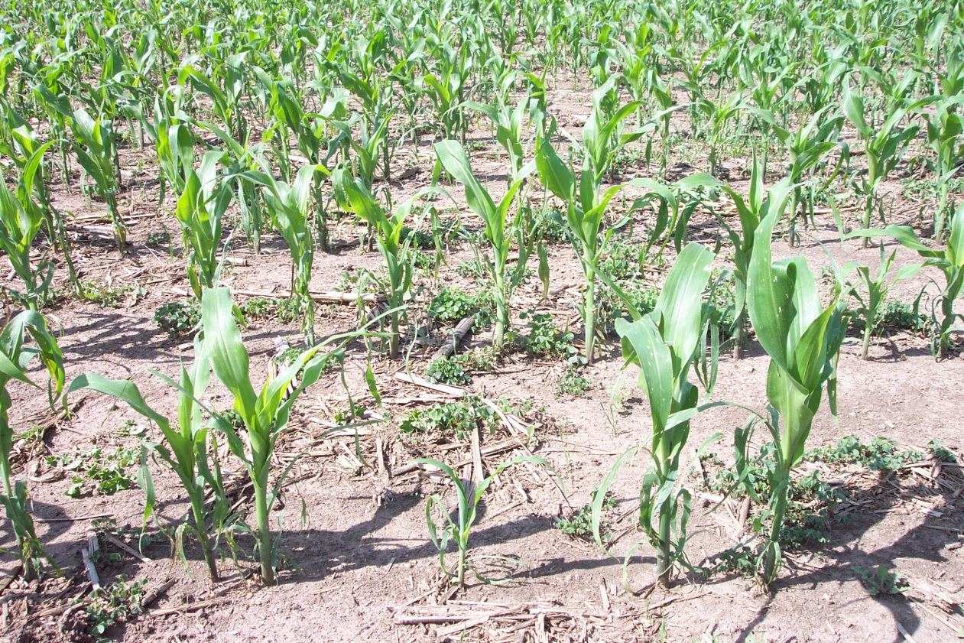
Production Unit Size?
By plant?

Slide 11
Spatial variability among production units.
What causes field delineation.
  Natural boundaries.
    Rivers
    Rock out-crops
  Political boundaries.
    Roads
    Survey units
  Land ownership
    Consolidation

Slide 12
Spatial variability among production units.
What causes field delineation.
  Soil productivity appropriate to the crop (e.g. bottom land for alfalfa).
  Size determined by land use
    Government acreage restrictions (CRP)
    Tees, fairways, greens
  Size that is “convenient” to the operation for administering production inputs.
    Cultivation
    Planting
    Harvesting (mowing)
    Fertilizing
    Irrigation
    Etc.

Slide 13
Spatial variability (macro) for agronomic land use.
Inherent (natural).
  Related to soil productivity and soil forming factors
    Time
    Parent material
    Climate
    Vegetation
    Slope

Slide 14
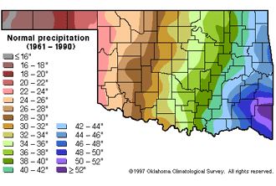
Soil acidity and Oklahoma rainfall
Usually not acidic
Usually acidic

Slide 15
Spatial variability (macro) for agronomic land use.
Acquired (use induced).
    Influence of historical crop production on soil properties.
      Alfalfa vs. wheat for acidification and soil organic matter.
      Fertilizer use and change in soil fertility (Garfield County).

Slide 16
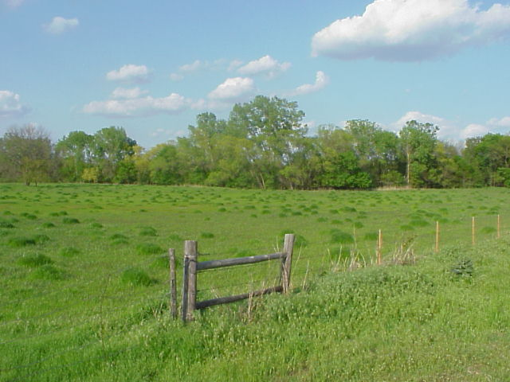
“Cow Pocks” in wheat pasture
Acquired spatial variability (micro).

Slide 17
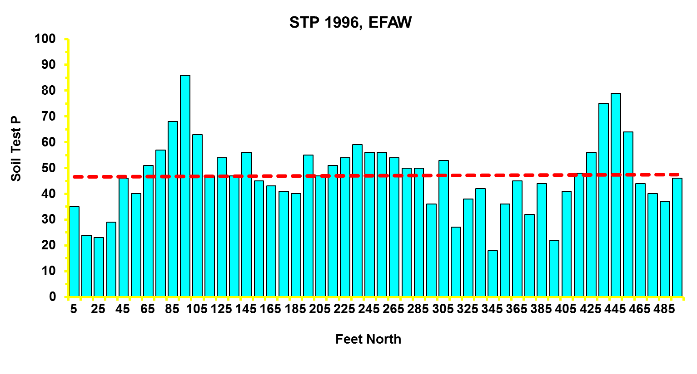
Acquired spatial variability (micro).
Ave = 47; CV = 30

Slide 18
1x1 (60-acre cell)

Slide 19
6x4 (2.5 acre/cell)

Slide 20
12x8 (0.625 acre/cell)

Slide 21
25x16 (0.15 acre/cell)

Slide 22
50x32 (0.0375 acre/cell)

Slide 23
100x64 (45 yd²/cell)

Slide 24
200x127 (11 yd²/cell)

Slide 25
472x300 (2 yd²/cell)

Slide 26
Management Zones
A
C
B

Slide 27
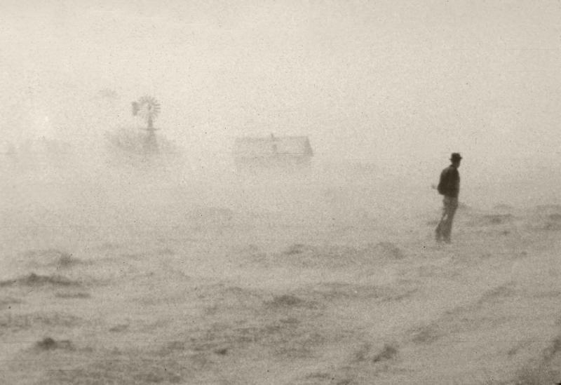
Fig. 2.2.
United States 1930s “dust bowl” (Source: USDA-ARS).

Slide 28
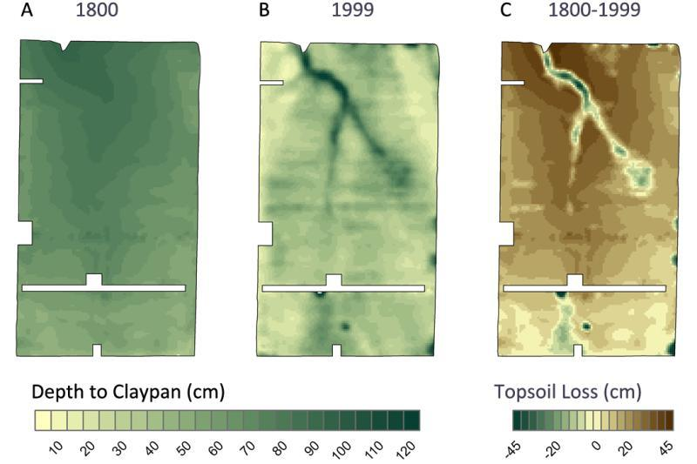
Fig. 2.3.
This Missouri field provides an example of the impact of erosion on within-field variability. The “depth to claypan” is a measure of topsoil thickness. A) A map of the estimated topsoil depth in 1800, prior to modern tillage practices. B) A map of topsoil depth measured in 1999 with the aid of soil electrical conductivity sensing. C) A map of net loss of topsoil (difference of the first two maps). Erosion has resulted in both lost productivity and increased within-field variability.

Slide 29
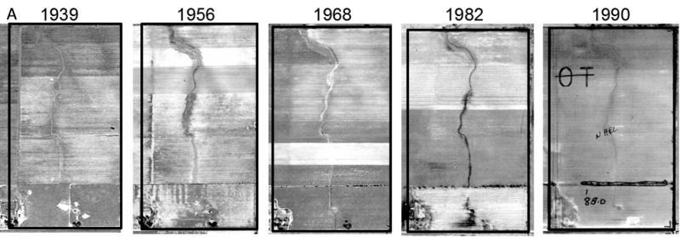
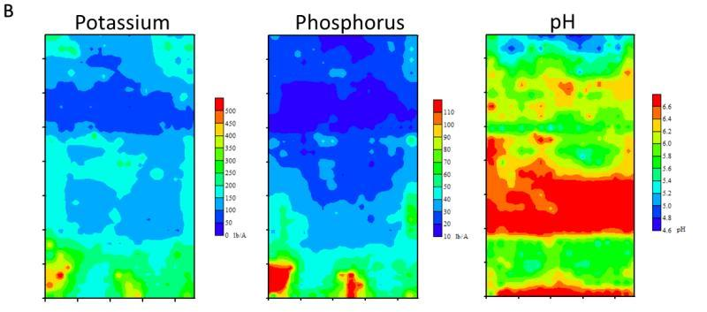
Fig. 2.4.
A) A time sequence of aerial images of a Missouri field over a 50-yr period. B) Soil fertility maps of the same field obtained from intensive grid-soil maps from 1999. Much of the variation in soil fertility for this field arises from historic anthropogenic activities.

Slide 30
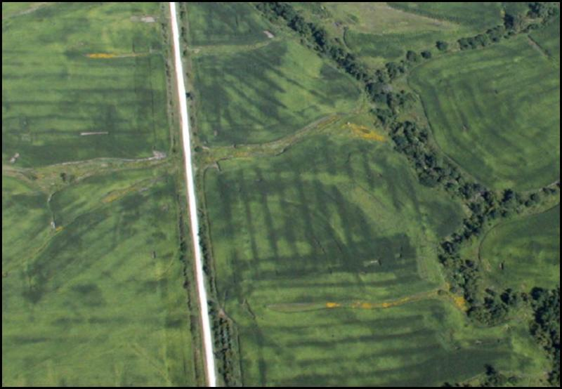
Fig. 2.5.
Uneven application of nitrogen fertilizer can result in variability in corn production.

Slide 31
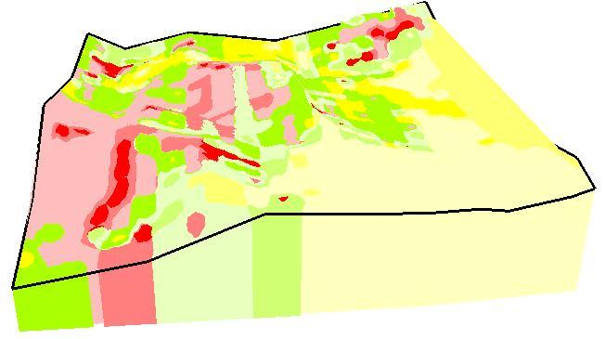
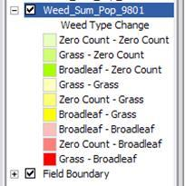
Fig. 2.6.
Changes in weed type in a 160-acre field intensively mapped in 1998 and 2001 (mapped as no weeds, grass, or broadleaf species present in both years). The legend on the left indicates the species shift. The darkest red areas were originally mapped as grass species and, in the subsequent sample, as broadleaf areas (Clay, unpublished data).

Slide 32
Videos
Video 2.1. What is the difference between spatial and temporal variability? http://bit.ly/spatial-temporal-variability
Video 2.2. What is G × E × M? http://bit.ly/GxExM
Video 2.3. Rainfall is never the same. http://bit.ly/rainfall-variability
Video 2.4.
Rainfall creates variability with crop nitrogen fertilizer.
http://bit.ly/rainfall-variability-nitrogen
Video 2.5. Soil erosion causes variability. http://bit.ly/soil-erosion-variability
Video 2.6.
What is soil compaction? http://bit.ly/what-is-soil-compaction

Slide 33
Questions
Chapter Questions
Describe how soil erosion creates variability in crop grain yield.
What technology enabled inexpensive and rapid mapping of spatial variability?
What is the source of anthropogenic variability?
Provide an example of how pests create variability and then identify a management practice you might use to address that variability.
What does the term “E_{ST}” in the expression G x E_{ST} x M represent?
Name two examples of abiotic factors that cause variability within crop production fields.
Name two examples of biotic factors that cause variability within crop production fields.

