Slide 1

Wesley M. Porter
Extension Irrigation Specialist
Variable Rate Irrigation
Pork and Dairy Farms

Slide 2
What If We Had the Ability To:
Develop Irrigation Management Zones
Apply correct and relevant amounts of irrigation to these zones
Apply no water to non-cropped areas
The Solution is Variable Rate Irrigation

Slide 3
Variable Rate Irrigation
Variable Rate Irrigation also known as VRI or Precision Irrigation
The controlled application of irrigation water over a particular area, based on observed or measured conditions.
  Varied rates
  On/Off
Scheduling Rates based on perceived or measured water requirements of sub-field zones:
  Soil Moisture Sensors
    Resistive or Capacitance
  Leaf Canopy Sensors
  Remote Sensing

Slide 4
Variable Rate Irrigation
In this case the predominate use will be to control the irrigation system on/off over particular areas:
  Wet Areas
  Overlapping Areas
  Non-Crop areas (Roads, Structures, waterways, ditches etc.)
  Sensitive Areas
  Field Variability

Slide 5
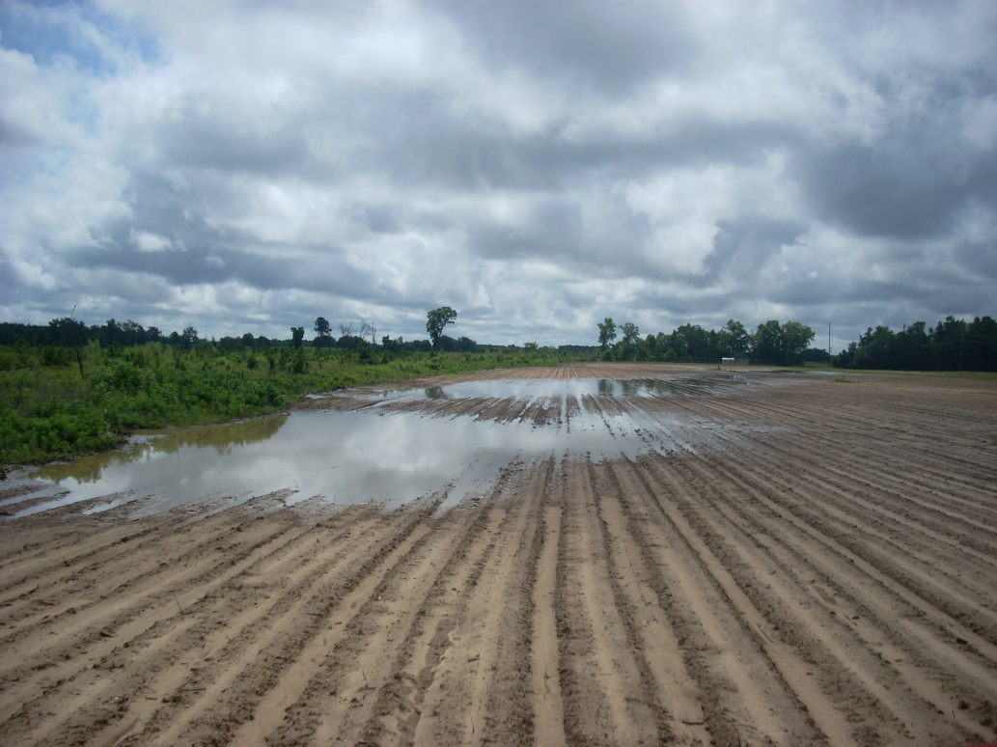
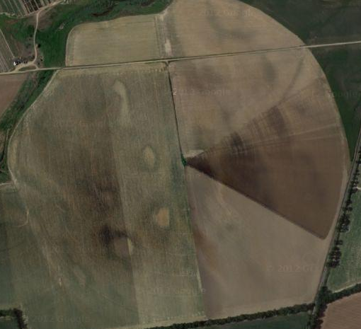
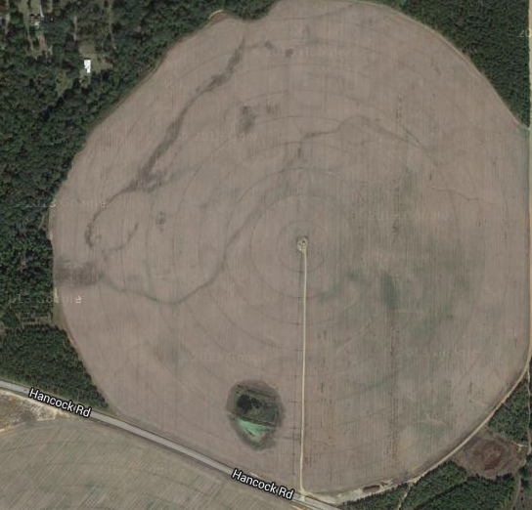
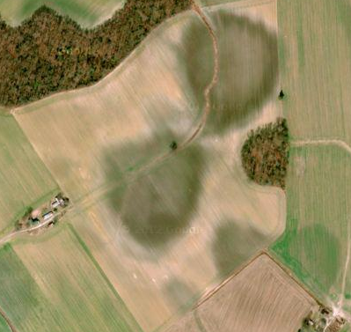
Variable Rate Irrigation: Wet Areas

Slide 6
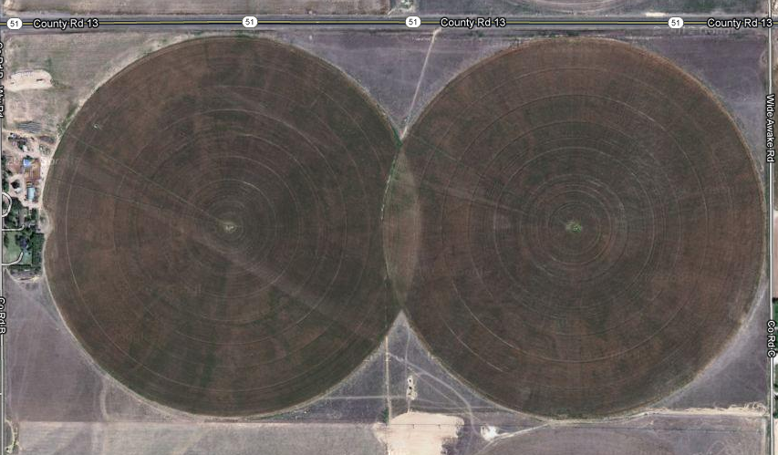
Variable Rate Irrigation: Overlap

Slide 7
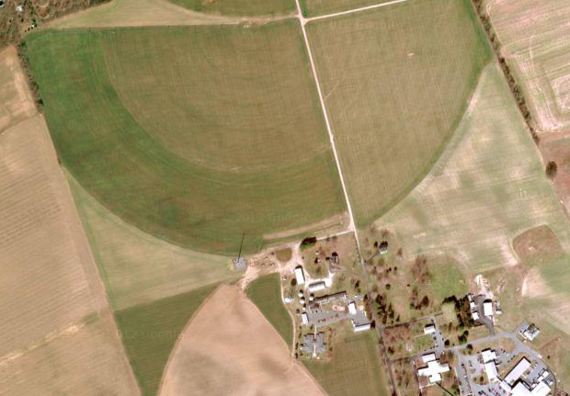
Variable Rate Irrigation: Non-Crop Areas
Non-Crop Area: House or building

Slide 8
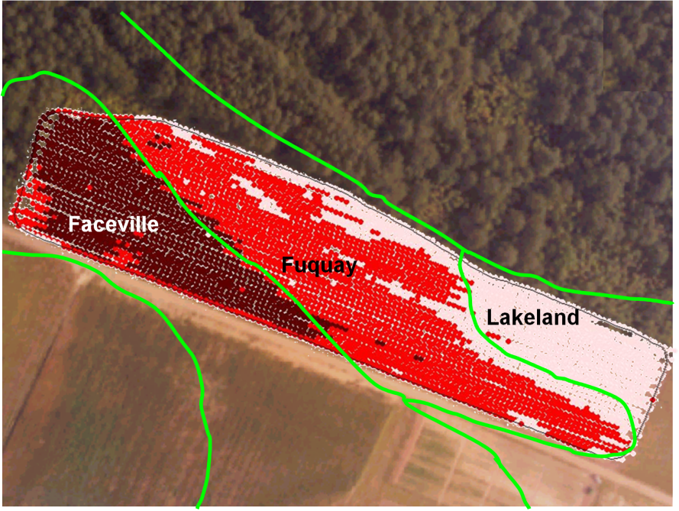
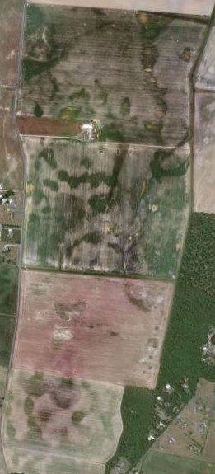
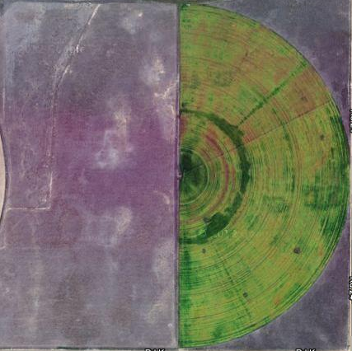
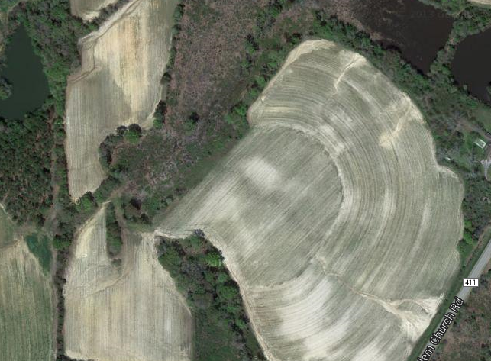
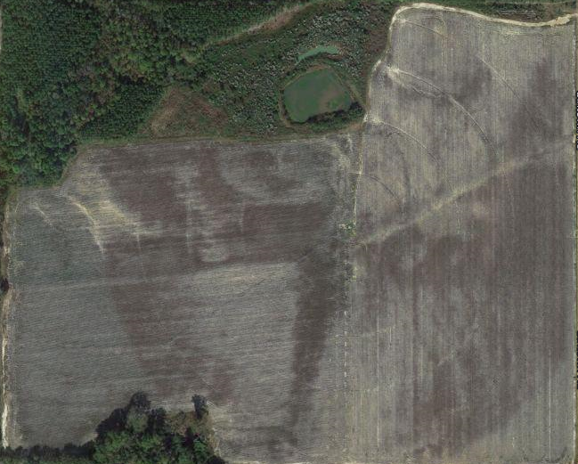
Variable Rate Irrigation: Variability

Slide 9
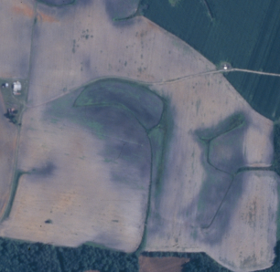
Variable Rate Irrigation: Variability

Slide 10
Variable Rate Irrigation: Variability

Slide 11
Variable Rate Irrigation: Variability
Drainage
Ditches
Lighter,
Drier Soil
Heavier,
Wetter Soil

Slide 12
Variable Rate Irrigation: Variability
Overlapping
Pivots
Non-cropped
Area

Slide 13
How Does VRI Work?
Retrofits onto existing center pivot/lateral systems
Integrates GPS positioning into a control system
Control system cycles individual sprinklers or groups of sprinklers ON & OFF (duty cycle, seconds ON per minutes).
System travel speed

Slide 14
How Does VRI Work?
A VR system requires:
  A control system for each developed zone
    Can consist of electronic or pneumatic valves
  A control software for inputting the developed zones and supplying a control signal
  Differential GPS (for accurate location of the system)
  Either a variable frequency pump or pressure relief to account for changes in flow and pressure due to varying zones.

Slide 15
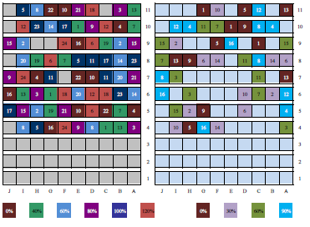
How Does VRI Work?
The controller uses the speed for the max rate required for the current zones and cycles the rest of the zones as a percentage of this rate.

Slide 16
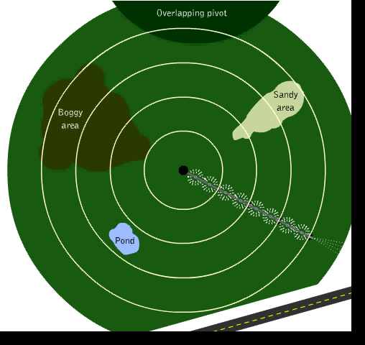
VRI

Slide 17
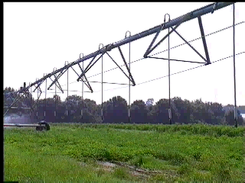
VRI

Slide 18
System Calibration
Little to no input needed from the user.
Can do a uniformity check.
  http://www.caes.uga.edu/publications/pubDetail.cfm?pk_id=7685
The software should handle the flow rate of the system as long as nozzles are properly sized.
Can check speed vs. application rate for calibration.

Slide 19
Potential Benefits
Save Water
Prevent double application
Improve irrigation management decisions
Improve efficiency (under- or over- watering)
Reduce weeds in non-cropped areas
Reduce nutrient leaching
Reduce disease in some crops
Reduce/optimize pumping costs
Increase yields
Regulatory Benefits

Slide 20
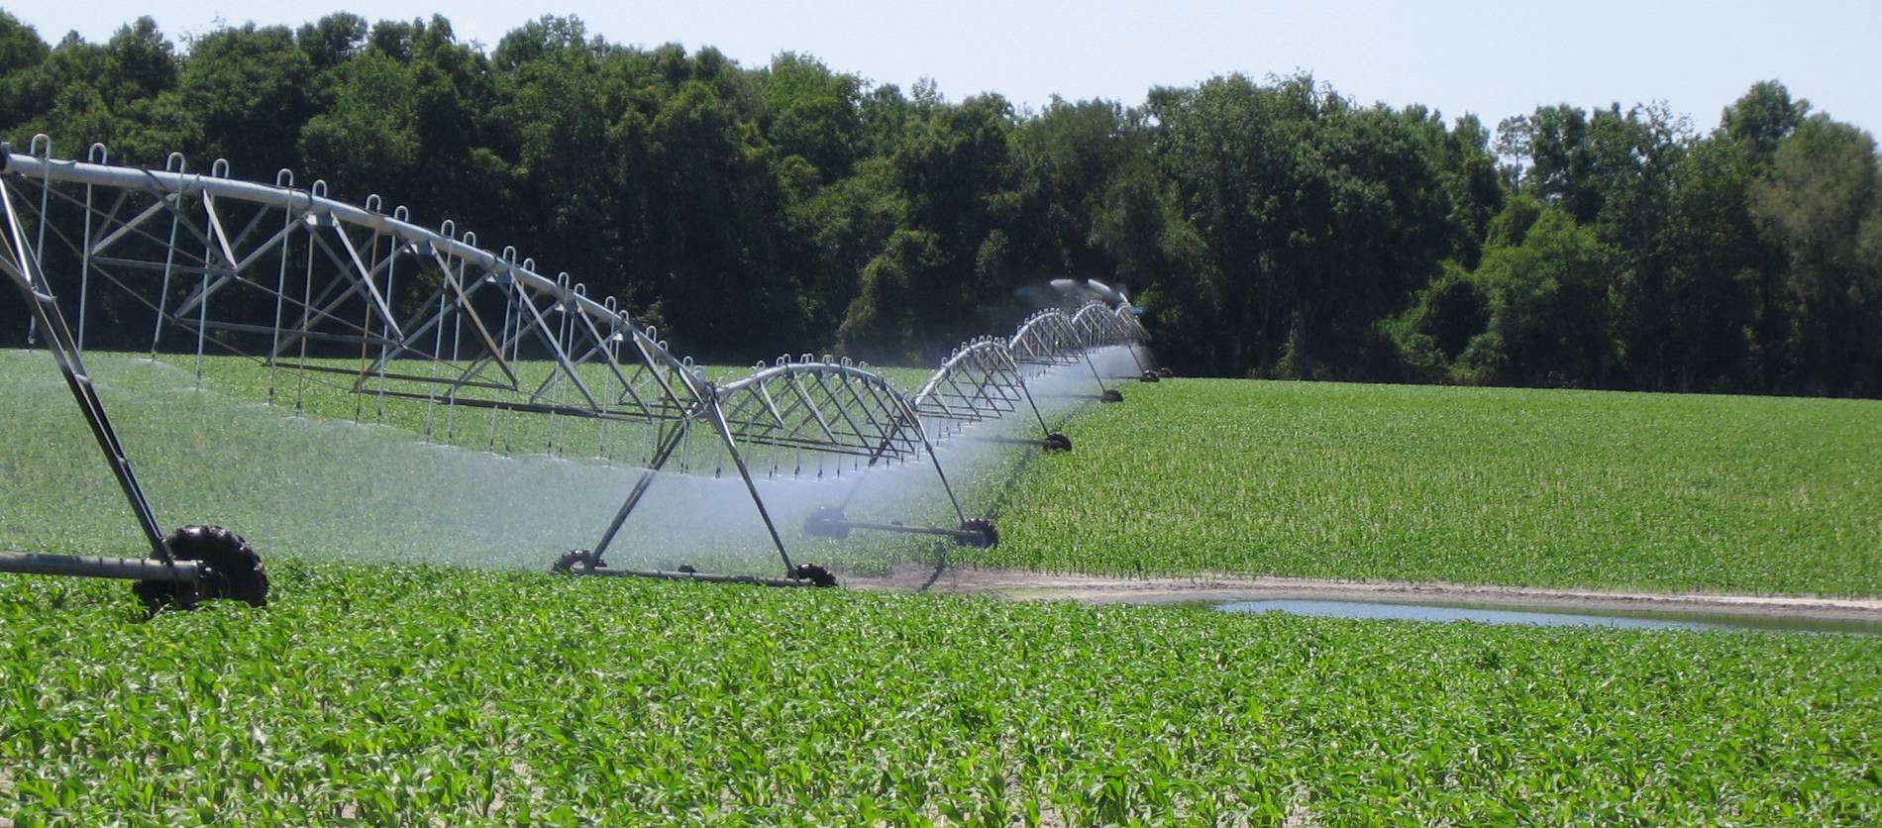
Reasons for Utilizing VRI

Slide 21
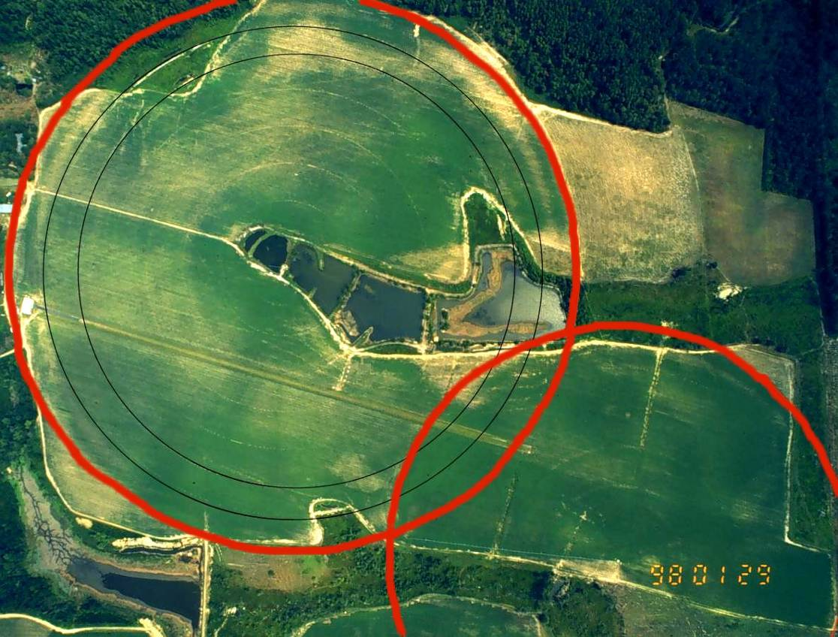
No Water Zones
Non-cropped areas not watered
Environmentally sensitive areas not watered
Overlapping pivots

Slide 22
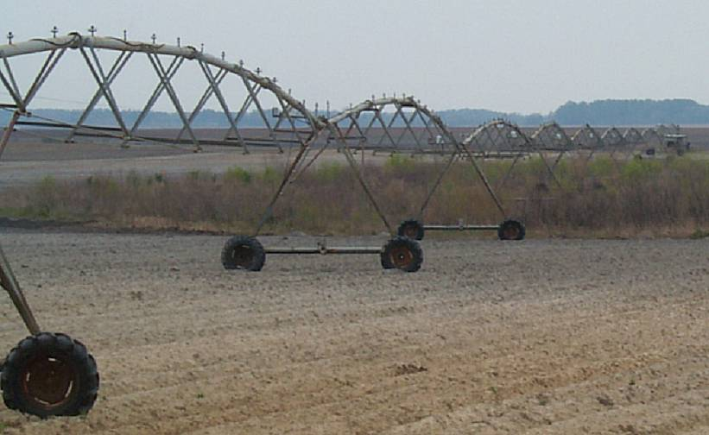
Non-cropped Areas

Slide 23
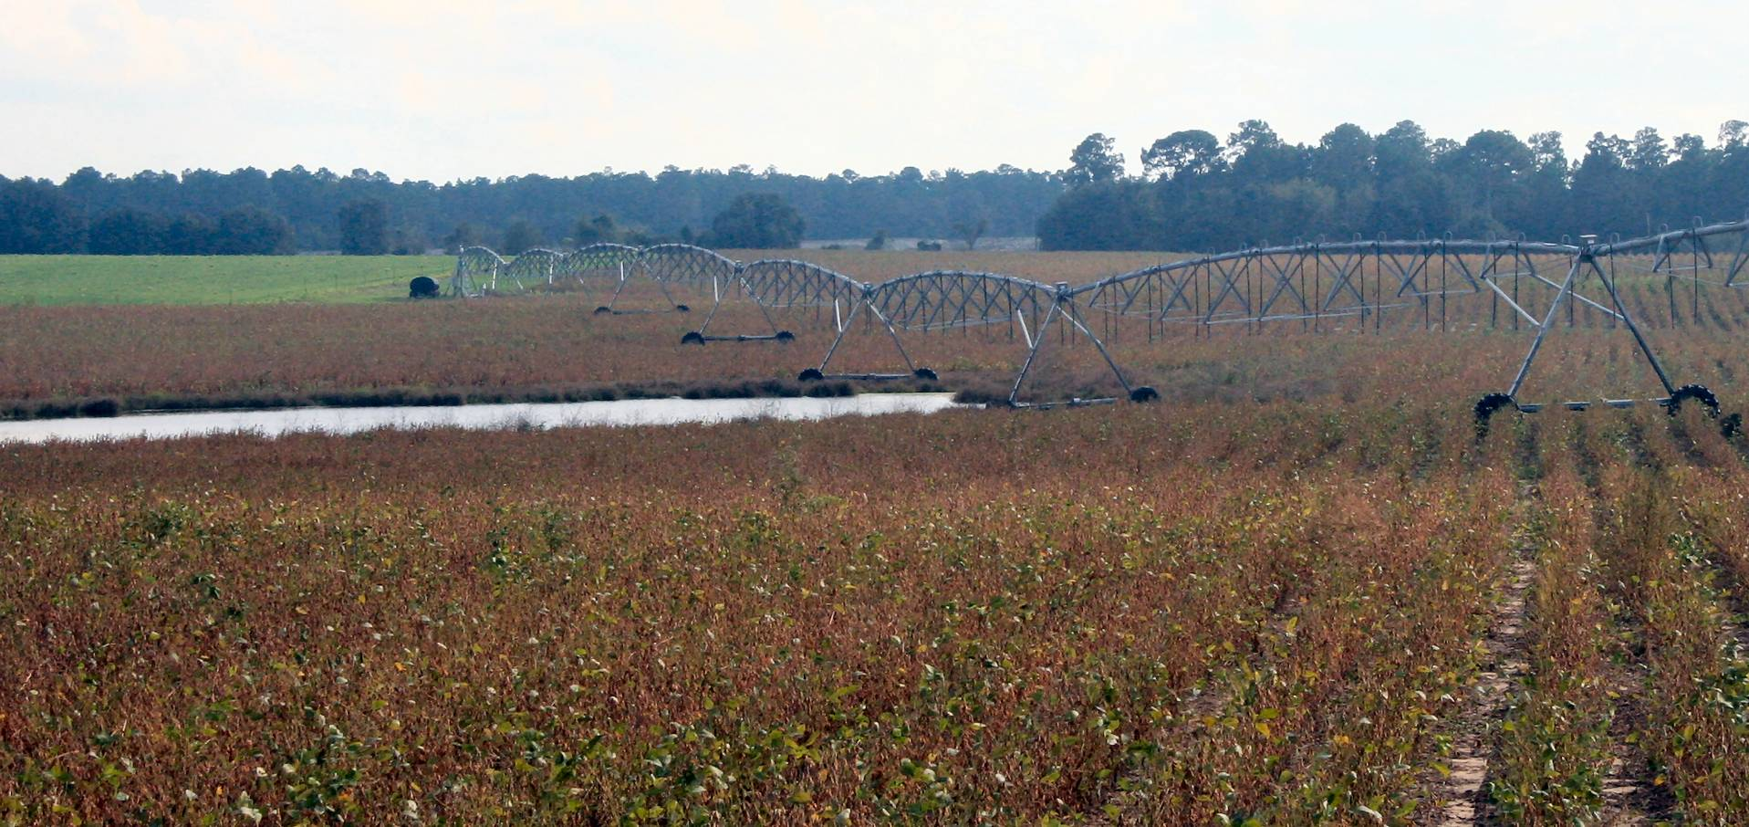
Non-cropped Areas

Slide 24
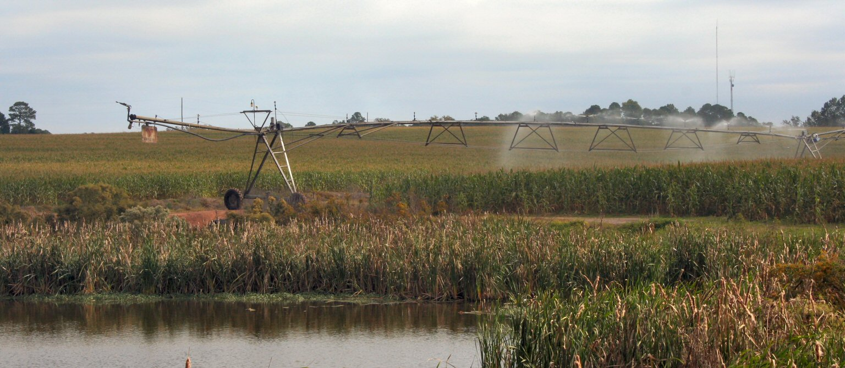
Non-cropped Areas

Slide 25
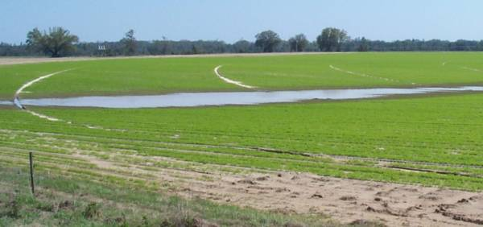
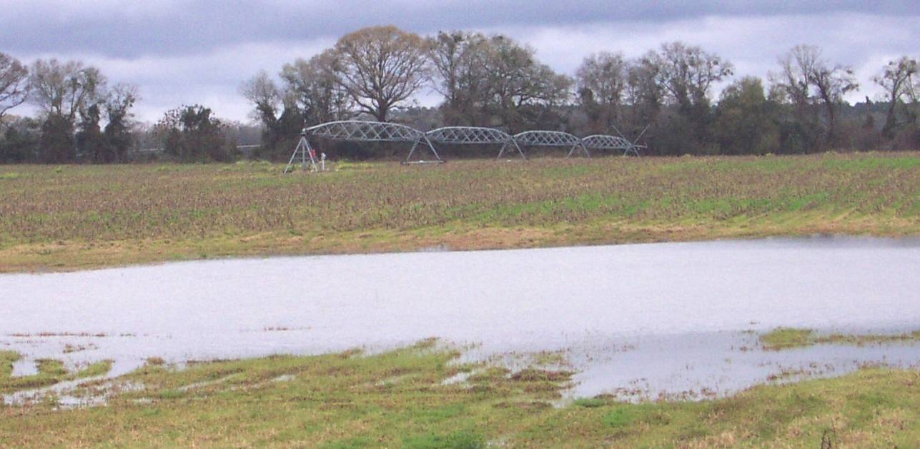
Topographical/Soil Variability

Slide 26
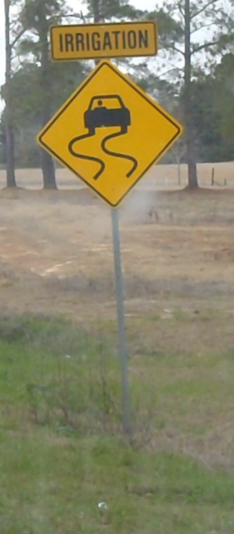
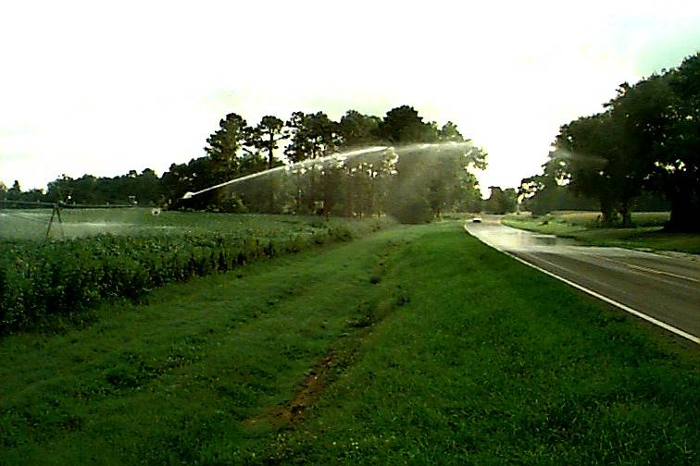
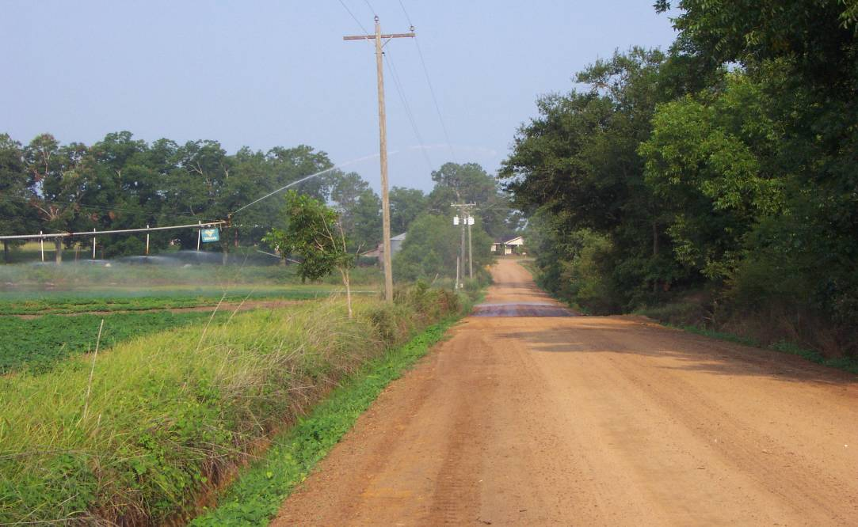
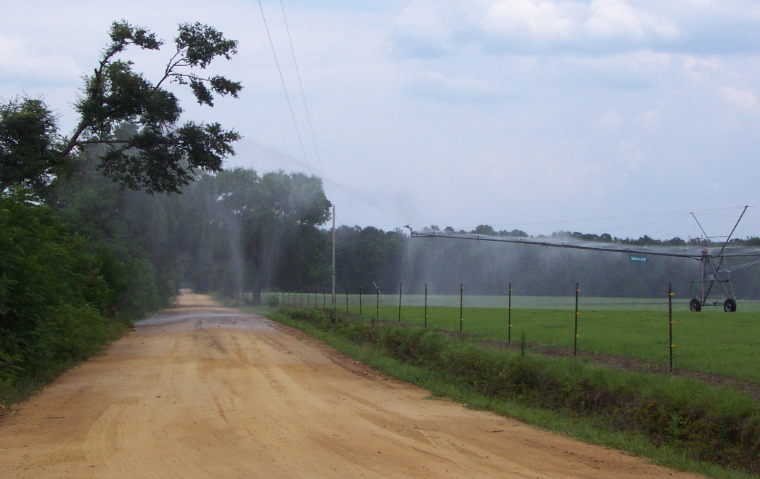
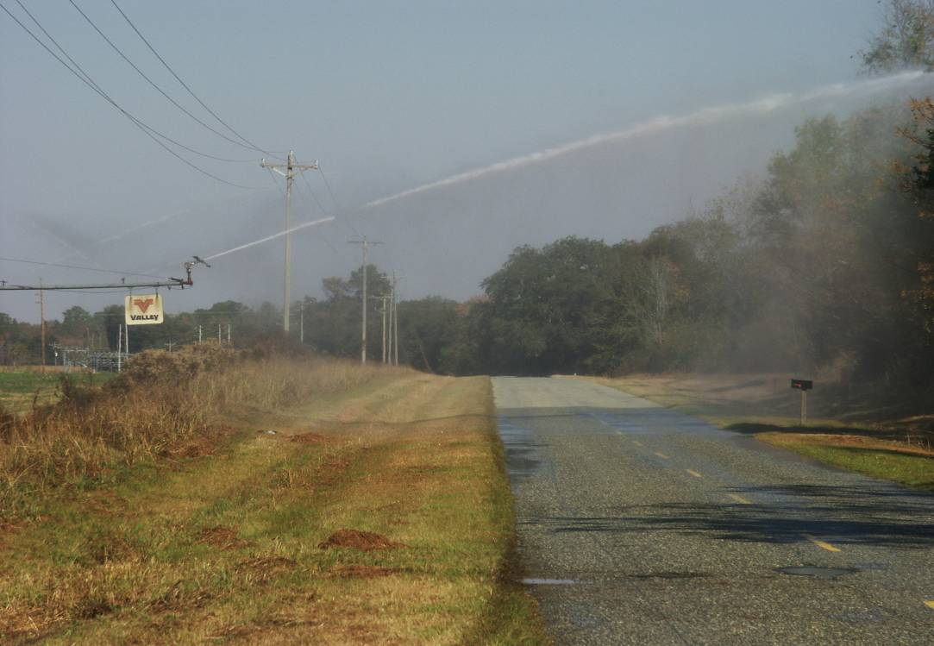
Non-cropped Areas

Slide 27
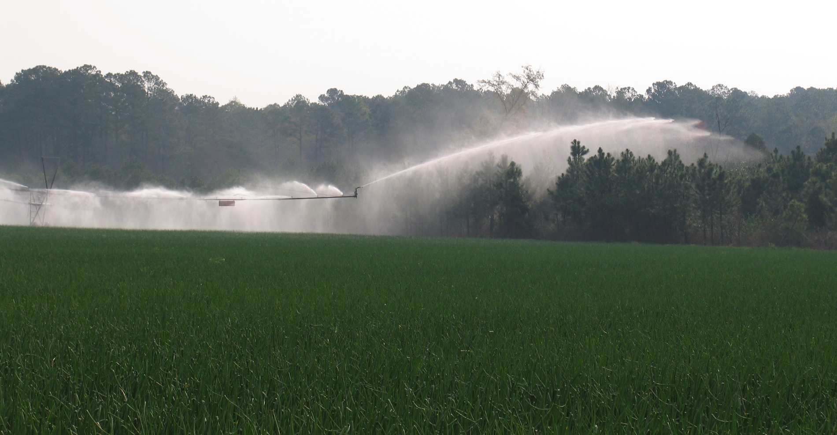
Off-Site Applications

Slide 28
Potential Benefits in Manure Applications
Fine tune waste water application
Reduce or eliminate effluent application to environmentally sensitive areas
More precisely apply effluent adjacent to buffers or “setback” zones.
Increase water use efficiency
Optimize nutrient management

Slide 29
Is VRI Relevant to My Operation?
Your farm’s irrigation system could benefit from VRI if your field has:
  Environmentally sensitive areas under the system coverage area (end gun or nozzles)
  Different nutrient management zones
  Non-cropped areas under pivot coverage
  Varying soil types

Slide 30
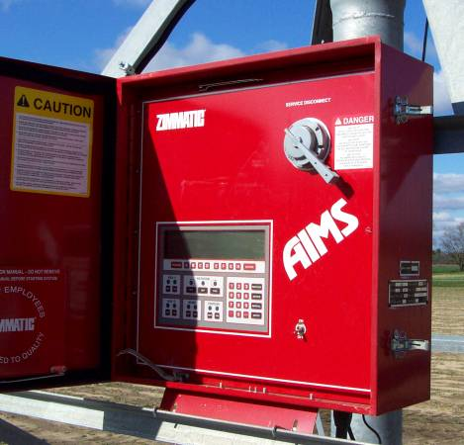
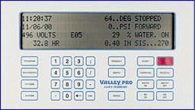
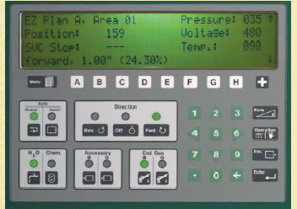
VRI Components

Slide 31
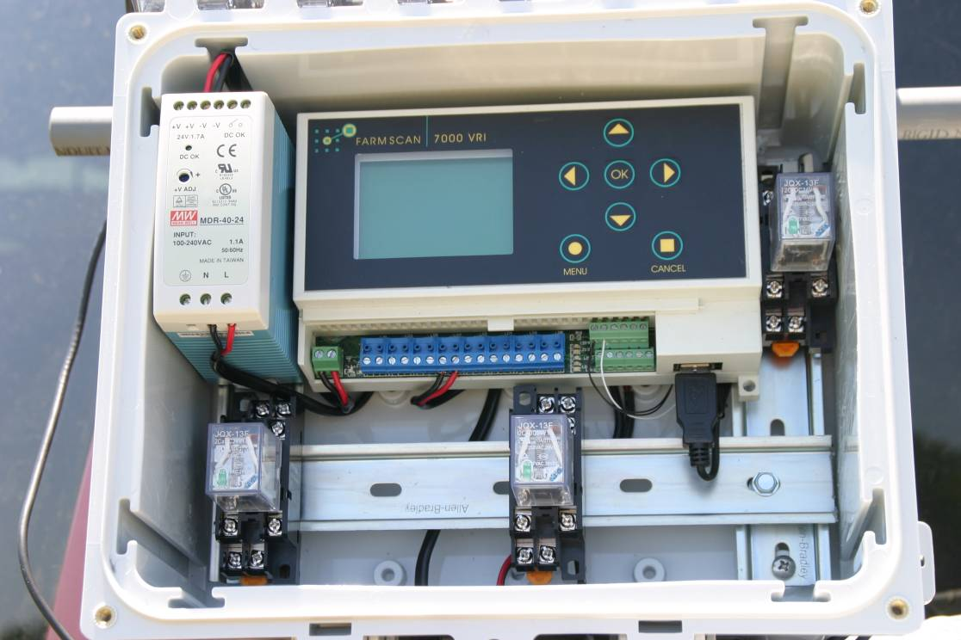
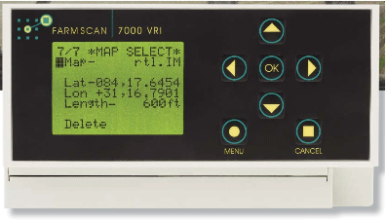
VRI Components
Controllers

Slide 32
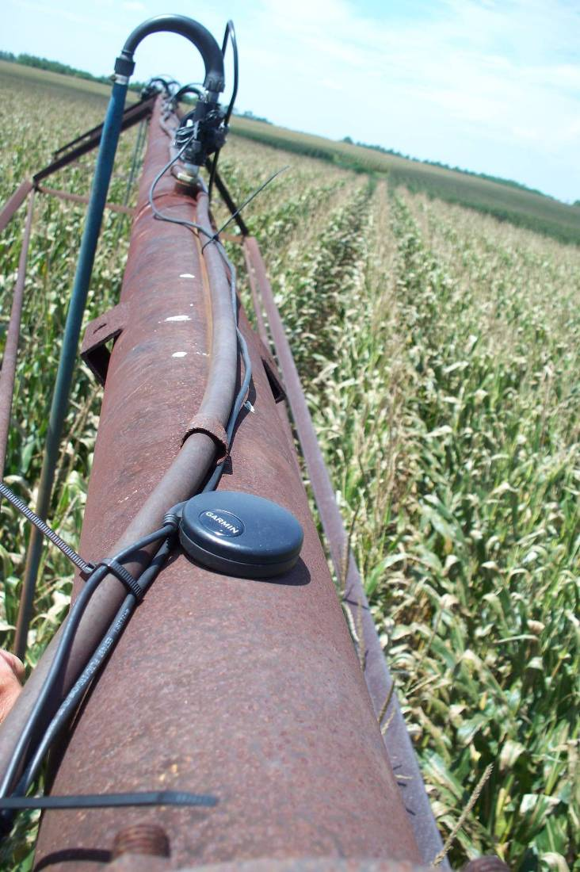
VRI Components
GPS Receiver

Slide 33
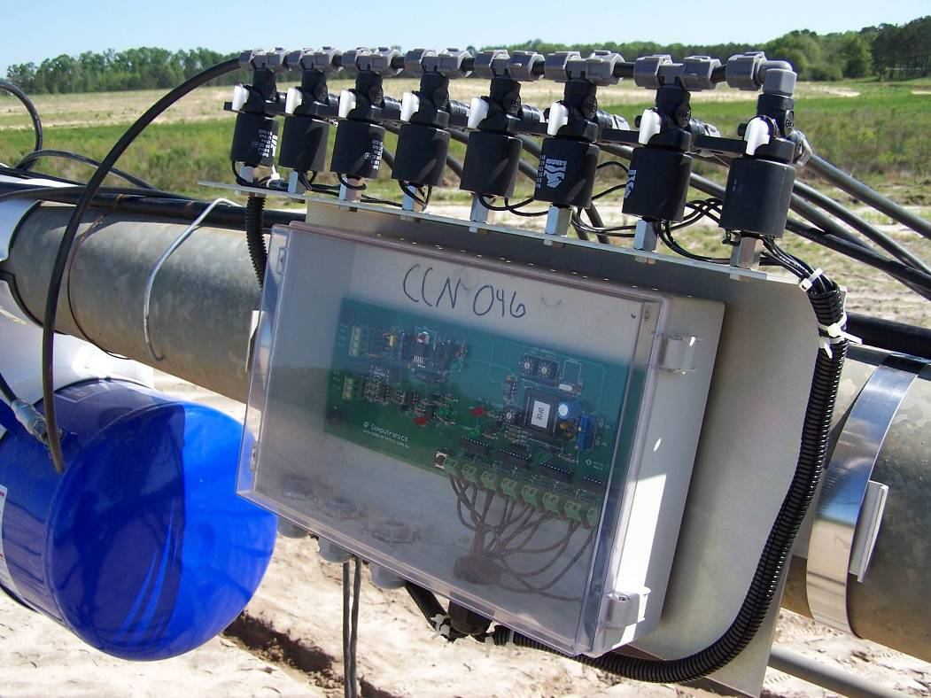
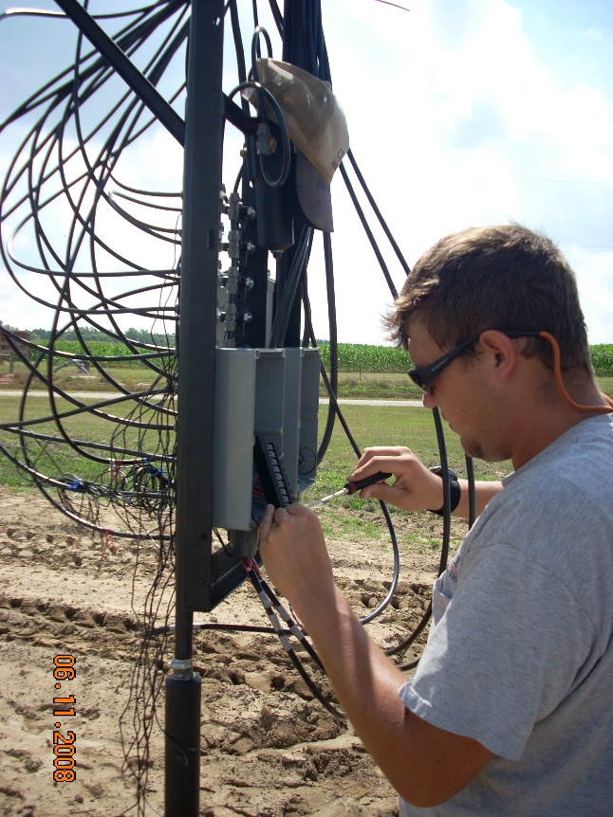
VRI Components
Node/Zone Circuits and Solenoids

Slide 34
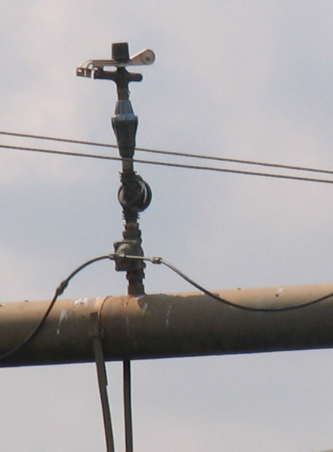
VRI Components
Flow Control Valves
(can be actuated via pneumatics or hydraulics)

Slide 35
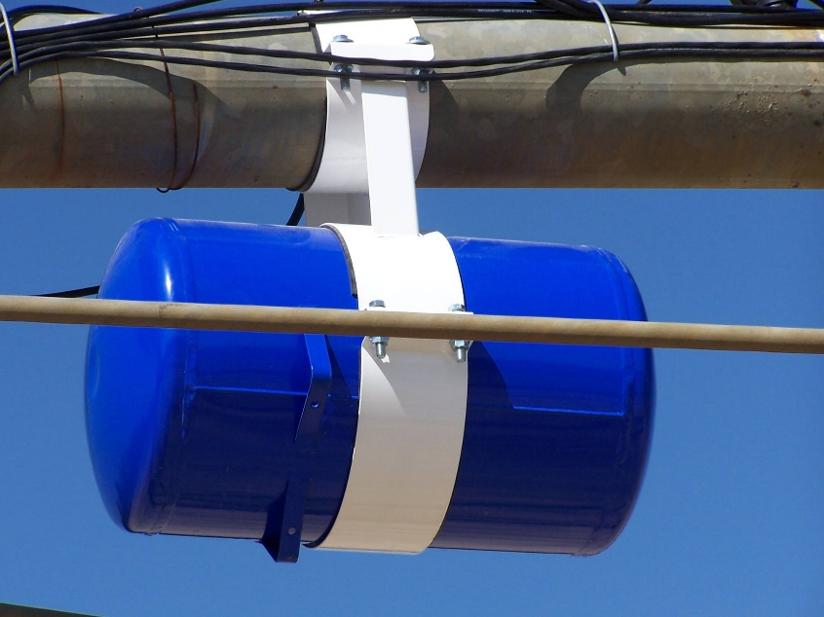
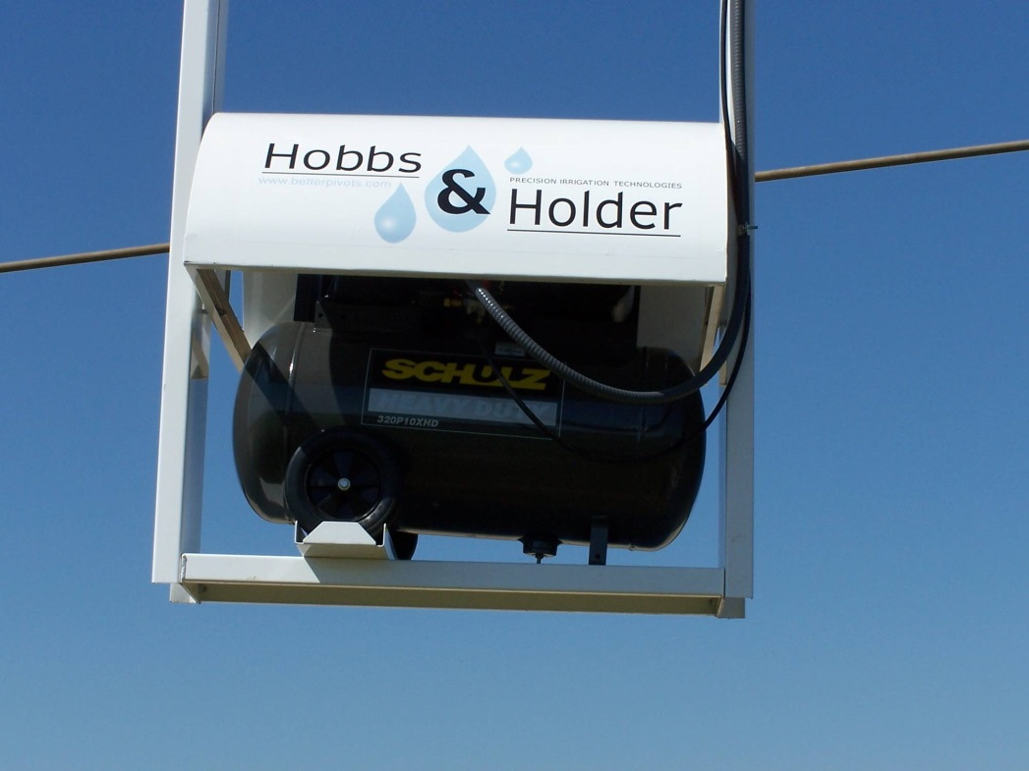
VRI Components
Compressed air supply

Slide 36
VRI Components
Compressed air supply
X
X
Most commercial systems use water from mainline in fresh water installations.

Slide 37
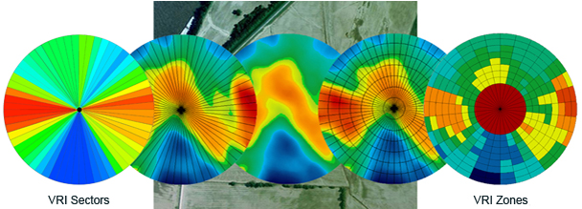
VRI Zone Development
Equipment widths
Soil EC
Soil Type
Elevation
Field Size
Irrigation Tower Length
Crops produced in field (single or multiple crops)
Other typical precision agriculture zone development tools.

Slide 38
VRI Zone Development
How large do I want my management zones?
  What is feasible for my operation?
  What type of field resolution do I want?
  How long is my irrigation tower?
  How many nozzles do I have?
  How wide do the management zones need to be?
  The higher the resolution the more control equipment required.
  Two nozzles per zone would be the minimum.
  Keep in mind that smaller zones can be treated uniform and “merged”, but larger zones cannot be divided once the control system is implemented.

Slide 39
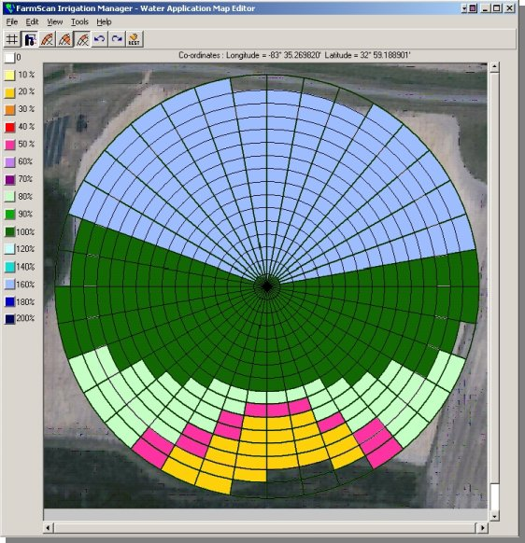
VRI Zone Development
How am I currently scheduling my irrigation?
  Using VR will require a more intensive management and scheduling strategy.
  Moisture sensors in every zone? In similar zones?
  Do I want to work towards an automated system or would I be better off calculating and entering each zones needed rate separately?

Slide 40
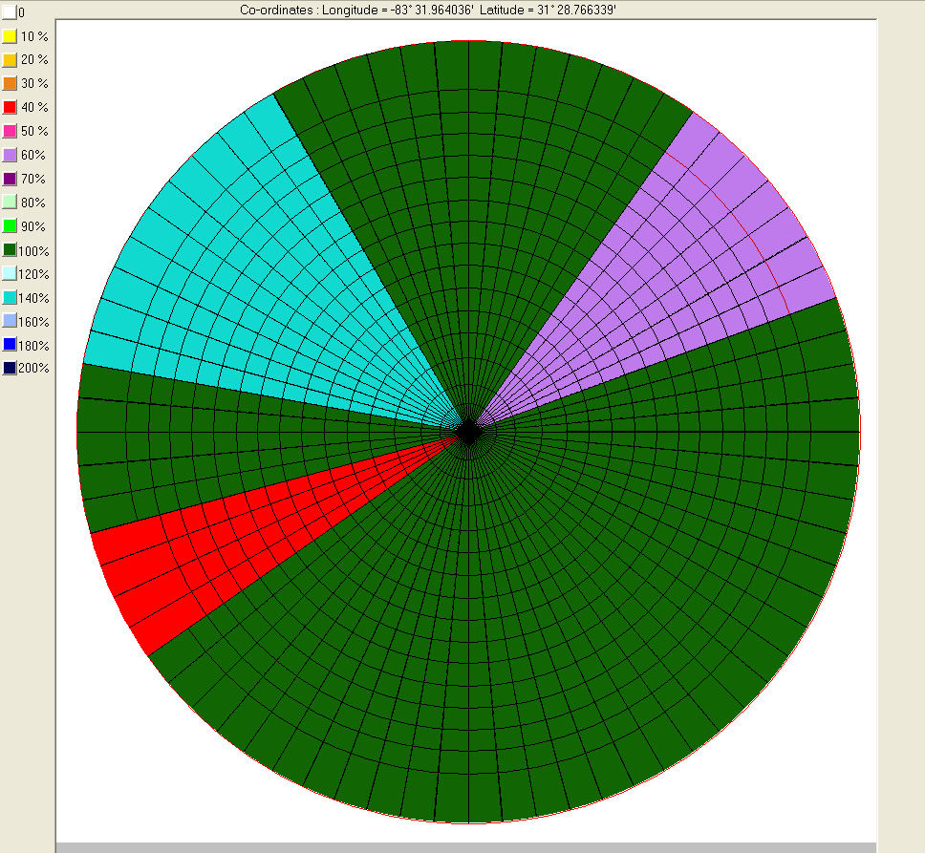
Application Map/Zone Development

Slide 41
Application Map/Zone Development
Overlapping pivot
Dry, sandy spot
Low, wet spot
Wet drainage spot
Wetland area

Slide 42
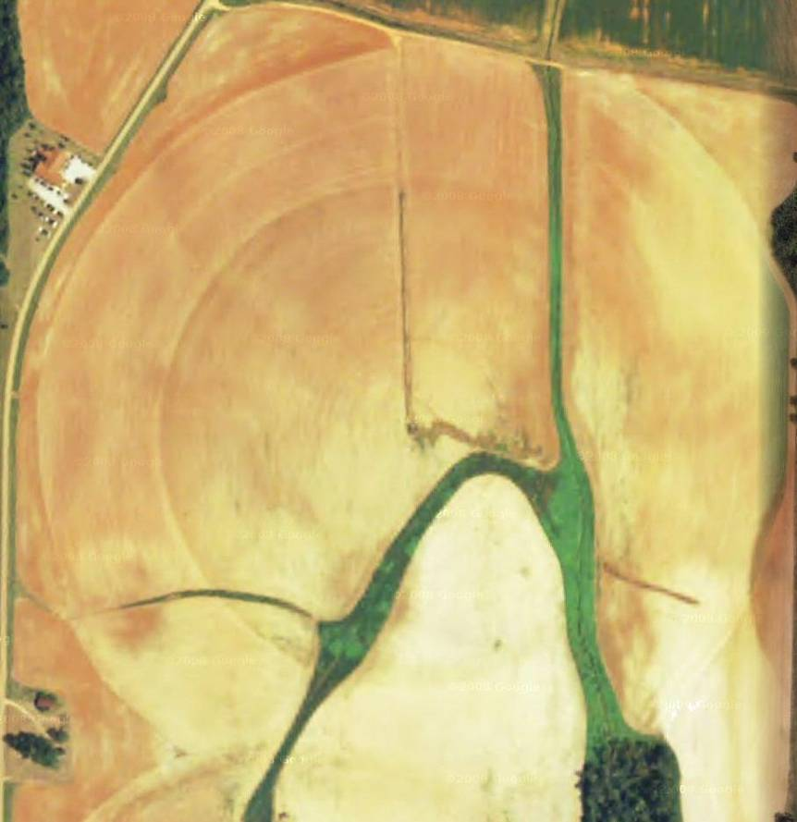
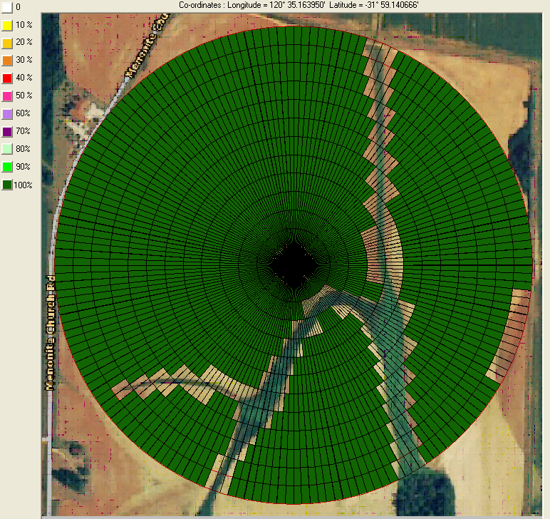
Applications

Slide 43
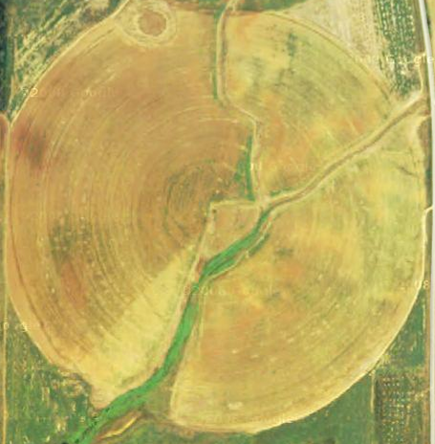
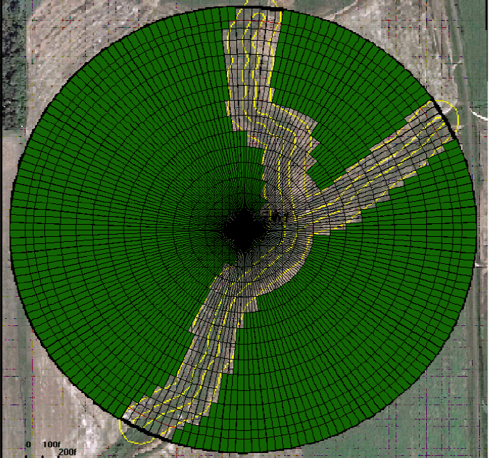
Applications

Slide 44
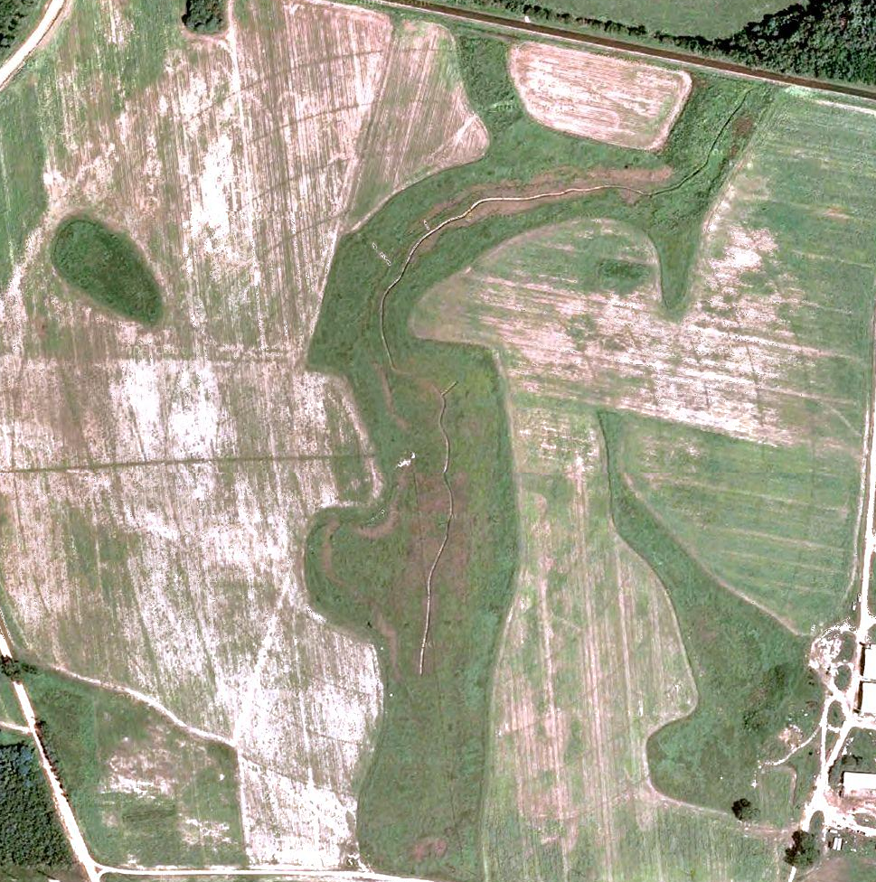
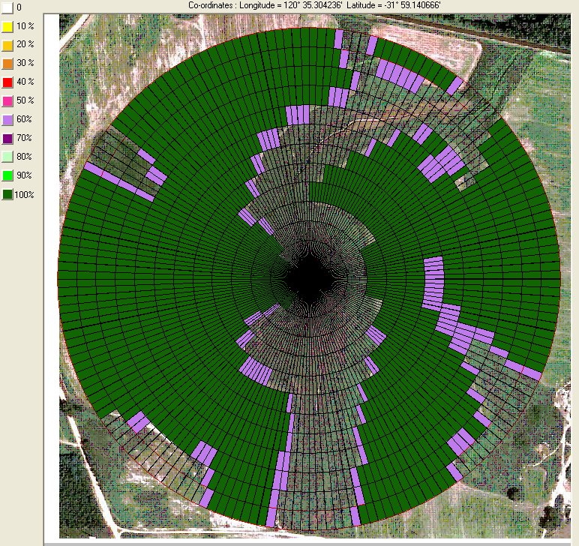
Applications

Slide 45
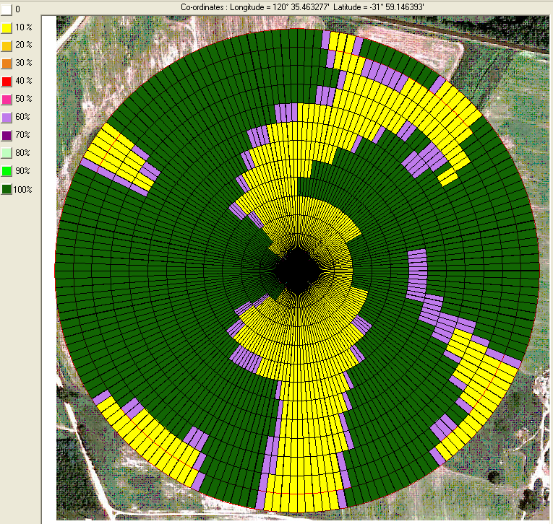
Applications

Slide 46
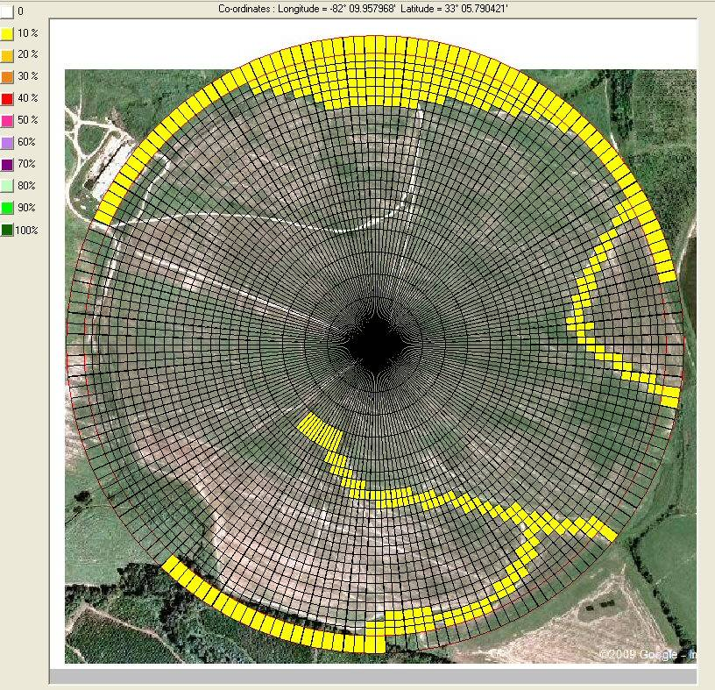

Applications

Slide 47


Applications

Slide 48


UGA Dairy Pivot-Tifton Campus

Slide 49


UGA Dairy Pivot-Tifton Campus
3rd tower sprinklers cycling
4th tower sprinklers OFF

Slide 50
NRCS Cost Share Example
Retrofit of and Existing Sprinkler System for water conservation:
  $4.34 per linear foot
Variable Rate Irrigation Retrofit
  $15.44 per linear foot
These are estimates and not representative of actual NRCS cost shares.
Contact your local NRCS office for exact cost share in your region and options for your particular situation

Slide 51


Questions/Comments?

