Slide 1
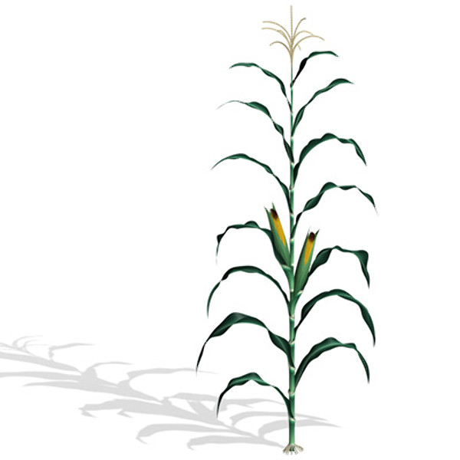
Maize Light Interception and Grain Yield as Affected by Precision Planting

Slide 2
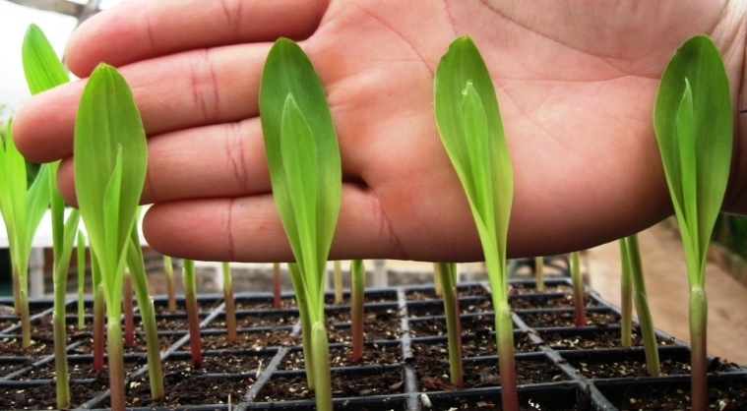

Slide 3
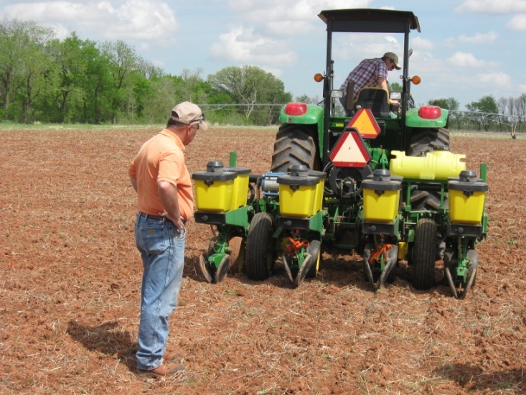
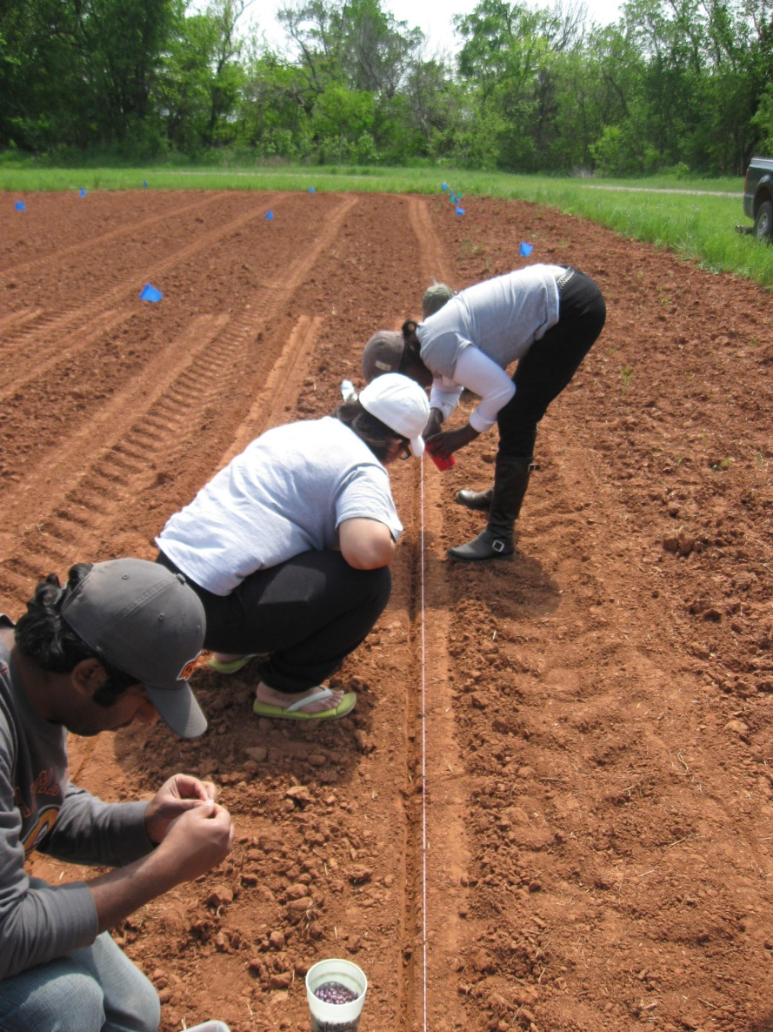
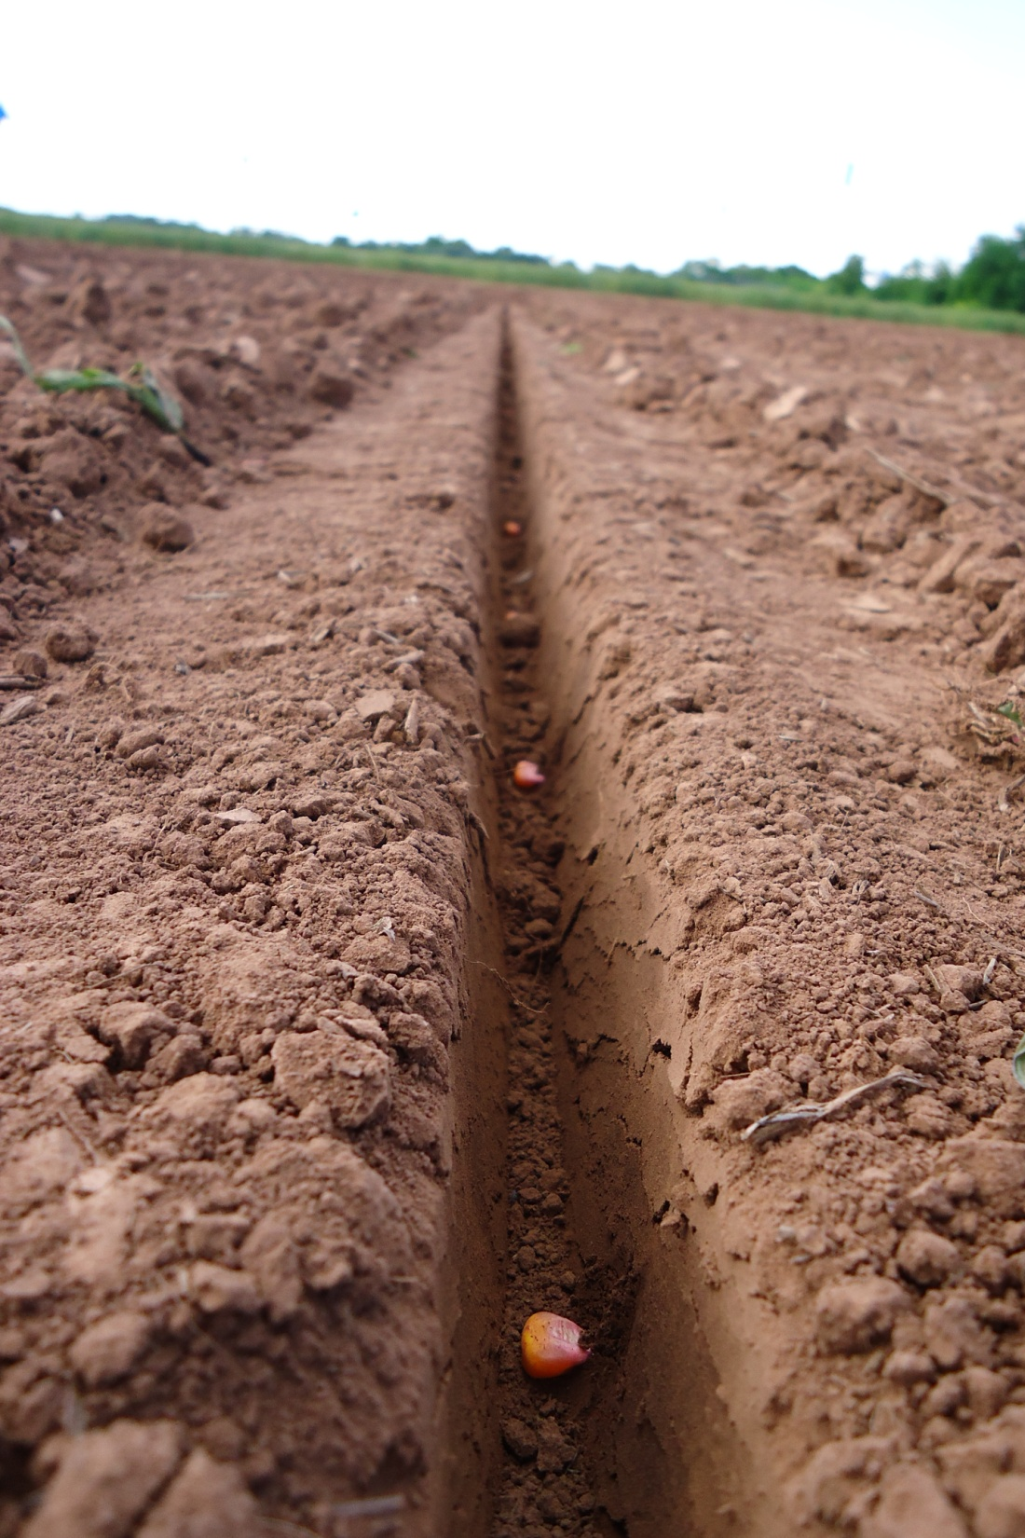
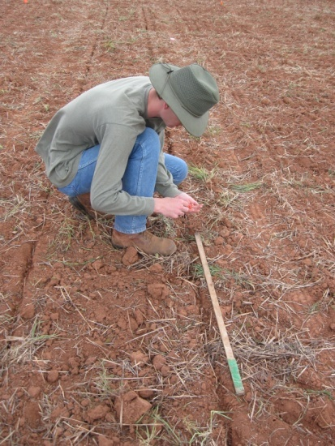

Slide 4
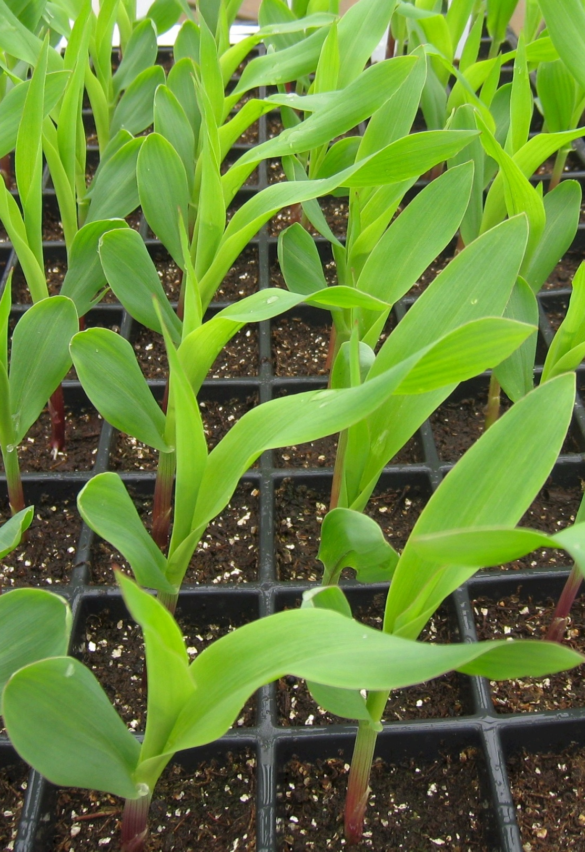
Precision Planting of Corn (Zea mays L.) to Manipulate Leaf Geometry

Slide 5
Research Questions
Can corn leaf orientation be manipulated by controlling seed position at planting?
Which seed position can result in across-row leaf orientation and what is the effect on emergence?
What is the effect of leaf orientation on light interception and grain yield ?

Slide 6
U.S. Maize Production
Source: http://usda.mannlib.cornell.edu/

Slide 7
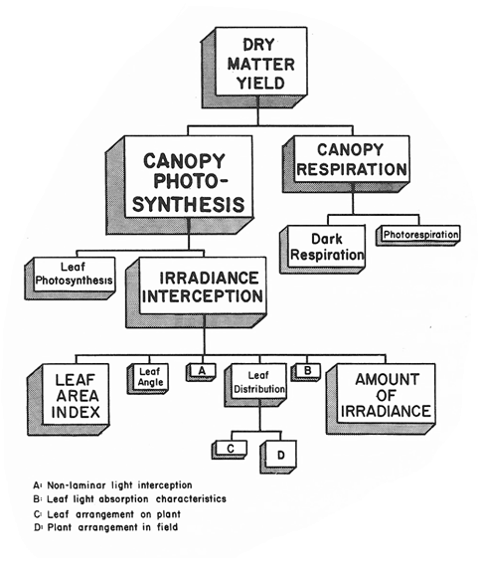
Capturing Solar Radiation
Y= Q x I x E x H
  Crop growth is the product of IPAR and RUE†
Plant population
Row spacing
Hybrid maturity
Canopy architecture
†Andrade et al., 1993 and Gifford et al., 1984
‡Figure from Gardner et al., 1985

Slide 8
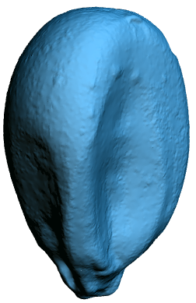
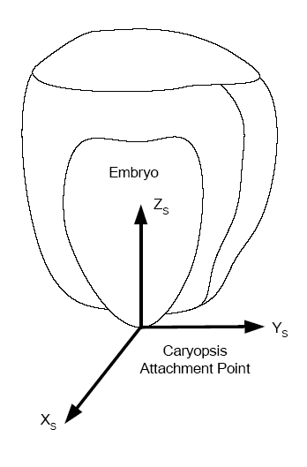
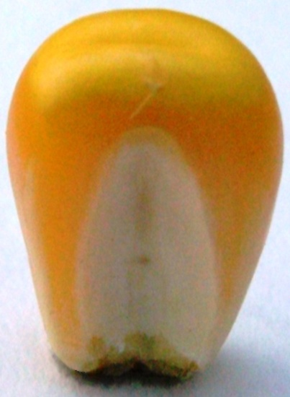
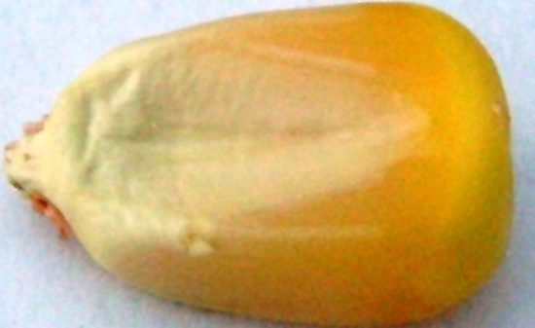
Maize Seed Orientation
  Systematic leaf arrangement can maximize light interception and increase yield†
Earlier and more complete emergence when maize seed was planted with the proximal end down‡
Upright
Flat
†Peters and Woolley, 1959; Peters ,1961
‡Patten and Van Doren, 1970
Figure: (c) Adrian Koller

Slide 9
Experiment
5 Dekalb hybrids
8 treatments
4 leaf stage
400 seeds
(c) Adrian Koller

Slide 10
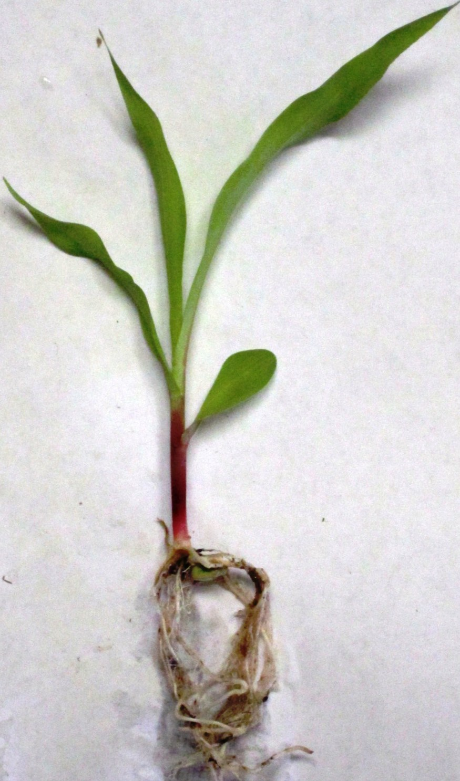
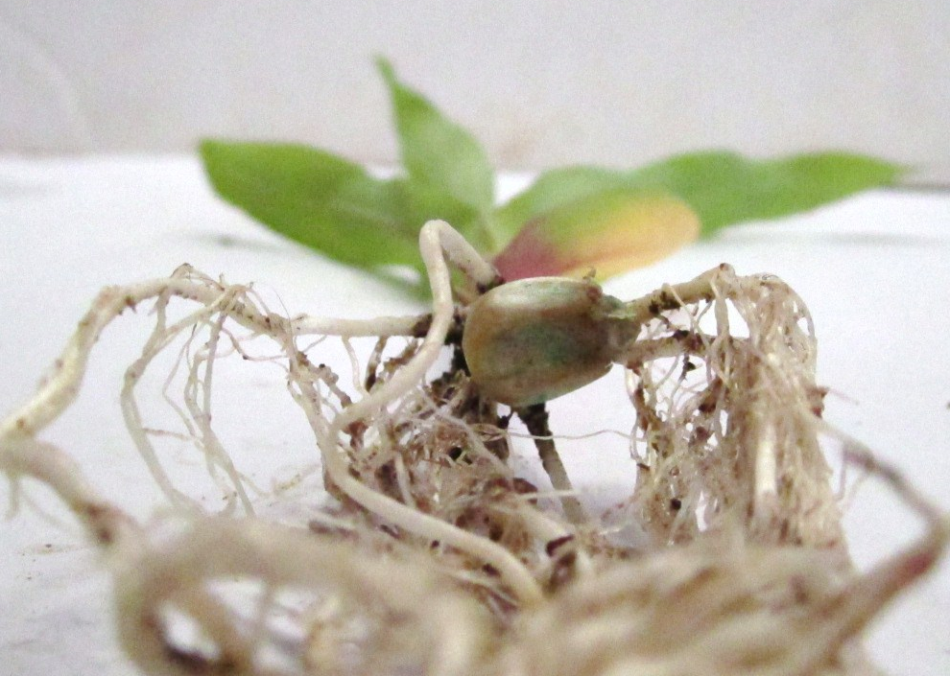
Seed Orientation and Leaf Azimuth
Leaf azimuth and emergence was affected
by seed orientation and hybrid
Upright and flat - 76 and 86% of plants with leaf azimuth between 60 and 90°
Mean leaf azimuth
  Upright = 64°
  Flat = 67 °
Torres et al., 2011

Slide 11
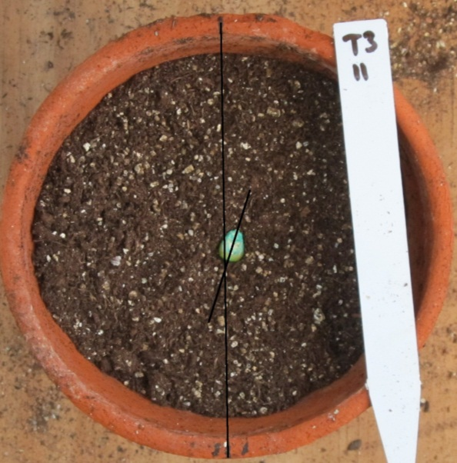
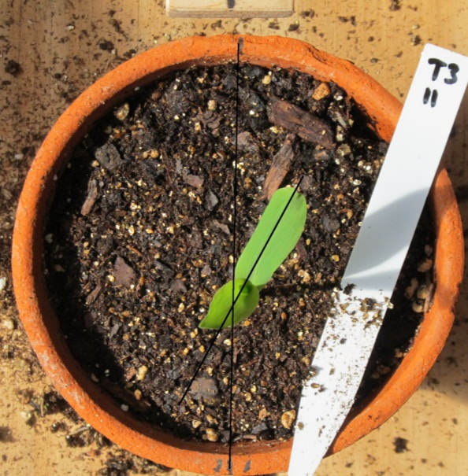
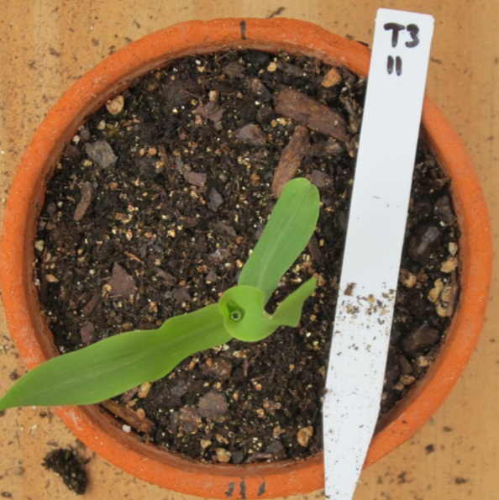
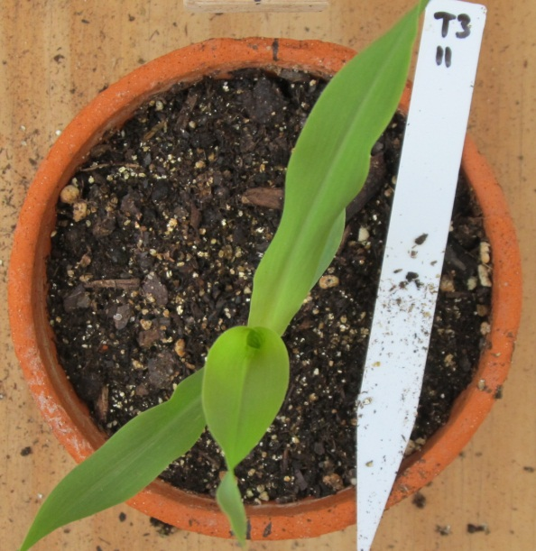
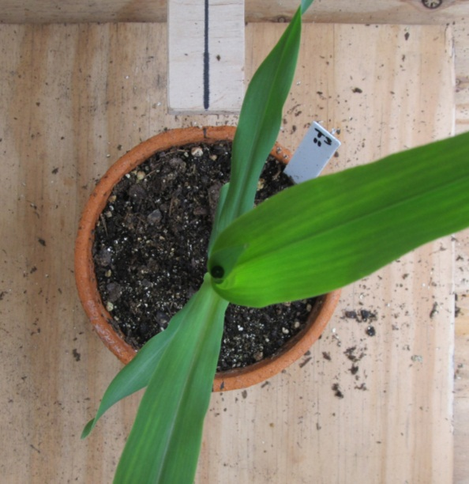
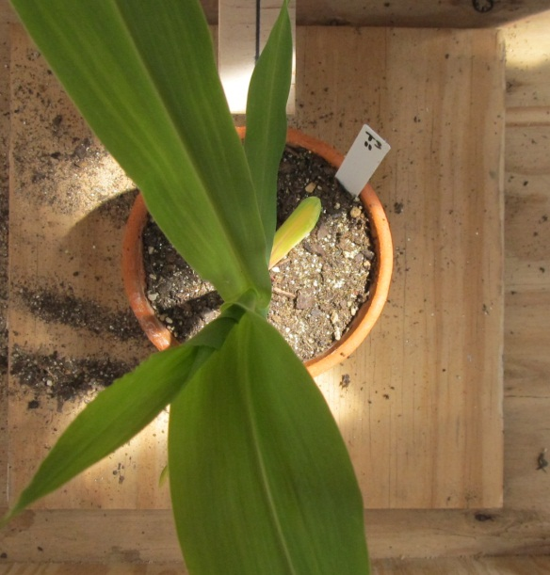
Seed-to-Leaf Correlation
Koller, 2012

Slide 12
Objectives
Evaluate the effect of seed orientation / leaf azimuth, plant population, canopy architecture, and row configuration on light interception, radiation use efficiency, and grain yield of maize.

Slide 13
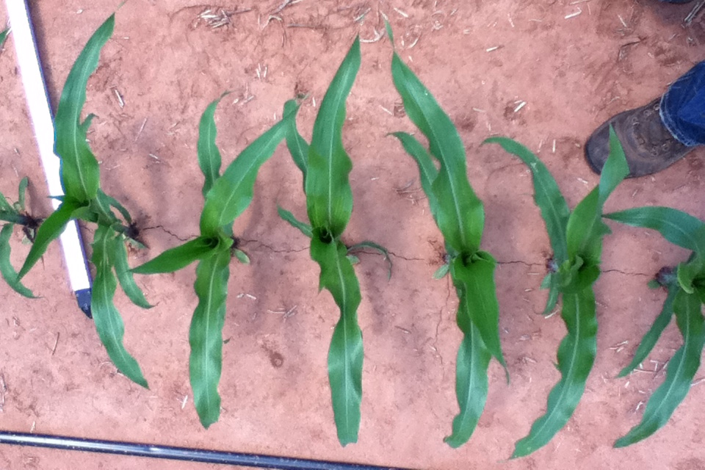
Upright
Flat
Row direction
EFAW and LCB, 2010-2012
RCBD, 12 treatments and 3 blocks
  Across-row, and random leaf azimuths
    Seed orientation - upright, flat, and random;
Plant population (plants ha⁻¹);
  37050, 49400, and 61750
  49400, 74100, and 98800
Hybrid canopy architecture;
  Planophile and erectophile
Flat = across row leaf azimuth

Slide 14
Measurements and Analysis
Light interception (IPAR, MJ m⁻²)
  fPAR x TU=daily fPAR
  IPAR (MJ m⁻²) = daily fPAR x total incident PAR
Cumulative IPAR (CIPAR, MJ m⁻²)
Grain yield (Yield, kg ha⁻¹)
Radiation use efficiency (RUE, g MJ⁻¹)
  RUE= grain yield / CIPAR
ANOVA, contrasts, regression, and correlation analysis

Slide 15
Light Interception
Significant treatment effect on fPAR was observed between V10 and VT growth stages
Notes:
Calculated as fPAR= 1-(I/I0)

Slide 16
Cumulative IPAR at Maturity
(Plant Population)
LSD=8.7 MJ m⁻²
At physiological maturity seed oriented treatments intercepted more light than random seed placement
Notes:
- Andrade (2001) noted that even small increments in light interception resulted on grain yield increases

Slide 17
Grain Yield
(Plant Population)
Upright and flat out-yielded random seed orientation by 6 and 9%
Toler et al. (1999) showed a 10% yield increase for across row
Notes:
Explain graph

Slide 18
Grain Yield
(Hybrid)
Upright and flat were 10 and 6% greater than random

Slide 19
Radiation Use Efficiency at Maturity
(Hybrid)

Slide 20
RCBD and Split-block, 12 trts and 3 reps
  Across-row, random, and with-row leaf azimuths;
  Seed orientation – flat (parallel and perpendicular to the row), and random
Plant population (plants ha⁻¹);
  37050 and 61750
  83980 and 98800
Row Configuration;
  Single rows
  Twin rows
Across-row
Random
With-row
0.20 m
0.20 m
0.76 m

Slide 21
Leaf Azimuth Effect on Light Interception
Across-row > random > with-row
Difference in fPAR between leaf azimuths was usually greater at later vegetative stages at LCB
No differences after V10 growth stage at Champaign
Notes:
Discuss the effects of drought on leaf

Slide 23
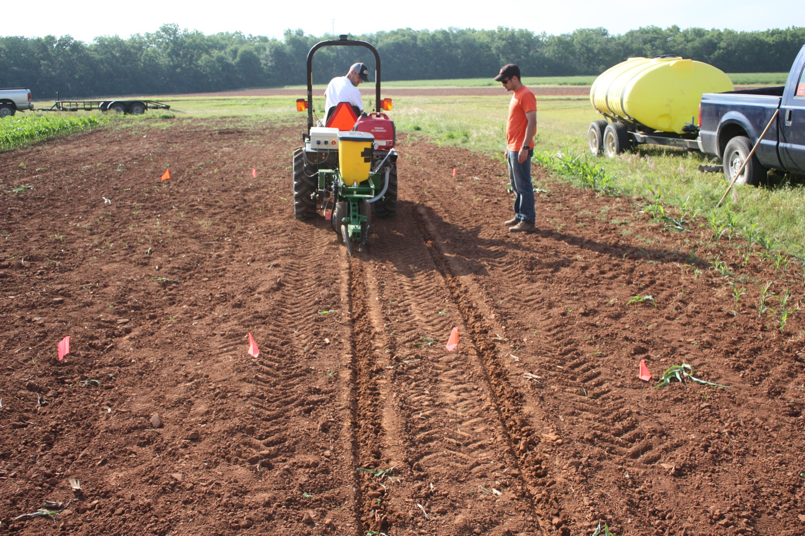
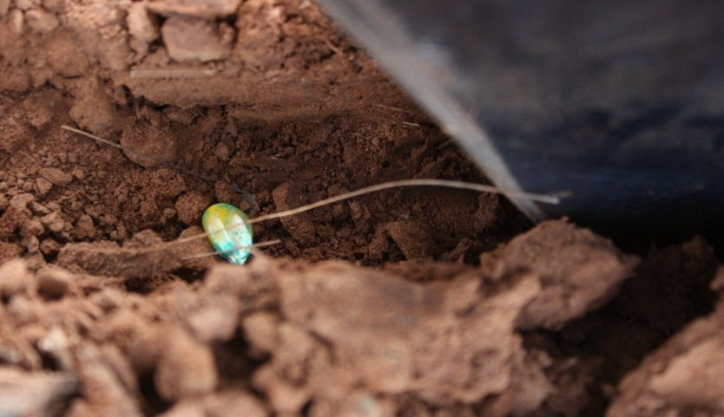
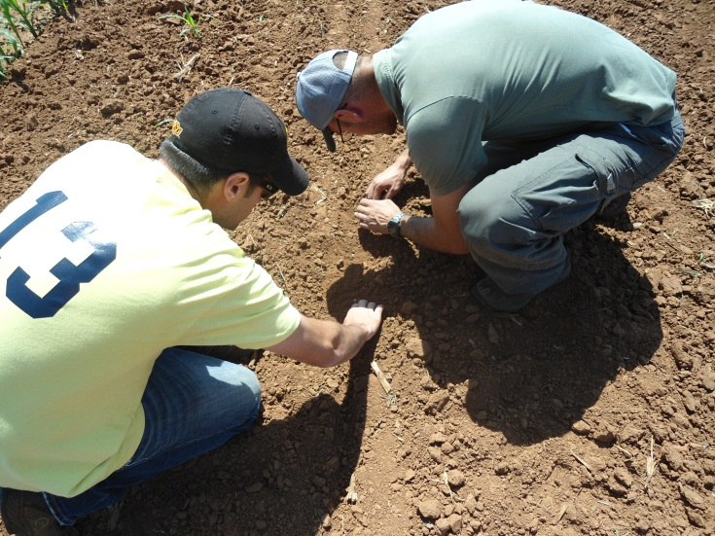

Slide 24
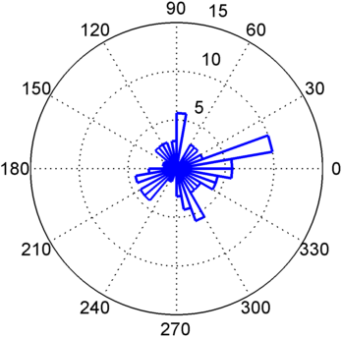
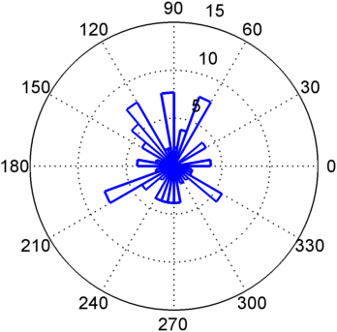
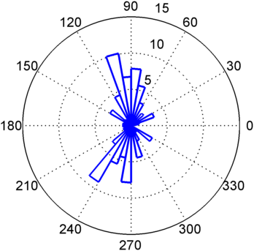
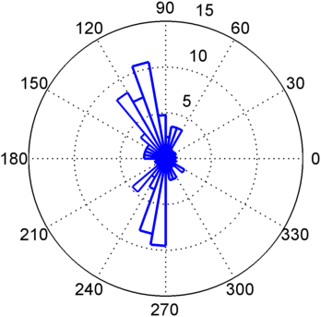
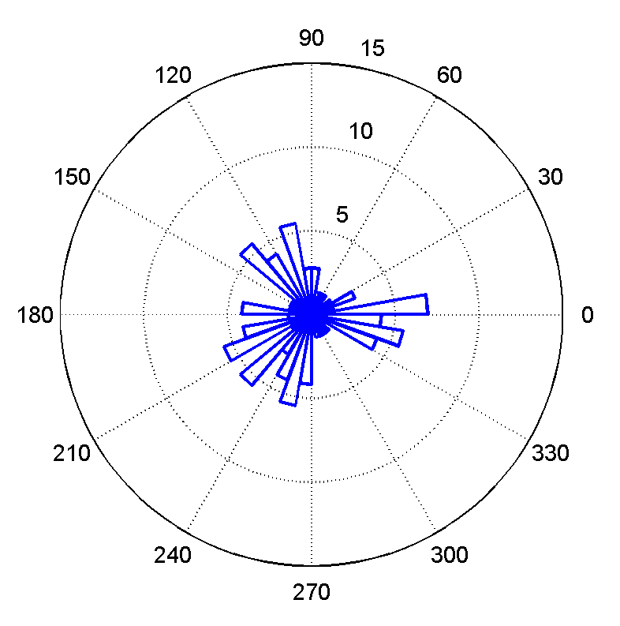
Orientation Performance
release seeds as close to the ground as possible
  cannot drop oriented seed 18" through seed tube
relative velocity between seed and ground is a challenge
  match ground speed?
planting directing
0.6 GS
0.8 GS
1.0 GS
1.2 GS
1.4 GS

Slide 25
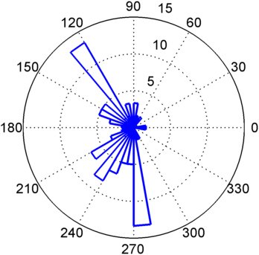
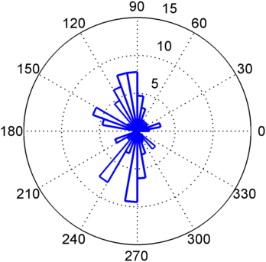
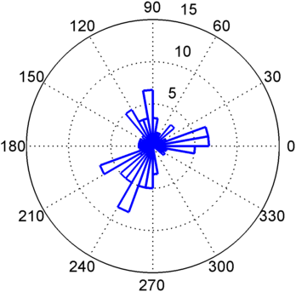
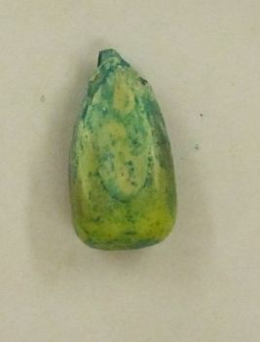
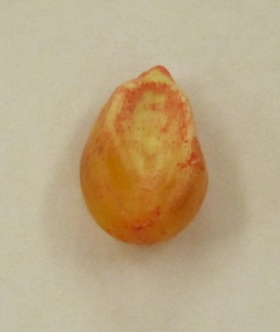
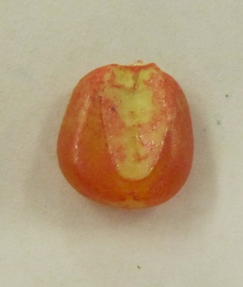
Hybrid Dependence
Performance dependent on seed shape (hybrid, grading)

