Slide 1
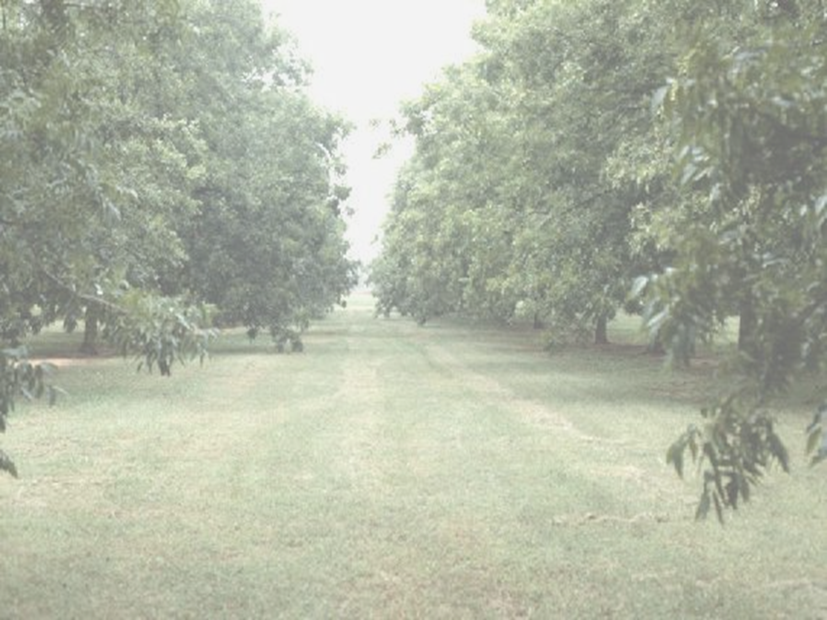

Precision Ag in Pecan Production
Sample Grid
4x7
This grid represents where the mullions are on the TV wall. Use it to help with placement of photos and text.
Dr. Paul Weckler, P.E.
Dept. of Biosystems & Agricultural Engineering,
Oklahoma State University,
Stillwater, OK 74078
February 24, 2014

Slide 2
Today’s Lecture
Sample Grid
4x7
Why Pecans…???
Recent OSU pecan research
Other precision ag sensor research
This grid represents where the mullions are on the TV wall. Use it to help with placement of photos and text.

Slide 3
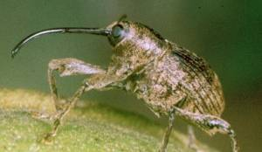
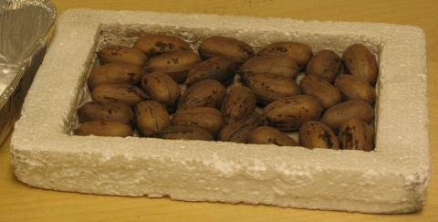
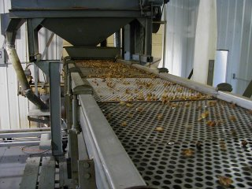
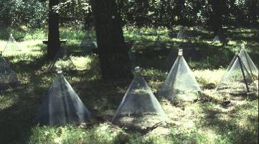
This presentation will highlight efforts at Oklahoma State Univ. aimed at developing innovative technologies that provide solutions to issues and problems affecting pecan production and processing
Sample Grid
4x7
This grid represents where the mullions are on the TV wall. Use it to help with placement of photos and text.

Slide 4
INTRODUCTION
Pecans (Carya illinoensis) are the only major cultivated nut native to the United States.
They are an important cash crop dispersed throughout the southern and southwestern states. (USDA, 2003)
In 2012, the U.S. pecan crop totaled 302.8 million pounds or 151,400 tons, with a value of $476.8 million.
Commercial pecan production was reported in 14 states, and overall the United States produced more than 80 percent of the world’s pecans.
Nearly three-fourths of U.S. pecans were produced in the states of Georgia, New Mexico, Oklahoma and Texas. (USDA-ERS 2013)

Slide 5
Industry Driven Pecan Research and Extension Priorities
Funded by:
USDA – Specialty Crop Research Initiative - $30,000
Oklahoma Pecan Growers’ Assn. - $1000
Georgia Pecan Growers Assn. - $1000
Texas Pecan Growers Assn. - $1000
New Mexico Pecan Growers Assn. - $1000
Oklahoma Agricultural Experiment Station - $24,000
Samuel Roberts Noble Foundation – Lodging & meeting rooms
Michael Smith, Department of Horticulture & L.A.
Paul Weckler, Biosystems & Agricultural Engineering
Oklahoma State University
February 2011 Ardmore, OK

Slide 6
Industry
Production
Processing
John Grundmann, OK
Buddy Adams, TX
Tim Adams, TX
Miguel Vallenavedo, TX
Dan York, AR
Marketing
Dan Zedan, IL
Dan Hamilton, OK
Retail
Chris Field, OK
Gaytha Ziegelmeier, OK
Tourism
Jeff Weeks, OK
Gary Underwood, AL
Mike Adams, TX
Bob Knight, OK
Scott Landgraf, OK
Sherman Richardson, LA
Joe Musick, LA
Phillip Arnold, NM
Basil Savage Jr., OK
Jay Glover, NM
Equipment & Production,
Basil Savage, OK

Slide 7
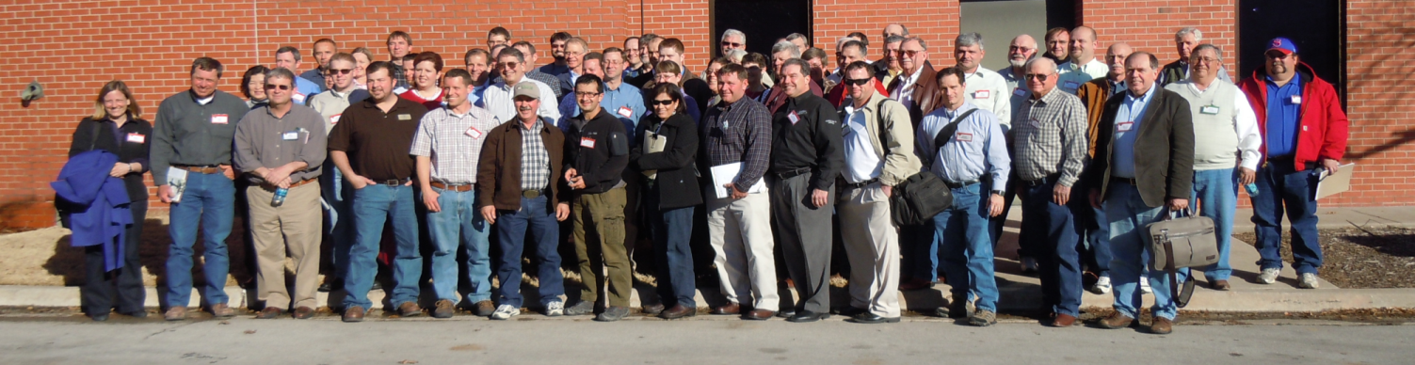
Scientists & Extension Specialists
45 Attended
  Oklahoma State University
  Auburn
  USDA-ARS
  Kansas State University
  Noble Foundation
  Texas A&M
  University of Georgia
  Saint Louis University
  New Mexico State University
  University of Arkansas
  Louisiana State University
Disciplines
  Horticulture
  Entomology
  Plant Pathology
  Molecular Biology
  Agricultural Engineering
  Human Nutrition
  Food Science
  Agricultural Economics
  Postharvest Physiology
  Plant Breeding/Genetics

Slide 8
Industry Identified Priorities
Alternate Bearing
Food Safety
Production & Pest Management
Marketing / Value Added
Unified Pecan Industry Coalition
Single Source Web Information

Slide 9
Some of the OSU sensor projects areas include;
1. Pecan yield measurement technique using backscattered terrestrial microwave sensing.
2. Dielectric spectroscopy for estimating quality of in-shell pecans.
3. Wireless image sensor networks for monitoring the population of pecan weevils.
4. Optical sensors and algorithms that adequately predict plant N status for nitrogen management.
5. X-ray machine vision inspection systems for pecan defect identification.
Sample Grid
4x7
This grid represents where the mullions are on the TV wall. Use it to help with placement of photos and text.

Slide 10
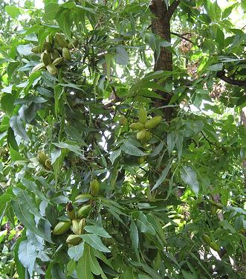
Pecan Yield Estimation Technique Using Backscattered Terrestrial Microwave Sensing.
Sample Grid
4x7
This grid represents where the mullions are on the TV wall. Use it to help with placement of photos and text.

Slide 11

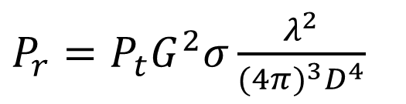

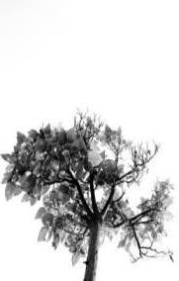


Microwave Sensing of Pecan Yield
Satellite microwave -- many issues
  Low resolution
  Ground reflections
  Orbital dependencies
  Sensitivity
σ = radar profile
Notes:
We need a better way. Optical methods combined with image processing have been tried on many other tree crops but hidden fruit detection is a big problem in oranges and apples – green pecans?
Microwaves are reflected from vegetation but they are able to penetrate vegetation to some extent. and are
The dielectric properties of a material dictate the interaction of electromagnetic waves with it. Water, a polar molecule has a very strong interaction, whileand are often defined in terms of the complex relative permittivity ( ) expressed as ; Where is the dielectric constant, which represents energy storage in the medium and is related to the phase of propagating waves through the material; is the dielectric loss factor, which represents energy dissipation in the medium and is related to the wave attenuation and is a combination of dielectric losses due to dipolar rotations in the medium and conductive losses due to ionic conduction in the medium
Microwaves are reflected from vegetation but they are able to penetrate vegetation to some extent. The dielectric properties of a material especially permittivity, dictate the interaction of electromagnetic waves with it. Epsion prine ise is the dielectric constant, which represents energy storage in the material as molecules align with e fields. This energy is released as reflections or transmission through the material; Epsilon double prime is the dielectric loss factor, which represents energy dissipation in the medium. It is related to the EM wave attenuation. Water, a polar molecule, has a very high relative permittivity compared to a vacuum or air. Polymer materials and wood have fairly low rel permitivity. What is a tree made of? Water, polymers and air.
Radar antenna and receiver designs are very complex, but in order to work at all, you need an acceptaptable returned signal power. The radar equation gives a simplified relationship between power transmitted and received by an antenna and illustrates problems with satellite radar.
Transmitt power, antenna gain and wavelength are properties of the satelite
Radar profile of the target includes reflections from the tree which we care about, and from the ground, neighboring trees etc which add interference.
Large distanceDistance is determinedwe can’t do much about that.
Schedule independence
Sensitivity and resolution
Many researchers have attempted to tease out information from this diffuse signal – to amazing success

Slide 12
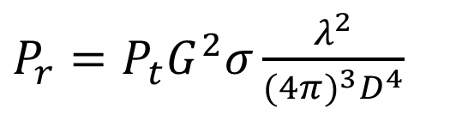

Microwave sensing of pecan yield
Short range terrestrial microwave
  Improved resolution, sensitivity and power characteristics
  Eliminates ground reflections
  Reflections from far side have are minimal
  Orbital independence
σ = radar profile
Notes:
We need a better way. Optical methods combined with image processing have been tried on many other tree crops but hidden fruit detection is a big problem in oranges and apples – green pecans?
Microwaves are reflected from vegetation but they are able to penetrate vegetation to some extent. and are
The dielectric properties of a material dictate the interaction of electromagnetic waves with it. Water, a polar molecule has a very strong interaction, while and are often defined in terms of the complex relative permittivity ( ) expressed as ; Where is the dielectric constant, which represents energy storage in the medium and is related to the phase of propagating waves through the material; is the dielectric loss factor, which represents energy dissipation in the medium and is related to the wave attenuation and is a combination of dielectric losses due to dipolar rotations in the medium and conductive losses due to ionic conduction in the medium
Microwaves are reflected from vegetation but they are able to penetrate vegetation to some extent. The dielectric properties of a material especially permittivity, dictate the interaction of electromagnetic waves with it. Epsilon prime is is the dielectric constant, which represents energy storage in the material as molecules align with e fields. This energy is released as reflections or transmission through the material; Epsilon double prime is the dielectric loss factor, which represents energy dissipation in the medium. It is related to the EM wave attenuation. Water, a polar molecule, has a very high relative permittivity compared to a vacuum or air. Polymer materials and wood have fairly low rel permittivity. What is a tree made of? Water, polymers and air.
Radar antenna and receiver designs are very complex, but in order to work at all, you need an acceptaptable returned signal power. The radar equation gives a simplified relationship between power transmitted and received by an antenna and illustrates problems with satellite radar.
Transmit power, antenna gain and wavelength are properties of the satellite
Radar profile of the target includes reflections from the tree which we care about, and from the ground, neighboring trees etc which add interference.
Large distanceDistance is determinedwe can’t do much about that.
Schedule independence
Sensitivity and resolution
Many researchers have attempted to tease out information from this diffuse signal – to amazing success

Slide 13
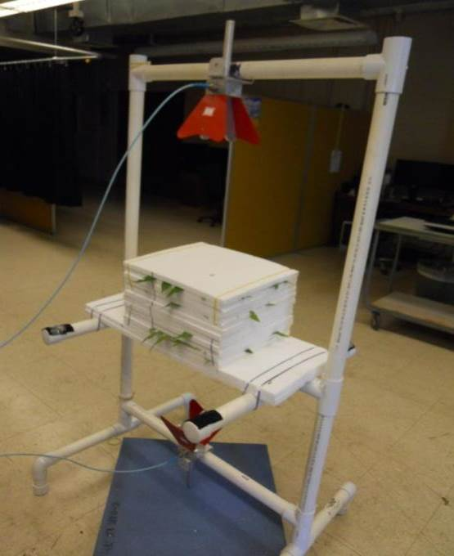






Experimental Objectives and Methods
Obtain baseline microwave backscatter response of pecan tree canopy components.
Identify:
  Spectral features to quantify nut yield
  Modeling parameters for future investigation
Notes:
We do this on a Vector network analyzer. A VNA is an instrument for measuring the impedance characteristics of microwave networks. In our case the VNA was configured to power an antenna and measure the microwave energy transmitted through and reflected from a target sample. We also measured phase shift of the transmitted signal. We measured 401 frequencies evenly spaced between 1 and 18 GHz. That corresponds to wavelengths from 30 cm to 1.67 cm. We also used horn antenna that produce a directional beam with a cone angle of about 25 degrees.

Slide 14
Partial Least Squares Regression (PLSR)
PLSR was used to analyze spectral data
Nut mass effects
  ~200-300 g dry mass
Total canopy water/mass
  ~0-300 g water
  ~0-300 g dry mass
Results for 0 – 9 nuts
Notes:
PLSR is a technique used for analyzing spectral data with many predictor factors (401) that are collinear or related to each other. It is similar to PCA…..
Except weighting of the resulting eigenvectors takes independent variable (nuts, mass) into consideration. We can use the PLS components for two things;
To look for important frequency bands

Slide 15
PLSR results – Nut mass measurement in canopy
○ 04 Aug
▢ 17 Aug
▽ 06 Sept
◇ 27 Sept
△ 25 Oct
+ All dates
Multispectral radar indicated
Significant seasonal effects
Notes:
Typical results for nut mass – nut water results are very similar so we can conclude that we are mostly measuring microwave response to water.
There is some seasonal effect in the data that is probably due to physiological differences. These effects are secondary to water.
This means multiple frequency analysis is probably needed to predict nut mass

Slide 16
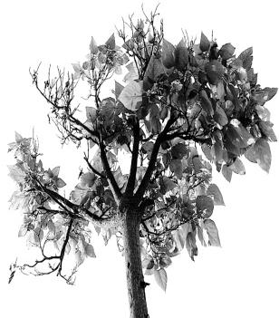
Microwave sensing of pecan yield
Backscattered microwaves respond to
canopy biomass
  Single frequency response R² ~ 0.6 for water and R² ~ 0.8 for canopy biomass in 5.5-8 GHz
  Define measurement scenarios
    Measure change in canopy
    mass during growing season
  Prototype RADAR design
    Distance measuring
    Power/bandwidth
    Antenna parameters
  Other applications
    Apply to other orchard crops
    Canopy biomass map

Slide 17
Wireless Sensor Networks For Monitoring Pecan Weevils
Sample Grid
4x7
This grid represents where the mullions are on the TV wall. Use it to help with placement of photos and text.

Slide 18
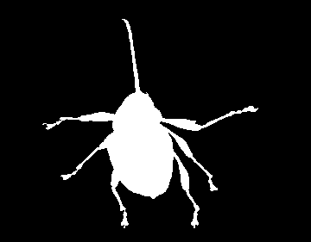
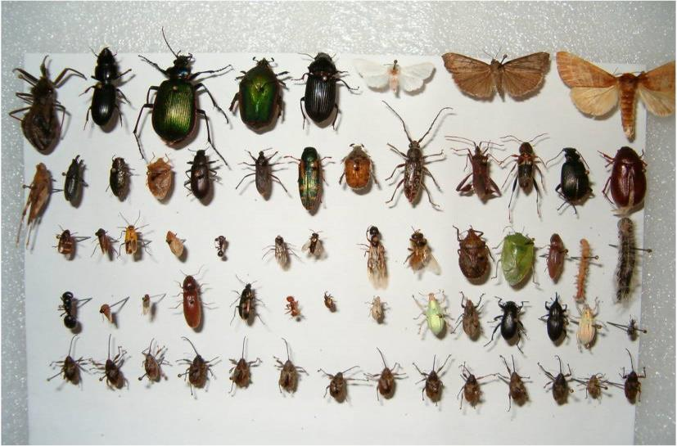
Wireless Sensor Network
Bug Cam
"Smart bug trap“
Automated Insect Monitoring System

Slide 19
Developed Image Recognition Algorithms
Training set template of 205 pecan weevils

Slide 20
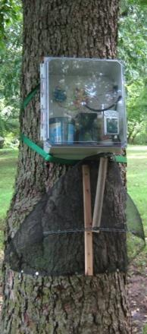
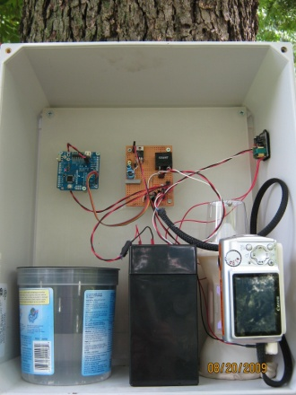
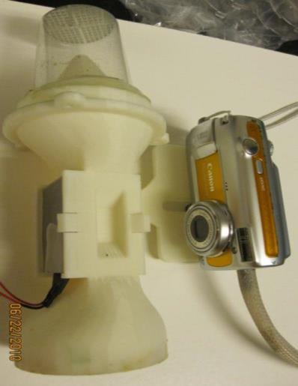
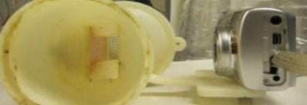
Algorithm Testing System
C
A
B
H
D
E
F
I
G
Trap Components: a) microcontroller, b) power regulation and switching, c) EL inverter, d) weevil collection cup, e) battery, f) camera, g) imaging chamber, h) EL backlight, i) Desiccant.

Slide 21
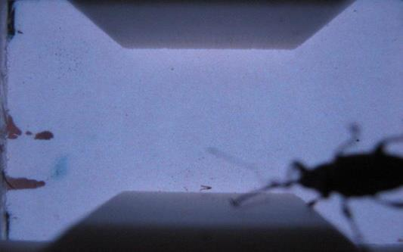
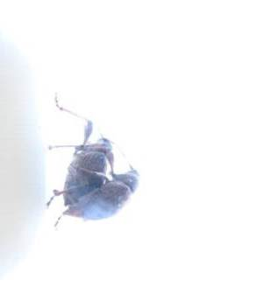
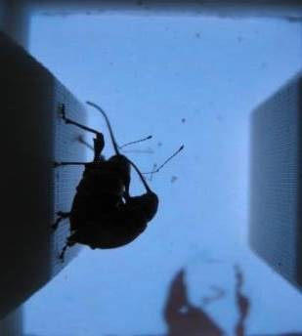
Imaging Performance
Poor autofocus performance
Over exposed image, and subsequent image with proper exposure

Slide 22
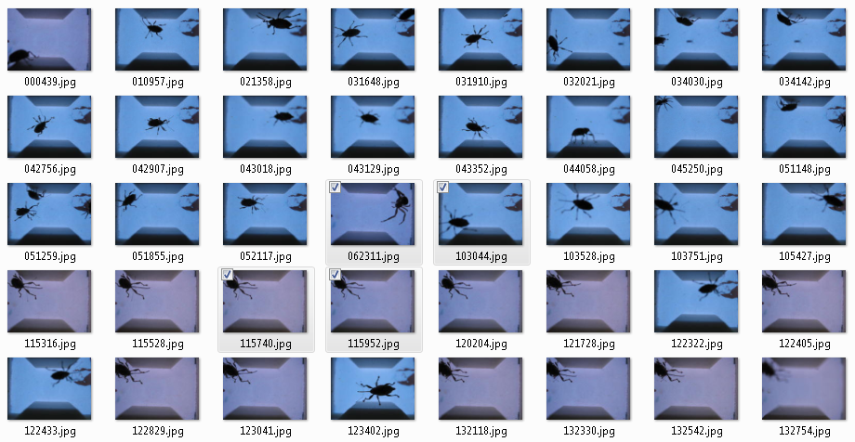
Imaging Performance
Eventually, good images collected over the course of the study

Slide 23
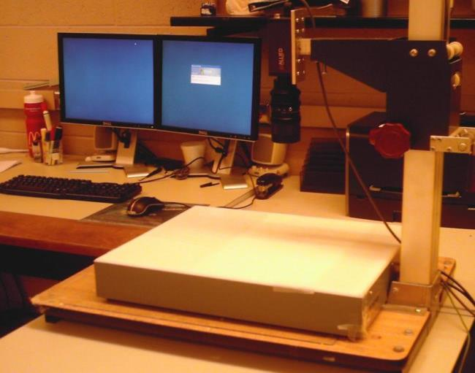
Next: Shrink the Sensor
Shrink

Slide 24
Current & Future Needs
Development of a low-power method for detecting weevils in order to trigger image acquisition
Redesign of the imaging chamber to promote weevil movement
Pecan Orchard RF attenuation characteristics should be investigated for the design of many-node deployable networks
(see recent ASABE paper by Dr. Ning Wang)

Slide 25
Current & Future Work
Selection/Design of a fixed focus, active exposure control imager
Component integration for reduced-size packaging
A less power-hungry camera is required
Purpose-built hardware is needed for improved power consumption and weevil trap compatibility

Slide 26
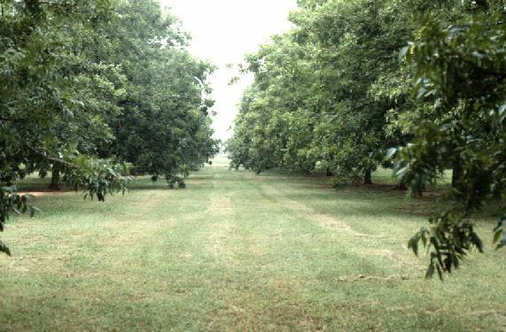
Optical sensors and algorithms to predict pecan N status for Nitrogen management
Sample Grid
4x7
This grid represents where the mullions are on the TV wall. Use it to help with placement of photos and text.

Slide 27
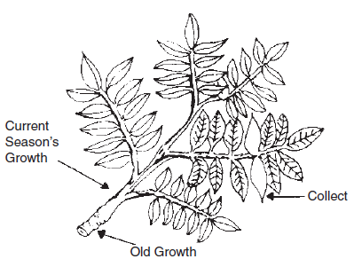
Project justification
Pecan nitrogen management
  Tree health
  Maximize nut production
  Minimize alternate bearing
Foliar |N| is currently used in management protocols
  Hand harvest and dry a leaf sample
  Send to a lab for analysis
Current methods are slow, imprecise and too costly to analyze every tree
Precision agriculture in pecan

Slide 28
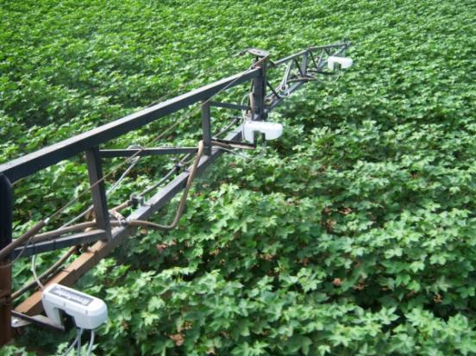
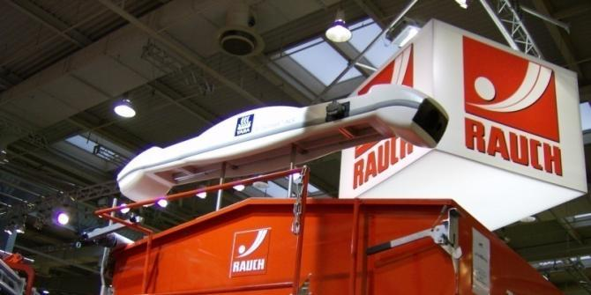
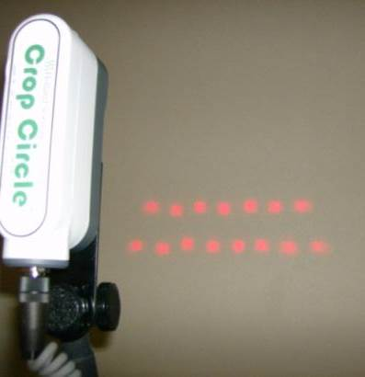
Commercial Crop Sensors
Active light sensors are necessary.
NDVI is related to plant physical condition
Correlated with:
  Plant biomass
  Crop yield
  Plant nitrogen
  Plant chlorophyll
  Water stress
  Plant diseases
  Insect damage

Slide 29
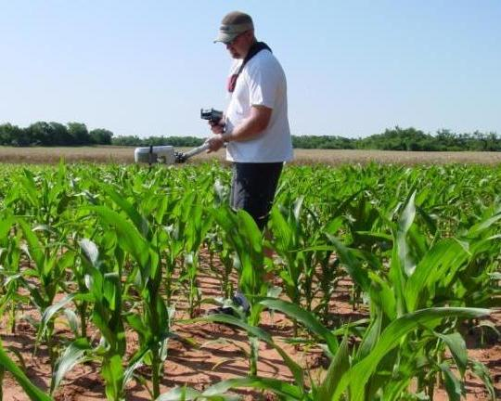
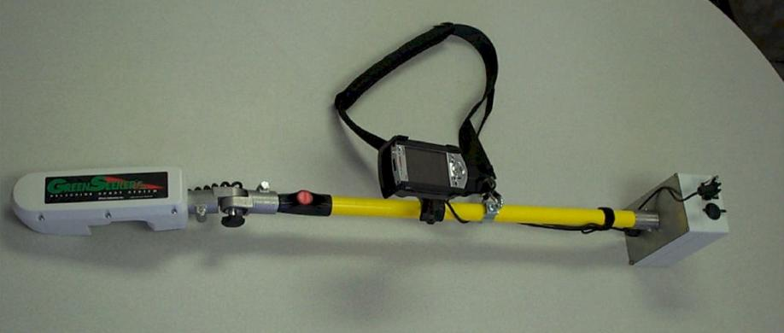
GreenSeekerTM N-Fertilizer Handheld Optical Sensor
The same active lighting optical sensor used on the variable rate fertilizer applicator
Optically measures plant biomass, total nitrogen in the crop, and plant stress
Can sample scan a wheat field (or other crop)
Data can use to calculated response index for added nitrogen fertilizer

Slide 30


Slide 31
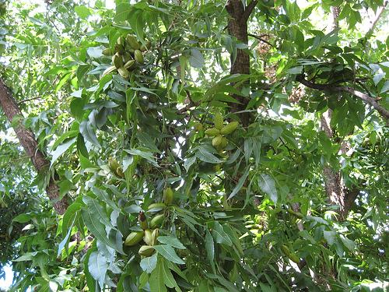

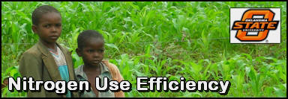
Experimental objective:
  Evaluate the performance of
  a chlorophyll (SPAD) meter
  a ground based vis-NIR multispectral camera using ambient light
  for rapid in situ measurement of foliar nitrogen in a pecan orchard during the summer growing season.

Slide 32
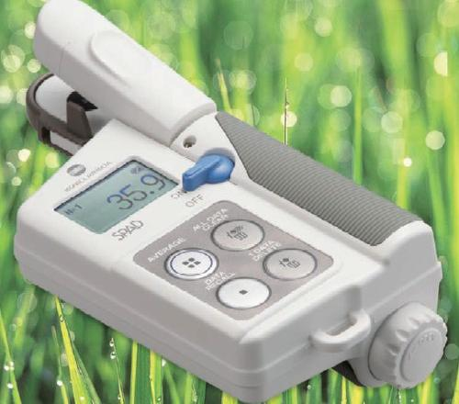
SPAD Meter Data
Mean of 10 SPAD readings on the middle leaflet on the center leaf of current season growth, equally spaced around the tree dripline
  Same leaflets collected for chemical analysis
  ‘Pawnee’ and ‘Kanza’: 6 dates: Apr – Oct 2010
  ‘Maramec’: 5 dates: Apr – Sept 2010

Slide 33
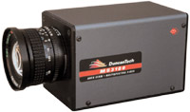
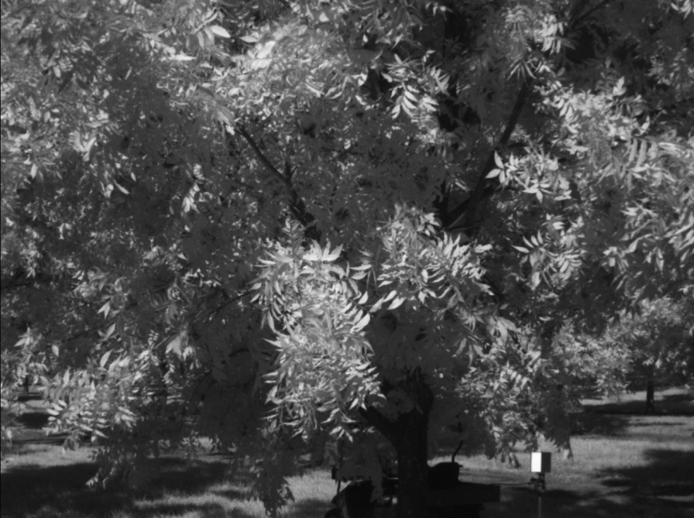
Multispectral Camera
Imaged ‘Pawnee’ and ‘Kanza’ trees Sept and Oct 2010
  Duncan Tech MS3100 camera
    1392 x 1040 x 8 bits
    550 / 670 / 780 nm images
    10% and 99% diffuse reflectance targets
    Solar illumination
MATLAB image analysis
  Manually select reflectance target and leaf area
  Leaf classification
  Calculate NDVI per pixel
  Filtering/thresholding
Significant |N| prediction models w/ low correlation
  ‘Pawnee’ for both months of study
  ‘Kanza’ for September only
  21% < R² < 51%

Slide 34
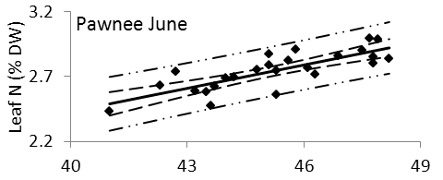
Results
  Useful prediction of |N| for ‘Maramec’ and ‘Pawnee’
  ‘Kanza’ for June and October only
  Insignificant correlation for newly emerged leaves (May)
  Medium correlations (39% < R² < 87%)
  Typical results:
SPAD value (mean of 10 readings)

Slide 35
Initial research has been done.
Proof of concept demonstrated.
Additional funding needed to further develop and refine the concepts.
Private industry involvement required.
Future precision ag research areas
Unmanned aircraft (UAVs)
THz sensing
Wide area soil moisture sensing

Slide 36
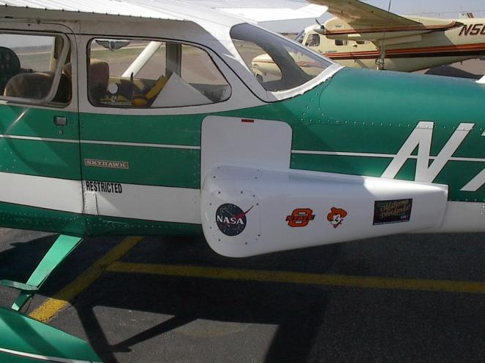
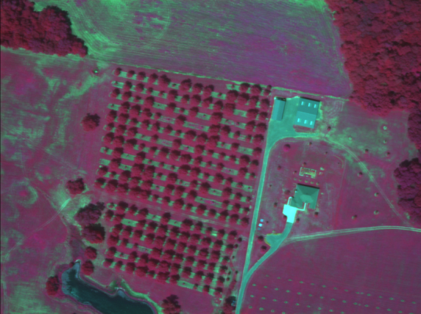
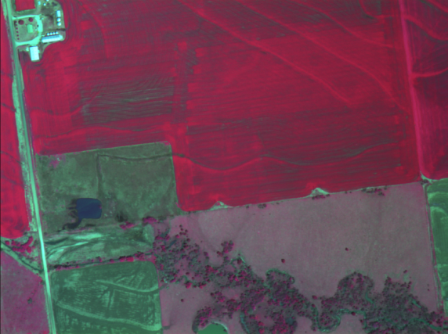
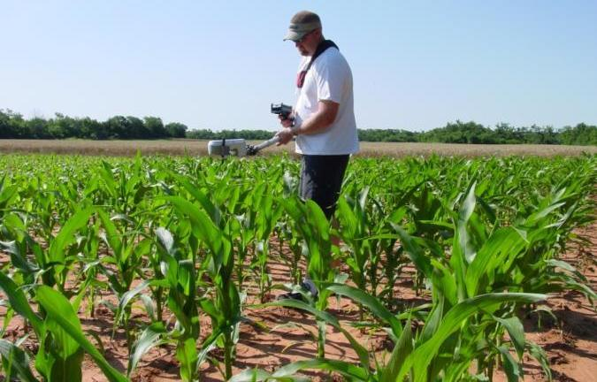
Precision Ag Research at OSU
Multi-Spectral Crop Sensing

Slide 37
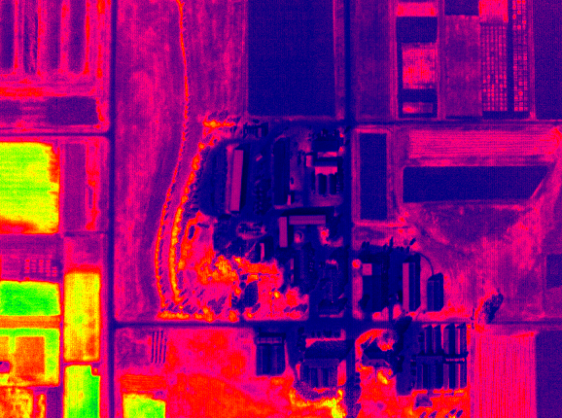
NDVI of OSU Experiment Station
1m Resolution

Slide 38
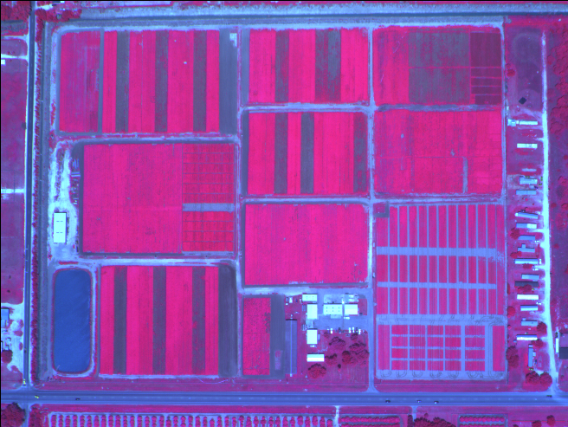
False Color (green, red, NIR) Image
< 1 m Resolution - Raw Radiometric Data
(Courtesy F. Schiebe, SST Software)

Slide 39
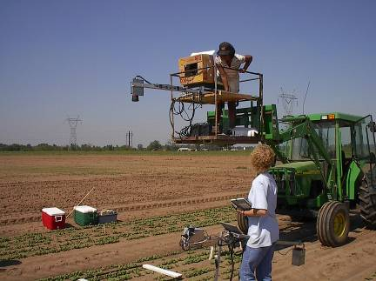
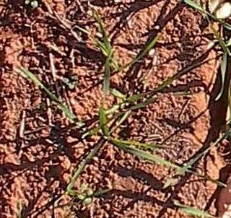
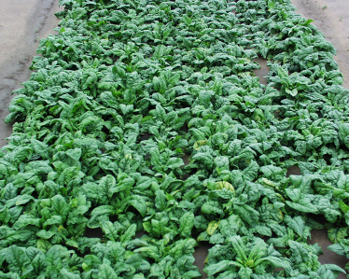
Other Precision Ag Research at OSU
Automated Weed Detection

Slide 40
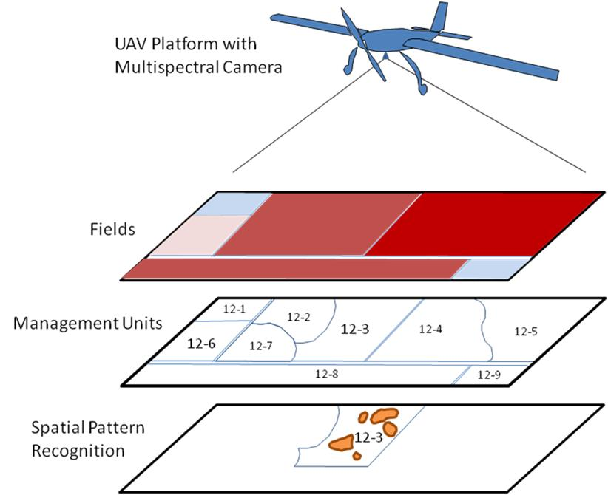
Multispectral Remote Sensing for Insect Pest Detection and Monitoring in Agricultural Crops

Slide 41
TERAHERTZ (THZ) APPLICATIONS IN FOOD AND AGRICULTURE:
A REVIEW
S. K. Mathanker, P. R. Weckler, N. Wang
ABSTRACT. Terahertz (THz) rays interact with materials at intermolecular levels, and because of this they are the focus of many active research areas. This study reviews the articles related to food and agriculture applications of THz spectroscopy and THz imaging. It also briefly introduces important THz techniques. The survey of the literature reveals great potential for this emerging and promising technology in agriculture. Food inspection, crop inspection, and material characterization could be potential research areas.
Keywords. Agriculture, Food, Imaging, Machine vision, Spectroscopy, Terahertz, THz.
Transactions of the ASABE Vol. 56(3): 1213-1226
© 2013 American Society of Agricultural and Biological Engineers
ISSN 2151-0032 1213

Slide 42
Figure 1. Terahertz waves in the electromagnetic spectrum
(adapted from Walther et al., 2010).

Slide 43
NON-CONTACT PREDICTION OF SOIL MOISTURE PROFILES USING
RADIO WAVE REFLECTION
D.L. Needham, P.R. Weckler, C.F. Bunting, M.L. Stone
Oklahoma State University

Slide 44
Objectives
Constructed theoretical predictions of radio wave reflection from moisture profiles in Oklahoma soil
Established a moisture profile restoration algorithm that utilized reflected CW magnitudes and phases from multiple frequencies
Tested the theoretical model and restoration algorithm in field trials detecting EM reflection from soil containing various moisture profiles

Slide 45
Detection Strategy
3.81m
Transmit w/ network analyzer & antenna #1
Detect reflection w/ antenna #1
Detect transmission w/ antenna #2
0.87m
20º
2.06m
3.05m
1.0m
1.23m
2.0m
2.34m
4.69m

Slide 46
Electromagnetic propagation at a boundary
E_{ll}^{i}
Intrinsic impedance
H_{ll}^{r}
E_{ll}^{r}
H_{ll}^{i}
Reflection coefficient
θ_{i}
θ_{r}
1
Transmission coefficient
2
Vector out
Propagation constant
Vector in
θ_{t}
E_{ll}^{t}
E Electric Field
H_{ll}^{t}
Skin depth
H Magnetic Field
θ Angle

Slide 47
Electromagnetic Reflection from Multiple Dielectric Slabs
Transmitter
Receiver
Air
Dry Soil
Wet Soil

Slide 48
Conclusions
5% differences in volumetric moisture resulted in significantly different reflection coefficients.
The frequencies used could detect moisture gradients to depths of 61 cm.
Measured reflections differed from simulated reflections by a significant amount.
The profile restoration algorithm was very sensitive to error and often diverged from realistic soil moisture values.

Slide 49
Collaborators
Ning Wang¹, Carol Jones¹, Tim Bowser¹,
Aaron Franzen¹, Marvin Stone¹, Sunil Mathanker², Niels Maness³, Mike Smith^{3,} James Hardin⁴,
¹ Dept. of Biosystems & Agricultural Engineering, Oklahoma State University, Stillwater, OK 74078
² Dept. of Agricultural and Biological Engineering, University of Illinois at Urbana-Champaign, Urbana, IL 61801
³ Dept. of Horticulture and Landscape Architecture, Oklahoma State University, Stillwater, OK 74078
⁴ Dept. of Mechanical Engineering, Western Kentucky University, Bowling Green, KY 42101

Slide 50
Questions ?

