Slide 1

Soil 4234 Lab # 11
Fall 2016
Soil Test for Potassium and Sulfur

Slide 2
Potassium Facts
Potassium is immobile in the soil, and mobile in the plant
Second most abundant nutrient in the plant.
Taken up as K⁺
  Remains in that inorganic form in the plant.
Soil test values are typically higher in
  Drier climates
  Soils with high shrink-swell clays
In Oklahoma, most fertilization is required in areas of high biomass removal systems
  Alfalfa, improved Bermuda grass

Slide 3
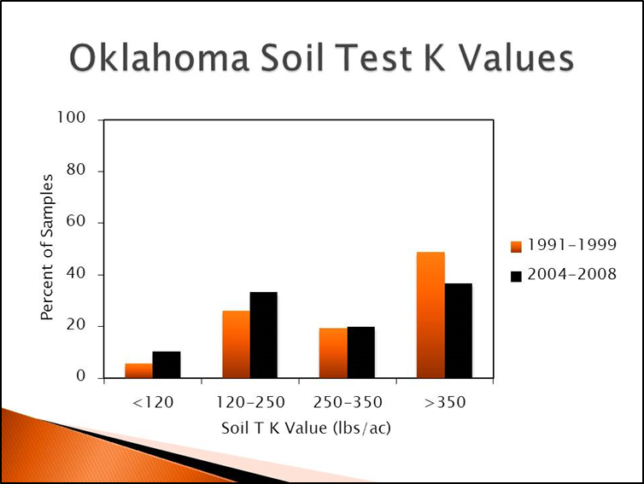

Slide 4
Potassium Soil Test
Mehlich III Extractant
10:1 extractant: oven dried soil ratio
Shaken for 5 minutes
Filtrate analyzed on ICAP or AA
Concentration reported as Soil Test K Index
Sources of Error
  High shrink-swell clays fix K⁺ in the clay inter layers in extremely dry years

Slide 5
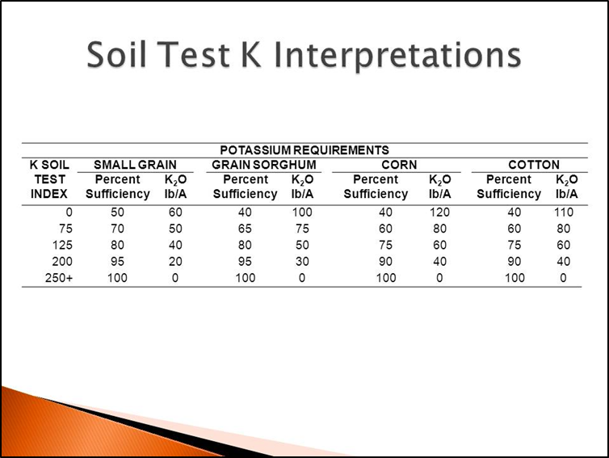

Slide 6
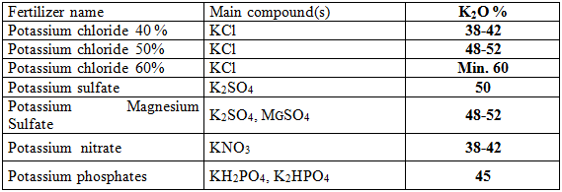
Potassium Fertilizer Sources
Muriate of Potash – KCl
  60 – 62 percent K₂O

Slide 7
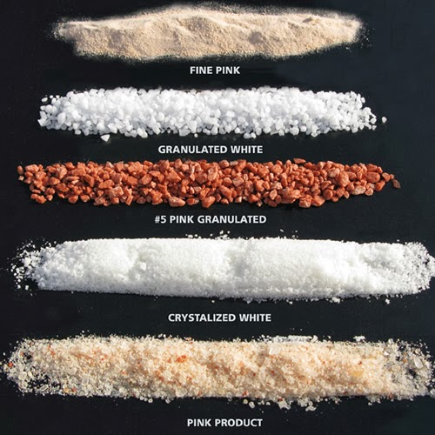

Slide 8
Sulfur Facts
Sulfur is mobile in the soil, and immobile in the plant.
Taken up as SO₄²⁻
  Used in the formation of two amino acids in the plant.
Because it is mobile in the soil, fertilizer recommendations are based on yield goals.
  20:1 ration of N applied/S applied (non-legumes)
Surface and subsurface soil sampling required.
Deficiencies usually only seen in sandy soils with low soil organic matter.

Slide 9
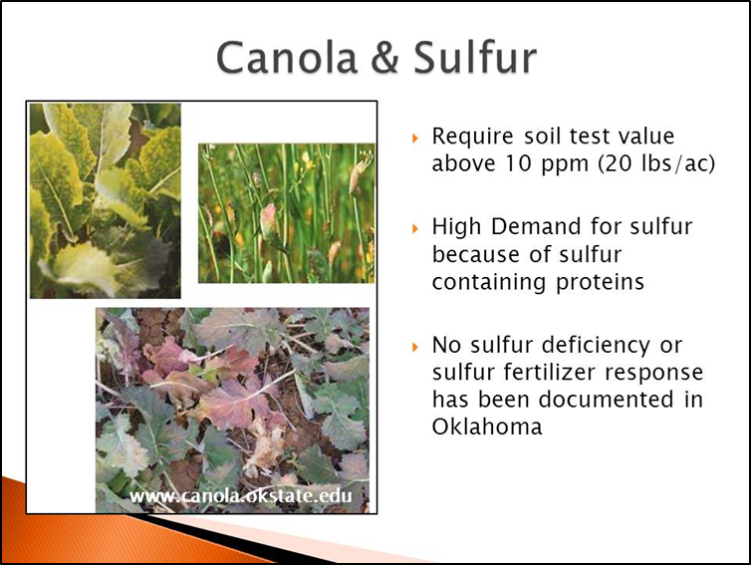

Slide 10
Sulfur Soil Test
Extractant = Calcium Monophosphate
2.5 : 1 extract : oven dried soil ratio
Shake for at least 30 minutes
Filtrate analyzed on ICAP
Concentration reported as lbs S/ac

Slide 11
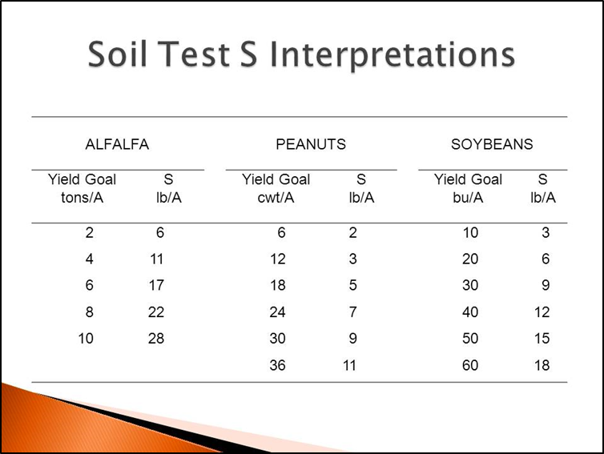

Slide 12
Sulfur Fertilizer Source
Gypsum – CaSO₄ + 2H₂O
  17 % sulfur
  Not very water soluble
Ammonium Sulfate – (NH₄)₂SO₄
  24 % sulfur
  Water soluble

