Slide 1
Precision Ag
SOIL 4234/5234

Slide 2
Introduction
Precision Ag is a technology that can be used to improve profitability while reducing the impact of agriculture on the environment
At its core, Precision Ag is used to help control aspects of variability

Slide 3
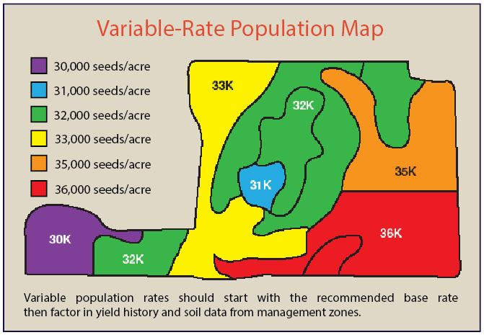
Precision Ag Tools
Variable Rate _________
  Seed
  Fertilizer
  Tillage
  Yield monitoring
Builds maps with information

Slide 4
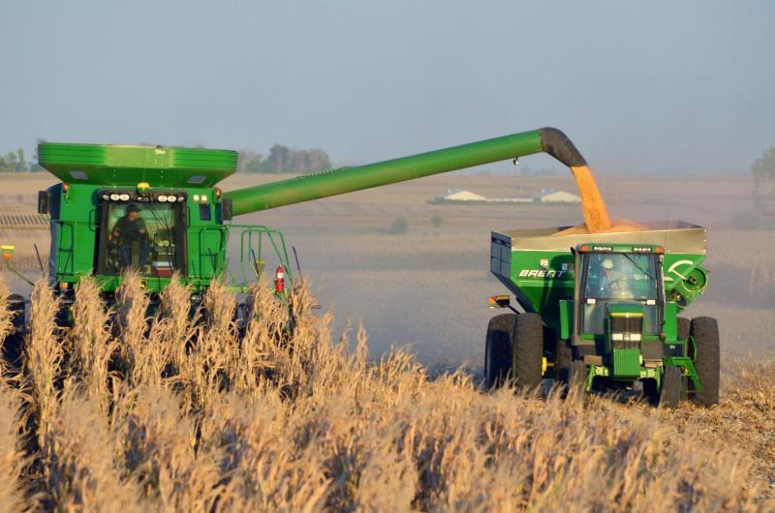
Precision Ag Tools
GNSS/GPS
  Global Navigation Satellite System
  Global Positioning System
Yield Monitors and Maps
Data Collection Devices
  In-cab
  On Equipment

Slide 5
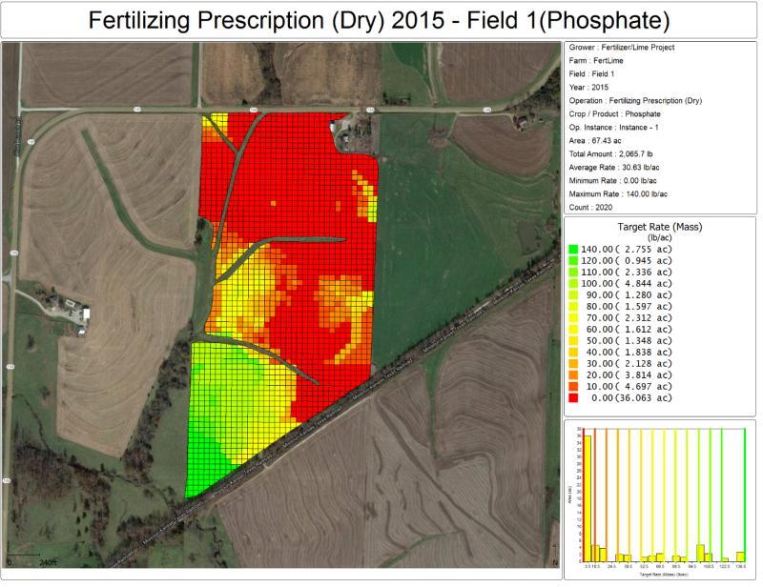
Precision Ag Tools
Sampling and Mapping
  Soil Sample
  EC Maps
  EM Maps
  Multi Spec
  By-row Planter
Remote Sensing and Imagery
  Ground Based
  Remote

Slide 6
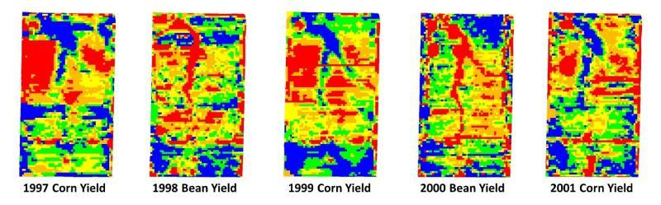
Precision Ag Tools
Can be used to see patterns over time
  Gives an idea of what needs to be investigated

Slide 7
Objectives
Understand impacts that Precision Ag has on current agronomic practices
Learn about available precision ag used in our area, and in our research
  Greenseeker
  Canopeo
  Soil Sensing

Slide 8
Greenseeker and SBNRC
Developed at OSU
Utilizes active sensors (active meaning uses own source of light, not dependent on sunlight)
Takes Red and NIR radiance readings, normalizes, and then feeds data back as NDVI
  Normalized Difference Vegetative Index
NDVI is then used to calculate Yield potential, and subsequent N rate recommendations

Slide 9
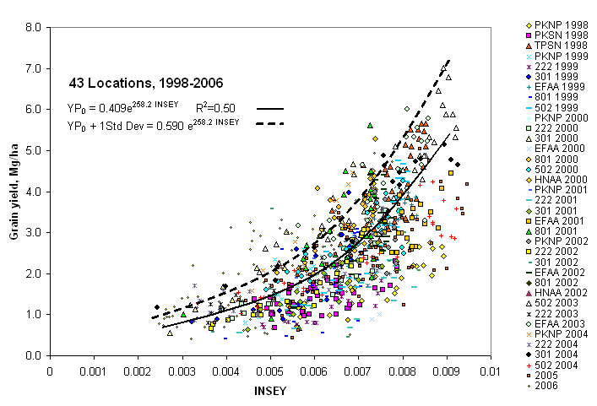
Greenseeker and SBNRC
Model was built on NDVI and yield values from 43 locations
Continued to be updated with over 20+ years of NDVI data
Limitations:
  Becomes less accurate at finding differences at NDVI > 0.72

Slide 10


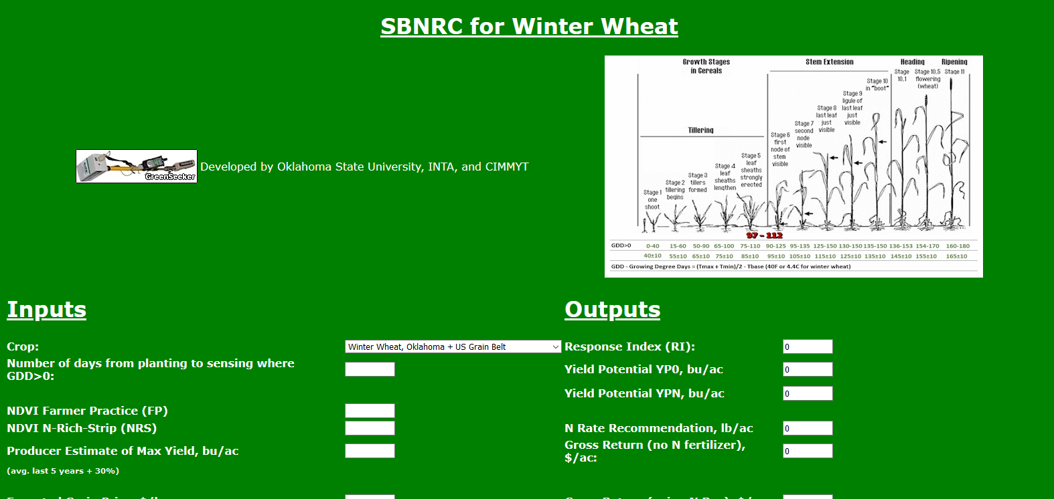



Greenseeker and SBNRC
Utilizes these equations to determine SBNRC
http://nue.okstate.edu/SBNRC/mesonet.php

Slide 11
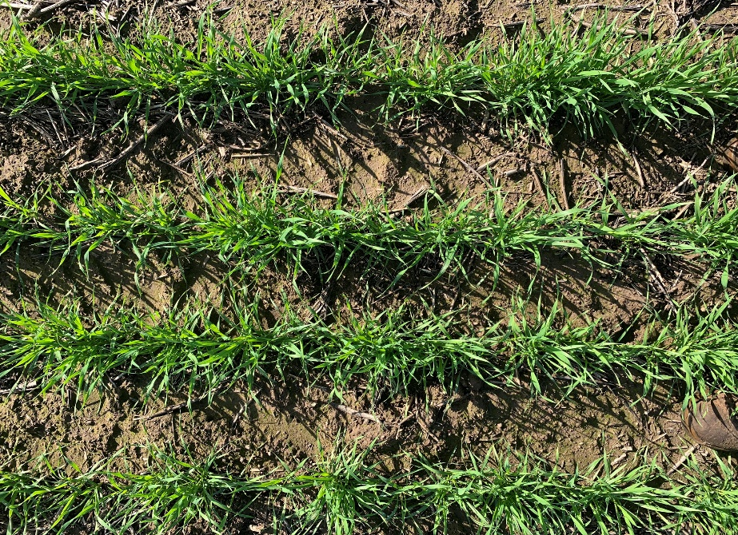
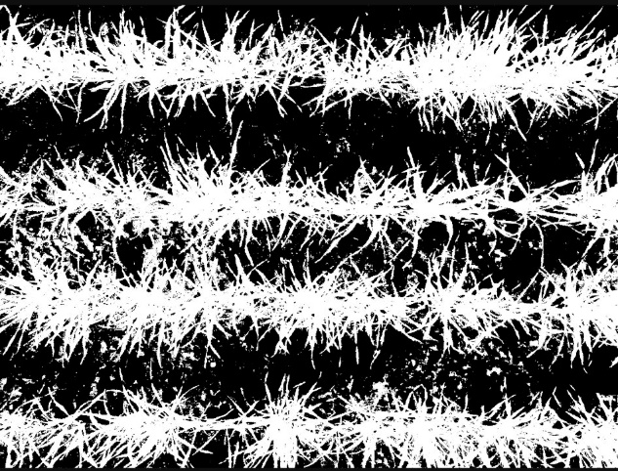
Canopeo
Also developed at OSU (Soil Physics, Dr. Tyson Oschner)
Rapid Green Canopy Cover measurement tool
Quantifies the percent canopy cover of live green vegetation for any agricultural crop

Slide 12
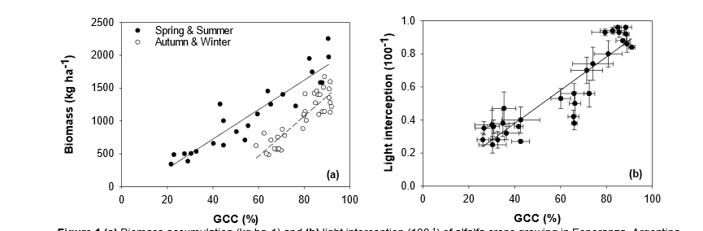
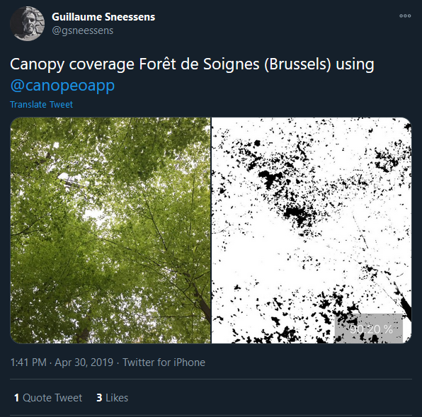
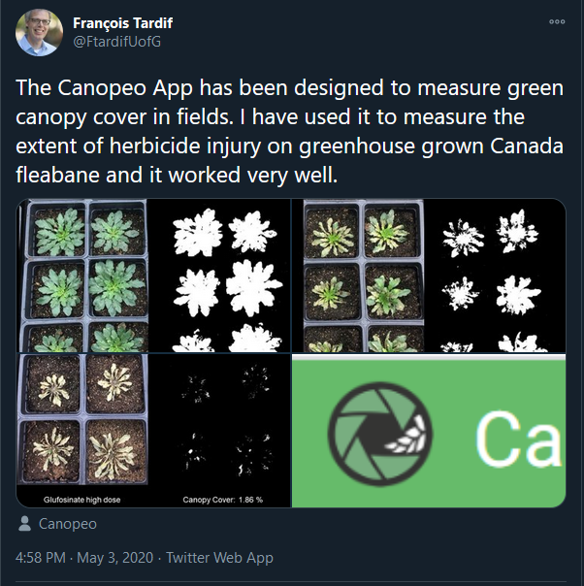
Canopeo
^ Estimation of Yield in Alfalfa
< Other uses of quantifying biomass vs. other
Limitations:
  Not very accurate estimate of yield/differences at above 80%

Slide 13
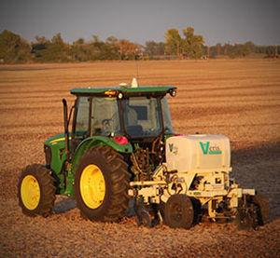
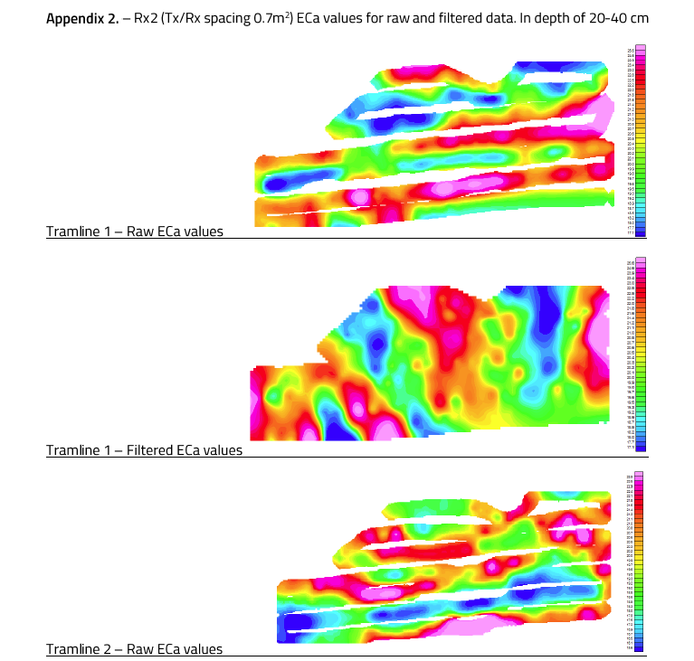
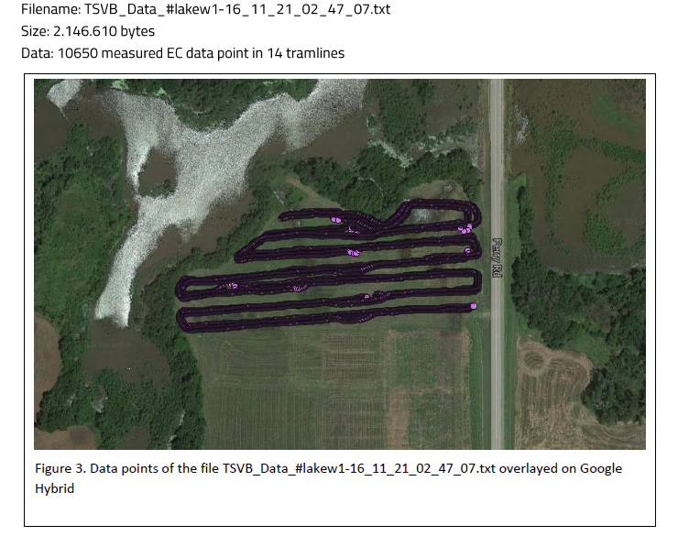
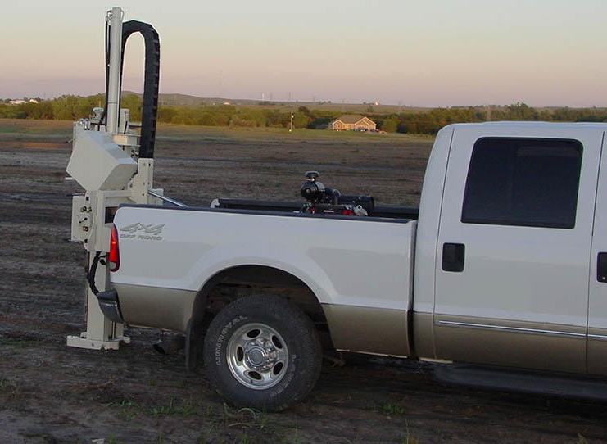
Soil Sensing Technology
Rather new works, not highly used yet
Measure EC using coulters at differing distances to allow for EC measures at different depths
OM from soil cores
Downforce to measure bulk density/texture differences
Even can do on the move pH readings

