Slide 1
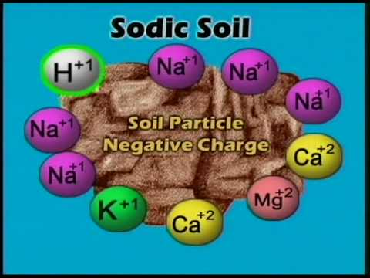
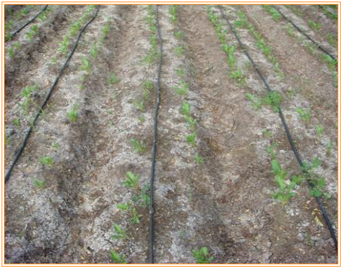
Saline and Sodic Soils
SOIL 4234 Laboratory No. 8

Slide 2
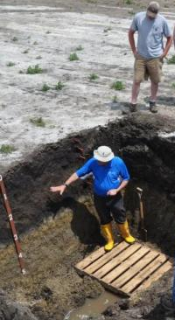
Problem Soils
Acid soils
Saline (salty) soils
Sodic (alkali) soils
  Saline-Sodic = formed when sodic become salty

Slide 3
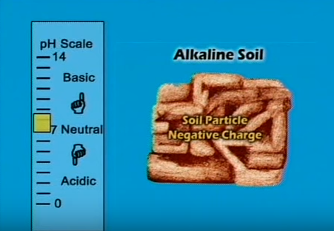
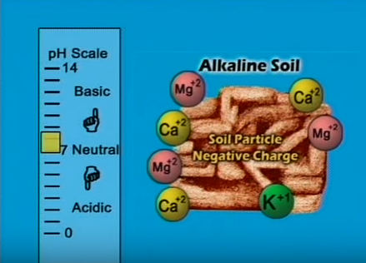
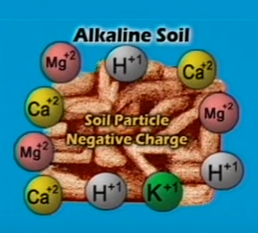
Saline Soil
Saline soil: is a non-sodic soil containing sufficient soluble salt to adversely affect the growth and development of plants

Slide 4
Saline Soil
Soluble salts most commonly present are the chlorides and sulphates of sodium, calcium and magnesium.
Soluble carbonates are always absent.
Soils are saline when electrical conductivity (EC) is greater than 4,000 micrimhos/cm.
Soil with an EC of 4,000 micromhos/cm will contain about 2600 ppm soluble salts in the saturated soil solution.

Slide 5
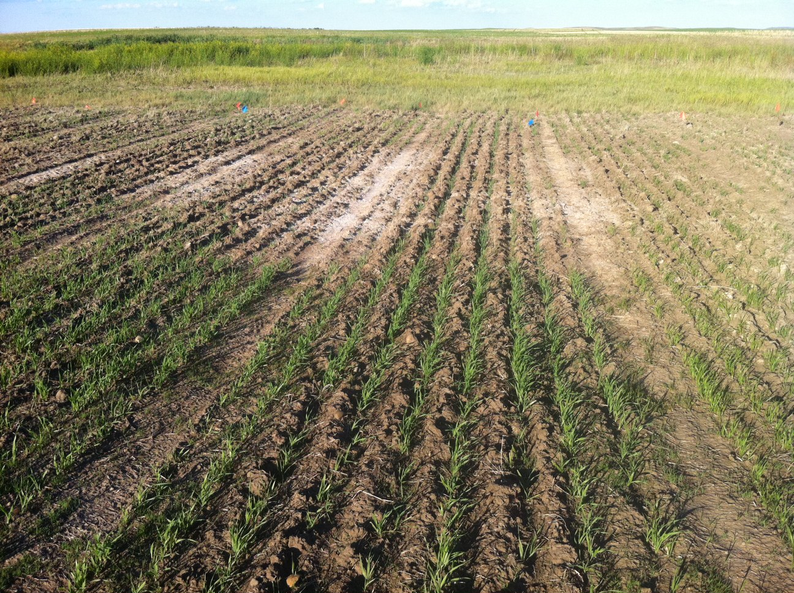
Saline Soils
Saline soils often show white-ish crusting. Often little or no plants growing in area.

Slide 6
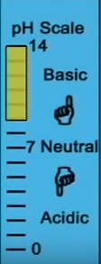
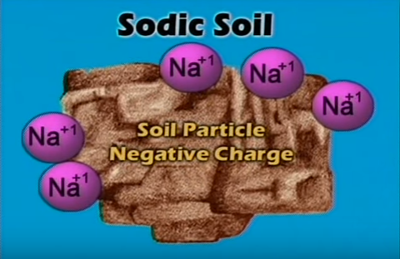
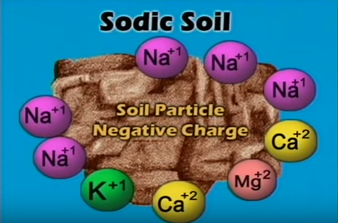
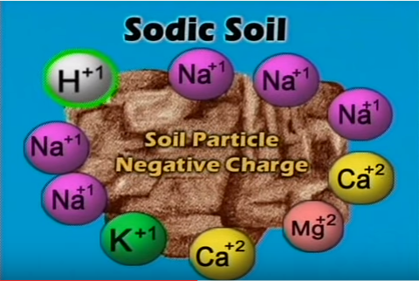
Sodic Soil
Sodic soil: is a non-saline soil containing sufficient exchangeable sodium (Na) to adversely affect crop production and soil structure

Slide 7
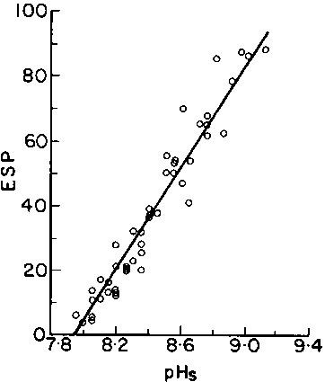
Sodic Soil
Exchangeable sodium percentage (ESP) greater than 15%.
Contains soluble carbonates.
EC generally is < 4,000 mhos/cm
Soil pH is generally greater than 8.2, But not all high pH soils are sodic.
Abrol et al. (1980) and Bhargava and Abrol (1978)

Slide 8
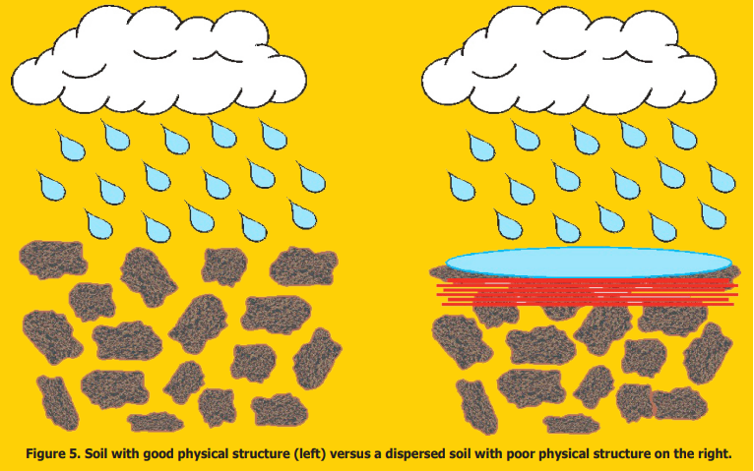
Sodic Soil
Clay particles are easily dispersed when excessive sodium is adsorbed onto negatively charged clay particles.
Once clay particles are dispersed and dry, porosity of soil decreases. Often leading to ponding on the surface.

Slide 9
Classification of salt- and sodium-affected soils
Criterion | Normal | Saline | Sodic | Saline-Sodic
pH | <8.5* | <8.5 | >8.5 | <8.5
EC (micromhos/cm) | <4,000 | >4,000 | <4,000 | >4,000
ESP (%) | <15 | <15 | >15 | >15
SAR (mmoles L⁻¹) | <13 | <13 | >13 | >13
EC – electrical conductivity
ESP – exchangeable sodium percentage
SAR – sodium adsorption ratio
* pH= 6.5 – 7.2

Slide 10
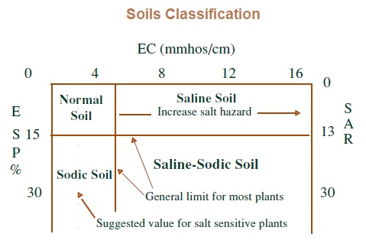
Verify problem
Soil sampling/testing
  Sample during a dry period
  At least one week from the last rain or irrigation
  Top 3”

Slide 11
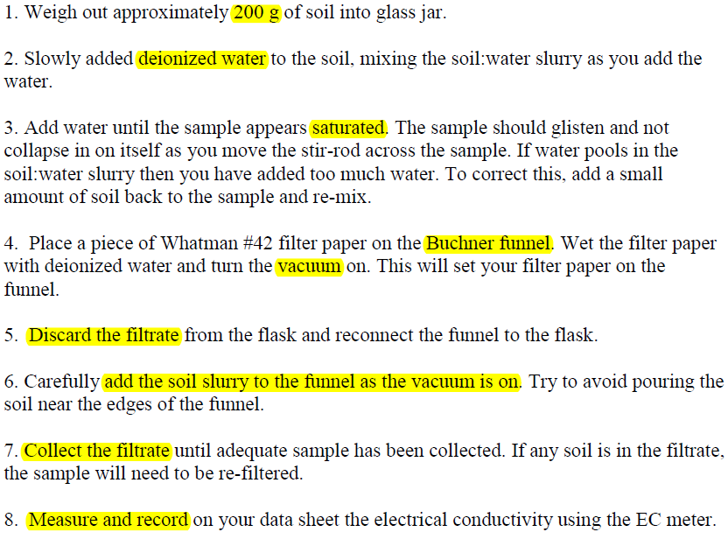
Procedure: Electrical Conductivity

Slide 12
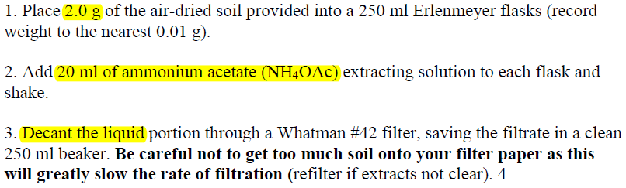
Determination of ESP

Slide 13
Saline - Sodic Soils
Often sodic - saline soils are in part caused by the presence of groundwater close to surface.
Salinity and sodicity often can increase due to capillary movement of water, salts and sodium higher in the soil profile.
Saline – typically occurs in semi arid, and temperate regions
Sodic – Occurs in areas of poor internal drainage

Slide 14
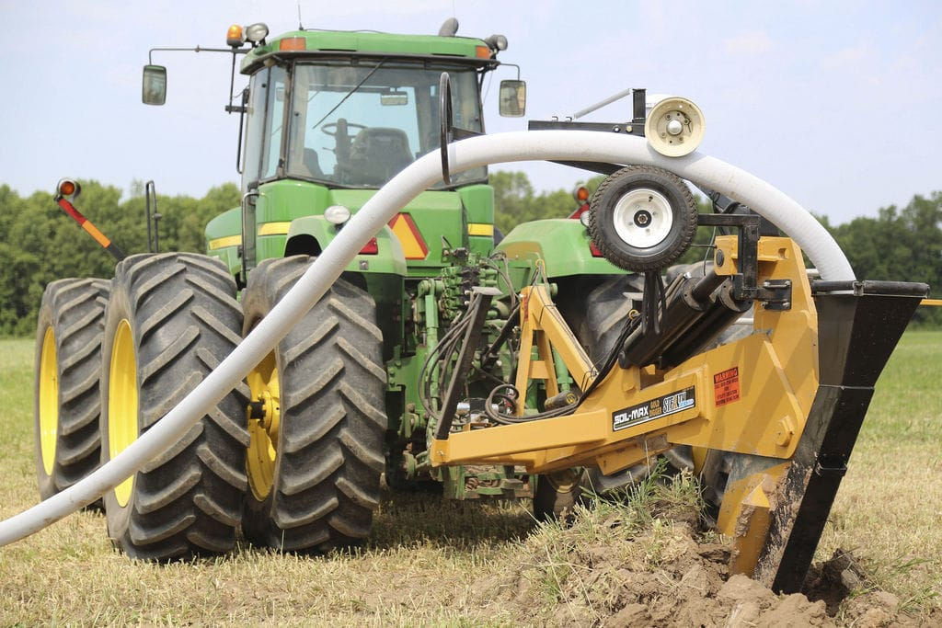
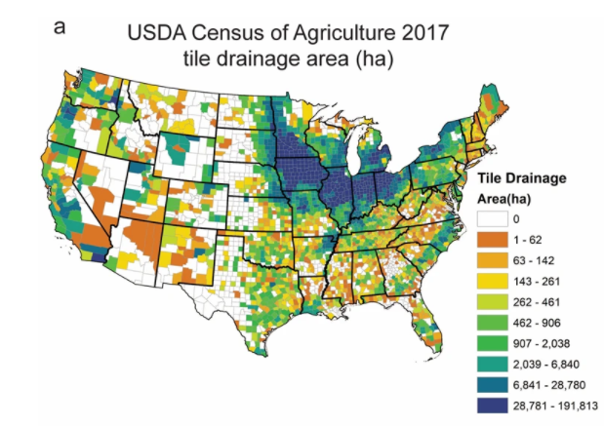
Tiling
Tiling is used to expedite removal of water from the upper soil profile.

