Slide 1
N-Rich Strip
GreenSeeker Sensor
SBNRC
Chapter 6

Slide 2
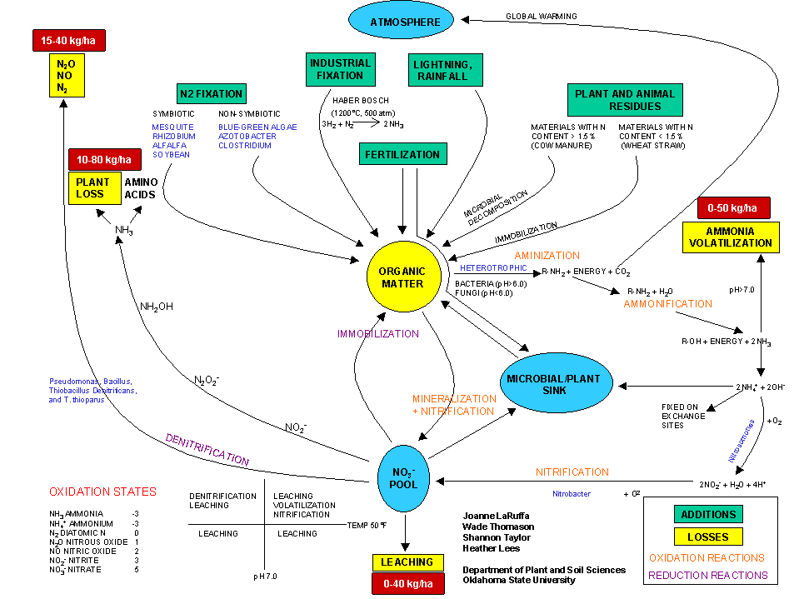
Nitrogen Not Used is Lost

Slide 3
N-Rich Strip
  Strip in the field where N rate is increased
GreenSeeker Sensor
  Active sensor that measure NDVI
SBNRC (Sensor Based Nitrogen Rate Calculator)
  Calculator using NDVI and Mesonet data in a algorithms that determines top-dress N rate.

Slide 4
N-Rich Strips
What: A high rate of N applied in, across, through, over or under each and every field
How Much: 40 to 50 lbs N above the rest of the field.
How and Where: 10 to 100 ft wide, anywhere representative.
When: Winter crops; before or after sowing (1+ months), Summer crops; before or immediately after planting.
Notes:
For small stack holders the N-rich in 3rd work can be area of 1 meter by 1 meter in the middle of their field.

Slide 5
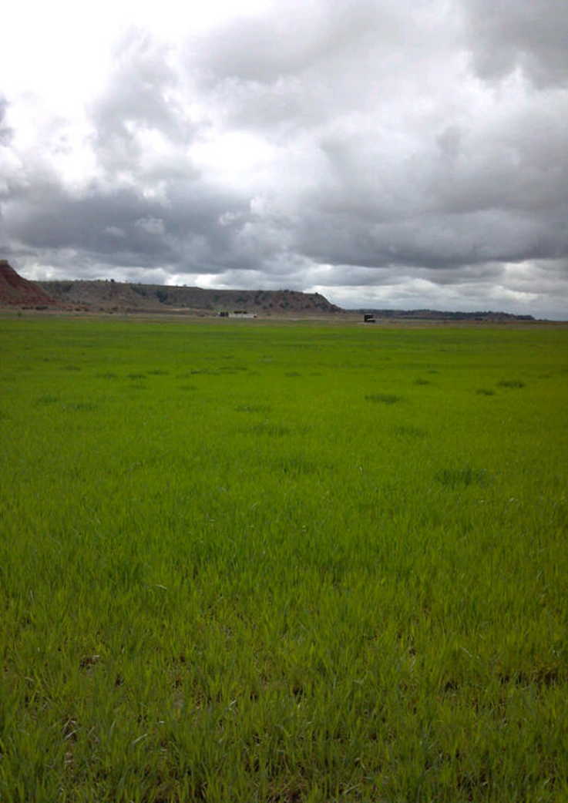
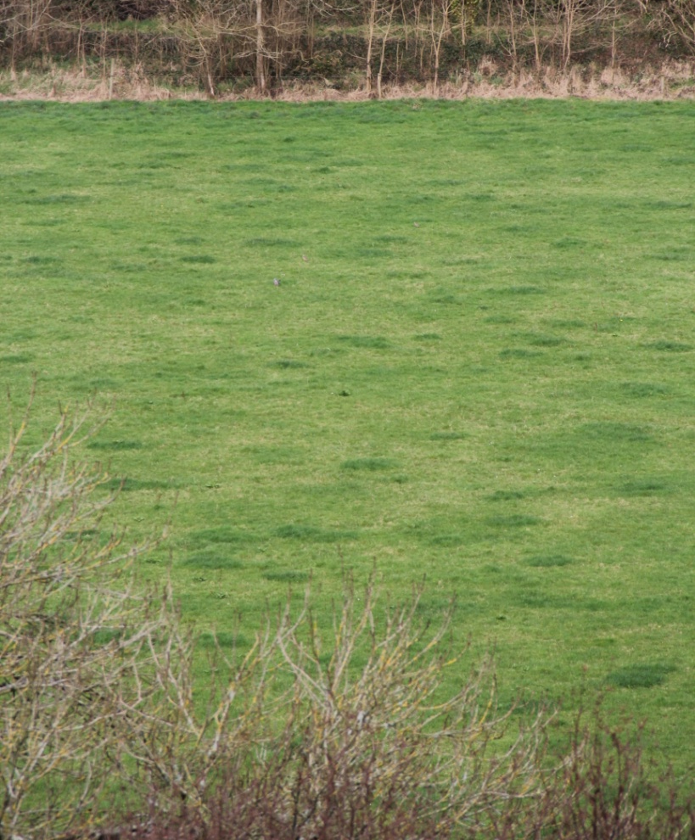
The Original NRS
View from Blarney Castle.
Fairview Oklahoma

Slide 6
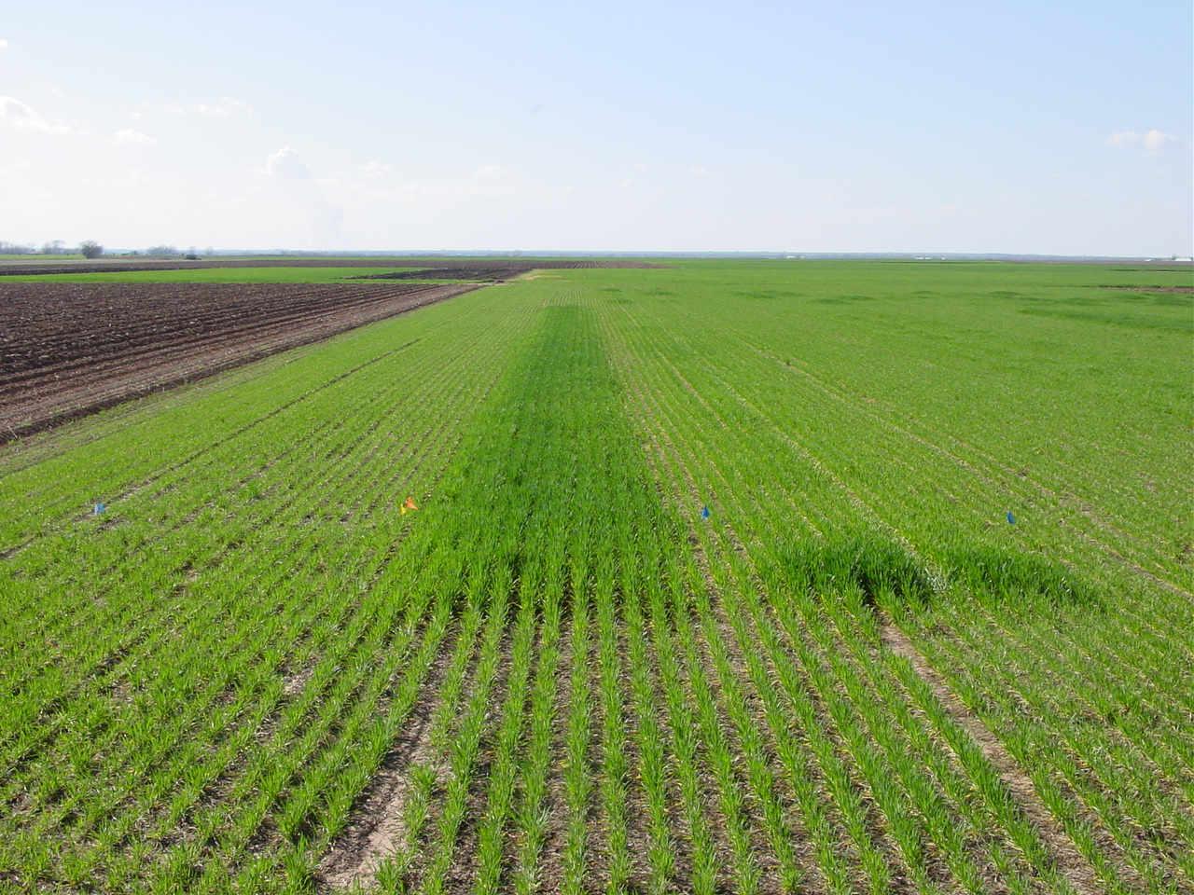
N-Rich Strip
Will tell you:
Yes, I need Nitrogen
No, I do not Need any!
Notes:
In response years the N-Rich strip is EASY to find. This one is Screaming FEED ME!!!

Slide 7
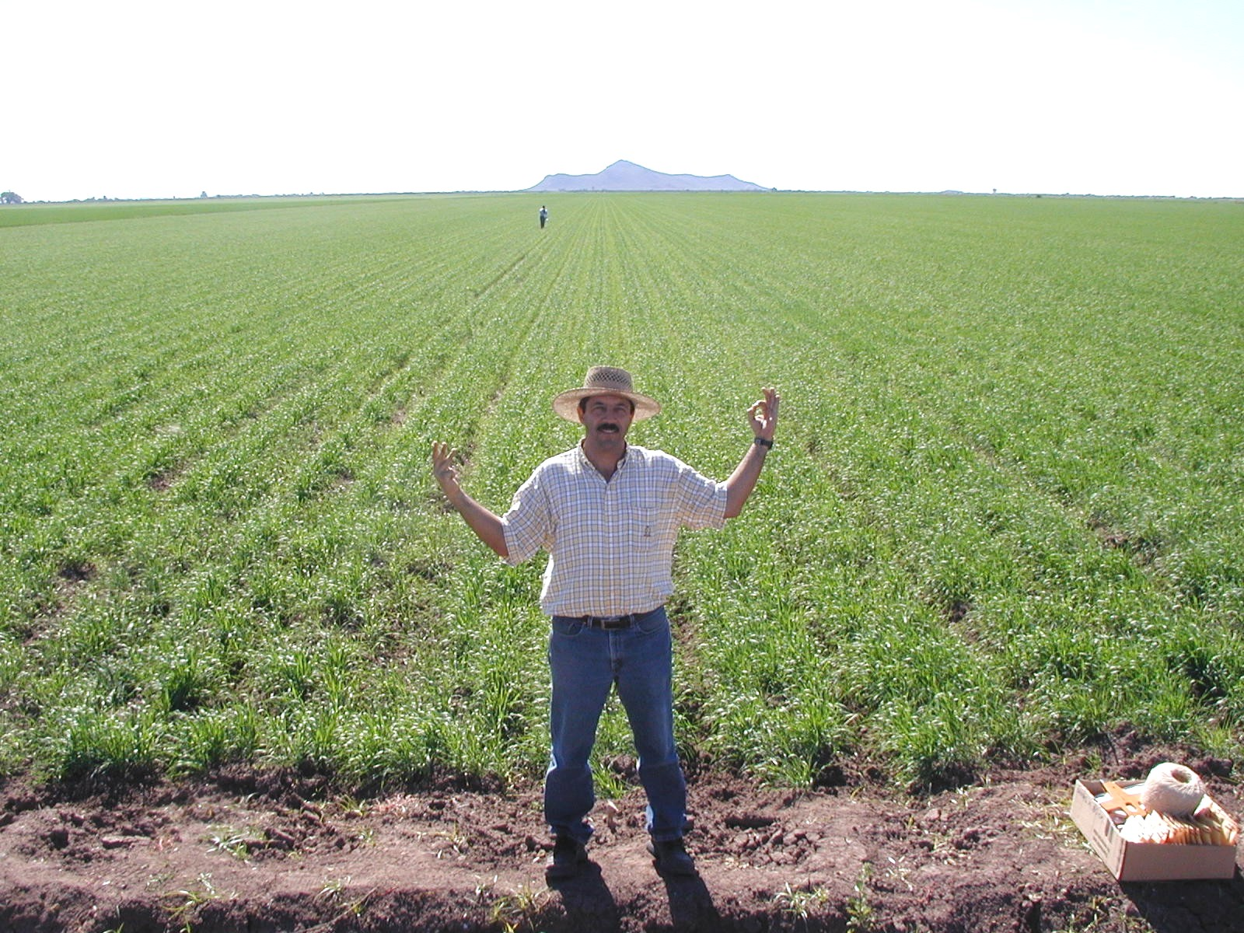
N-Rich Strip
Mid-Season Evaluation of N Rich Strip (Ciudad Obregon, MX)
Average Wheat Yields = 150 bu/ac (irrigated spring wheat)
300 lbs N ac⁻¹ 0 lbs N ac⁻¹
Notes:
But in other years the N-Rich strip will never show it. More N is NOT needed.
7

Slide 8
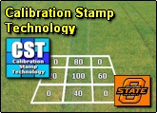
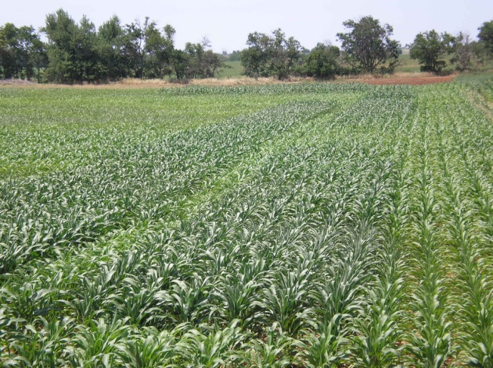
Evolution of Multi rate NRS
Notes:
Shows the many evolutions of our multi rate strips. Now only the changing rate across a boom is used. But in 3rd world a producer can but out multiple rates by hand to have his/her very own N rate experiment to determine optimum rate.

Slide 9
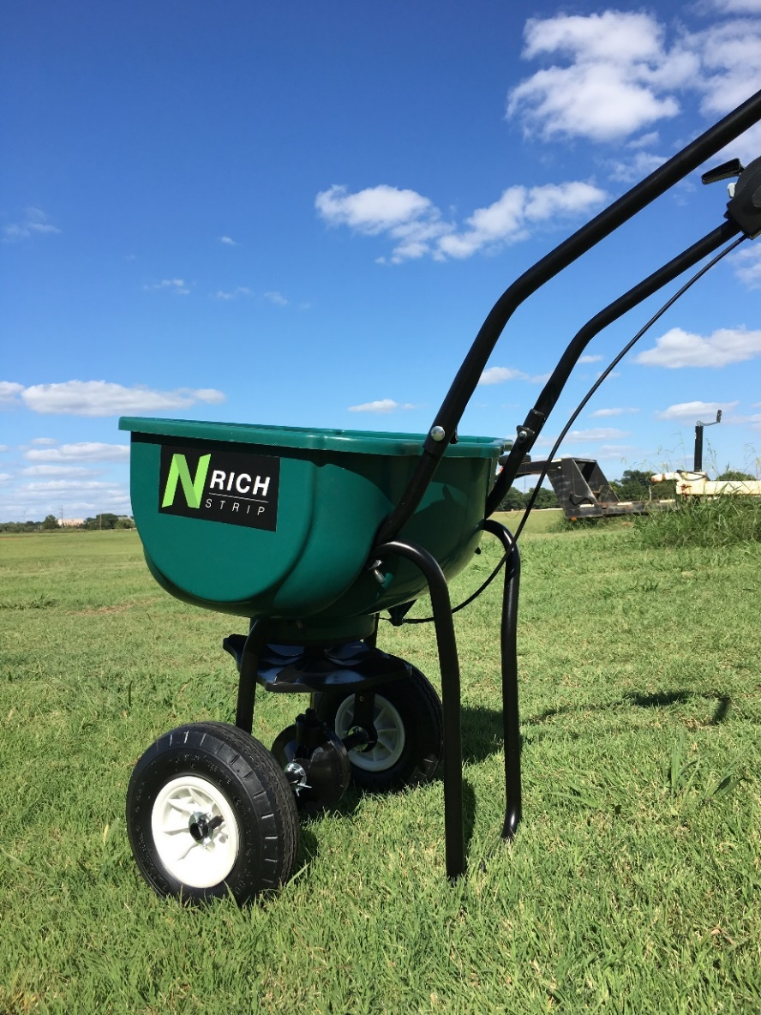
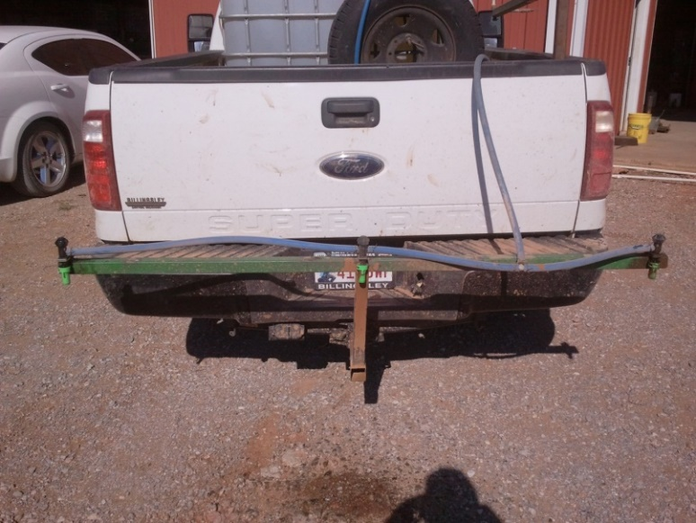
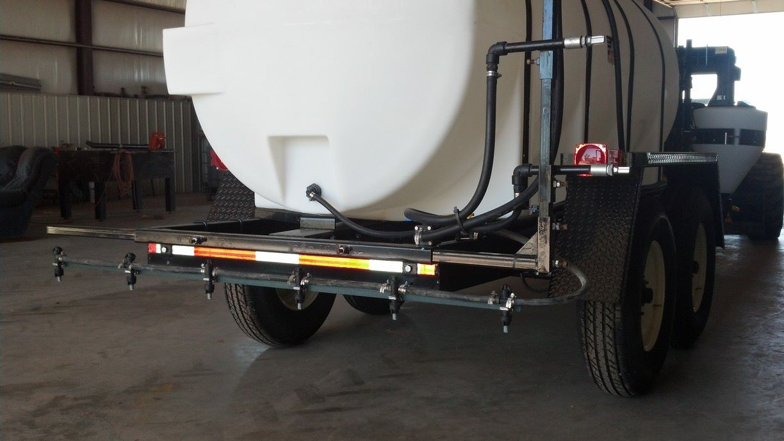
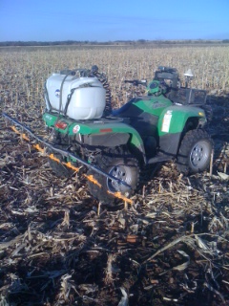
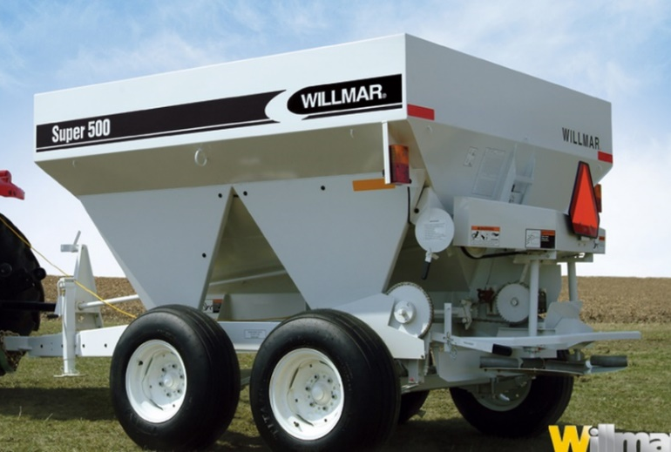
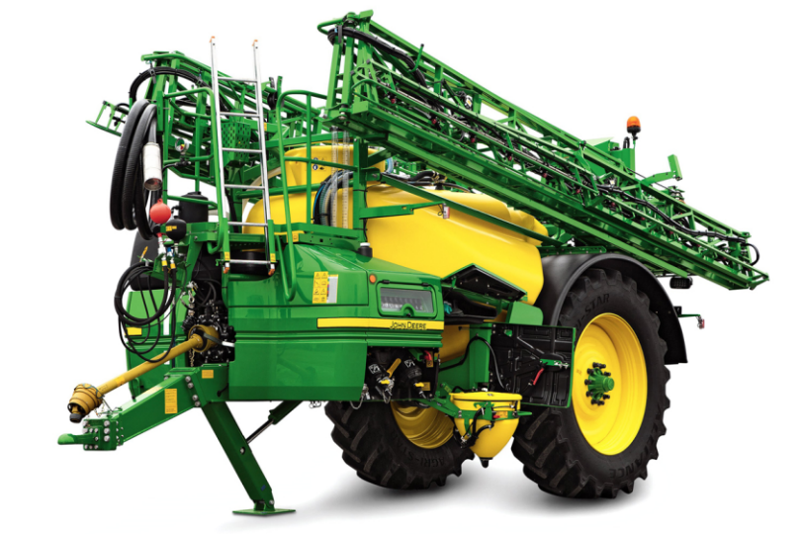
N-Rich Applicators

Slide 10
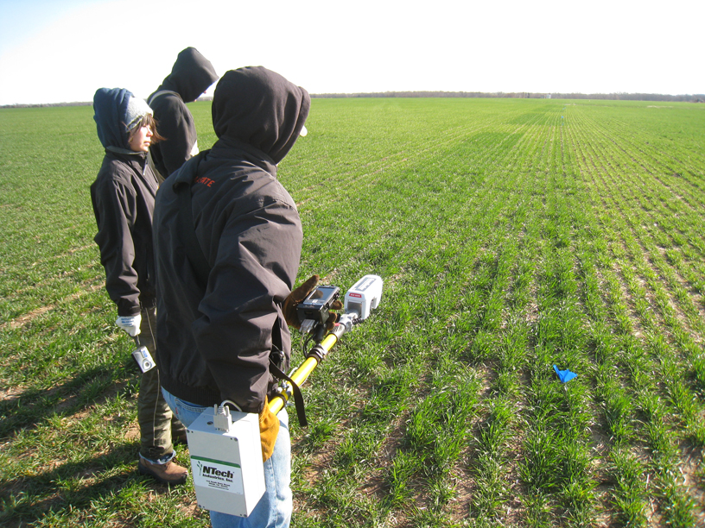
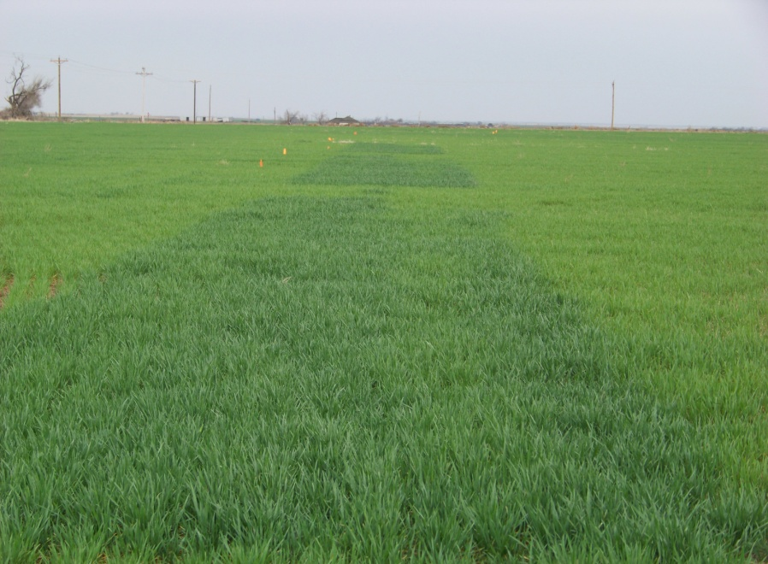
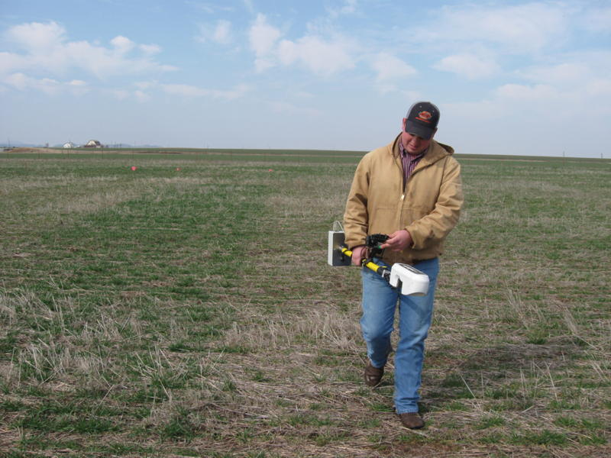
N-Rich Strips
Are Very Visual..
But only a Yes or NO

Slide 11
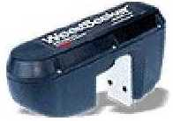
GreenSeekerTM Sensor Light Detection and Filtering
Detection of
Reflected
NIR and RED
+Sun
Notes:
11
The GreenSeeker emits its own light and filters out that of the sun. This means the Sensors can be operated day or night and the amount of direct sunlight is not a factor.

Slide 12
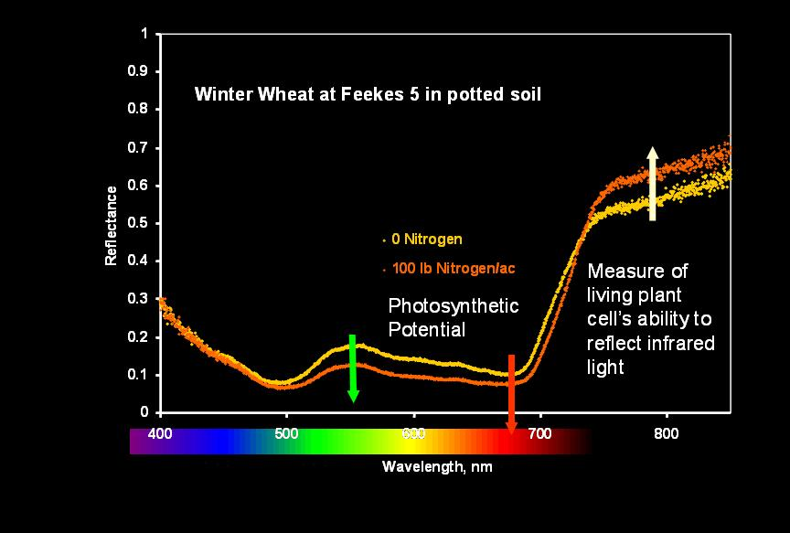
Spectral Response to Nitrogen
NDVI=
NIR – Red
NIR + Red
NIR
Red
Notes:
Importance of this Graphs.
In the Red Wavelength The 0 reflects more than the 100 lb rate. Plants want to absorb red for Photosynthesis, the more leaf area the more Red is absorbed.
In the NIR Wavelength The 100 reflects more than the 0 lb rate. NIR wavelengths cause heat. Healthier plants will reflect more NIR.
So Red is an indication of leaf area and photosynthetic potential and NIR is a measure of plant health.
NDVI is a relationship of Red and NIR reflectance.

Slide 13
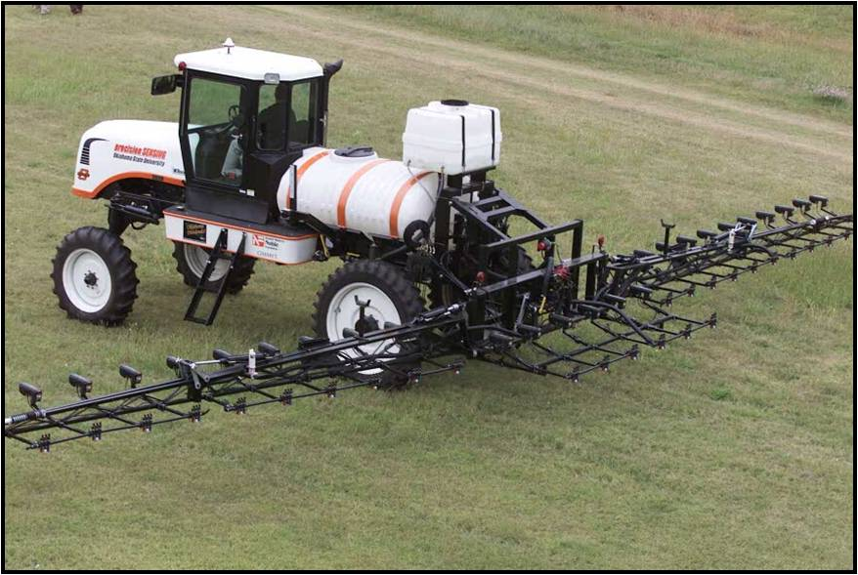
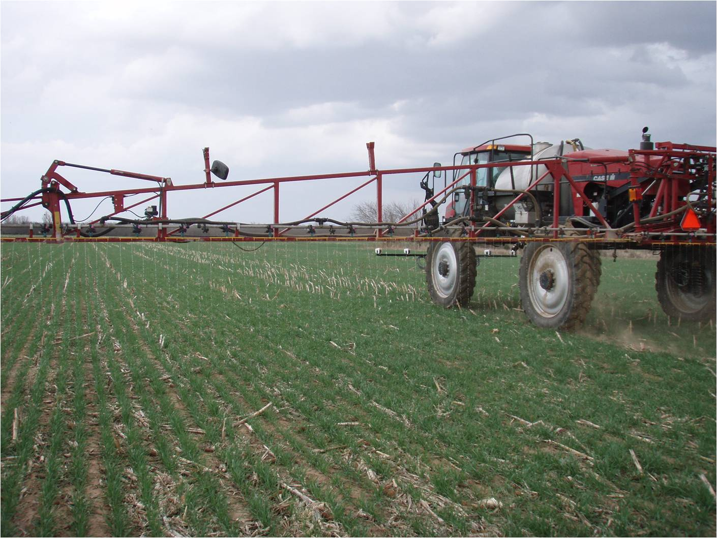
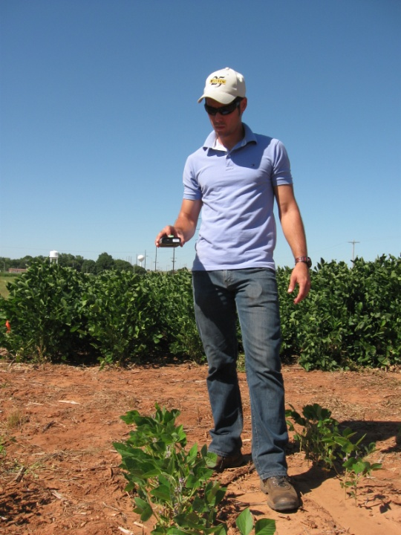
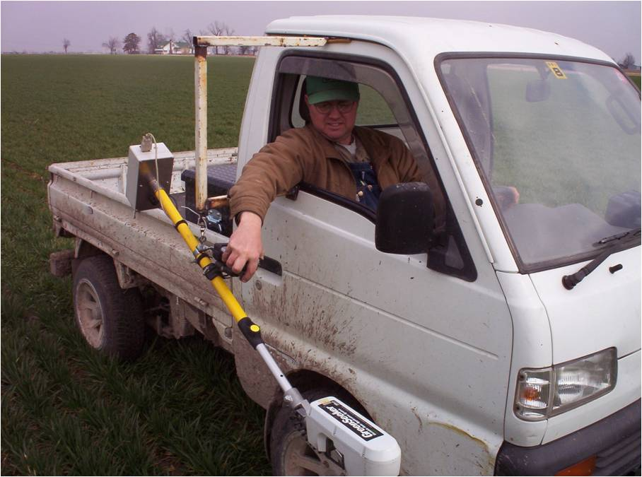
Optical Sensors

Slide 14
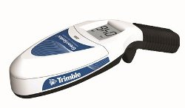
Commercial Handheld

Slide 15
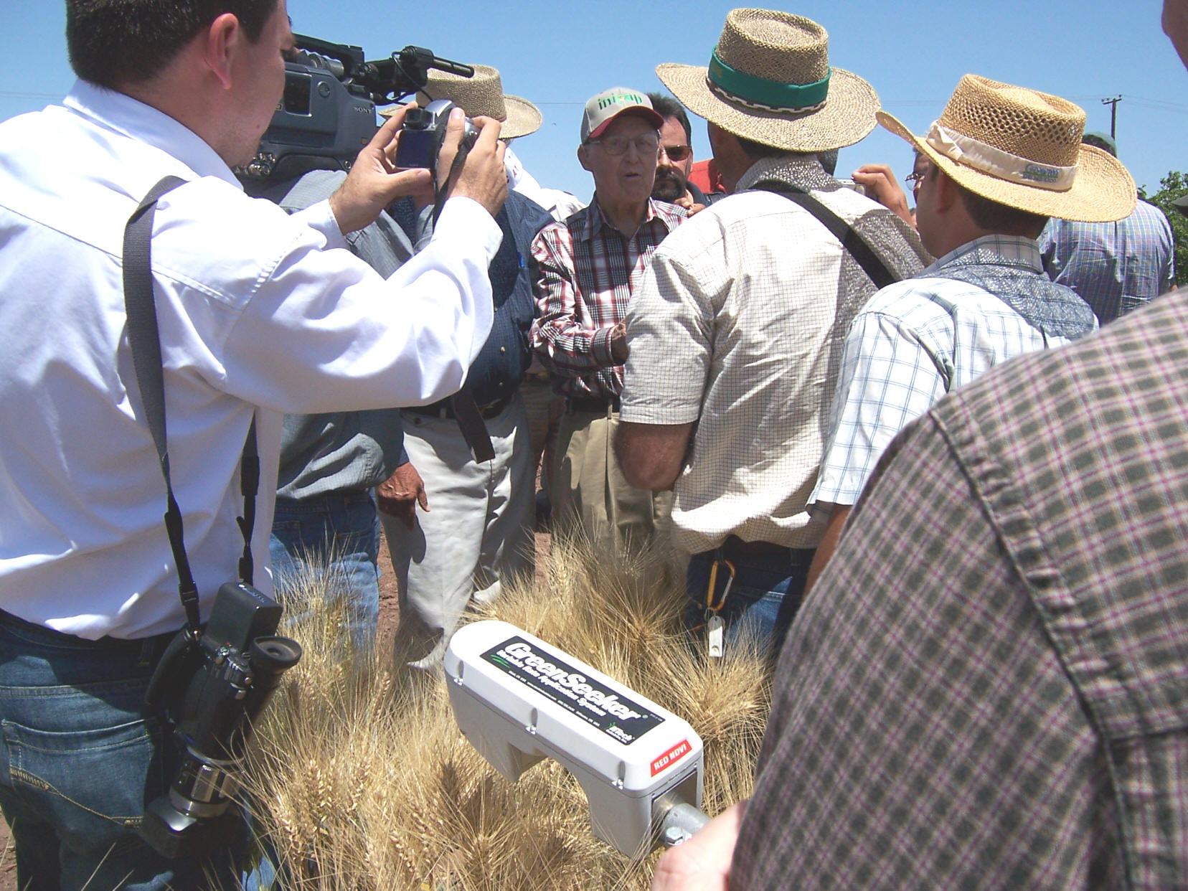
April 16, 2007
Dr. Norman Borlaug
Ciudad Obregon, MX

Slide 16
Sensor Based Nitrogen Rate Calculator?
What is needed for a
Response Index
Yield Prediction Model
Nitrogen Removal
The calculation looks like:
N Rate =
(Potential Yield of Farmer Practice * RI)* N in Grain/NUE
Notes:
This is the basics behind the N rate Calculation.
We predict yield with the sensor.
The predicted yield of the reference is compared to the rest of the field (farmers practice)
For example N-rich Pot yld= 50 bu and the farmer practice pot yld 40 bu. This means to meet max yield we have to supply enough N to make 10 bushel.
We know N that is need for 10 bushel and the efficiency. F we used the adage of 2 lbs of N per bushel.
So in a rough calculation that field would need 20 lbs of N.

Slide 17
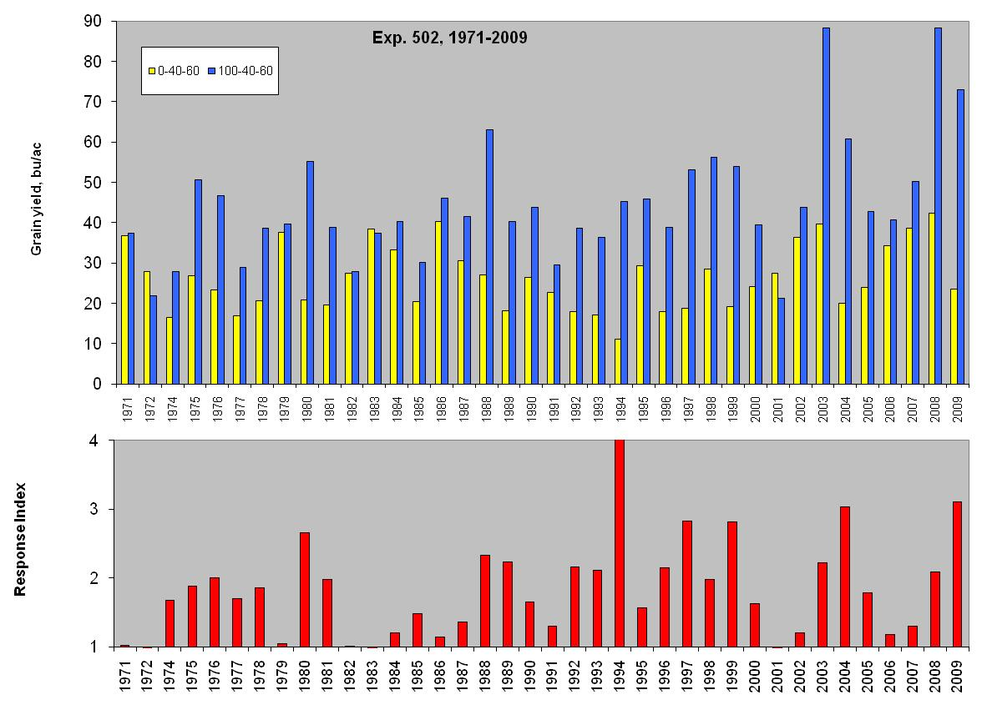
Consistent Yield and Response
Ave Yld 42 bu/ac

Slide 18
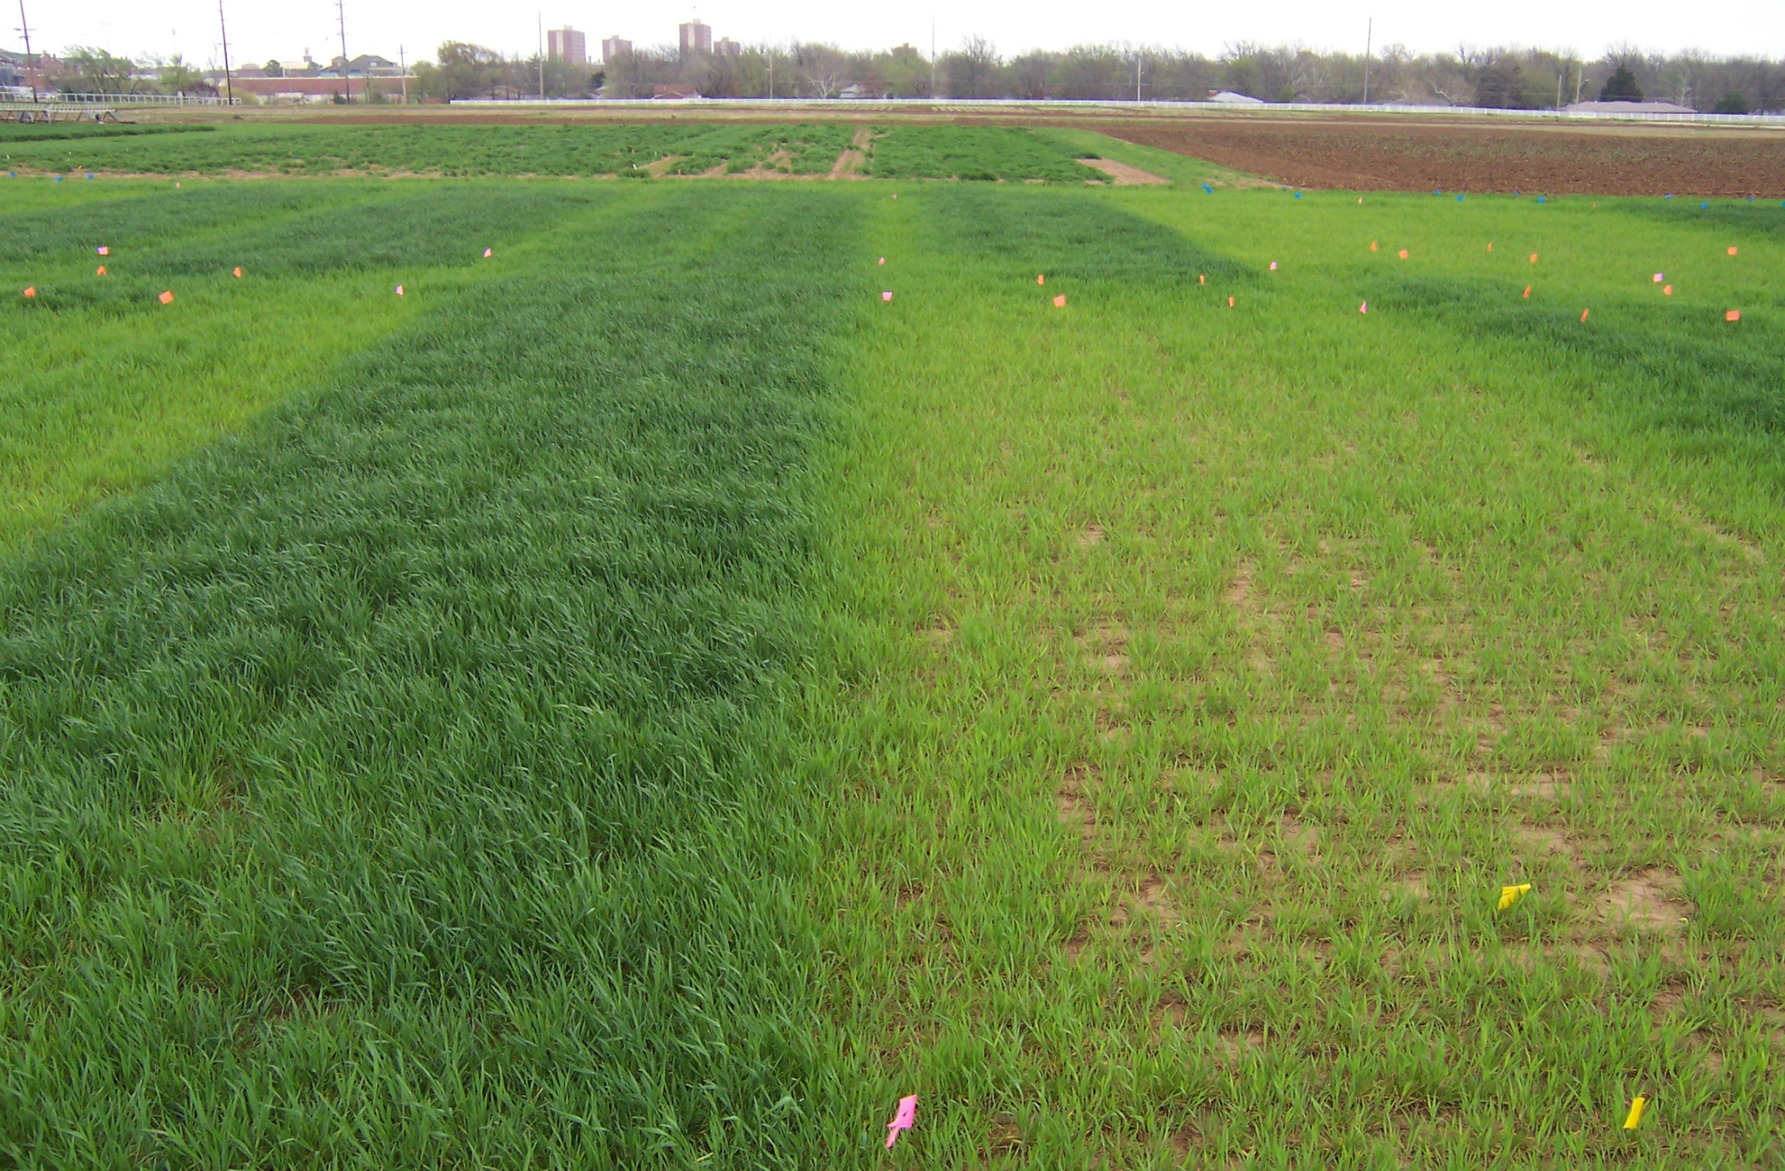
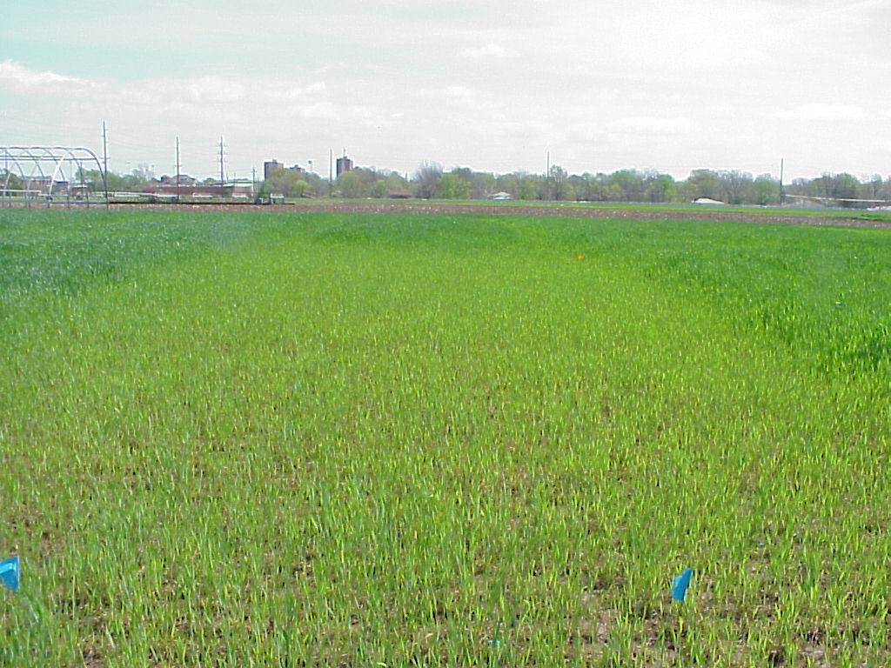
Response Index
2004
variable from year to year in the same field
1995
Long term N-P-K Experiment
(1969-2008)
Dr. Billy Tucker
Notes:
18

Slide 19
Predicting yield Potential at Feekes 5
Have done a far job of predicting potential yieldin-season.
Over prediction is typically preferred
This data uses a single point in time, farmers are not.

Slide 20
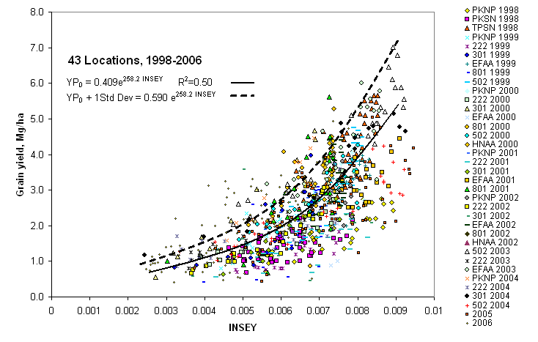
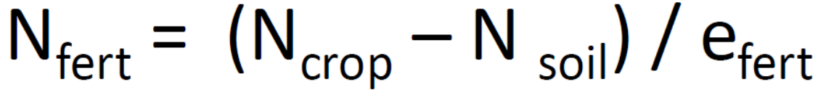
Yield is highly variable
Long term trials show annual
variability in yield.
Data base of yield x NDVI
Normalized by weather data.
Day’s of Growth post planting.
INSEY –
In season Estimate of Yield
Yield Potential
not Yield Prediction.

Slide 21
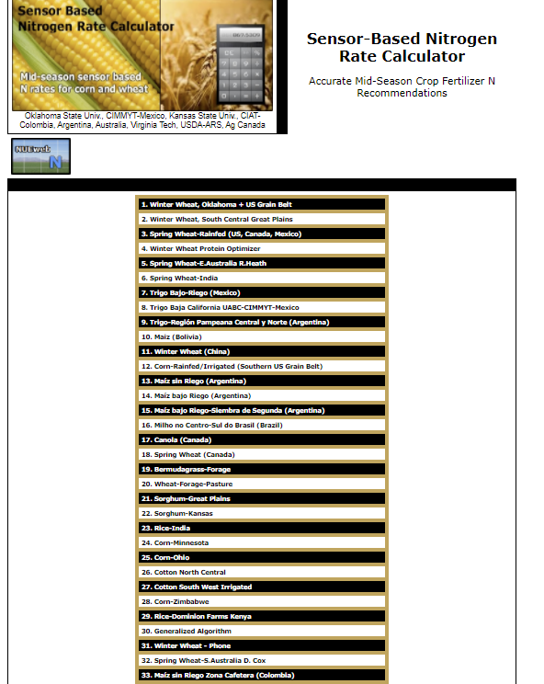
SBNRC
Online
www.nue.osktate.edu
Notes:
21
Yield Prediction, response Index, and the Greenseeker are all brought together for world to see at NUE.OKSTATE.EDU.
Countries listed our those who have adopted the technologies developed in Oklahoma.

Slide 22
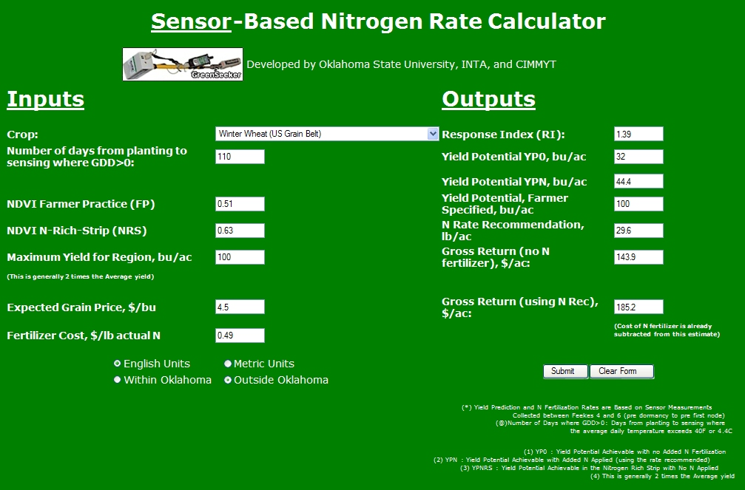
Notes:
22
Online Calculator.
You input planting data, or numbers of days from planting. NDVI of reference and NDVI of farmer practice plus some Econ. (Grain and Fert Price)
Output is RI, Potential Yield without Fert., Potential Yield with Fert. N rate recommendation, Gross $ with and w/o fert.

Slide 23
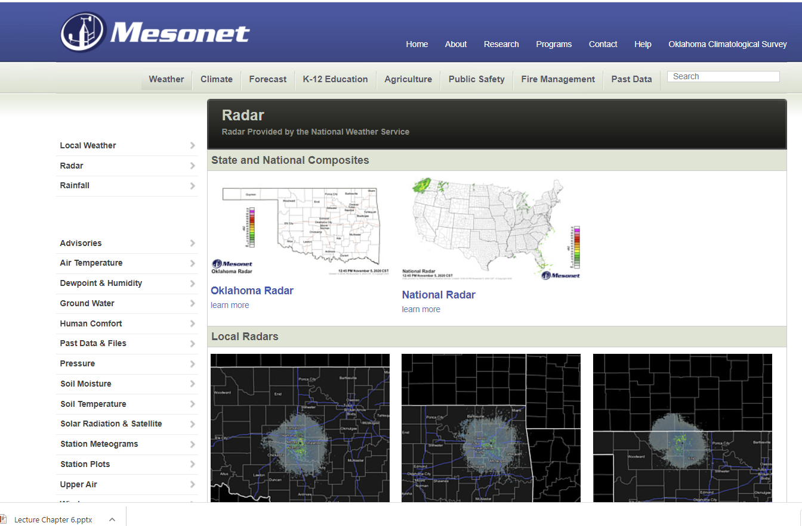
Mesonet tie

Slide 24
Research
Econ at 11 of 14 sites SBNRC > FP ($0.5 N and $5 Wheat, and $0.4 N and $4 Wheat)
Over all site years SBNRC N rate was 19 lbs less than FP with equal yield. So average saving is dependent on N price.
6 of 14 site SBNRC recommended more N than FP.
5 of 14 Protein was affected by method.
FP higher 3 times and SBNRC higher 2 times.

Slide 25
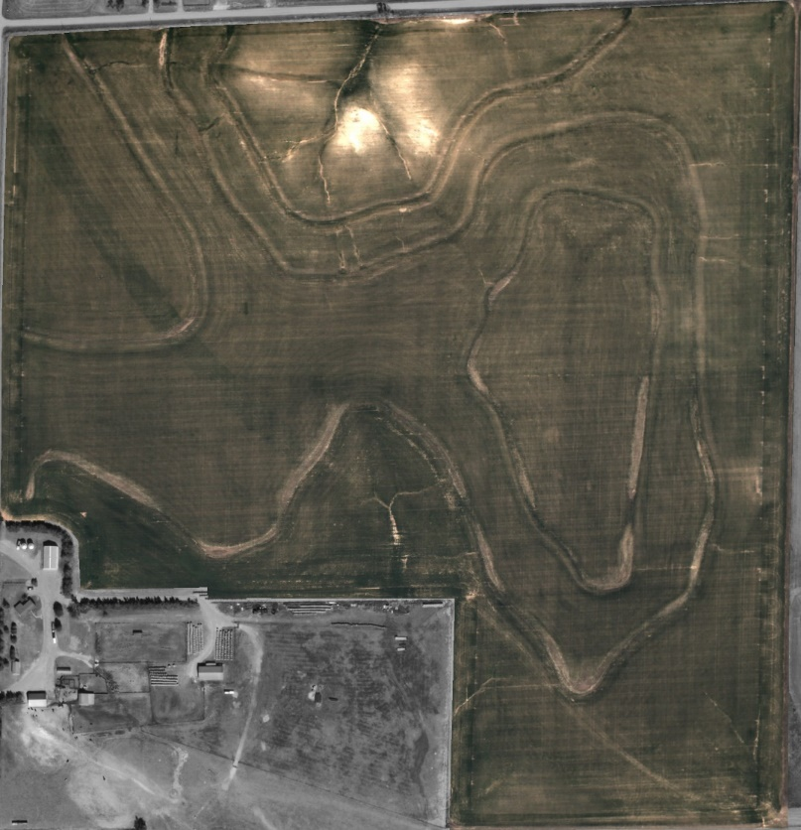
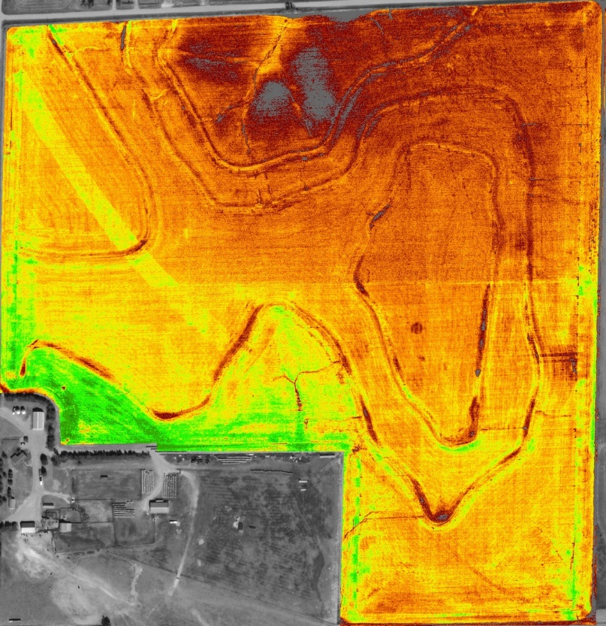

Estimated use in 2019 1 million acres.

Slide 26
Testimonials
West central Kansas
1 farmer spent 10 hours (total) applying & sensing NRS over 2,200 acres of wheat for a net return of $42K aka $4,200 per hr.
North west Oklahoma
I spend about ¾ of a day with a truck and spinner spreader to hit 3,000 acres of wheat.
I since while scouting so the time is marginal.
Each year its worth about $12 an acre
South west Oklahoma
I spend 8 hours a year applying strips
I spend 8 hours a year reading strips
Last 10 years that’s 160 hours.
I have saved fertilizer and increased yields. At an est. $768,000
So its making be $4,800 per hour invested.
North east Oklahoma
I averaged $15/ac net increase in income on wheat using N strips & GreenSeeker.
I figure 0.5 hr total per N strip per crop season to put out and read. Average field for me is 60 ac so $1800 - $2000 added income per hour of effort.

Slide 27
Sensors and No-till
There is no cookie cutter recipe
No Text Book
Learn from others Mistakes
Adopt to your farm, soil, machinery, management and mindset.
Do not go 100% the first year, but put out 100% of the strips.
Art

Slide 28
VRT
Variable Rate Technologies
Zones
  Can easily apply different flat rates in Management Zones
RT-200
  Utilizes the GreenSeeker Technology to make decisions and apply N on the go.

Slide 29
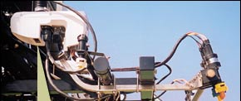
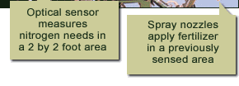
Sensor Function
Light signal
?
Calculate NDVI
?
Lookup valve setting
Valve settings
Light
Light
?
Apply valve setting
Valves and
Nozzles
detection
generation
?
Send data to UI
“Sensor”
Notes:
Changing the Fertilizer rate on the go works because the Sensor can “talk” to the applicator.

Slide 30
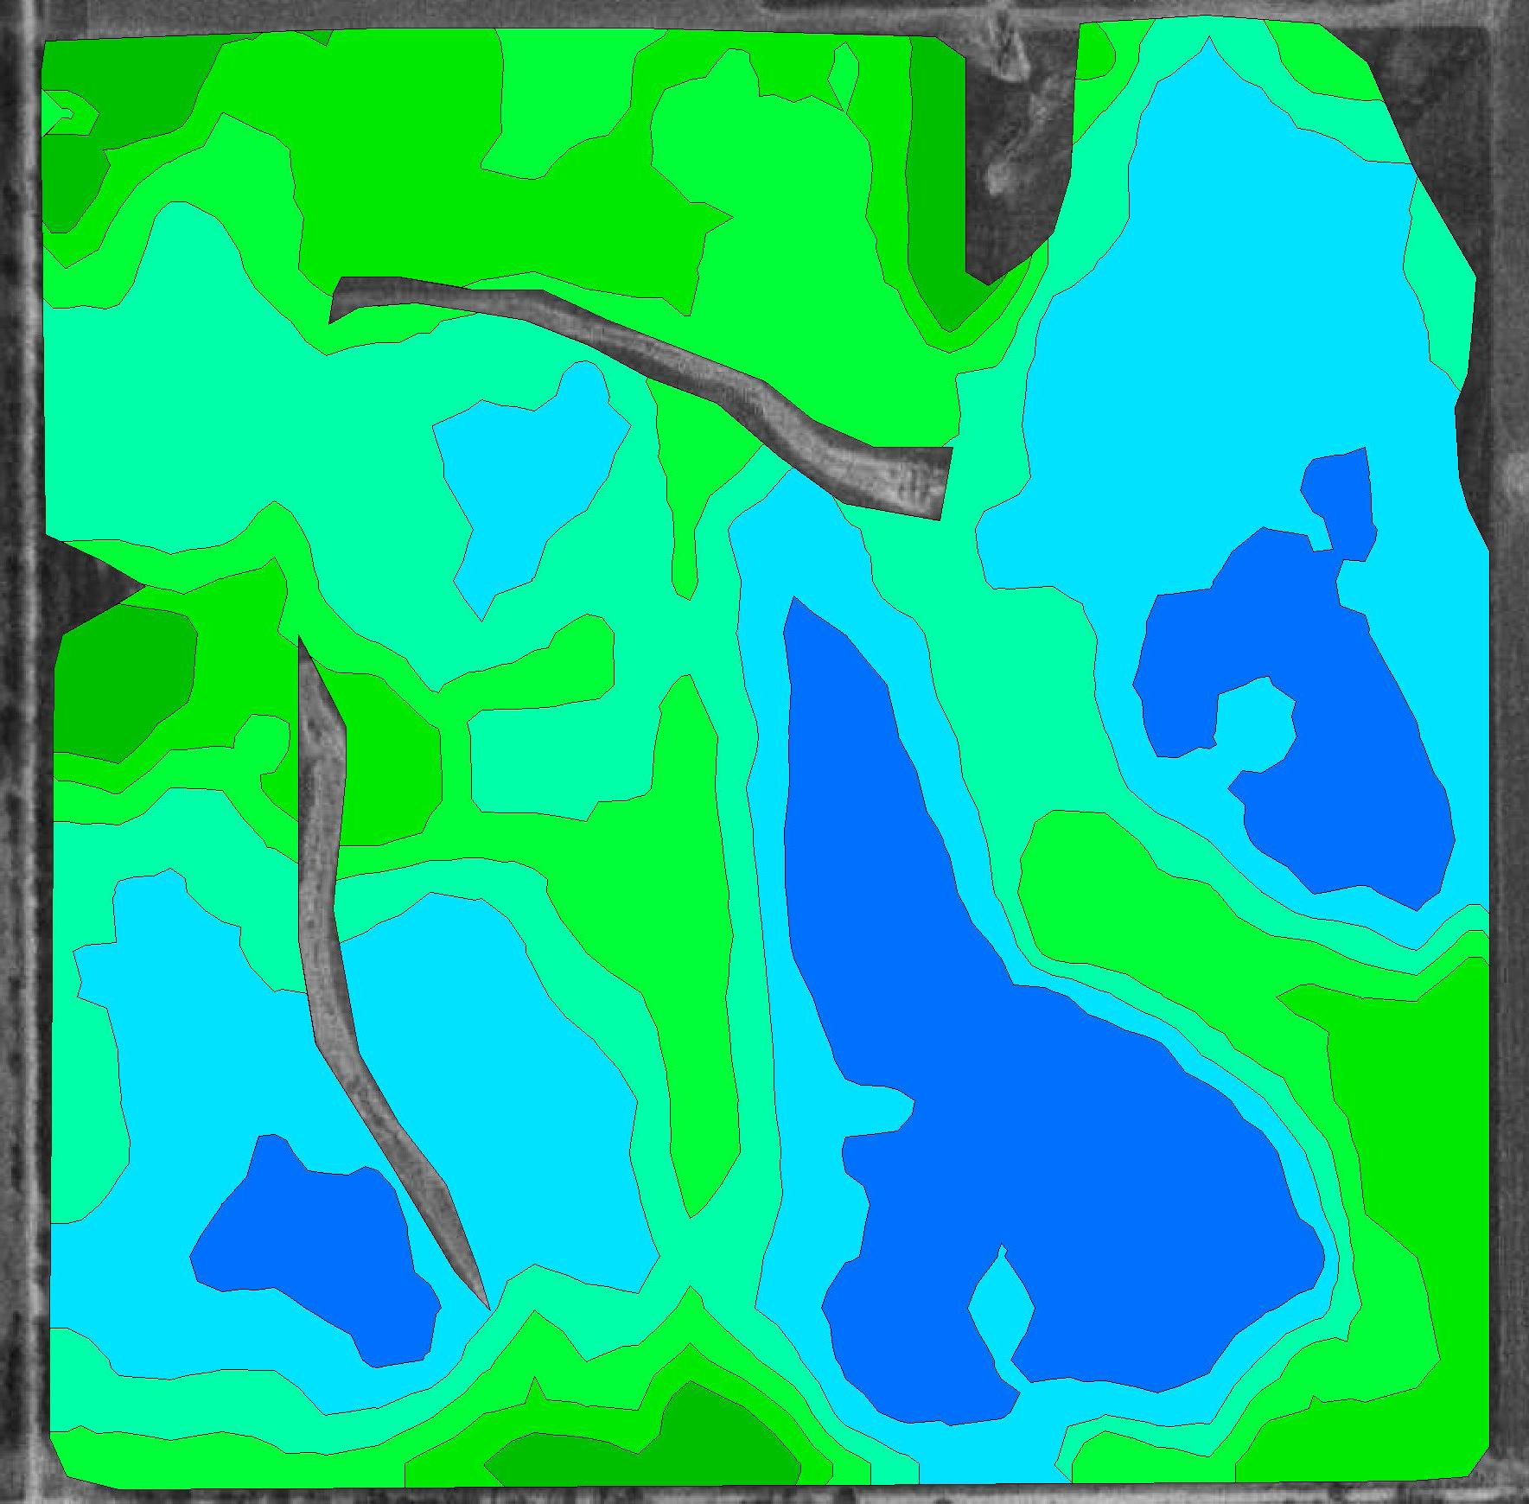
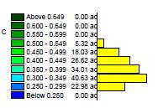
SE of Billings, OK NDVI
March 7, 2009
98 GDU > 0
NDVI

Slide 31

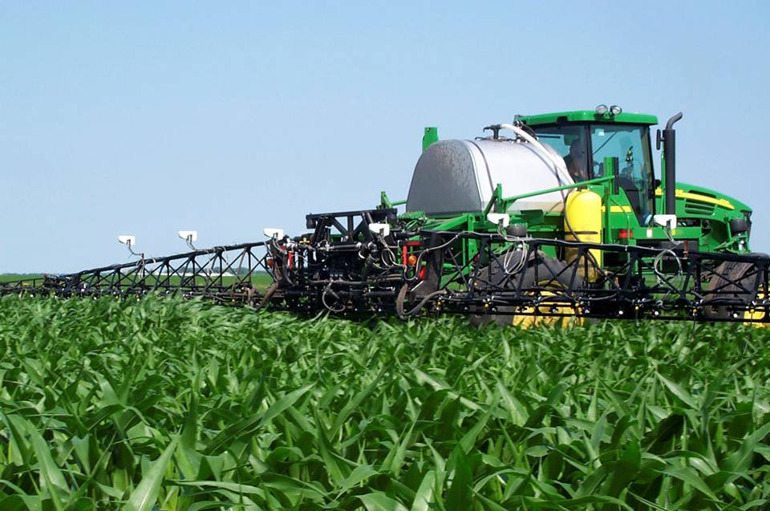


Notes:
Technology currently available to the producer.
Applies the same rate across the boom, and rate changes every second. Treatment area Approx. 8ft x boom width.

Slide 32
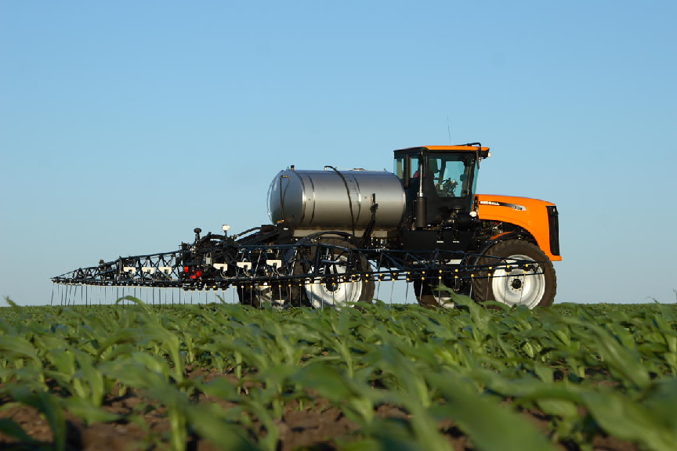

Slide 33
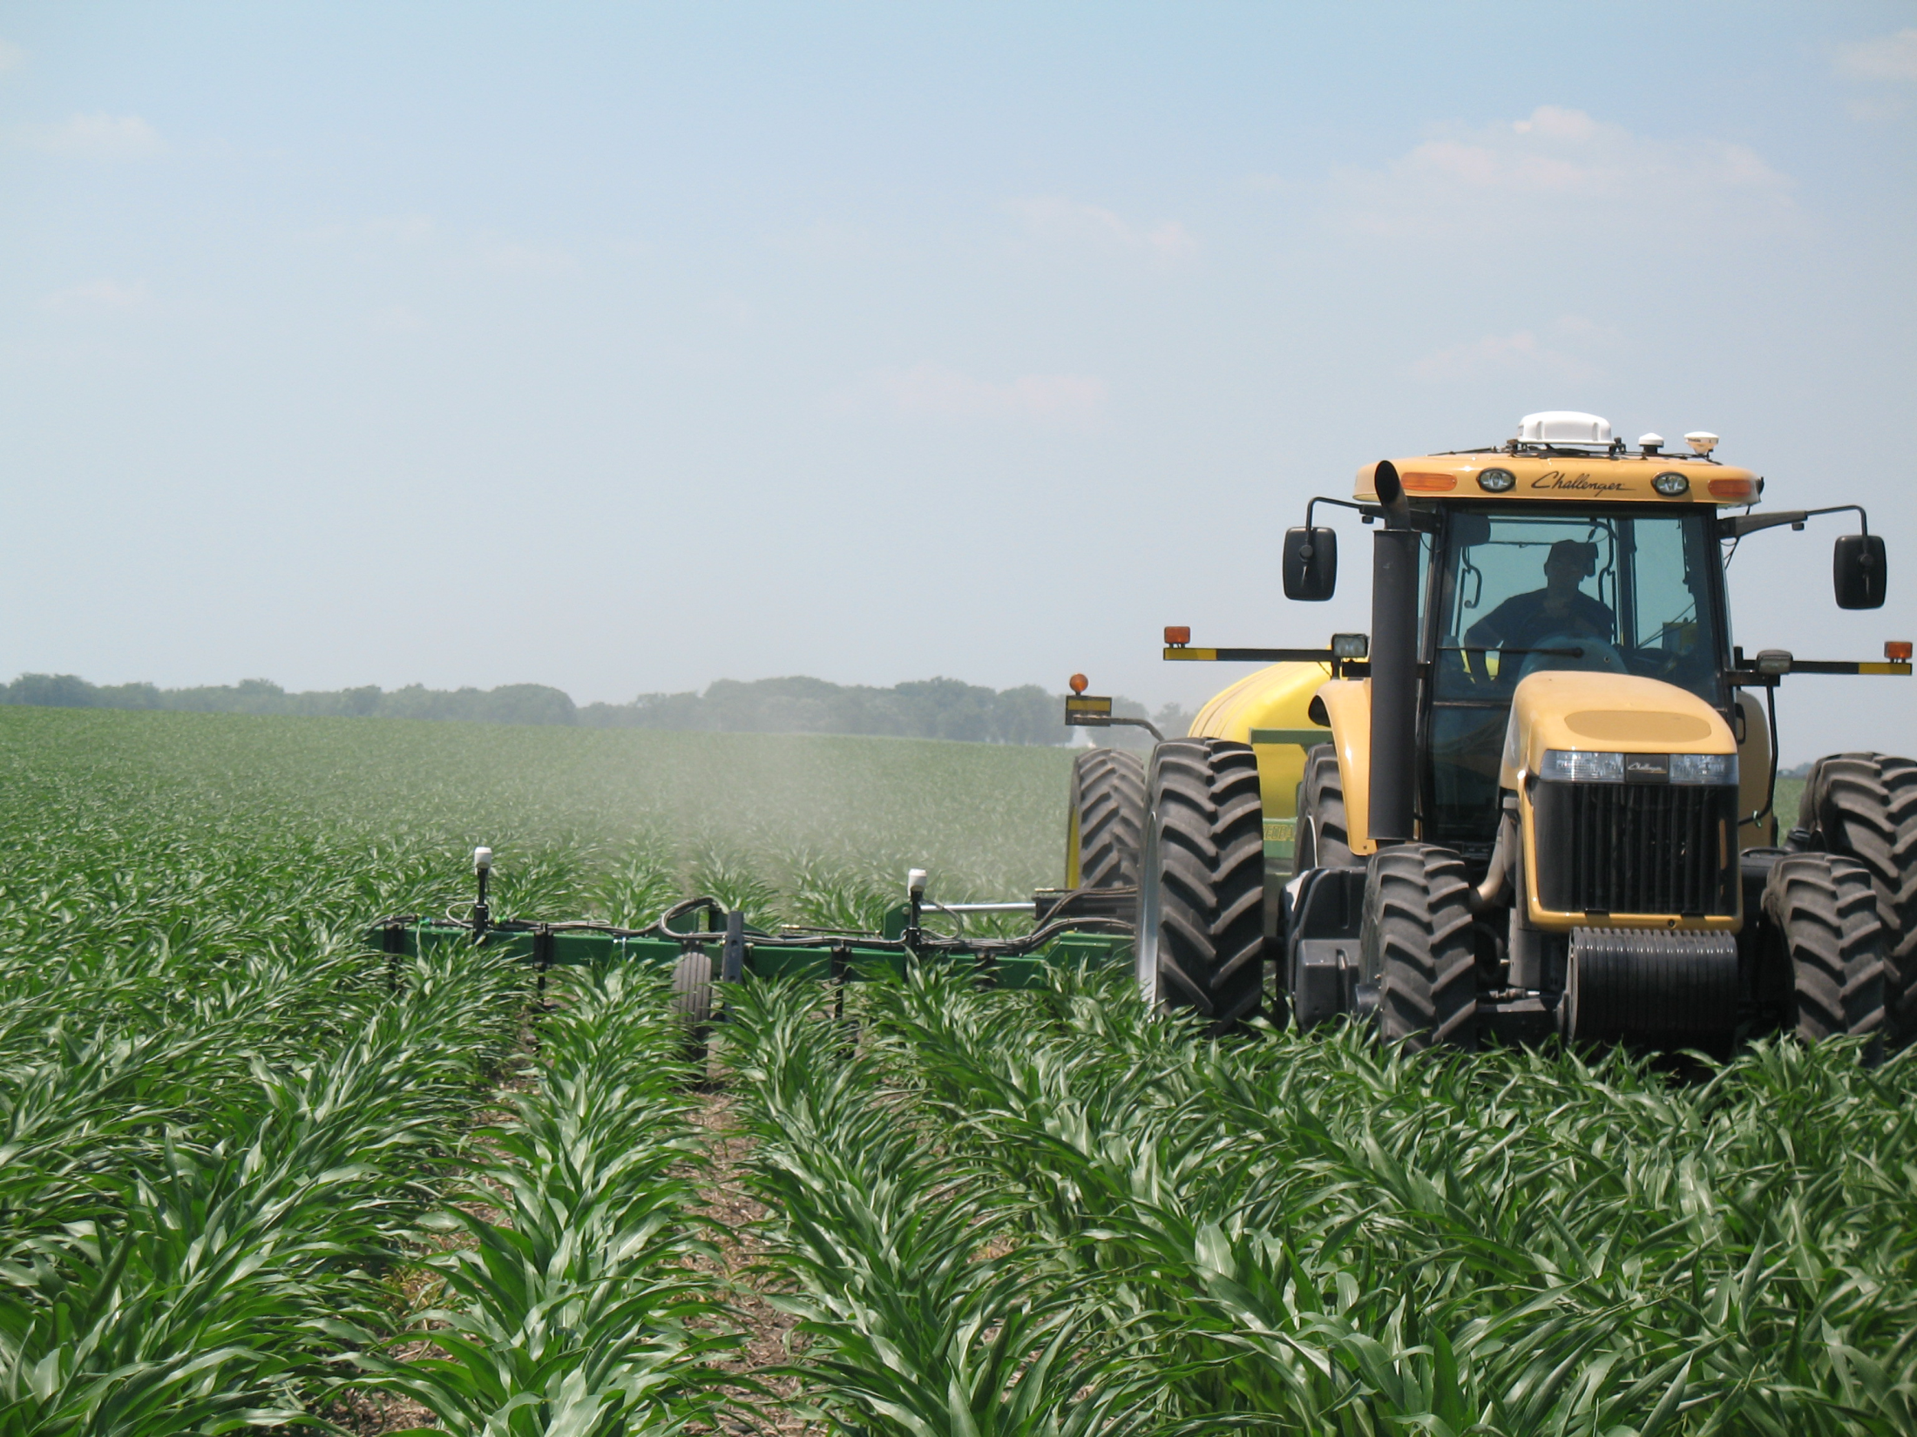
Notes:
Clarifying the standard GreenSeeker commercial nitrogen recommendation.
NRS makes good sense even without GreenSeeker

Slide 34
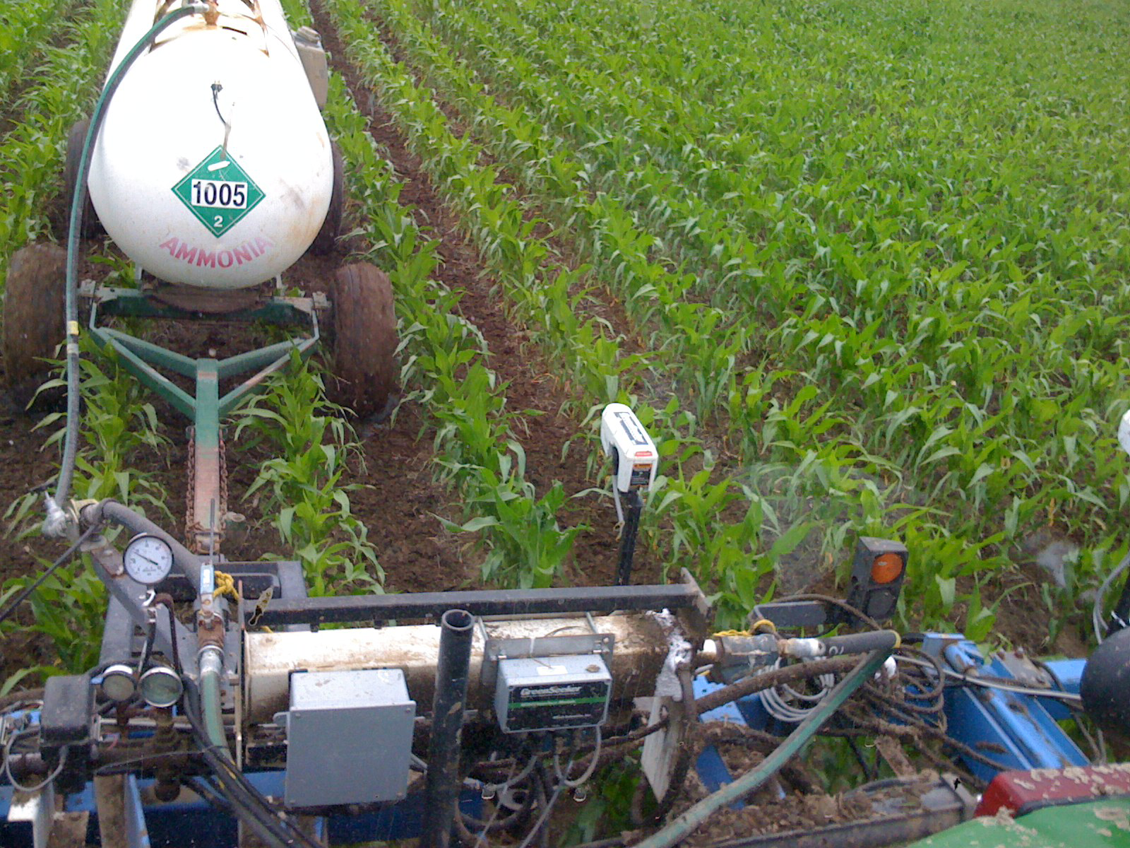
Record Harvest, Nevada, MO

Slide 35
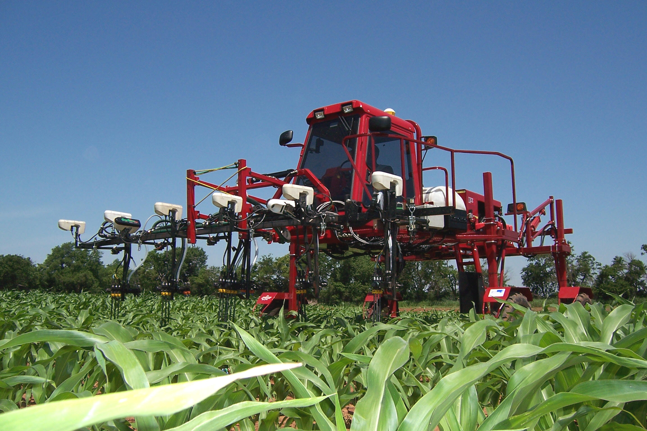
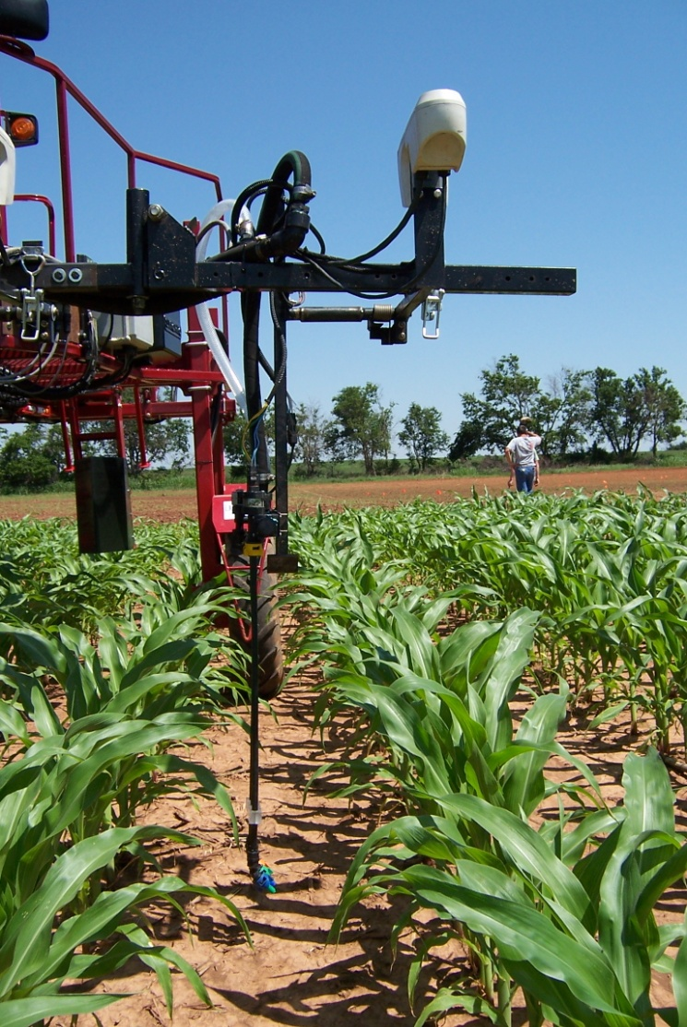
Variable Rate Technology
Treat Temporal and Spatial Variability
Returns are higher but require larger investment
Notes:
35

