Slide 1
Dos and don’ts with annual forages
Jaymelynn Farney
Beef Systems Specialist
Kansas State University

Slide 2
I have used annual forages in my operation as a hay
True
False

Slide 3
The annual forages I hay are grown in what season?
Summer forage
Winter forage

Slide 4
I graze annual forages
True
False

Slide 5
I graze annual forages in what season?
Winter (Nov – Feb)
Spring (March – May)
Summer (June-Aug)
Fall (Sept - Nov)

Slide 6
I came here to learn (enter 3 numbers)
How to integrate cattle in crop ground
More about cover crops
More about annual forages
How to use annual forages for cattle production
The secrets to life success
Good food

Slide 7
I am a ____________ producer
Cattle
Row crop
Cattle and row crop
Multi-livestock species
Forage/hay producer
Cattle, forage, and row crop
Industry/academic
All the above

Slide 8
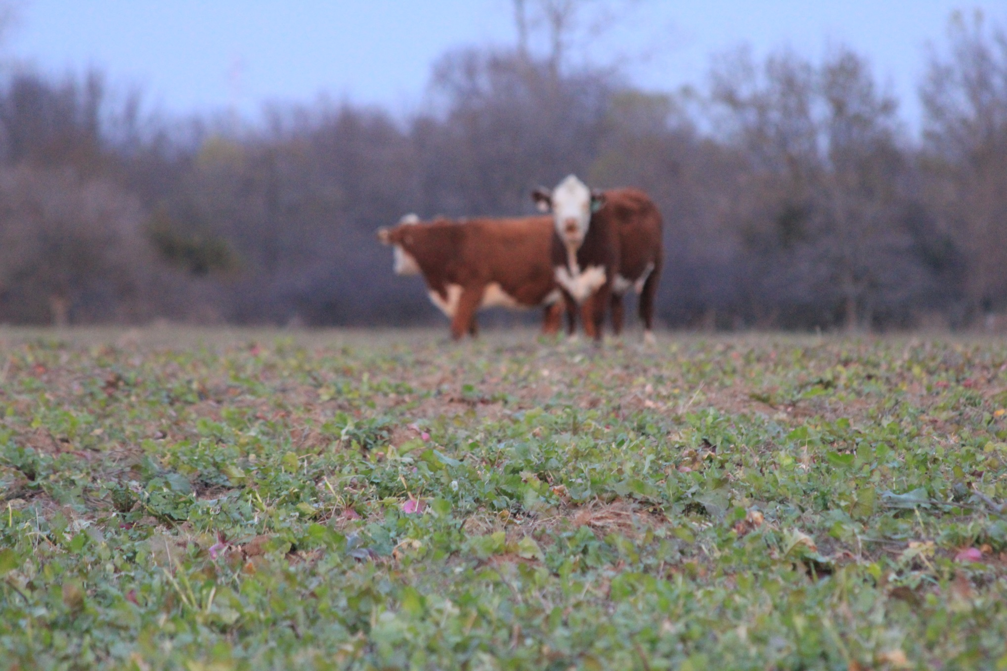
Why integration of cattle and covers on operations

Slide 9
Cattle Performance
Measure | Tillage¹ | Winter CC² | Summer CC³
Calf daily gain (lb/hd/d) | CT | 4.61 | 1.81*
 | NT | 5.00 | 2.05*
Cow daily gain (lb/hd/d) | CT | 0.55 | 2.00
 | NT | 2.98 | 2.16
Cow/calf pair daily gain (lb/hd/d) | CT | 3.17* | 3.22
 | NT | 4.32* | 3.64
Calf gain (lb/a) | CT | 157* | 206
 | NT | 213* | 230
Cow gain (lb/a) | CT | 38* | 54
 | NT | 149* | 77
Cow/calf pair gain (lb/a) | CT | 182* | 247
 | NT | 312* | 289
¹ CT = conventional till and NT = no-till ² Summer grain (Sorghum 2002-2004) or corn (2005) and winter cover crop (Rye) ³ Winter grain (Wheat) and summer cover crop (pearl millet) * Indicates difference in tillage treatment

Slide 10
Economics - $/acre
Franzluebbers and Stuedemann, 2007. Renewable Ag and Food Systems
System | Tillage | Grazing | Total Cost | Crop Value | Calf gain value | Total crop and calf value | Net return over variable costs
Sorghum (corn) + rye | CT | Ungrazed | 159.62 | 122.13 | 0.00 | 122.13 | -37.49
 |  | Grazed | 160.00 | 131.75 | 117.57 | 249.32 | 89.32
 | NT | Ungrazed | 160.59 | 153.13 | 0.00 | 153.13 | -7.46
 |  | Grazed | 159.16 | 117.50 | 159.66 | 277.16 | 118.00
Wheat + pearl millet | CT | Ungrazed | 122.96 | 100.17 | 0.00 | 100.17 | -22.79
 |  | Grazed | 118.58 | 103.25 | 154.31 | 257.56 | 138.98
 | NT | Ungrazed | 129.71 | 95.50 | 0.00 | 95.50 | -34.21
 |  | Grazed | 127.75 | 97.83 | 172.35 | 270.18 | 142.43
No cost associated for fence in this analysis
Notes:
Dollars/acre values

Slide 11
K-State 1 yr Study
Lyndon, KS
Fescue versus cocktail cover crop
  Hay, mineral, corn/distillers supplement
  Fescue – 8 lbs/hd/d and Cocktail 5 lb/hd/d
Wheat – cover crop – soybean
Turn out Nov. 18 remove Feb. 10
Shrunk body weight on an off pasture

Slide 12
Raw Results
Item | Fescue | Cover Crop
Heifers
No. head | 24 | 24
Initial weight | 457 | 460
Final weight | 602 | 626
Total gain | 145 | 166
Average daily gain | 1.63 | 2.00

Slide 13
Cattle Economics
Fescue
Covers
Supplement: $0.72/hd/d
Fescue rental: $0.75/hd/d
Hay/mineral: $19.88/hd
Feeding cost: $140.42/hd
Sale wt: 602 pounds
Sale value: $878.92
Supplement: $0.43/hd/d
CC cost: $0.61/hd/d
Hay/mineral: $19.88/hd
Feeding cost: $105.16/hd
Sale wt: 626 pounds
Sale value cattle: $913.96
$35.26 lower cost in covers
$35.04 more in sale value
$70.30/hd advantage to the covers
Notes:
supplement

Slide 14
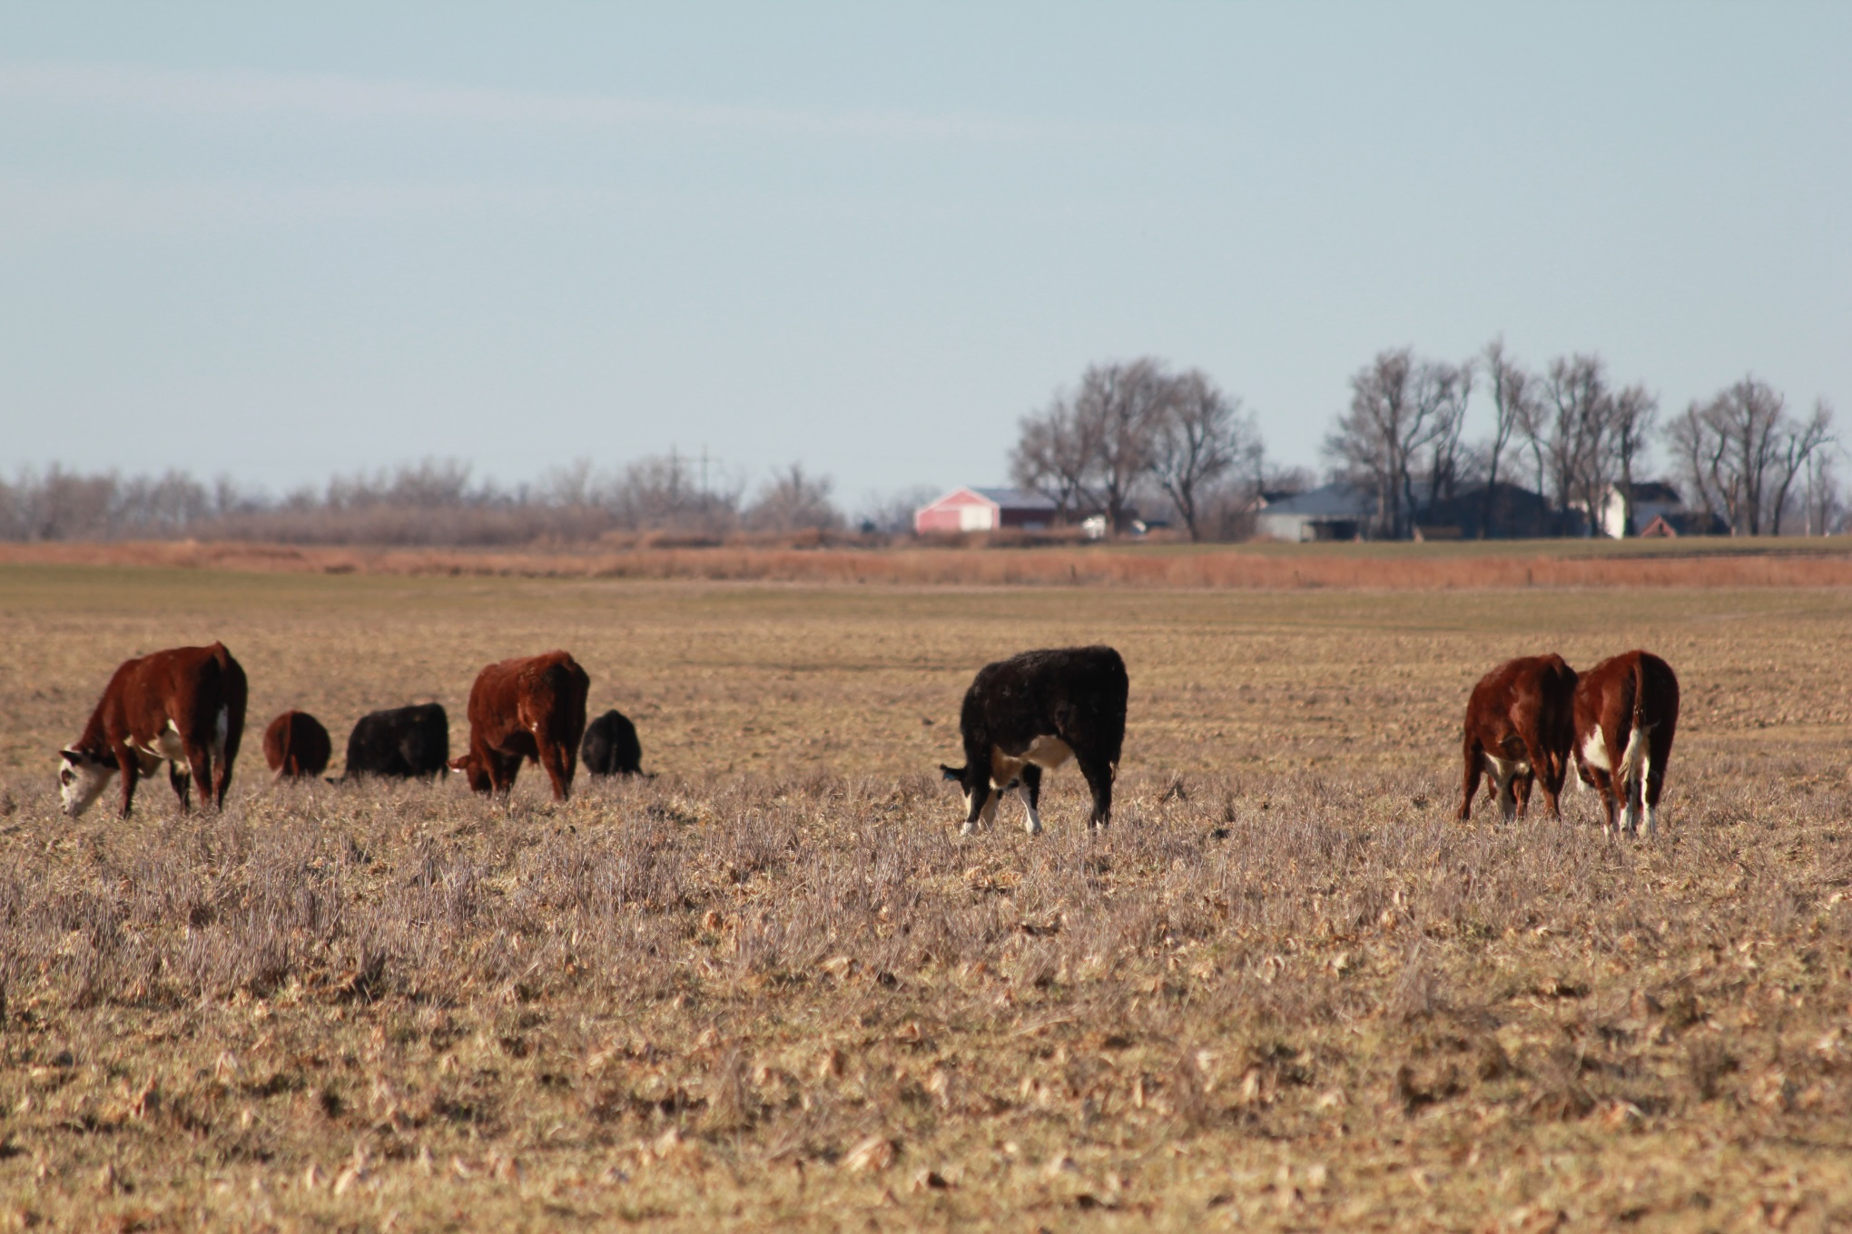
What do we know about covers as an annual forage?

Slide 15
Type and common annuals
Fall/Winter
Summer
Grasses
  Rye, barley, oat, triticale, wheat, rye, ryegrass
Broadleafs
  Brassicas, buckwheat
Legumes
  Winter pea, clovers
Grasses
  Sorghums, sudans, millets, corn, teff
Broadleafs
  Sunflowers, buckwheat
Legumes
  Sunn hemp, forage soybeans

Slide 16
What do we plant?
Perennial systems diversity is the best (Gunter et al., 2012; Gadberry et al., 2015; Keyser et al., 2016)
  Bermuda/bahiagrass pastures addition of wheat+ryegrass, wheat+ryegrass+red clover, wheat+ryegrass+white clover+crimson clover
  Calf weaning weight greater – cow effects no difference
Legumes in meadow or tall fescue cattle gains improved (Schaefer et al., 2014)
In an already diverse perennial pasture – addition of 3, 5, or 8 additional plant species did not affect cattle performance (Tracy and Faulkner, 2006)

Slide 17
What do we plant?
Annual forages – few head to head between grass only and mixture
Florida study addition of triticale into ryegrass did not improve cattle gains and was more expensive (Vendramini et al., 2016)
Gains: Oat-ryegrass mixture = rye-ryegrass-oat mixture > rye-ryegrass mixture (Mullenix et al., 2012)
Gains: Wheat = wheat+radish (Farney et al., unpublished)

Slide 18

Average Hay Quality of 2012 Winter Forages
Crop | % Crude Protein Dry Basis | % TDN Dry Basis | NO3 ppm
Brassica | 29 | 80 | 2736
Cereal | 25 | 72 | 2435
Brome/fescue | 21 | 57 | 817

Slide 19
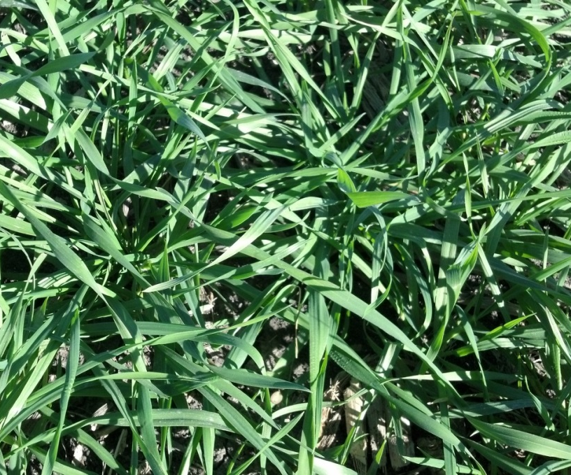
Stockpiled Forage
Fall cereals will typically have 150 lbs/acre of dry matter forage for ever inch of top growth
  6” tall rye would have 900 lbs/acre usable forage
In an open graze situation cattle will utilize ~70% of the forage
  So only 630 lbs/acre of forage will be consumed

Slide 20
Brassicas
Brassicas are a highly productive and high quality forage
  Turnips
  Radish
  Hybrid brassica
Good utilization on crop fields for fall and winter grazing when fields would remain fallow otherwise
Brassicas are >80% water, so maintaining a dry roughage in their diet is important

Slide 21
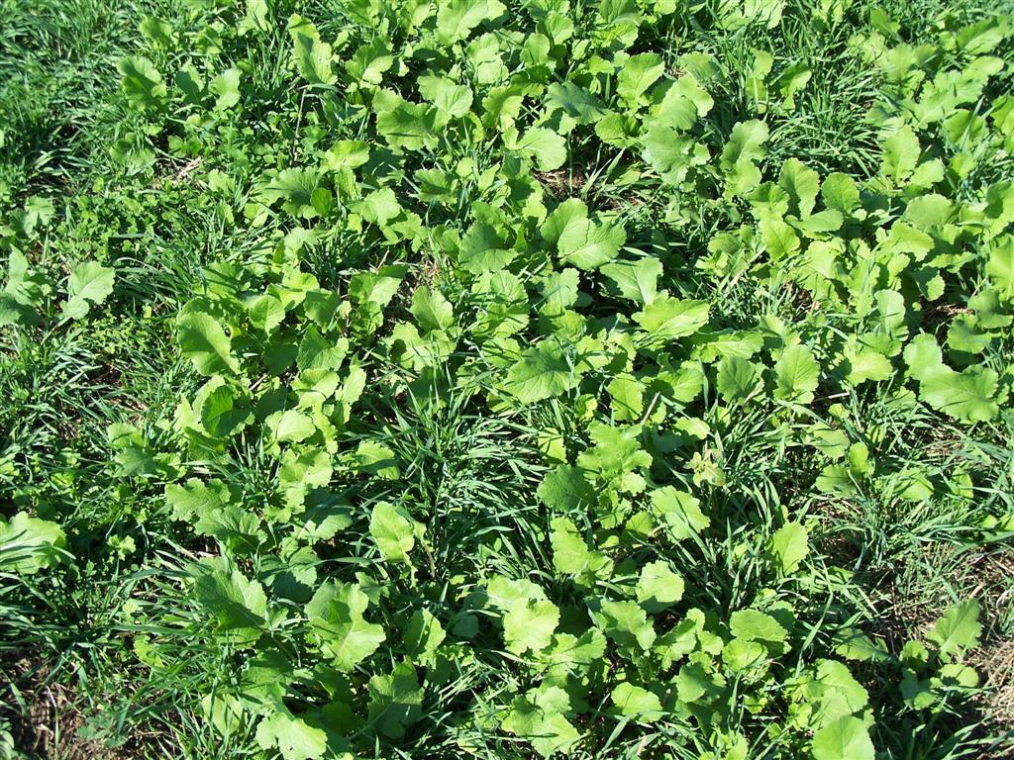
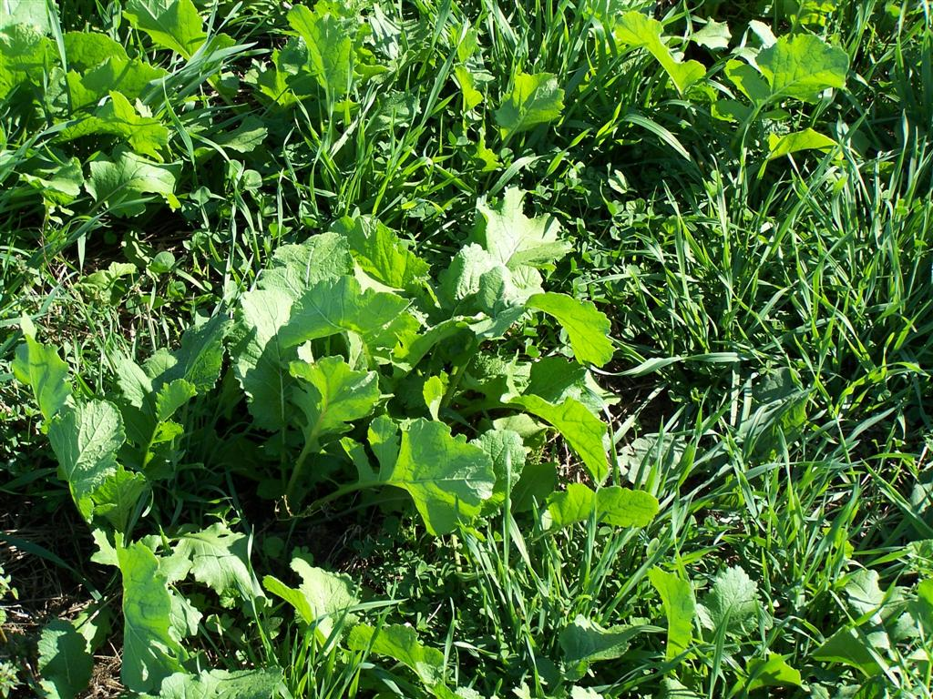
Brassica
Brassica forage quality is very high ranging from 17-22% protein
  Turnip bulb protein content ranges from 12-15%
Cattle will generally seek out the cereal before utilizing the turnip tops

Slide 22
Brassica Quality
Livestock devour brassica forage more rapidly following a hard freeze (28°F)
  Digestibility increases significantly
Forage quality measurements of canola PRE and POST freeze
Treatment | Protein | ADF | NDF | NEM | TDN | RFV
 | % | % | % | (Mcal/lb) | (%)
PRE | 26.2 | 21.8 | 24.5 | 0.84 | 73.2 | 277.3
POST | 25.0 | 17.8 | 20.0 | 0.90 | 77.9 | 352.3
LSD (0.05) | - | 1.65 | 1.5 | 0.03 | 1.9 | 23.9
Stamm, et. al

Slide 23
Legumes
Incorporated into mixes for N-fixation
Winter growth of legumes very low in most of KS studies
  Also around the country (minus hairy vetch; Coombs et al., 2017)
Do we need legumes from a cattle diet perspective?
  Plenty of N (CP from cereal grasses and brassicas)
    Dairy study milk yield, fat, protein same in ryegrass or ryegrass + Berseem clover, crimson clover, and Persian clover (Veiga et al., 2016)
  What’s the difference in the amount of N contribution to the soil of plant vs cattle excretions?

Slide 24
Statewide 2014 Fall samples

Slide 25
Columbus 2014-2015

Slide 26
Columbus 2014-2015

Slide 27
Seed cost $37.91/ha
Seed cost: $67.14/ha
2014: Biomass ton/acre (P = 0.68) and Biomass $/ton (P = 0.01)
2015: Biomass ton/acre (P = 0.38) and Biomass $/ton (P = 0.03)

Slide 28
Winter legume emerged or not
Columbus study NO difference in winter cover if legume emerged or did not
  Biomass
  Crude protein
  TDN
  ADF
  NDF
  Carbon
  Nitrogen
  C:N

Slide 29
Alternative forage - TEF
High yielding forage
  Demo plot in Neosho County – 2.5 ton DM, 45 d after planting
Usually used as a hay
  Tremendously high quality if harvested correctly
  If harvested too late – B-A-D
  Tiffany tef study in Idaho – boot stage and early-heading hay responded well in the cattle : late-heading resulted in significant reductions in protein availability and circulation in blood
Grazing???
  Tiffany tef in study in Texas – cattle gains well along with a DDG supplement – the forage was maintained through the 63-d grazing period

Slide 30
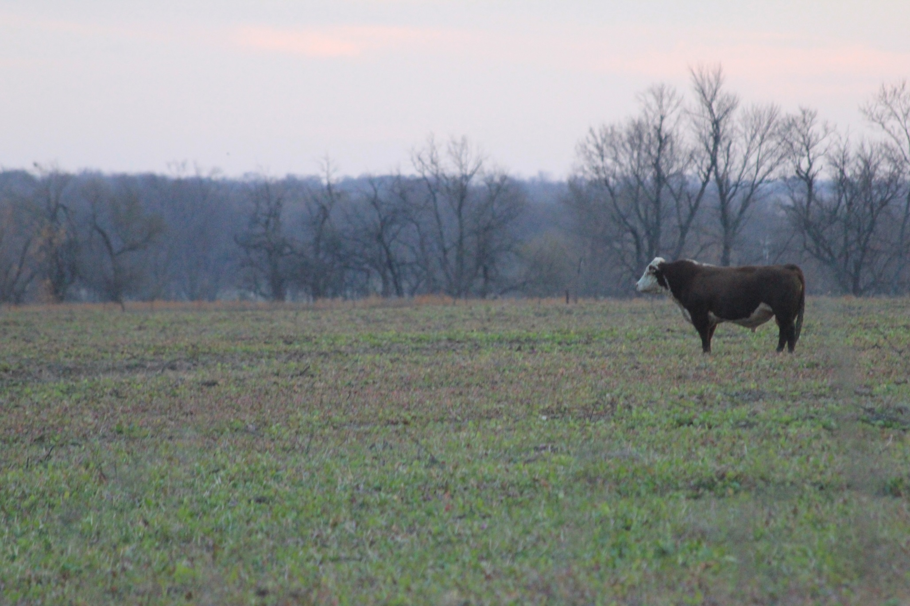
How do we use annual forages for cattle?

Slide 31
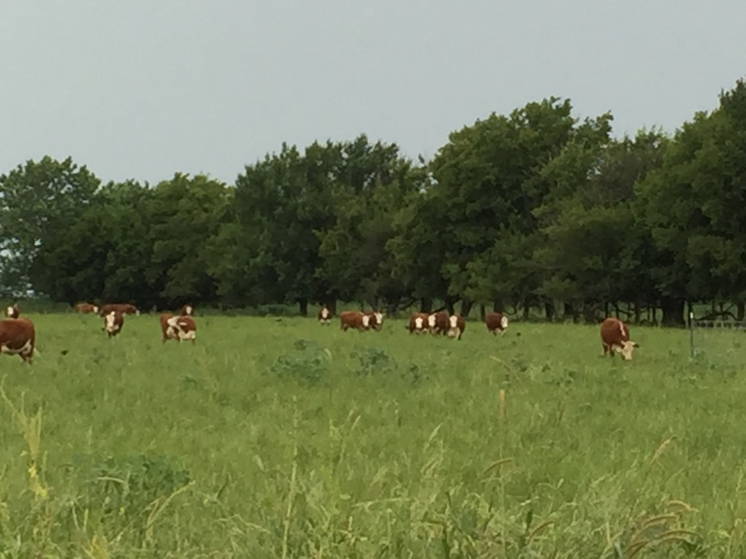
Know purpose - Cattle
Are gains a priority
  Might need to include supplement
Is maximizing land a priority
What class of animal maximizes the acreage

Slide 32
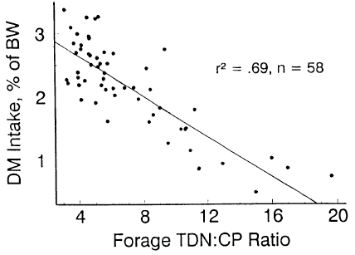
Moore and Kunkle, 1994

Slide 33
Which supplement to feed?
 | Dormant forage |  | Wheat forage
 | CSM | Corn | CSM | Corn
Forage CP% | 5 | 5 | 25 | 25
Forage TDN% | 45 | 45 | 75 | 75
Supplement CP% | 45 | 9 | 45 | 9
Supplement TDN% | 76 | 88 | 76 | 88
Forage DOM:CP | 9 | 9 | 3 | 3
Supplement DOM:CP | 1.7 | 9.8 | 1.7 | 9.8
DOM:CP target | 4-6 | 4-6 | 4-6 | 4-6

Slide 34
Maximizing land
Another way to increase pounds produced per acre is to have adequate gain X increased stocking rate
  Supplementation can do this…
  Energy supplement (higher TDN value)
Oklahoma research (Cravey et al., 1994)
  Corn-based supplement fed at 0.7-1% of BW resulted in a 1:1 substitution rate
  Led to 33% increase in stocking rate

Slide 35
Forage Quality
Species | NDF % | ADF % | Calculated TDN
Barley | 40.6 | 13.9 | 79.9
Black Oats | 42.0 | 24.0 | 73.3
Purple Top Turnip Bulb | — | 13.8 | 79.9
Purple Top Turnip Leaf | 17.6 | 10.3 | 82.2
Radish Bulb | 18.0 | 14.9 | 79.2
Radish Leaf | 20.3 | 12.1 | 81.2
Tillage Radish Bulb | 14.0 | 12.0 | 81.1
Tillage Radish Leaf | 22.0 | 18.1 | 77.1
Rye | 33.6 | 12.7 | 80.7
Cow Pea/Soybean | 36.0 | 16.3 | 78.3
Triticale | 38.4 | 15.4 | 78.9
Triticale/Oats | 36 | 14.7 | 79.3
Turnip/Radish/Brassica Bulb | 18 | 10.6 | 82.0
Turnip/Radish/Brassica Leaf | -- | 17.7 | 77.4
Wheat | 39.5 | 15.7 | 78.7
Winter Pea | 21.6 | 15.7 | 78.7
A 1400 lb dairy cow producing 120 lbs/d needs 45.9 lbs of TDN/d = Most of these winter forages meets 73% of a Holstein cows peak milk production …. Food for thought

Slide 36
Winter Annuals and Cows
Cow requirements, especially if dry, pregnant is much, much lower than what is offered by the winter annuals
Issues
  Too much body condition
  Inefficiency in production system
  Loss of potential revenue
Practices to manage for this:
  Short term grazing on high quality forage
  Combination paddock

Slide 37
Short term grazing
Allow cows a couple of hours/d to graze high protein, high energy forage at least 3x/week
  This is also know as limit grazing wheat pasture
Oklahoma State University study
  Allowed cows to graze wheat pasture for 4 hours 3x/week (Fall-calving herd)
  Rest of the time cows where on native hay
  From calving to weaning cows on this system performed exceptional

Slide 38
Combination paddock
Portion of pasture is corn/milo stalks the other portion is cereal grain or brassica
  Flying on brassicas or cereal grains into residue
  Planting corners of circles with high quality forage
Cattle will consume a combination of residue and high quality forage
Cows maintain appropriate body condition
Removes the need for supplemental protein on residues

Slide 39
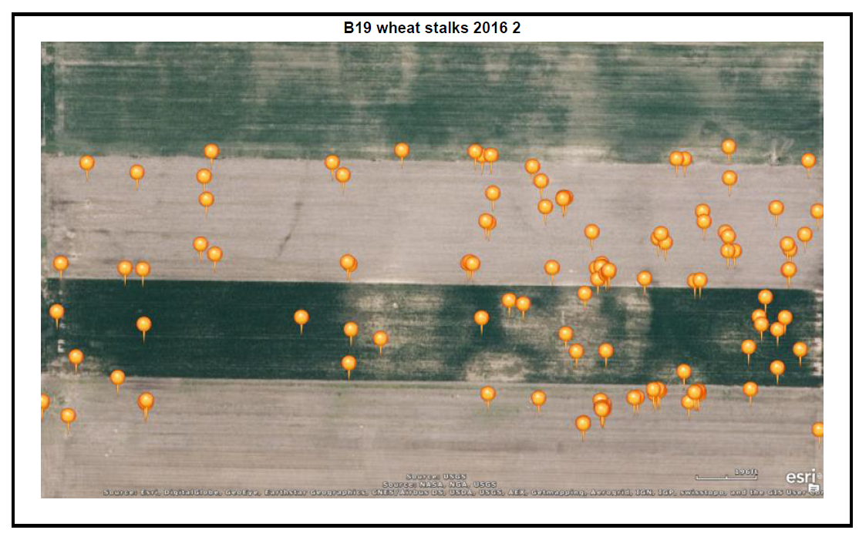

Slide 40
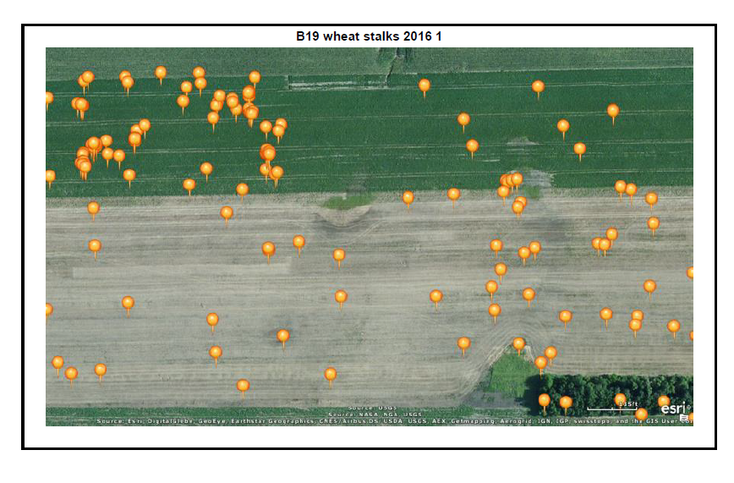

Slide 41
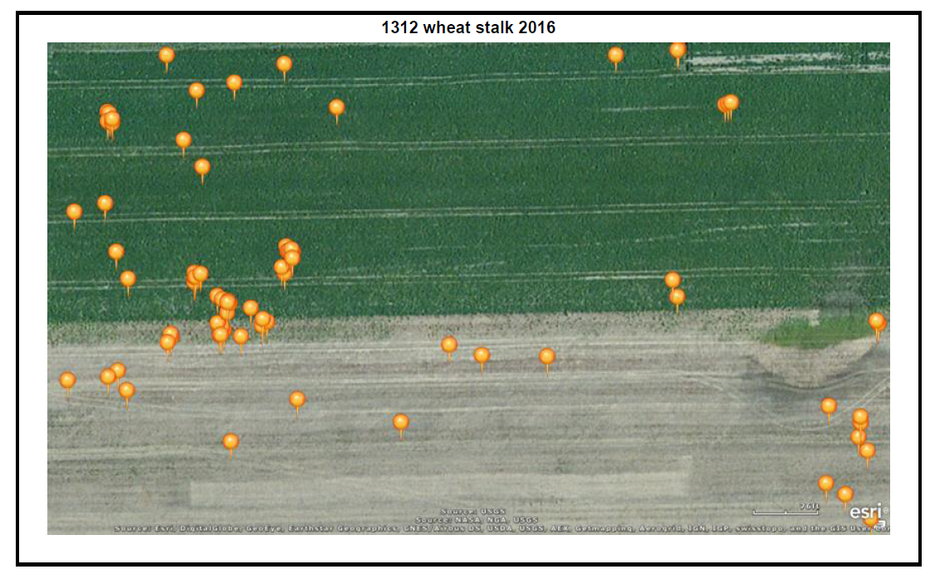

Slide 42
Weaned Calves
Most of the time, we still are offering too much protein (much higher than requirements)
Need another source of dry forage/feed
Maximize gain potential want to make protein to energy ratio optimal
Maximize gain = maximum dry matter intake

Slide 43
Value of winter cover crops - stockers
Nebraska data showed that calf gains are VERY variable with cover crop mixtures
Over 10 studies
  ADG ranged from 0.8 lb/d up to 2.3 lb/d
  Same cocktail in back-to-back years
    2.3 lb/d one year and 1.3 lb/d next year

Slide 44
Calf gains on cereal grains
Cereal type | Cattle Type | Gain | Location
Oat | Heifer | 1.96 | North Dakota
Barley | Heifer | 1.96 | North Dakota
Barley | Heifer | 1.75-1.96 | South Dakota
Barley | Steers | 3.0 | Canada
Oat | Steers | 2-3.5 | Canada
Rye | Steers | 2.25-2.6 | Canada
Triticale | Steers | 1.7-2.4 | Canada
Wheat | Steers | 1.87 | Canada
Oat-Ryegrass | Steers | 3.06 | Alabama
Oat-Rye-Ryegrass | Steers | 2.78 | Alabama
Rye-Ryegrass | Steers | 2.50 | Alabama
Ryegrass | Calves | 1.96 | Florida
Ryegrass-triticale | Calves | 1.68 | Florida

Slide 45
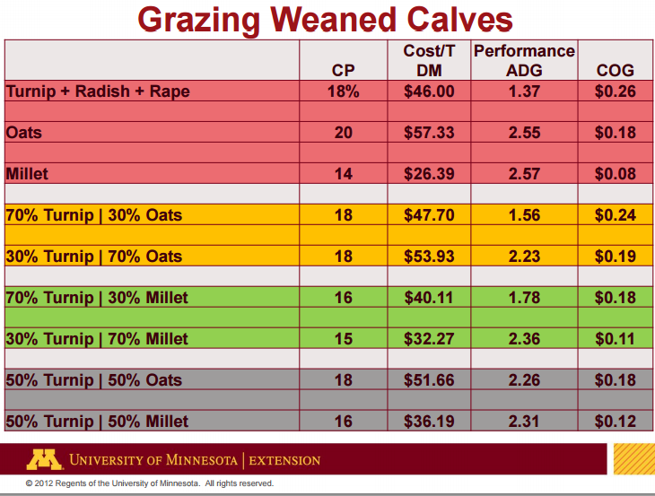
Data - Eric Mousel

Slide 46
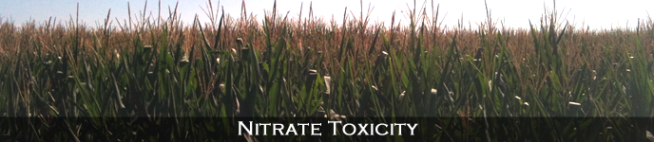
What are issues with using annual forages

Slide 47
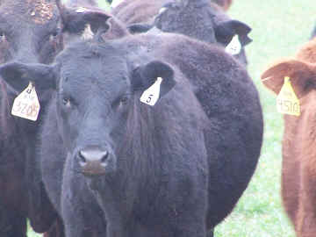
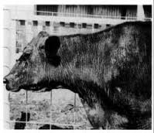
Potential problems
Bloat
Glucosinolates
Grass tetany
Nitrates
Polioencephalomalcia (PEM)
Prussic acid
Sweet clover
Just simply poisonous…

Slide 48
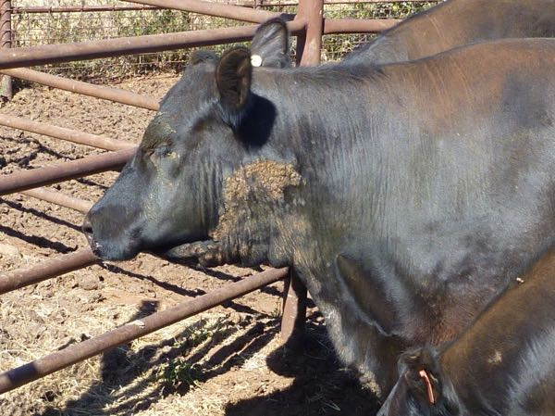
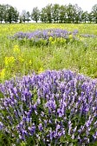
Poisonous plants
Hairy vetch
  Mortality 50-100% for affected animals
  Not all animals affected
  Black pigmented most commonly affected
  “Allergic” reaction
  Death due to kidney failure
  Risky to graze at any stage of plant maturity
Dermatitis on hairy vetch pasture

Slide 49
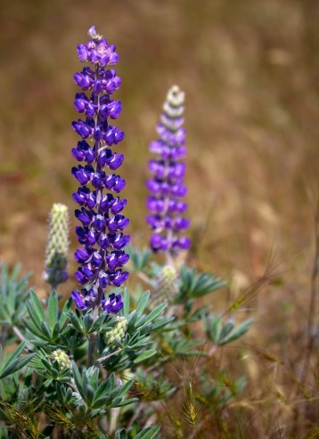
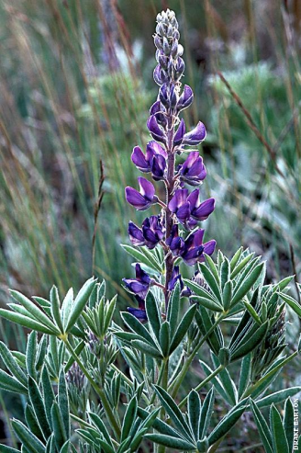
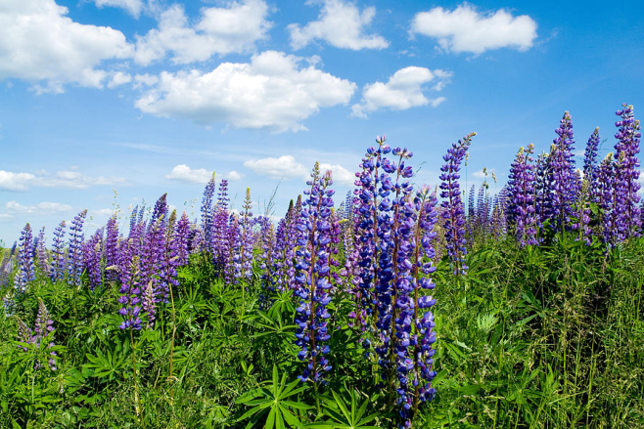
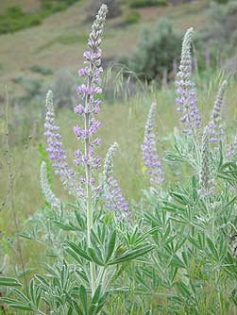
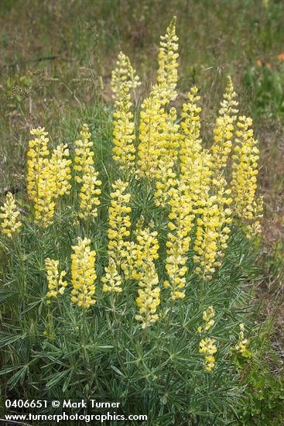
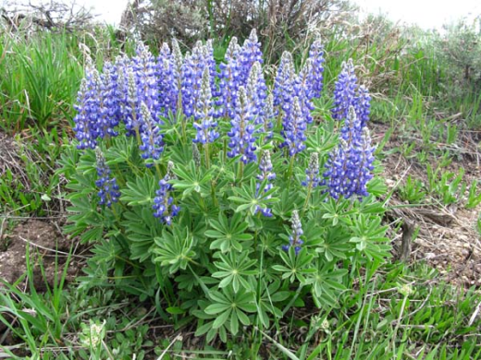
Poisonous plants
Lupins (6 toxic species)
  Silky lupine
  Tailcup lupine
  Velvet lupine
  Silvery lupine
  Summer lupine
  Sulfur lupine

Slide 50
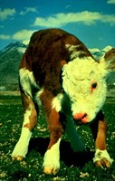
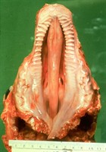
Poisonous Plants
Lupines
  Cleft palates
  Crooked legs
  Malformed spines
  Death
  Cause issues because of alkaloids
  Western US is where lupines primarily occur in nature
  Seed stage is when plant most toxic
  Most cattle deformities occur when pregnant cow is 40-70 days of gestation
  Sheep most commonly affected with lupines

Slide 51
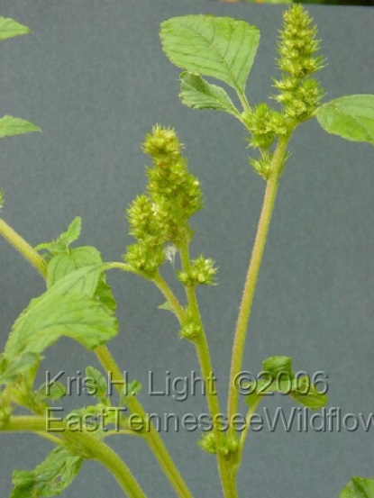
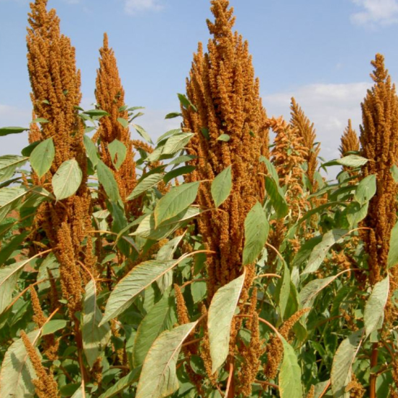
Poisonous Plants
Amaranth
  Pigweed cousin
  Death due to nitrate toxicity
  Kidney failure issues
  “True weed” – hard to control in pasture and crop ground
    Glyphosate resistant…
  Some amaranth species for grain production can be good cattle feed
  Before using for cattle feed make sure you know the species
Green amaranth
BAD
Grain amaranth
Seed possibly ok to feed

Slide 52
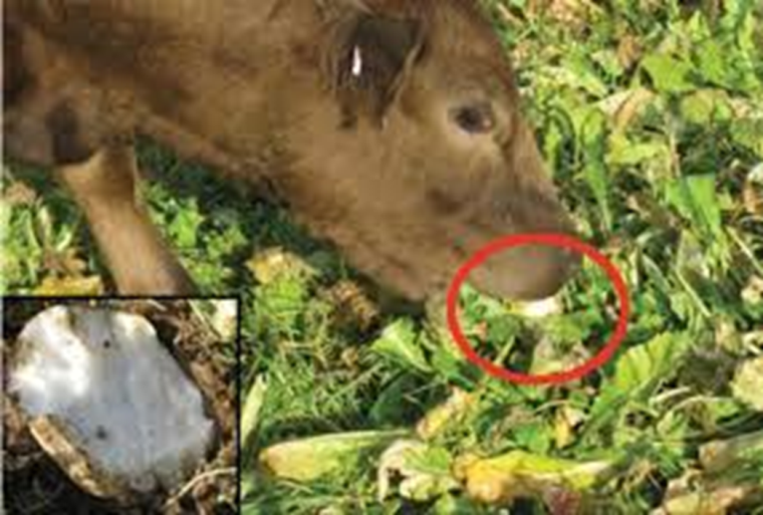
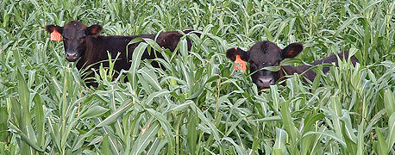
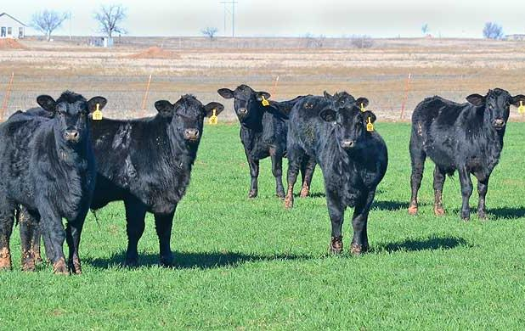
Concerning Popular Plants
These plants cause metabolic issues that need to be addressed….
  Brassicas
  Small grains
  Legumes
  Summer grasses

Slide 53

Brassicas
Issue
Management to resolve
High moisture, low fiber
  Loose stool
Glucosinolates
  Decrease mineral absorption
    Iodine – thyroid issues
  Low in Cu, Mn, Zn
    Eye and feet issues
PEM, anemia, emphysema
Nitrate ???
  Brassicas are nitrate accumulators and will test high in nitrate
Supply a dry feedstuff
  Stalks
  Hay
Provide chelated/highly absorbable and palatable mineral
Offer mineral in daily feed supplement
Brassicas <75% of total diet
Allow plant to mature (usually decreases nitrate further in season)
Slow introduction to plant

Slide 54
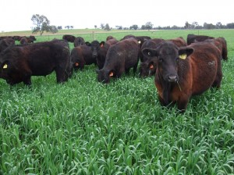
Small Grains
Barley, oats, rye, ryegrass, wheat, triticale
  Grass tetany – fall, winter, spring
    Manage with magnesium mineral ~8-12% Mg
    Graze non-lactating cattle
    Include legumes @ ~30% of pasture
  Bloat
    Dry forage
    Ionophores
    Bloat blocks
  Nitrates???

Slide 55
Legumes
Clovers, alfalfa, lablab, cowpea, sunhemp, mungbean, soybean, medics
#1 issue – bloat
  Non-bloating legumes: lespedeza, birdsfoot trefoil, sainfoin
Clovers – sweet clover poisoning; coumarin
  Sweet clover, yellow clover, and white clovers
  Red clover – low coumarin
  Moldy hay most common culprit

Slide 56
Summer Grasses
Sorghum, sudans, millets, corn
Prussic acid
  Sudan grass < sorghum-sudan < sorghum
  No prussic acid: corn, pearl or foxtail millet
  Graze when plants are taller than 18 inches
    Might have new regrowth within 5 days so a rotational grazing system is best in summer to graze sorghums and millets

Slide 57
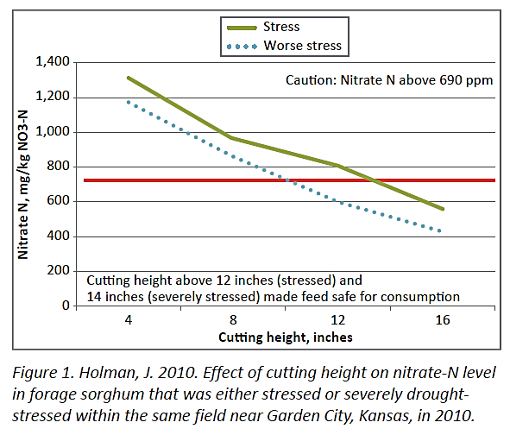
Summer Grasses
Sorghum, sudans, millets, corn
Nitrates
  Can have ↑ nitrate
  Manage for nitrate
    Allow plant to mature
    Harvest at higher cutting height if making hay

Slide 58
Sorghum Grazing Considerations
Rotational grazing best option
  Start grazing sorghum when > 24 inches tall
  Graze until 8 inches left
  Grazing time per paddock should be less than 10 days – optimal a couple days
  Rest time ~25 days should give 24 inches
  Estimated stocking rate 5-6 AU/acre

Slide 59
Sudangrass and millet grazing considerations
Rotational grazing still best option
  Start grazing 18 inches tall
  Stop grazing 8 inches tall
  Grazing days 7-10 days
  Rest period of ~21 days
  Estimated stocking rate 4-5 AU/acre

Slide 60
Determining grazing plan
Determine forage DM yield
Determine stocking rate or grazing days
Determine number of paddocks needed
Be flexible….cattle don’t read the book and follow our directions

Slide 61
Additional information
MF3244 – Forage Crops Grazing Management: Toxic Plants
  www.bookstore.ksre.edu/pubs/MF3244
Beef Tips May 2015
  http://www.asi.k-state.edu/about/newsletters/beeftipsMay2015.pdf
  “Sorghums and millets for summer forage”
  “Estimating the amount of forage available for grazing in summer annuals”
Android and iPhone mobile app – Grazing Mgmt Toxic Crops

Slide 62
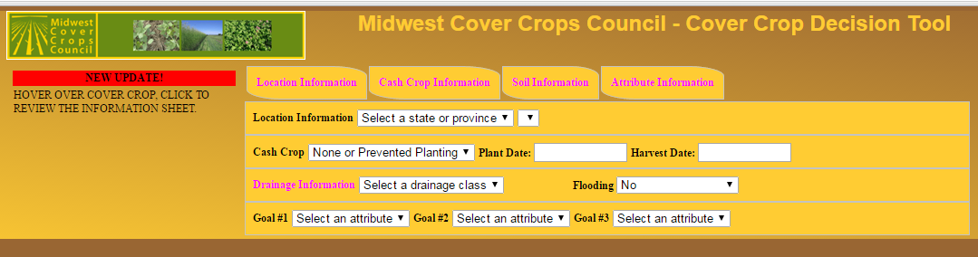
Additional Tools
Tool to help determine cover crops that work in your area and to meet your operations goals
http://mcccdev.anr.msu.edu/covercroptool.php

Slide 63

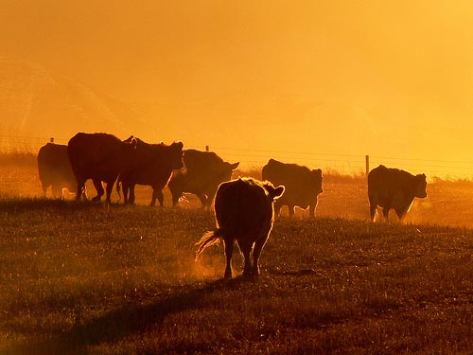
Thanks!!
jkj@ksu.edu
620-820-6125
Questions

Slide 64
Survey
Please help us in regards to some nitrate toxicity in cattle research
There is some questions we are asking you to help us answer via the clickers
All answers are anonymous and this survey is completely optional
Thanks

Slide 65
How often do you use annual forages as a source of forage for cattle
Almost always (4 out of 5 yrs)
Often (3 out of 5 yrs)
Sometimes (2 out of 5 yrs)
Seldem (1 out of 5 yrs)
Almost never (less than 1 out of 5 yrs)

Slide 66
How important is the issue of nitrates in annual forages and the potential for toxicity to you?
Very important
Important
Moderately important
Slightly important
Not important

Slide 67
Do you test annual forages that will be GRAZED for nitrates
Very frequently
Frequently
Occasionally
Rarely
Never

Slide 68
Do you test annual forages harvested as hay for nitrates
Very frequently
Frequently
Occasionally
Rarely
Never

Slide 69
How often do your annual forages test high for nitrates
Very frequently
Frequently
Occasionally
Rarely
Never

Slide 70
When annual forage pasture test high in nitrates (potentially toxic), what is the likelihood that you rill graze the forage?
Almost always
Usually
Often
Occasionally
Rarely
Almost never

Slide 71
If you grazed high nitrate forage what mitigation strategies did you use (select all that apply)
Allowed limited access to the forage
Provided a high energy supplement
Used a direct fed microbial
Waited until levels were safe
Lightly grazed the forage
Made sure animals were full before turnout
Other
None

Slide 72
When annual forage hay test high in nitrates (potentially toxic), what is the likelihood that you rill graze the forage?
Almost always
Usually
Often
Occasionally
Rarely
Almost never

Slide 73
When you fed high nitrate forage hay what mitigation strategies did you use (select all that apply)
Allowed limited access to the forage
Provided a high energy supplement
Used a direct fed microbial
Waited until levels were safe
Lightly grazed the forage
Made sure animals were full before turnout
Other
None

Slide 74
Have you experienced an issue with nitrate toxicity (animals died or aborted) when grazing annual forages?
Yes
No

Slide 75
If you suspected nitrate toxcity in grazed cattle did you consult your vet for diagnosis?
Yes
No

Slide 76
Have you experienced an issue with nitrate toxicity (animals died or aborted) when feeding annual forage hay?
Yes
No

Slide 77
If you suspected nitrate toxcity feeding annual forage hay did you consult your vet for diagnosis?
Yes
No

Slide 78
Number of beef cows owned or managed
0
1-49
50-99
100-500
501-999
>1000

Slide 79
Number of back-ground/stocker calves owned or managed
0
1-49
50-99
100-500
501-999
>1000

