Slide 1
Added Value of Preconditioning
Gant Mourer
Oklahoma State University

Slide 2
Value of Gain + Salvage Value (20%)
- Cost of Gain (Production)
= Profitability (+-)

Slide 3
Efficiency!!!

Slide 4
Two Ways to Efficiency
Manage to increase production &
Market how we manage to increase value.

Slide 5
Increase Cow (Productivity) Efficiency
Day to Day Activities
Pregnancy Rate
Weaning Rate
Tight Breeding Season
Grazing Management
Supplementation program
  Hay wastage
Progressive
Genetics

Slide 6
#1 most important economical trait?
Reproductive Efficiency
#2 Most important Economical Trait?
Cow Longevity

Slide 7
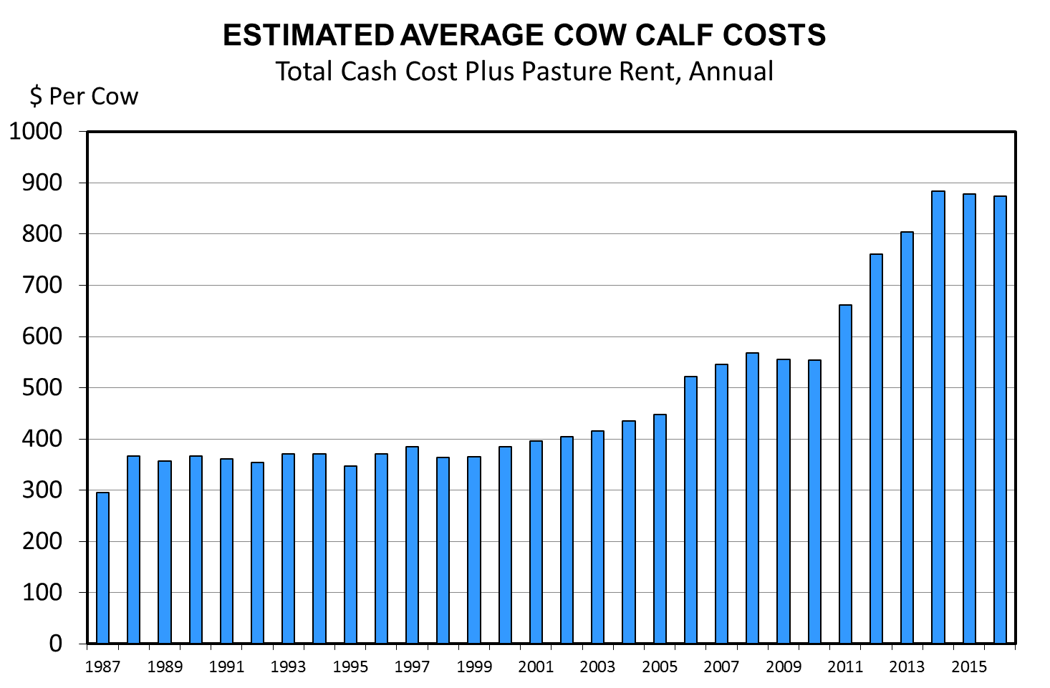
COG (Highly Variable)
Not Efficient
Efficient

Slide 8
Warning!!!!!

Slide 9
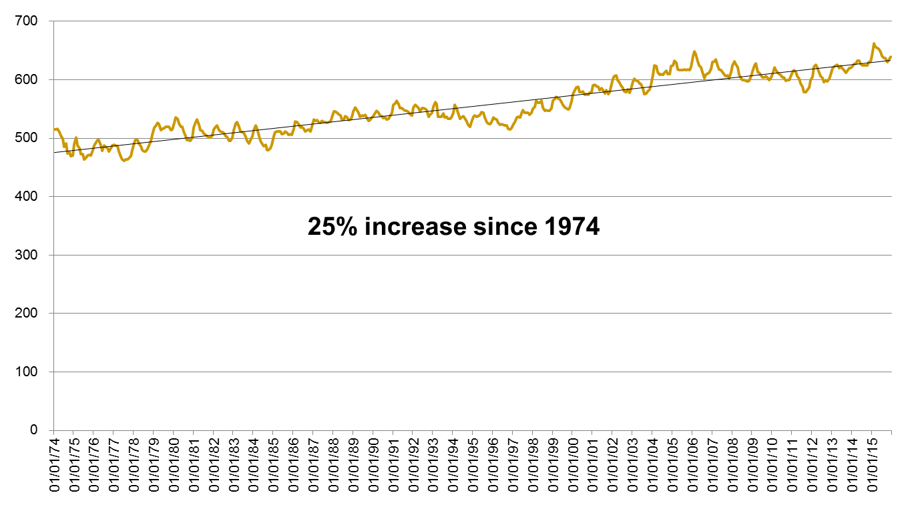
Cow weight

Slide 10
1974
  475 cow carcass/ 700 steer carcass = 1.47%
2016
  625 cow carcass/ 825 steer carcass = 1.32%

Slide 11
Total hay production/Beef Cows that Calve

Slide 12
Preconditioning
OSU in the 1960’s
Setting up a calf crop to succeed
Increase Health
Increase Gains
Increased Value
Selfishness

Slide 13
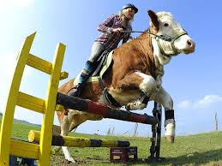
Quality #1 in Profitability
Quality Cattle and Management Practices…Repeat
A bovine that meets or exceeds production expectations in a given system or environment.
Producers must establish marketing goals

Slide 14
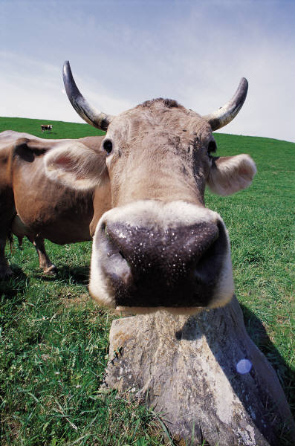
Marketing
Develop Heifers
Natural
  Holder Brothers Beef
  Duff
Retained Ownership
Local Markets
Stocker Cattle
Purebred
Commercial
Many More

Slide 15
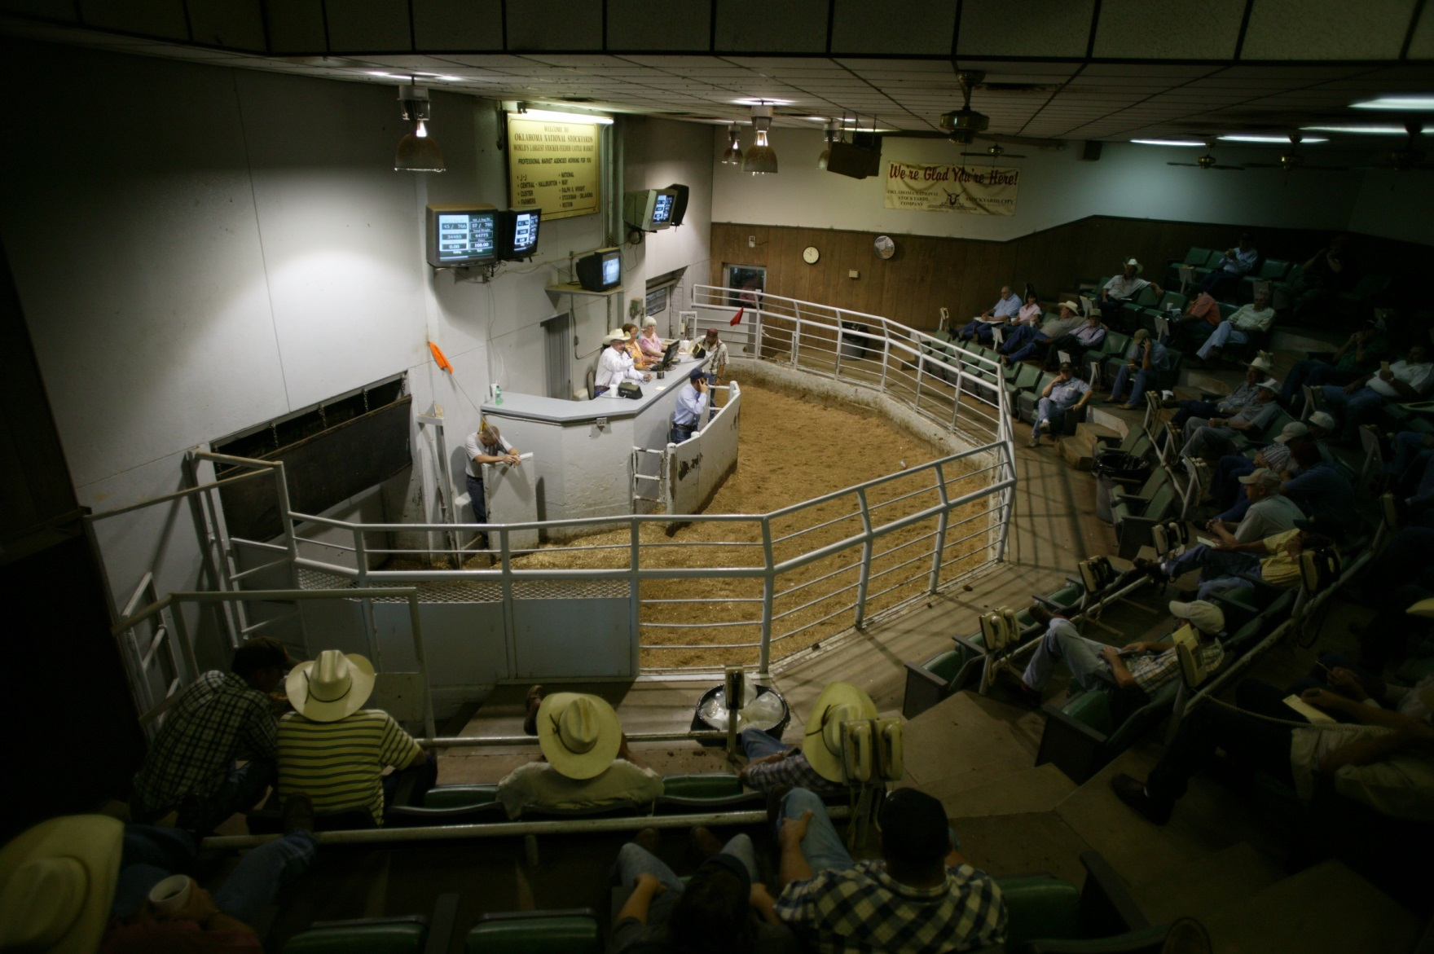
Traditional Markets and Management

Slide 16
Value of Gain
Total value of calf at two points in time.
  550 lbs steer $155/cwt = 852
  650 lbs steer $150/cwt = 975 $1.22/lbs
  750 lbs steer $143/cwt = 1072 $0.97/lbs $1.10/lbs
  Beef Basis.com

Slide 17
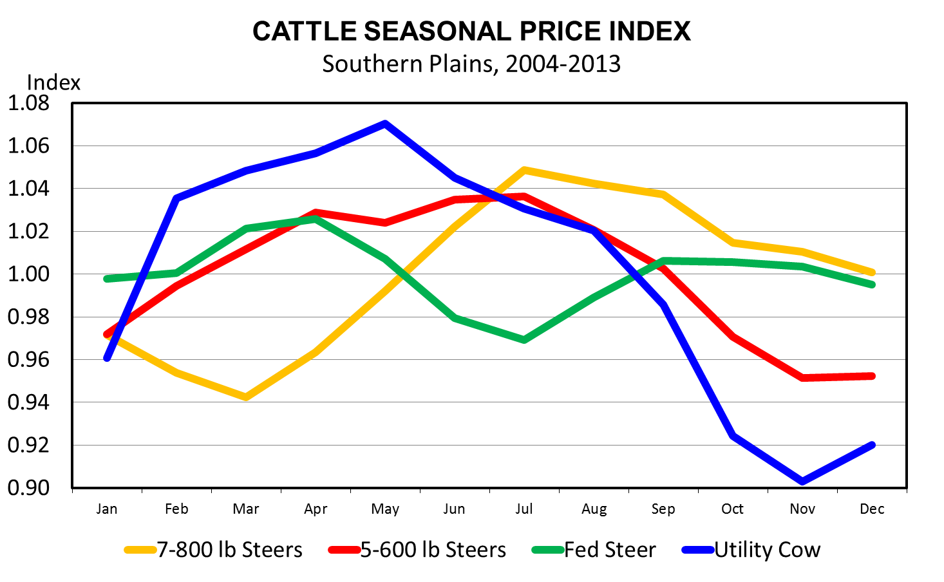
Data Source: USDA-AMS, Compiled & Analysis by LMIC
Livestock Marketing Information Center

Slide 18
Bull Discount
Bull Discount
 | 550-600 lbs |  | 700-750 lbs
 | $/cwt | % | $/cwt | %
2001-2016 | $10.77 | 7.79 | $15.16 | 11.62
2001-2011 | $8.51 | 7.66 | $12.62 | 11.98
2011-2016 | $15.58 | 8.06 | $20.30 | 10.90

Slide 19
Lot Size

Slide 20
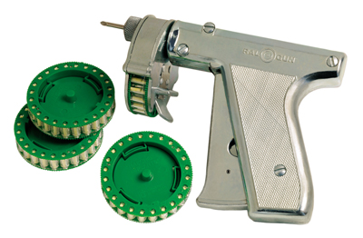
Technology
Implants
  0.12 lbs/day suckling calf
  8-10% increase in efficiency
Zeranol-1969

Slide 21
Economics of Implants
1980
  18 lb gain
  $0.60 value of gain = $10.80 increase in revenue
2015
  18 lb gain
  $1.30 value of gain = $23.40
  $.85 value of gain = $15.30
Cost?
Notes:
Mader: referring to WW
Selk: 23 trial summary
Kuhl: stocker phase

Slide 22
“Current” Use of Implants
Cow/Calf
National Animal Health Monitoring System

Slide 23
Percentage Lots Implanting / Not Implanting
Superior Livestock, 1995-2014
Source: Modified from King, Seeger, et al. JAVMA,2006, 2011

Slide 24
Natural and Organic Beef Sales
Source: FreshLook Marketing Data 13 weeks ending 12/28/14.

Slide 25
Price Advantage for Not Implanting
Superior Livestock, 1995-2014
Source: Modified from King, Seeger, et al. JAVMA,2006, 2011

Slide 26
Value Added Programs
Confidence to Cattle Buyers
Programs
  Age and Source Verification
  Genetic Verification
  Production System Verification
  Management Verification
3rd Party Verified
  USDA Certified Companies
    IMI Global, Verified Beef
  Breed Association
  Universities
  Pharmaceutical Companies

Slide 27
Genetic Verification
Not necessarily a USDA Program
3rd party
  Breed Associations
    Maternal Edge
  Verified Beef
Identify cattle consist of high % of that particular breed

Slide 28
Production System
Natural Beef
Never ever 3
  No implants
  No antibiotics
  No animal byproducts
  Tested for residues
NHTC

Slide 29

Organic Beef
Organic Beef Claims
  Born and raised on certified organic pasture
  Never received antibiotics
  Never receive growth-promoting hormones
  Are fed only certified organic grains and grasses
  Must have unrestricted outdoor access
  Must receive humane treatment
  No genetically modified cattle or embryos

Slide 30
Performance
 | Natural | Conventional
d 0 BW | 562 | 562
Final Wheat Weight | 822 | 869
Wheat ADG | 2.27 | 2.68
Feedlot in BW | 821 | 868
Feedlot final BW | 1274 | 1385
Feedlot ADG | 3.26 | 4.19
Feedlot DMI | 24.28 | 25.95
Feedlot F/G | 7.43 | 6.15
Net Returns | 0.00 | 203.69
Maxwell et al. 2013,2014

Slide 31
Production System
    Must Market as Natural (verify) or use technology!!

Slide 32
Management Verification
Precondition/Health
Vaccination protocol
Castration
Dehorned
Nutrition
Weaned
3rd party verification
PI BVD Neg?

Slide 33
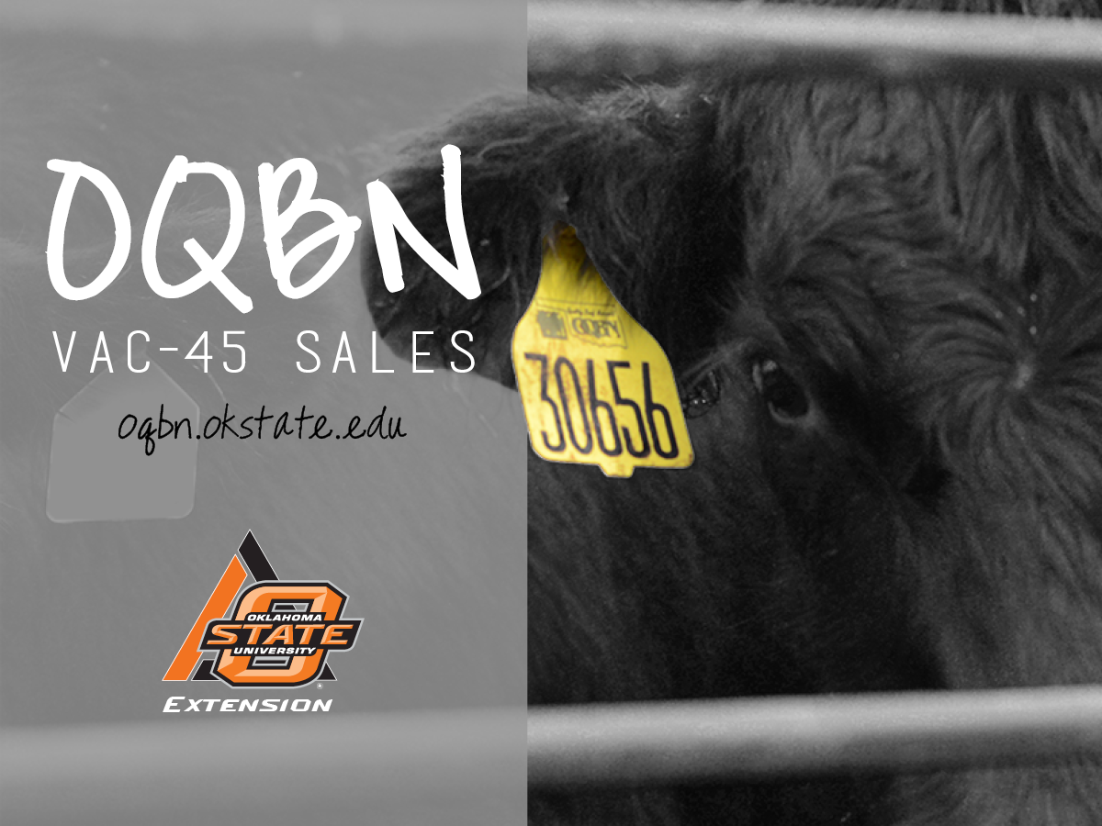

Slide 34
OQBN Vac-45 Requirements
Vaccination Protocol (3 Options)
Castrated and healed
Dehorned and healed
Weaned at LEAST 45 days
Verification of requirements
  3rd party (OSU)

Slide 35
OQBN Premiums

Slide 36
How Much Does it Work?
Practice | Likelihood of positive Return
45 Days Weaned | 62.2%
Vaccination | 61.4%
Dehorn/Polled | 56.3%
Wean+Vaccination | 60.4%
Wean+Vac+Dehorn | 67.2%
Certified Vac-45 | 79.3%
DeVuyst and Williams, 2013

Slide 37
550-600 Steer Ok Avg
94.04 $/cwt
or
0.26$/cwt/d

Slide 38
2015 OQBN Breakeven
 | Date | Weight | Price | value | Δ Value | Cost of gain | Break Even
2 lbs/d | 9/4/2015 | 475.00 | 251.97 | 1196.86
 | 10/23/2015 | 575.00 | 215.50 | 1239.13 | 42.26 | -70 | -27.73
 | 12/11/2015 | 675.00 | 177.60 | 1198.80 | -40.32 | -70 | -110.33
 |  |  |  |  |  |  | -138.06
1 lbs/d | 9/4/2015 | 475.00 | 251.97 | 1196.86
 | 10/23/2015 | 525.00 | 224.50 | 1178.63 | -18.23 | -70 | -88.23
 | 12/11/2015 | 575.00 | 192.11 | 1104.63 | -73.99 | -70 | -143.99
 |  |  |  |  |  |  | -232.23
0 lbs/d | 9/4/2015 | 475.00 | 251.97 | 1196.86
 | 10/23/2015 | 475.00 | 224.99 | 1068.70 | -128.55 | 0 | -128.16
 | 12/11/2015 | 475.00 | 201.07 | 955.08 | -113.62 | 0 | -113.62
 |  |  |  |  |  |  | -241.78

Slide 39
2016 OQBN Breakeven
 | Date | Weight | Price | value | Δ Value | Cost of gain | Break Even
2 lbs/d | 10/1/2016 | 575.00 | 132.44 | 761.53
 | 11/18/2016 | 675.00 | 133.11 | 898.49 | 136.96 | -70 | 66.96
1 lbs/d | 10/1/2016 | 575.00 | 132.44 | 761.53
 | 11/18/2016 | 625.00 | 140.11 | 875.68 | 114.15 | -70 | 44.15
0 lbs/d | 10/1/2016 | 575.00 | 132.44 | 761.33
 | 11/18/2016 | 575.00 | 136.70 | 786.02 | 24.69 | 0 | 24.69

Slide 40
Other Factors
Wheat Acres 100K = 0.23%
Distance from 4 lane = -0.06%
Sale Volume 1000 hd = -0.34%
Hide Color
  Black = 0.00%
  Black Mixed = -1.58%
  Red Mixed = -2.13%
  White/Grey = -2.03%
  Hereford = -7.40%

Slide 41
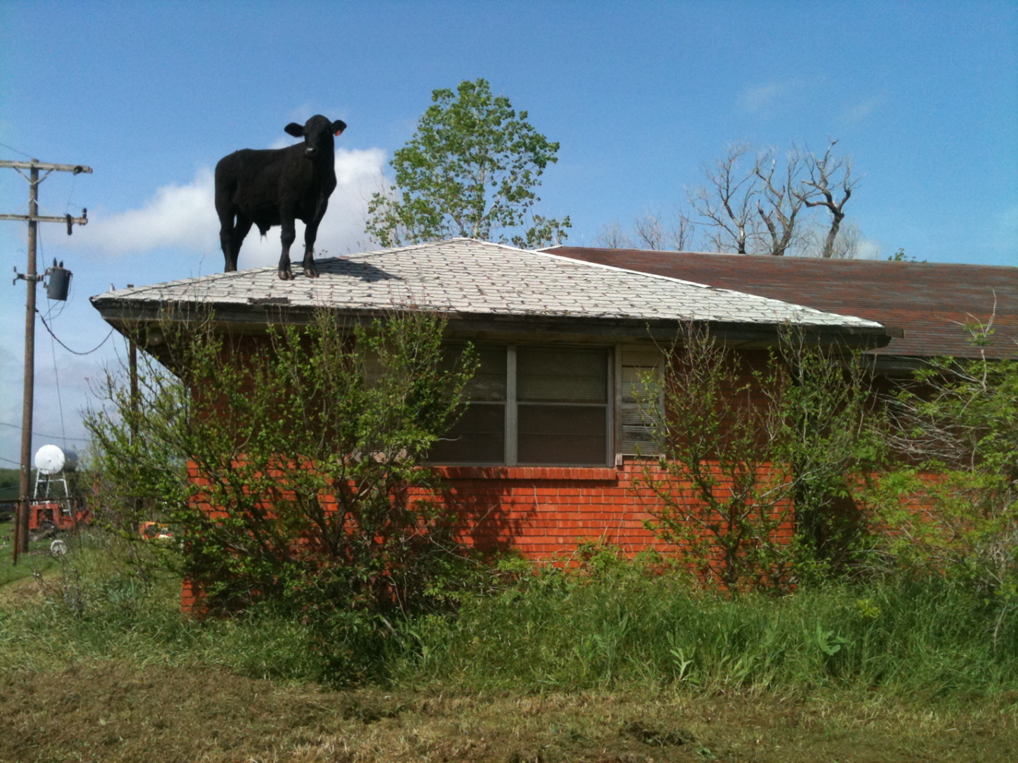
Questions?
Gant Mourer
(405) 744-6060 gantm@okstate.edu

