Slide 1

“The two most important days in your life are the day you are born and the day you find out why.” Mark Twain

Slide 2
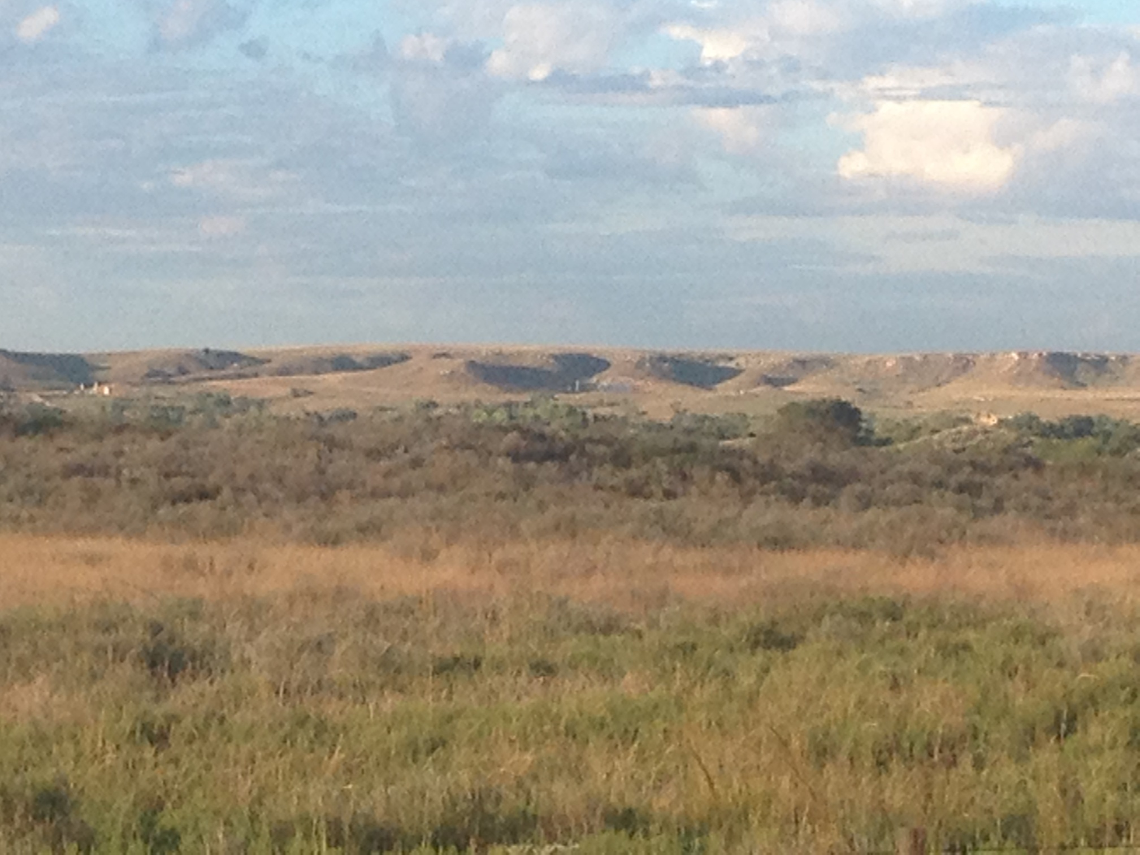

Slide 3
Purpose for Discussion
Sustainability
Profitability

Slide 4
Today’s Topics
      History
      News Stories affect our way of life
      Statistics
      Herd Health Information

Slide 5
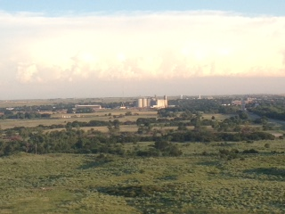
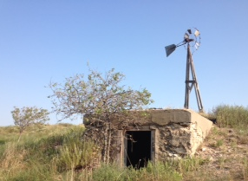
What Determines
Our Sustainability???

Slide 6
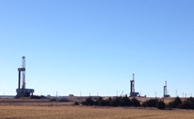
Non Agricultural Revenue

Slide 7
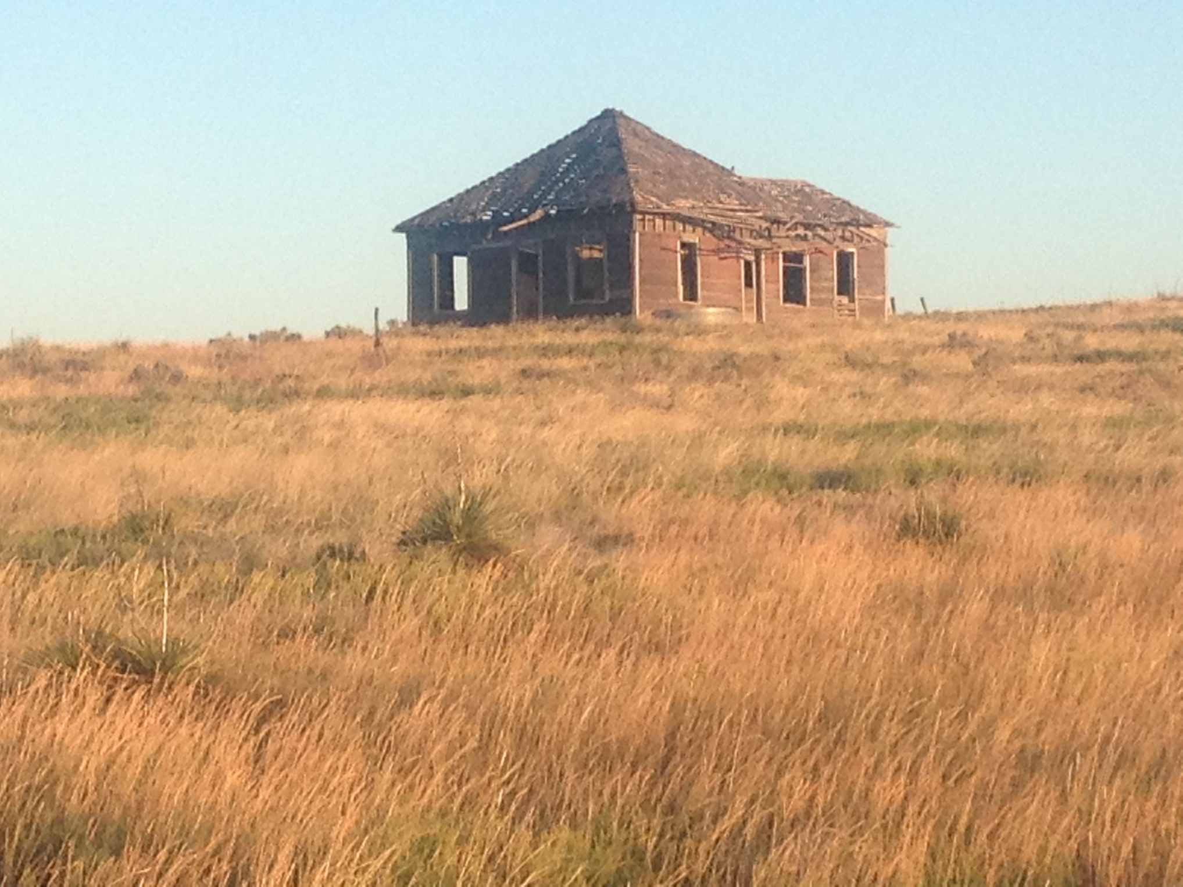

Slide 8
Oklahoma Statistics
Ellis County
      ~ 4,200 people
      21,500 Beef cows
Payne County
      ~ 80,000 people
      22,500 Beef cow

Slide 9
A Sampling of History
.… 1959
Average Cost of new house $12,400
Average Yearly Wages $5,010
Cost of a gallon of Gas ¢ 25

Slide 10
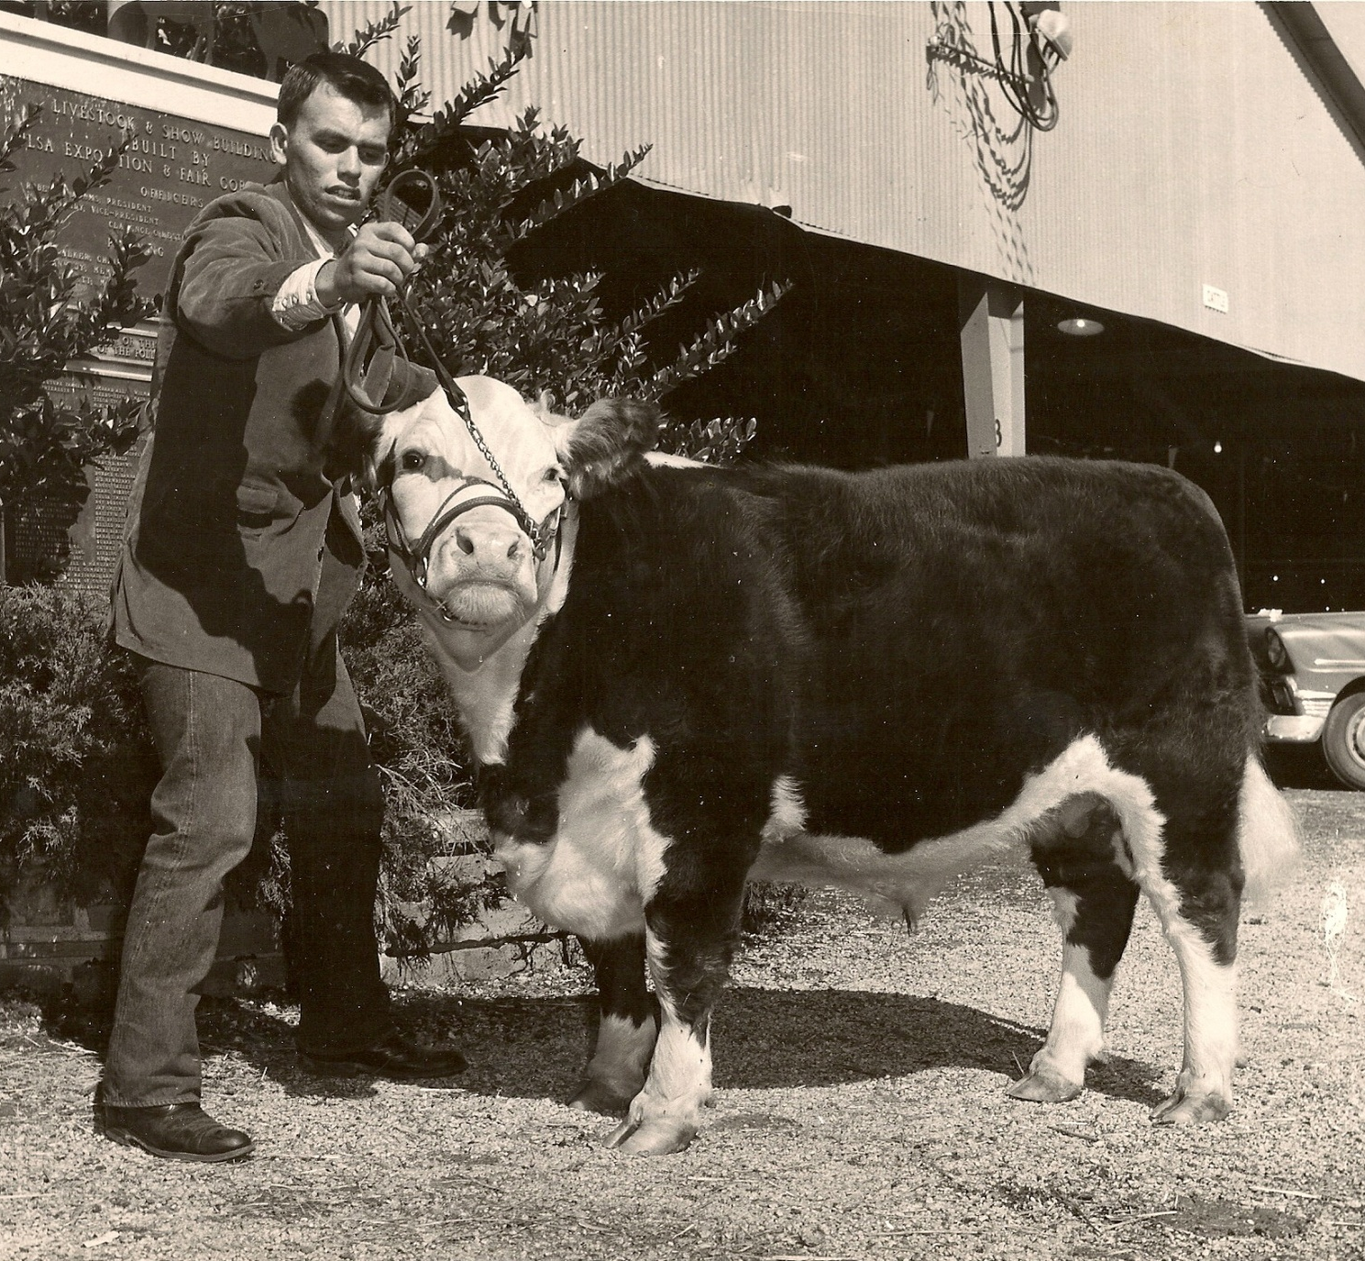
1959 Class Champion
Tulsa State Fair,
Photo courtesy J.G. Kirkpatrick DVM

Slide 11
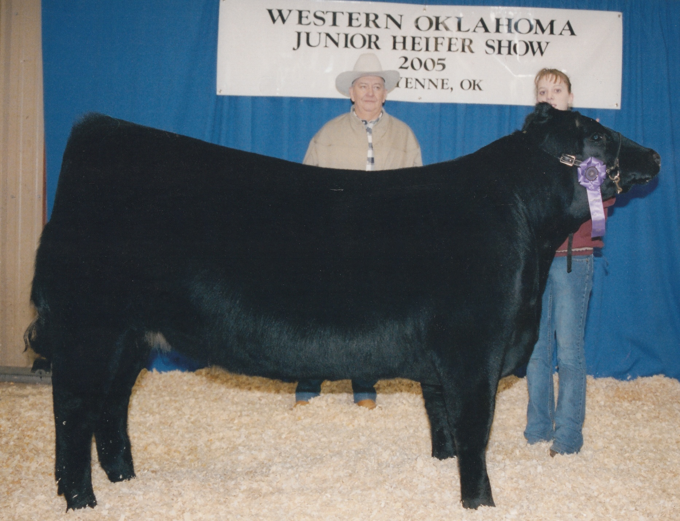
45 yrs, Productive Change?
Mean Slaughter Weight = 1,300 lb.
  200 lb heavier than 1980’s

Slide 12
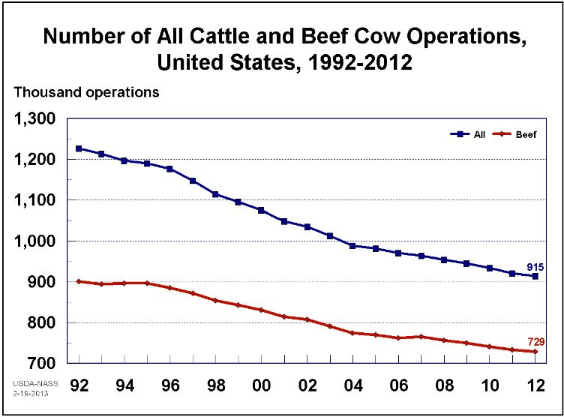

Slide 13
Environmental Impact
30 % less Animals
Beef Production in the United States:
20 % less feedstuffs
12 % less water
On only 67 % of the land
Journal of Animal Science, 2011, 89:4249-4261
J.L. Capper, Washington State Univ.

Slide 14
Major shift in way “Our” customers think…
in 1949, Americans spent 40%
of their income on food
the 2011 total spending for food was 15.3% of income
Bureau of Labor and Statistics

Slide 15
Hot Topics
  Antibiotics in food
  How we treat our animals
  Environmental issues

Slide 16
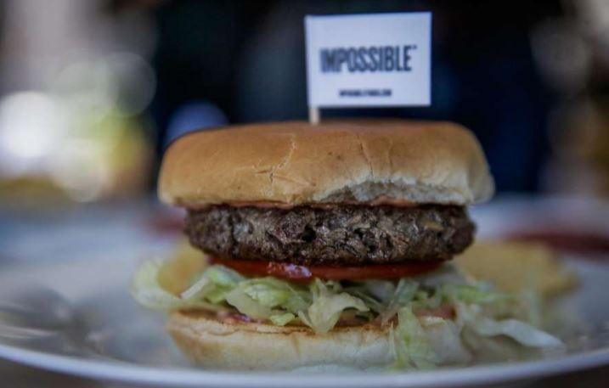
Patrick Brown, founder - California

Slide 17
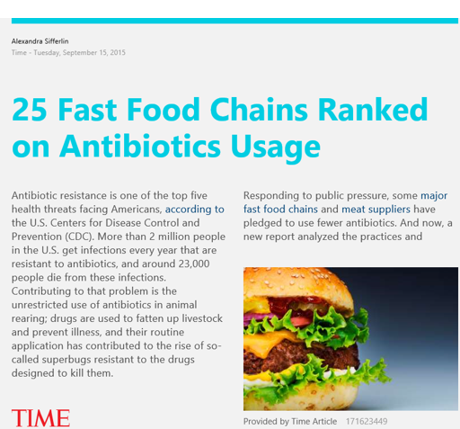

Slide 18
Reprinted from “HumaneWatch.org”
HSUS CEO Wayne Pacelle’s total compensation package $ 287,786
    up roughly 7 percent from the previous year.
HSUS spent $3.6 million on lobbying.
- Bottom Line -
HSUS’s “Kind News” magazine reached 644,000 kindergarten to 6th grade students.

Slide 19
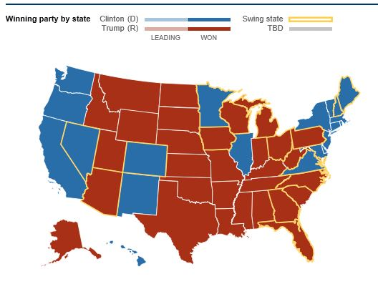
Politicians find sensitive issues that get them elected !
60 % of States < half popular vote
Market our product
Makes the rules

Slide 20
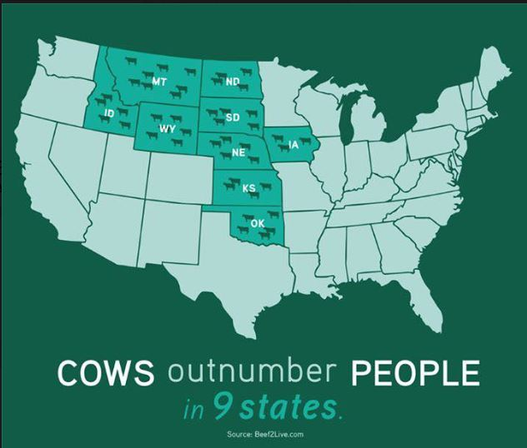

Slide 21
FDA
Guidance # 209 – Judicious use of antibiotics
Limit unnecessary use of medically important
  antibiotics in food animals
use only under veterinary supervision - VCPR

Slide 22
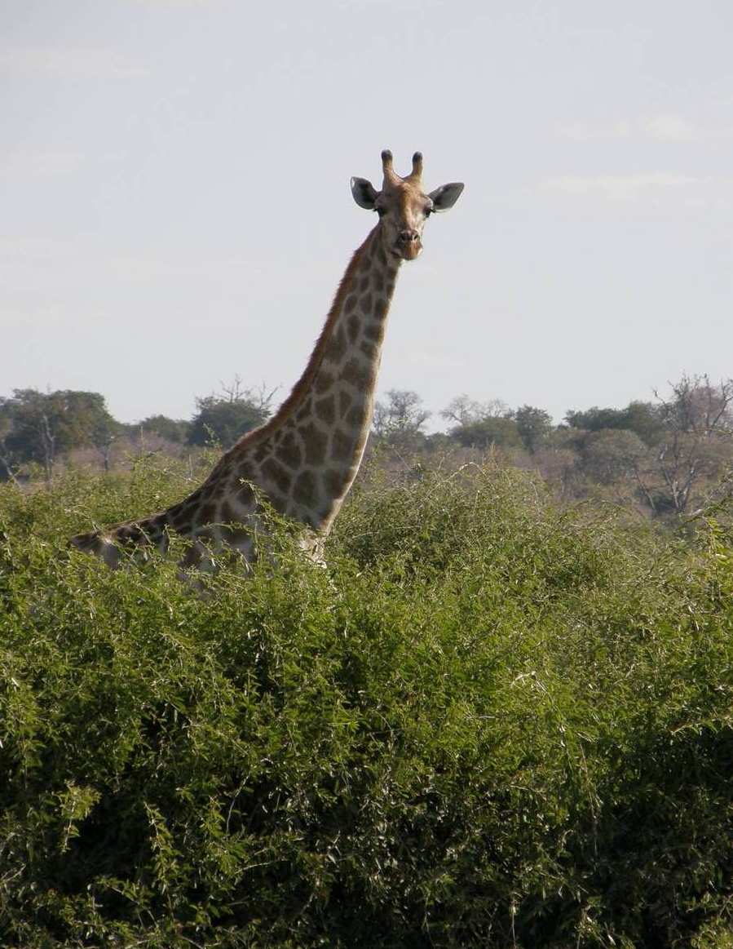
“If you change the way you look at things, the things you look at change”
Wayne Dyer

Slide 23
Demographers say it took until 1804 for the world to reach its first billion people,
and a century more until it hit 2 billion in 1927.
4 billion in 1974
5 billion in 1987
6 billion in 1998
7 billion in 2011
The U.N. estimates the world's population will reach 8 billion by 2025

Slide 24

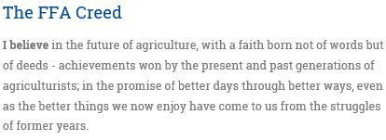
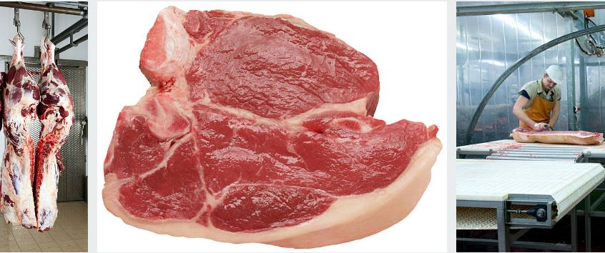
Why are we here?

Slide 25
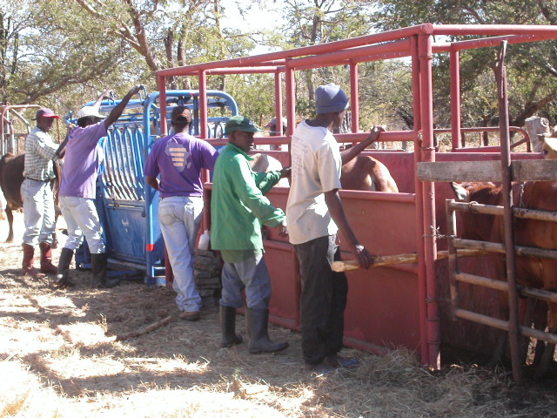
Tools for Efficiency and Sustainability

Slide 26
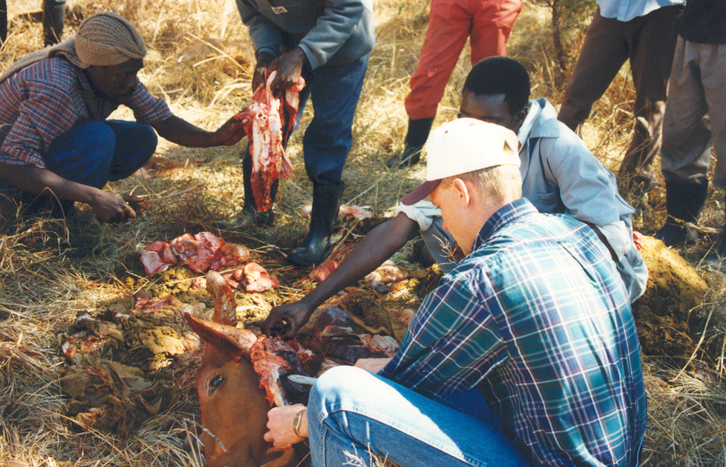
Food Safety !

Slide 27
Hot Topics
  Antibiotics in food
  How we treat our animals

Slide 28
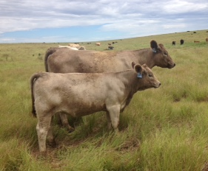
Don’t let what you can’t do
Keep you from doing what you can
Heifers: 21 days
Cows: 60 – 90 days

Slide 29
Multiple Studies – Harvested Lungs at Slaughter
  Gardener et.al.
      Untreated cattle = 37% with lesions
      Treated cattle = 48% with lesions
                J An. Sci. 77:3168-3175, 1999
  Wittum
      Untreated = 68%
                JAVMA 209:814-818,1996

Slide 30
Feedlot Fatal Disease Onset
Days On Feed
  M. haemolytica – 19 ( ˜13 – ˜20 %Booker 2015)
  P. Multocida – 24
  H. somni – 13
  Mycoplasma – 28
  BVD - (sum of all strains) range: 5 – 22
  BHV 1 – 2
  BRSV – 17
  Corona virus (BCV) – 11
Fulton , Confer , Panciera, Blood, et.al.
J Vet Diagn Invest 21: 464-477 2009)

Slide 31
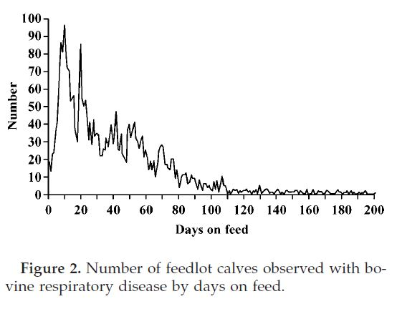
10 DOF
Bovine respiratory disease in feedlot cattle: Environmental, genetic & economic factors. G.D. Snowder, et.al. USDA MARC, Clay Center, NE --- J. Anim. Sci. 2006 84: 1999 - 2008

Slide 32
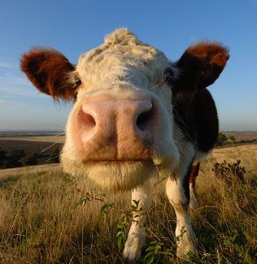
What’s happening
???

Slide 33
Failure of Passive Transfer
Calves that do not consume adequate colostrum
  Calves from heifers – almost 10 times as likely to get sick
  Calves from cows – over 3 times as likely to get sick
Calves that do not consume adequate colostrum
  Increased incidence of respiratory disease in feedyard
  Decreased average daily gain and higher close out cost

Slide 34
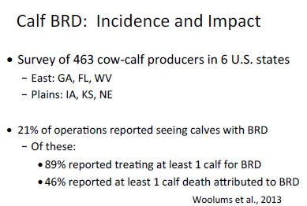

Slide 35
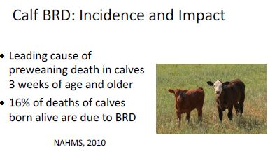
How do we use less Antibiotics?

Slide 36
NAHMS – National Animal Health Monitoring System
2007
49.8 % Sold calves immediately at weaning
60.6 % did not vaccinate beef calves for respiratory disease from birth to sale
68% of operations used an antibiotic to treat disease in any cattle or calves
https://www.aphis.usda.gov/aphis/ourfocus/animalhealth/monitoring-and-surveillance/nahms/nahms_beef_cowcalf_studies

Slide 37
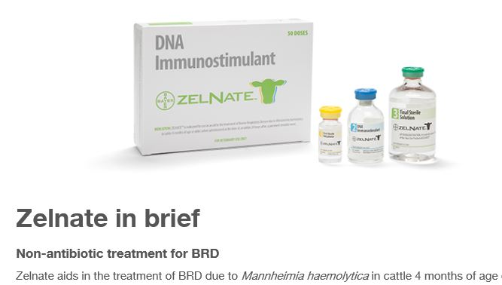
http://www.zelnate.com/zelnate-bovine-respiratory-disease/

Slide 38
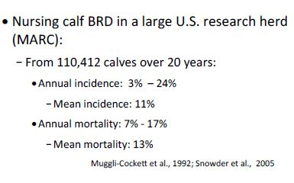

Slide 39
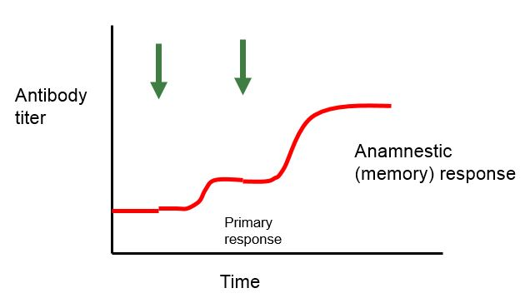
Vaccination ≠ Protection

Slide 40
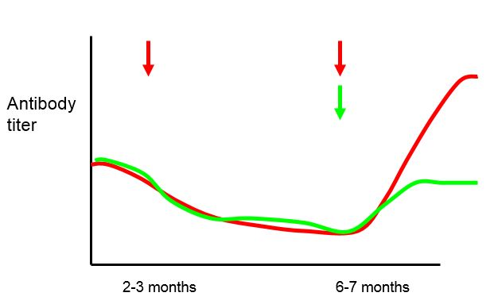
Vaccination Timing

Slide 41
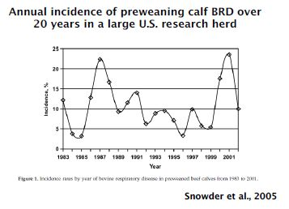
Utilizing Vaccination
Stabilize volatility
MARC -- Clay Center, NE

Slide 42
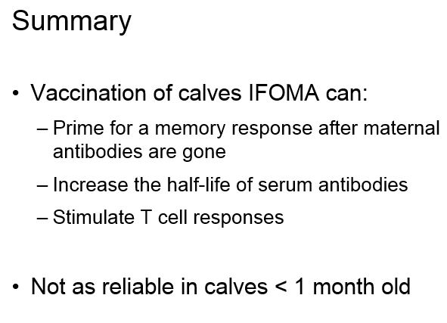

Slide 43
Effect of Calf Age – Antibody titers
& Feedlot Performance
3 Study groups
  Branding and weaning (MLV)
  Weaning and post weaning (MLV)
  Control
Significant outcomes
  vaccinates had higher titers than controls
  vaccinates lower treatment costs
  vaccinates lower mortality
Kirkpatrick, Step et.al. JAVMA 2008; July 1, 136-42

Slide 44
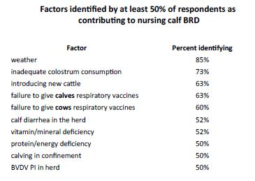

Slide 45
Production Goals for Beef Cow/Calf Producers
Birth to Weaning rates
  Cows – > 95 %
  Heifers – > 95 %
  Weaning morbidity < 10 %
  Weaning mortality < 0.5%
Weaning Weight
  2.5 lb /day
  50 % of Dam’s weight
“If you can’t measure,
you can’t manage”

Slide 46
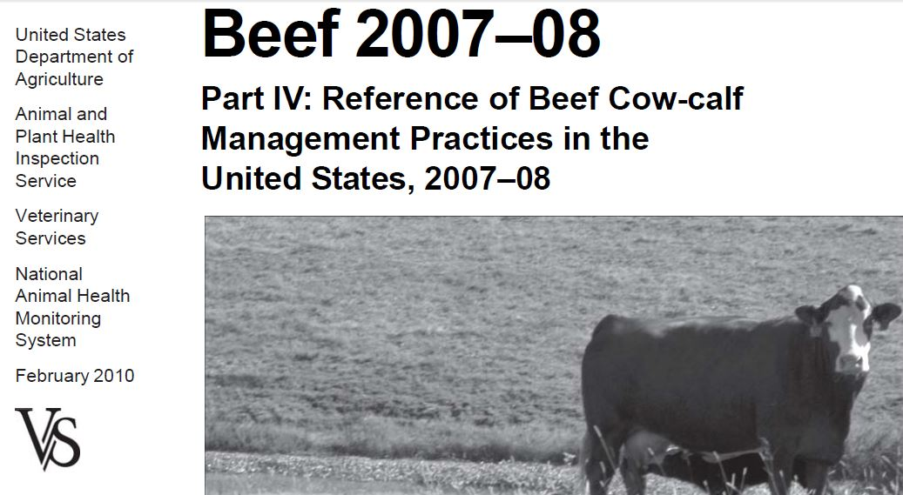
NAHMS – National Animal Health Monitoring System
https://www.aphis.usda.gov/aphis/ourfocus/animalhealth/monitoring-and-surveillance/nahms/nahms_beef_cowcalf_studies

Slide 47
