Slide 1
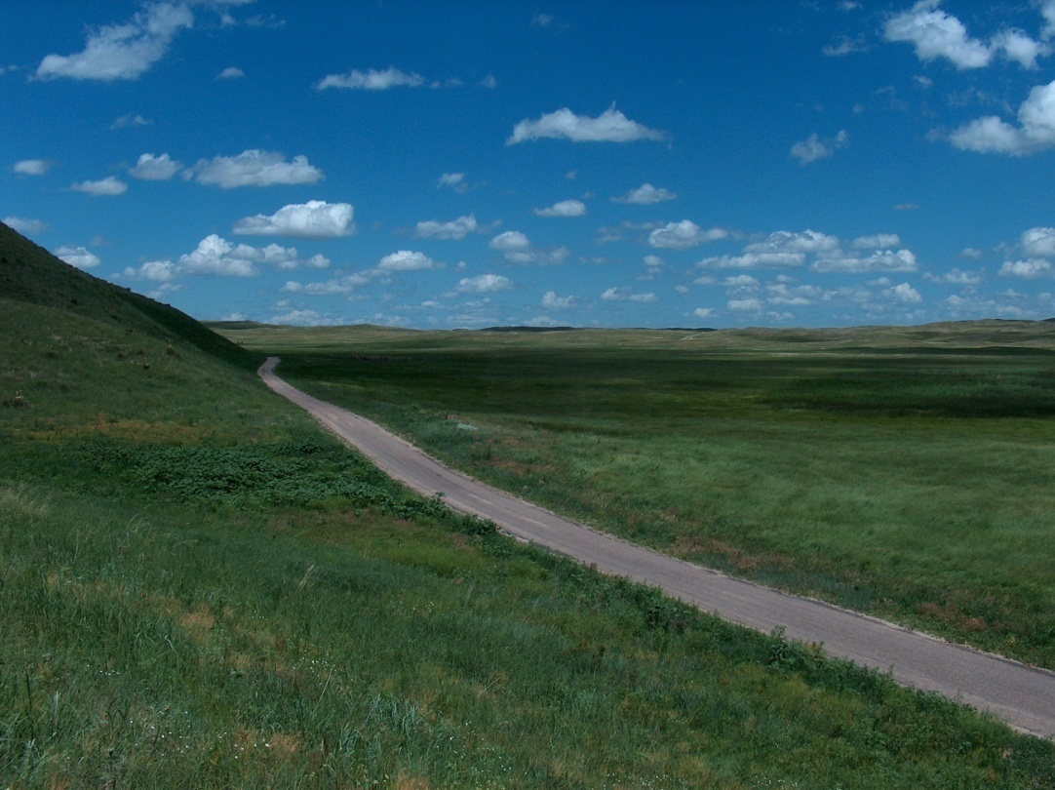
Five Essentials for Successful
Ranch Management
Burke Teichert
Speaker
Consultant
Contract Manager

Slide 2
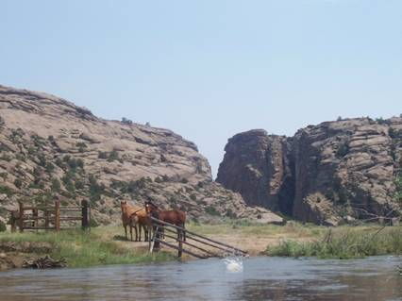
Four Areas to Manage
Production
Economics/Finance
Marketing
People

Slide 3
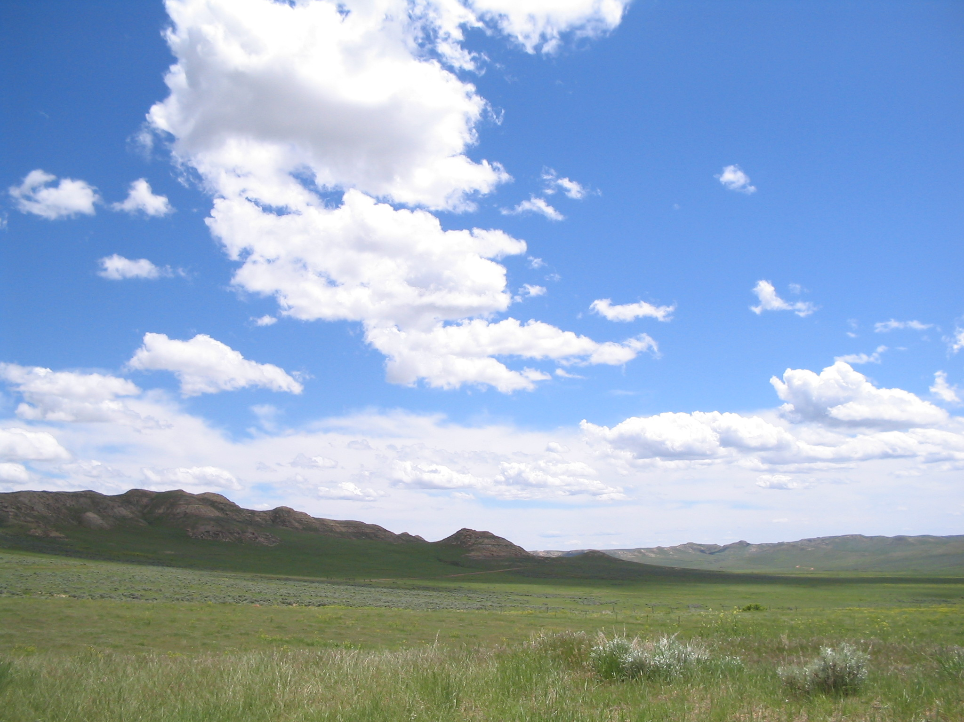
Three Ways to Improve Profit
Increase turnover
Decrease overheads
Improve gross margin
  Total returns – Direct costs

Slide 4
Whole Ranch Profit
It’s Profit per Acre
or Whole Ranch Profit
that you strive to improve—
not Production or even
Profit per Cow.

Slide 5
Major Determinants of Profits
Overheads (Including People)
Stocking Rate
  Cow Size and Milk Production
  Grazing & Pasture Management
Calving Season
Fed Feed vs. Grazed Feed
Realized Herd Fertility
Heifer Development or Rep. Cow Cost
Wise Input Use and Ranch Production
Marketing

Slide 6
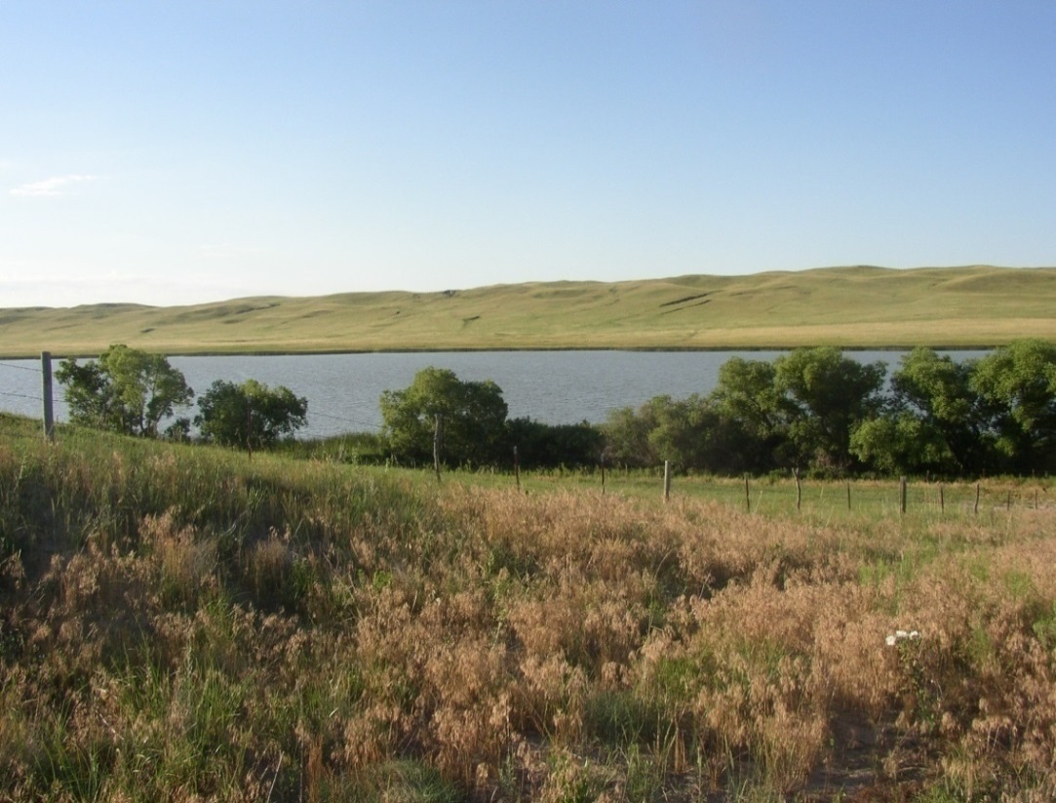
Reduce Overheads
Market Well
Improve Three Key Ratios
Acres per Cow
Cows per Man
Fed Feed vs Grazed Feed

Slide 7
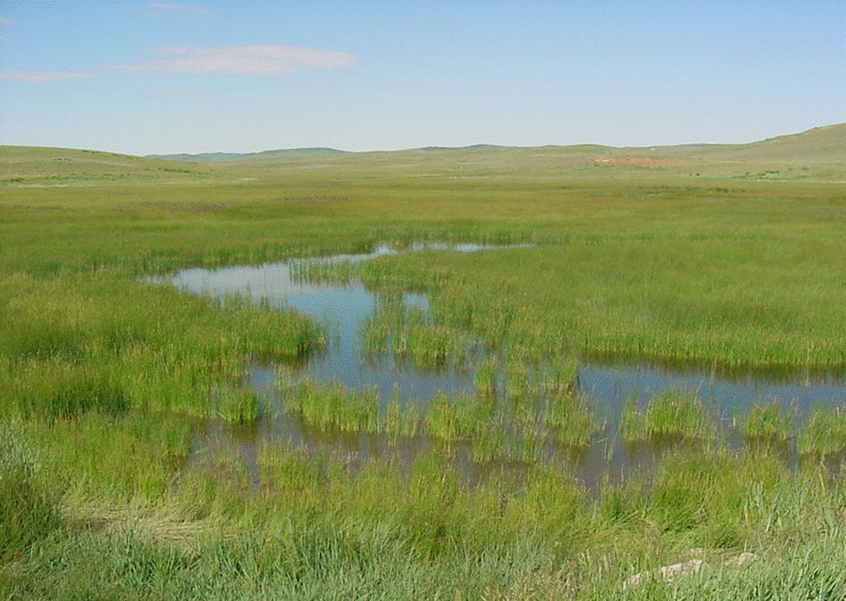
Five Essentials for
Successful Ranch Management

Slide 8
Five Essentials for
Successful Ranch Management
1. The approach must be both integrative and holistic

Slide 9

Systems Approach
Holistic Approach
Enabled by integration

Slide 10
Illustrations of systems thinking

Slide 11
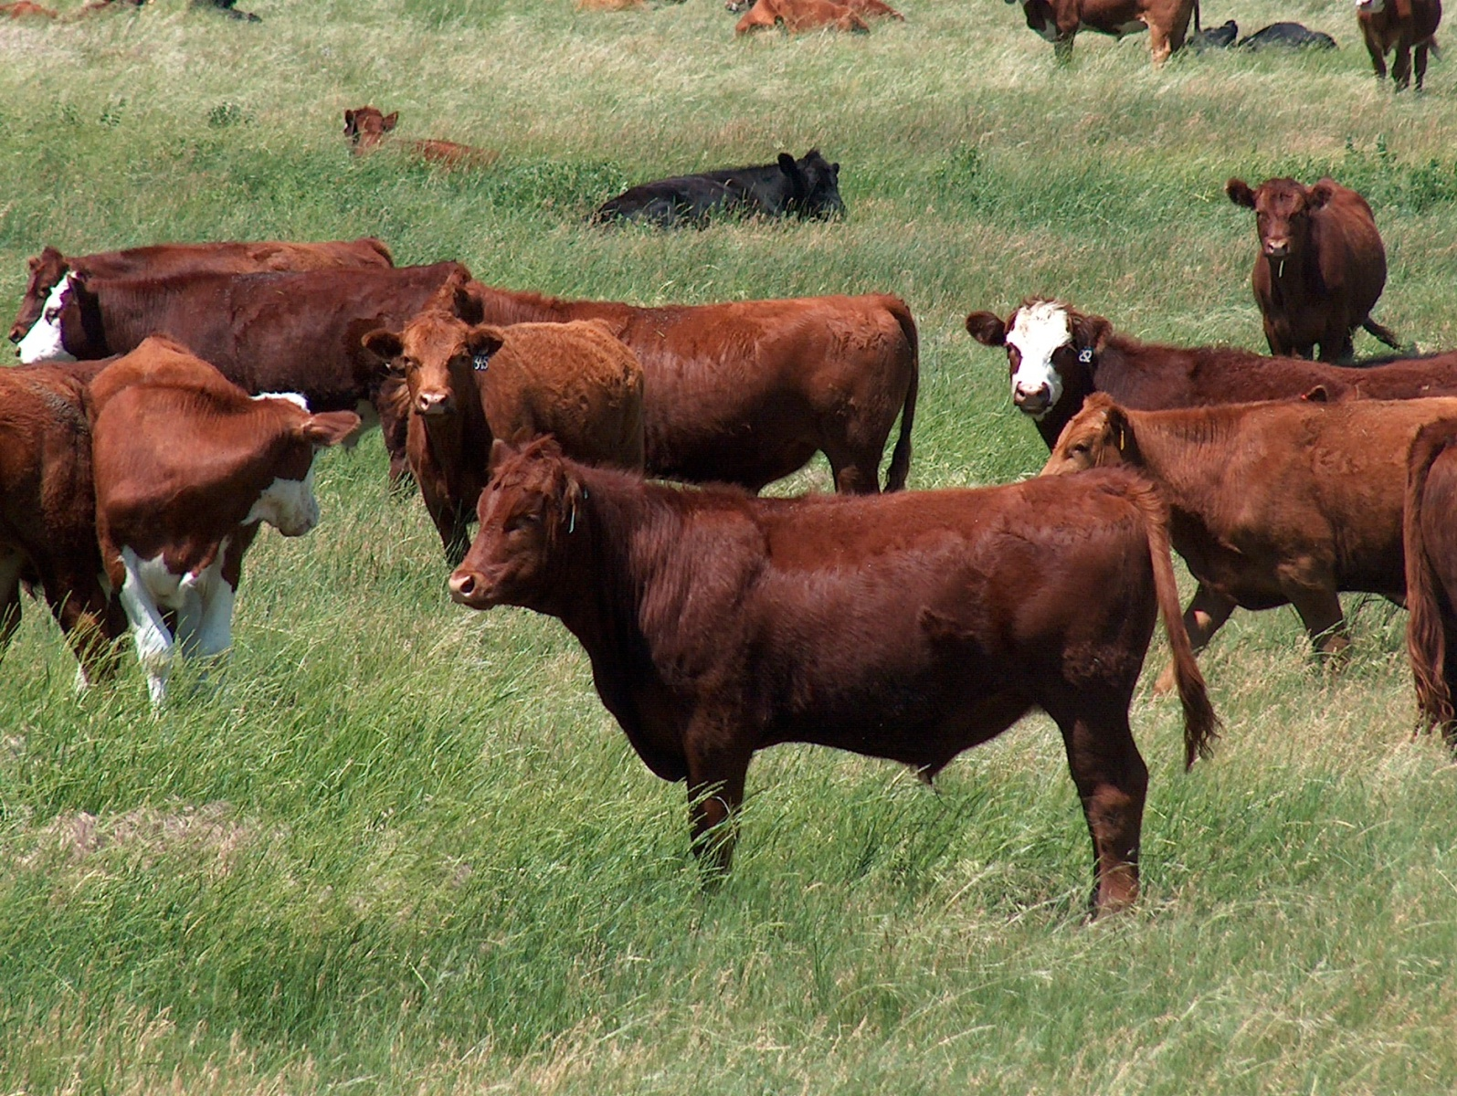
High growth rate bulls

Slide 12
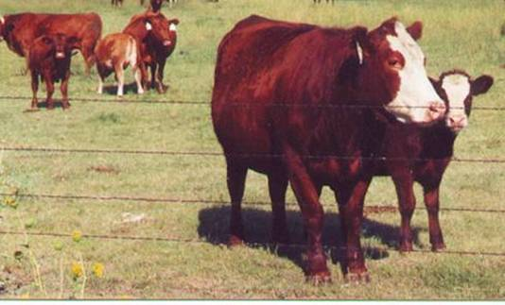
High Milking Ability

Slide 13
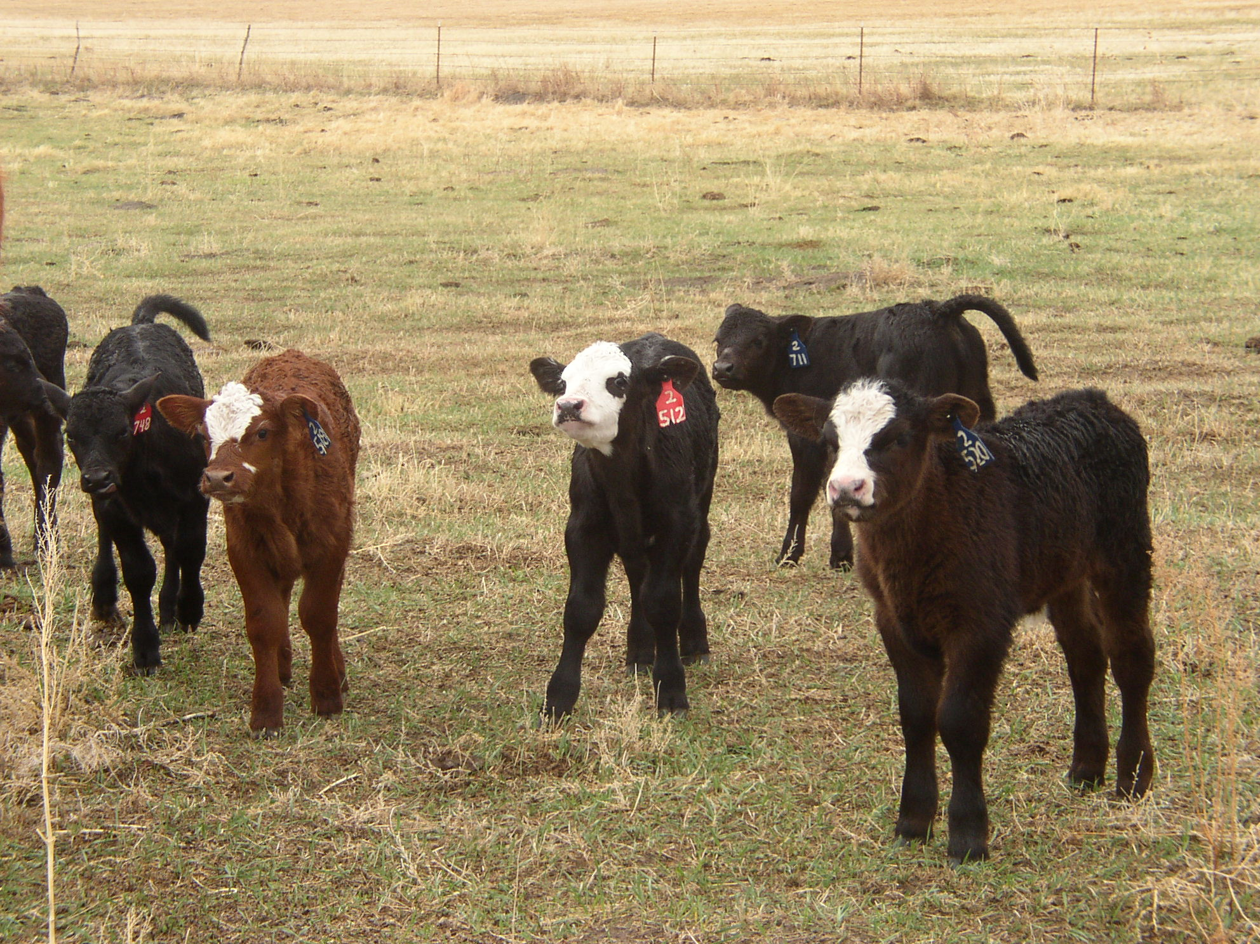
Sophisticated Cross-breeding

Slide 14
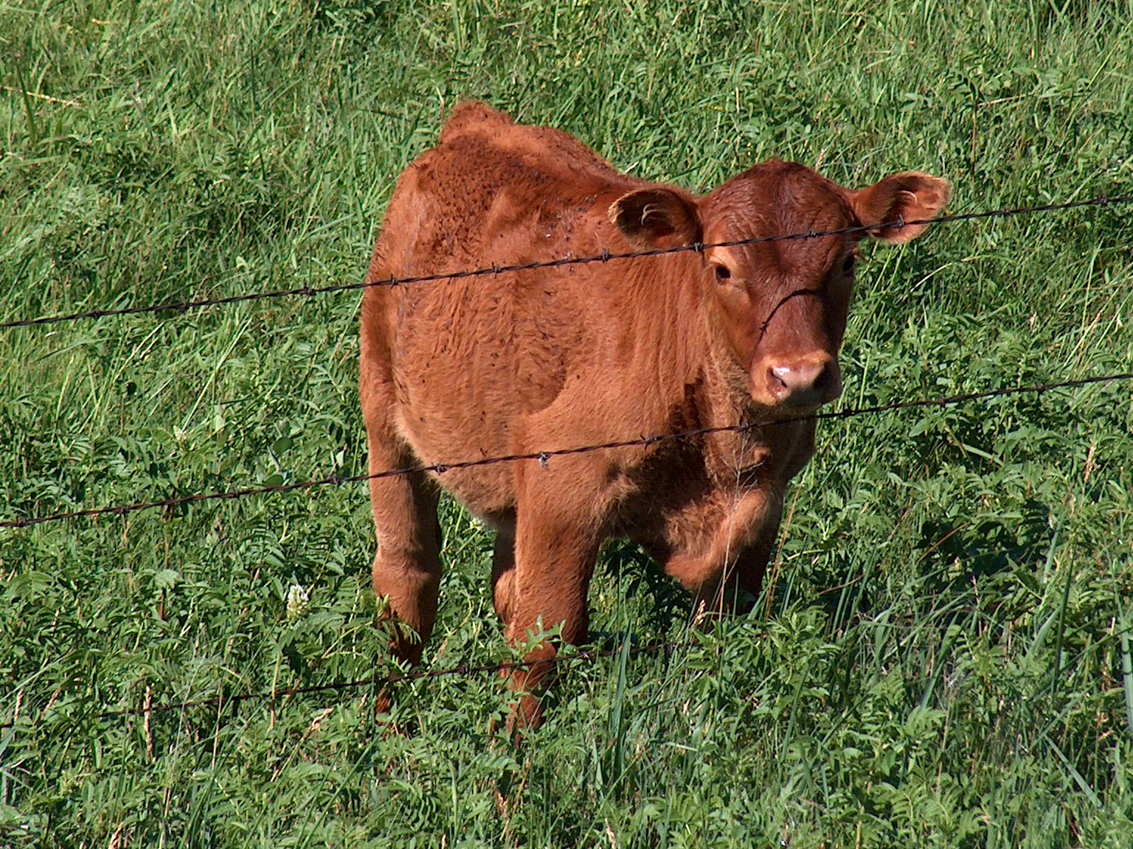
Early Calving

Slide 15
Wormers and Insecticides

Slide 16
Five Essentials for
Successful Ranch Management
2. Continuous improvement of the key resources – Land, Livestock, People

Slide 17
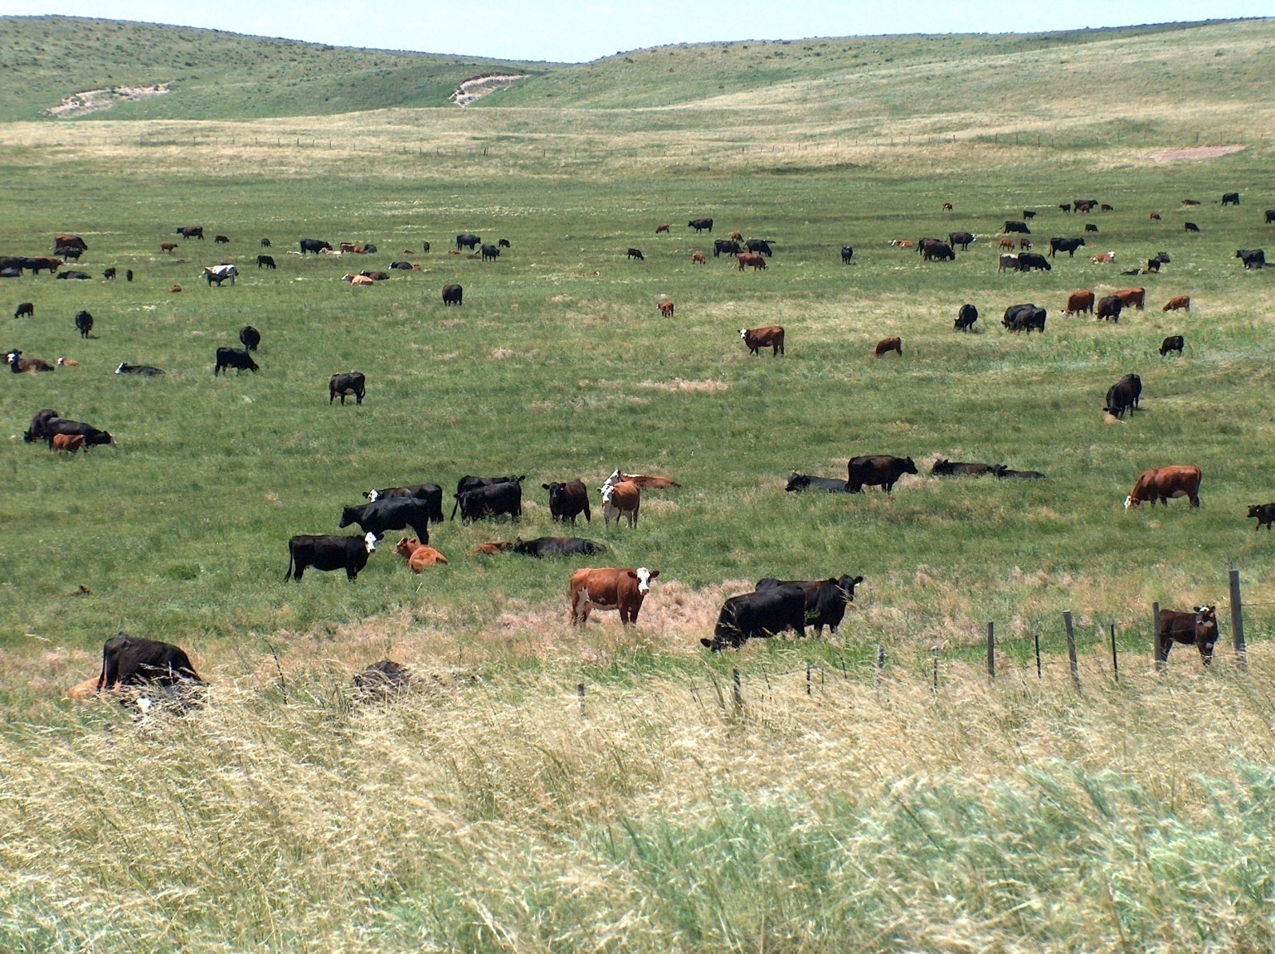
For improvement of land—
Planned, Time Controlled Grazing

Slide 18
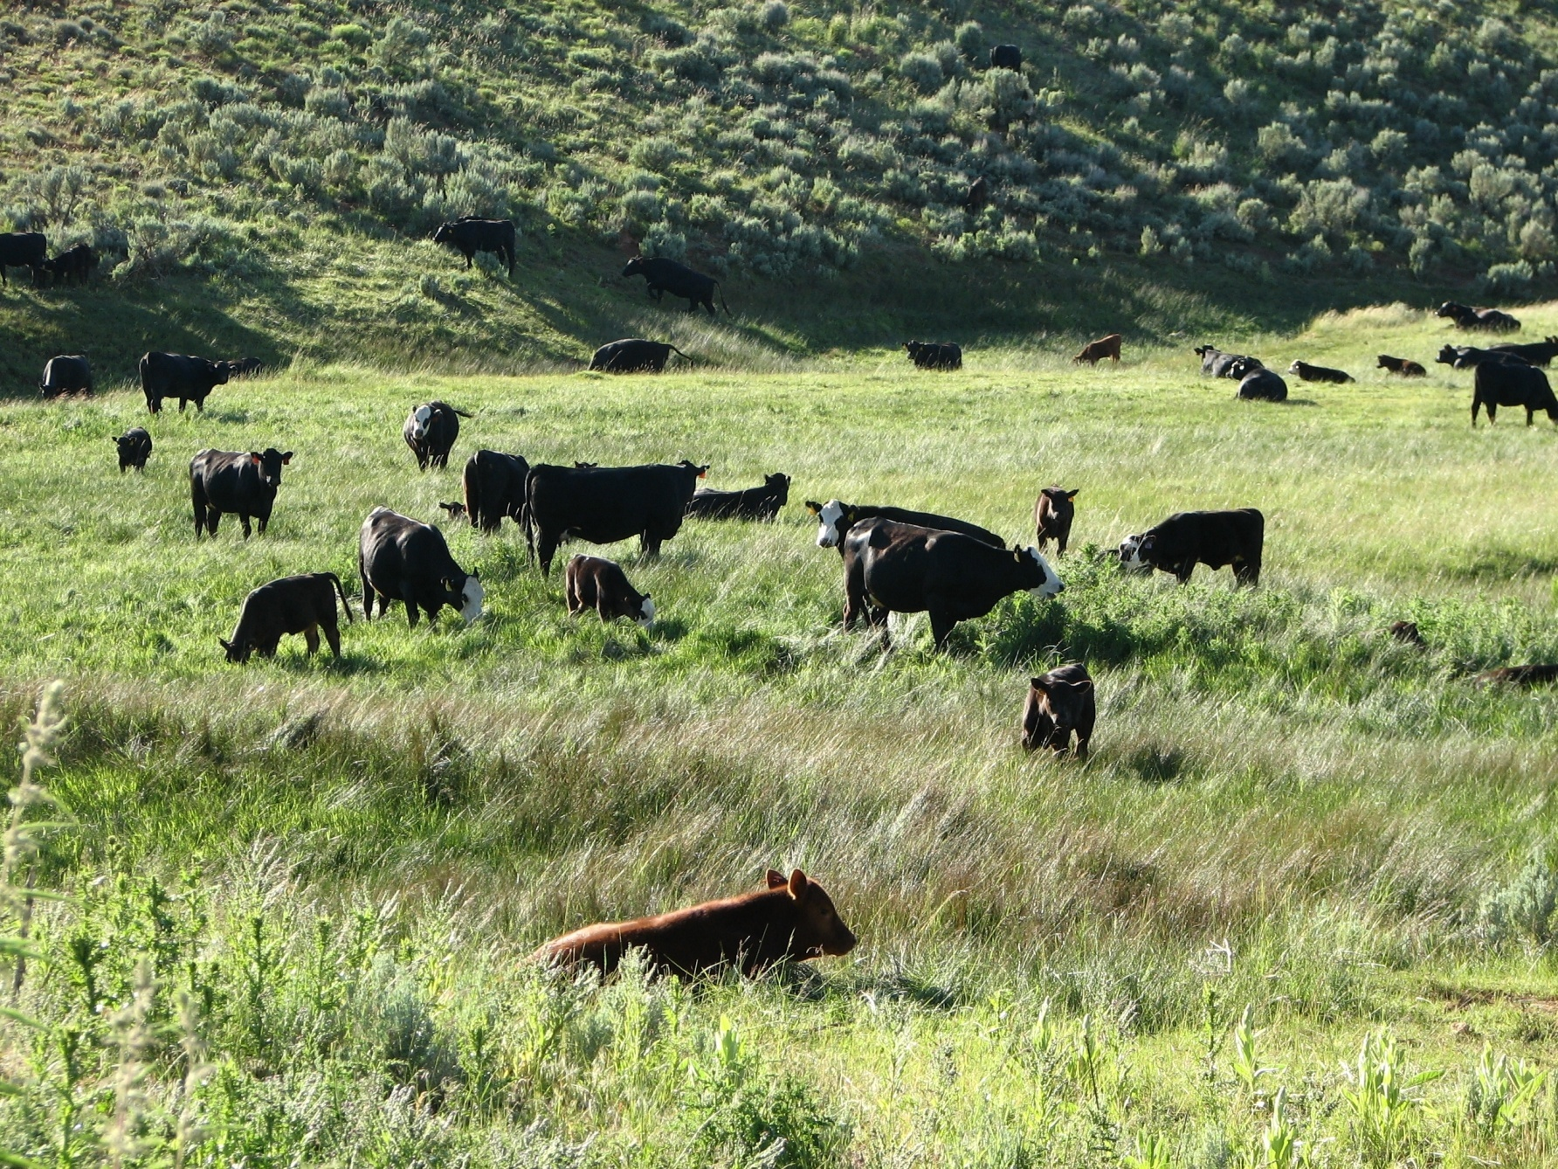
One year plus since last graze

Slide 19
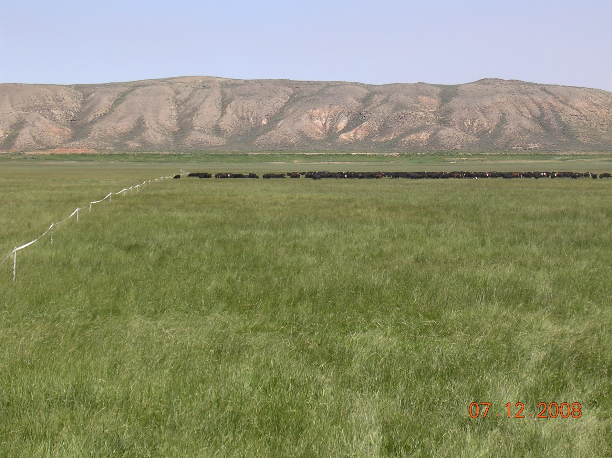
21- 30 days since last graze

Slide 20
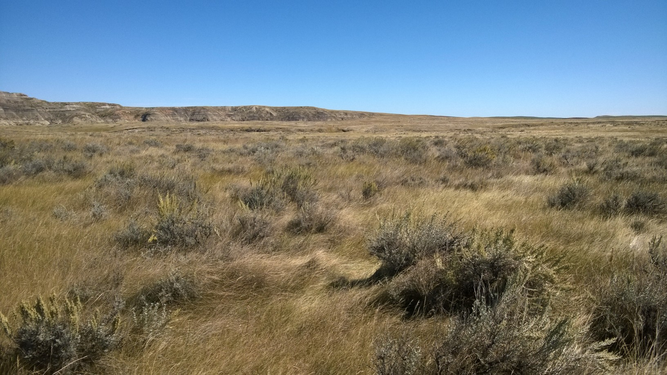
Haydens’—Baker, Montana

Slide 21
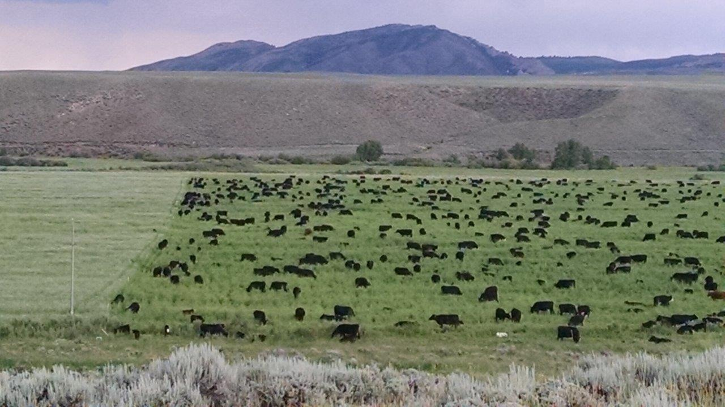
TA Ranch—Saratoga, WY
1230 pairs 7-1-15

Slide 22
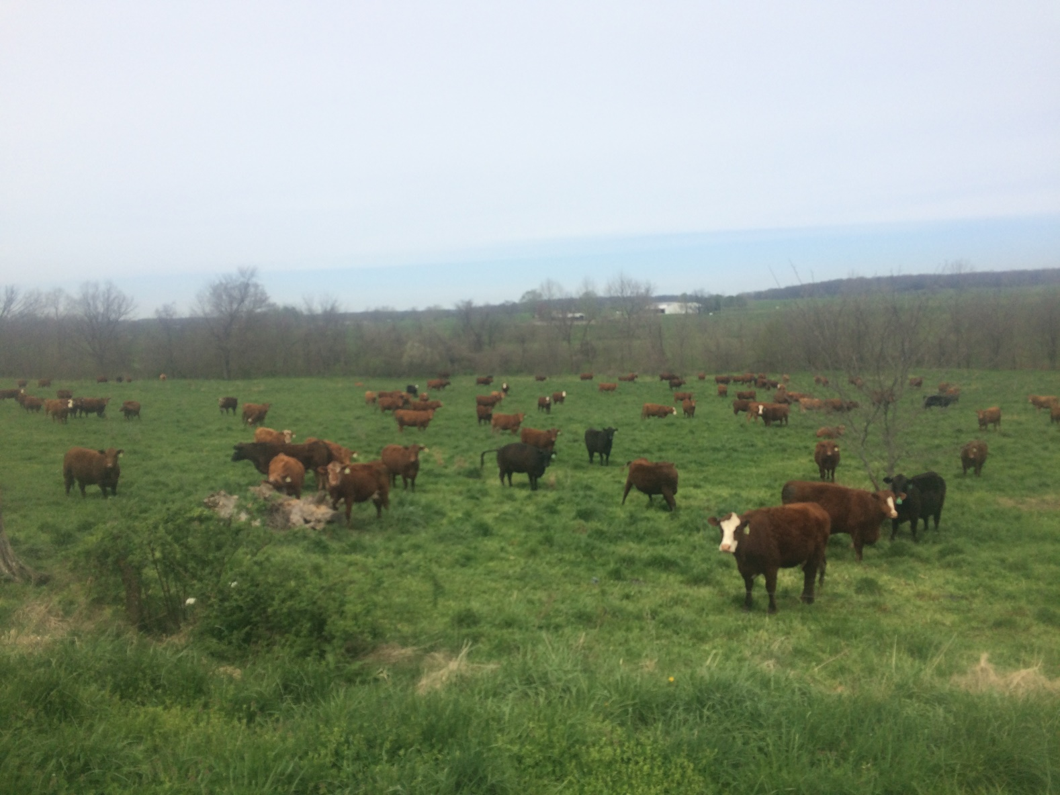
Steve and Judy Freemans’
Hartville, MO 4-17

Slide 23
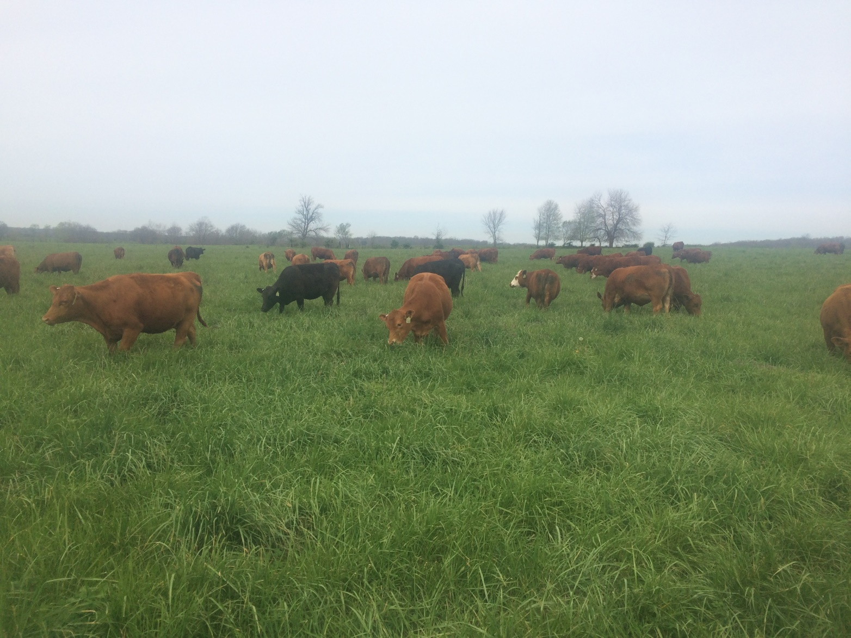
Steve and Judy Freemans’
Hartville, MO 4-17

Slide 24
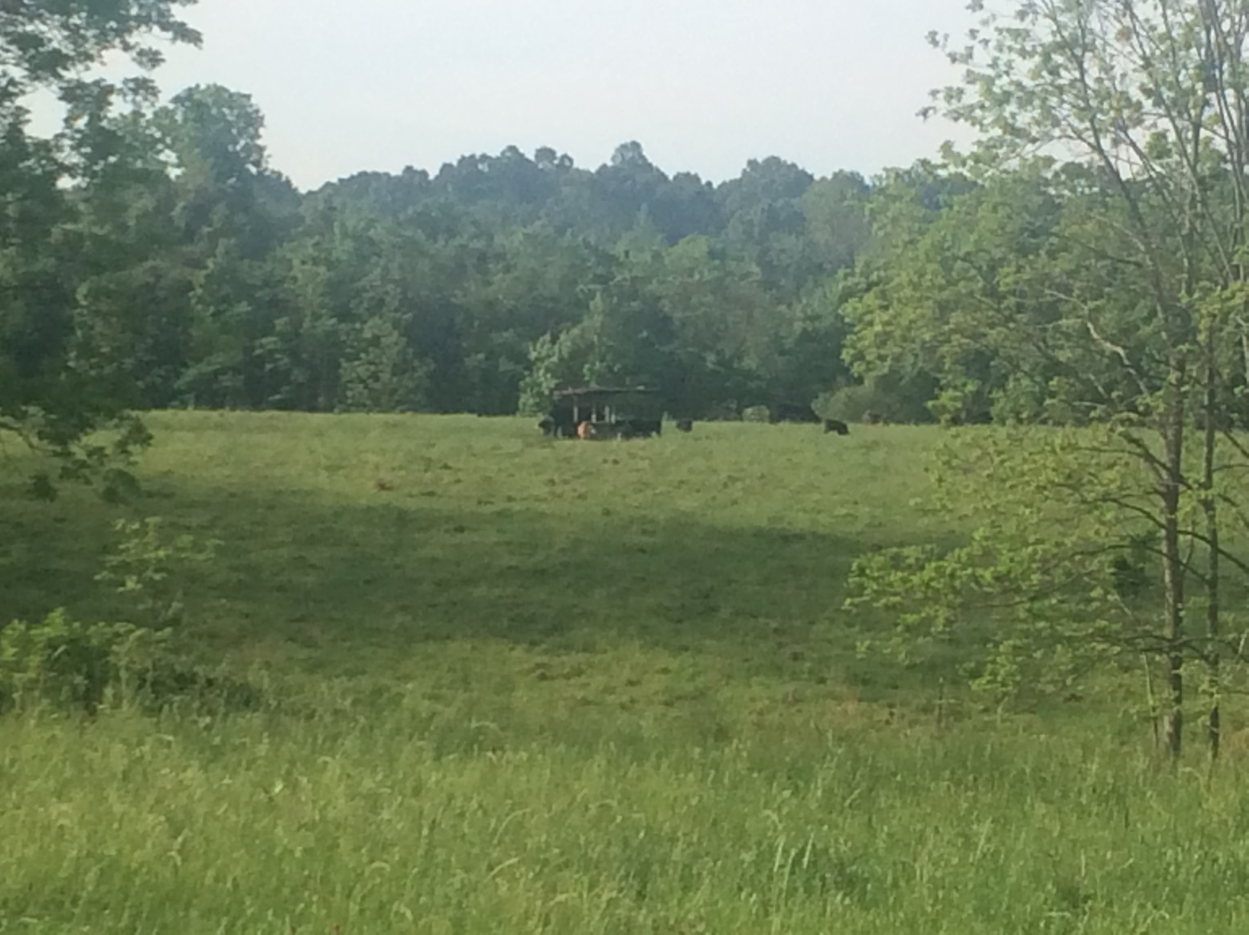
Cooper and Katie Hursts’
Woodville, MS 4-17

Slide 25

Cooper and Katie Hursts’
Woodville, MS 4-17

Slide 26
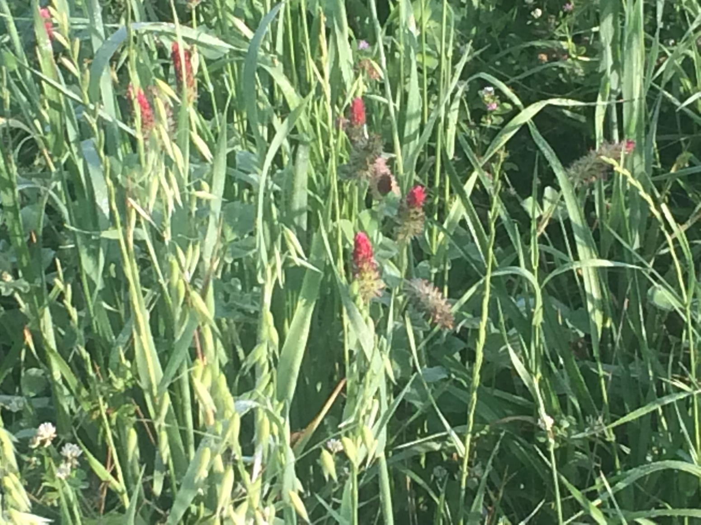
Cooper and Katie Hursts’
Woodville, MS 4-17

Slide 27
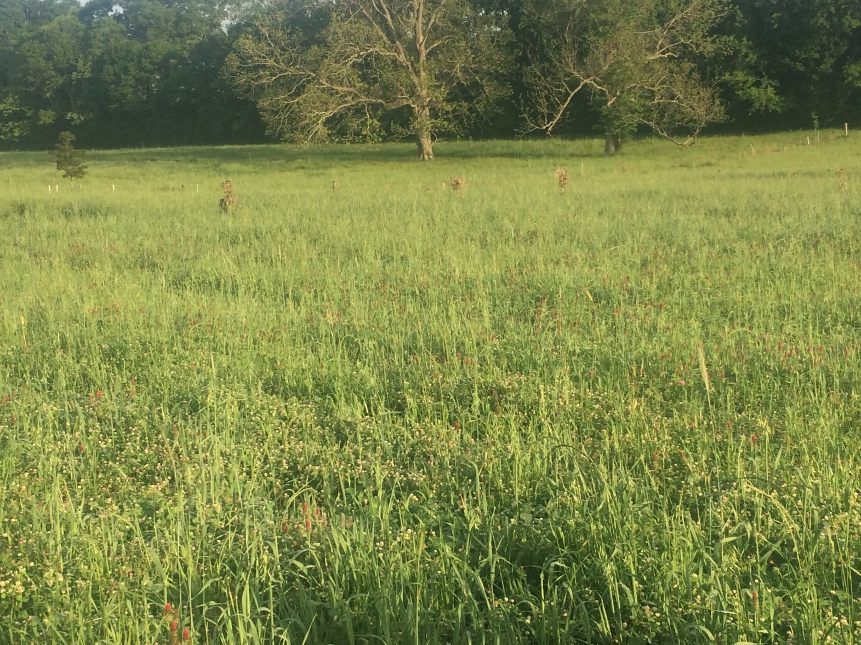
Cooper and Katie Hursts’
Woodville, MS 4-17

Slide 28
What are the economic effects of good grazing?

Slide 29
Planned, Time Controlled Grazing
Will improve the land
The results will be--

Slide 30
Improvements in
Carrying Capacity and
Stocking Rate.
Which
Reduces acres per cow
Increases turnover.

Slide 31
Good Grazing can and usually will produce:
Better animal performance
Fertility
Growth Rates
Health

Slide 32
Better Performance will improve Gross Margin.
Remember, this is not foolproof.
Initial Biological Performance Dip.
Pushing stocking rate too hard.
Learning curve for graziers and livestock.

Slide 33
Continuous Improvement of
Livestock
Begins with

Slide 34
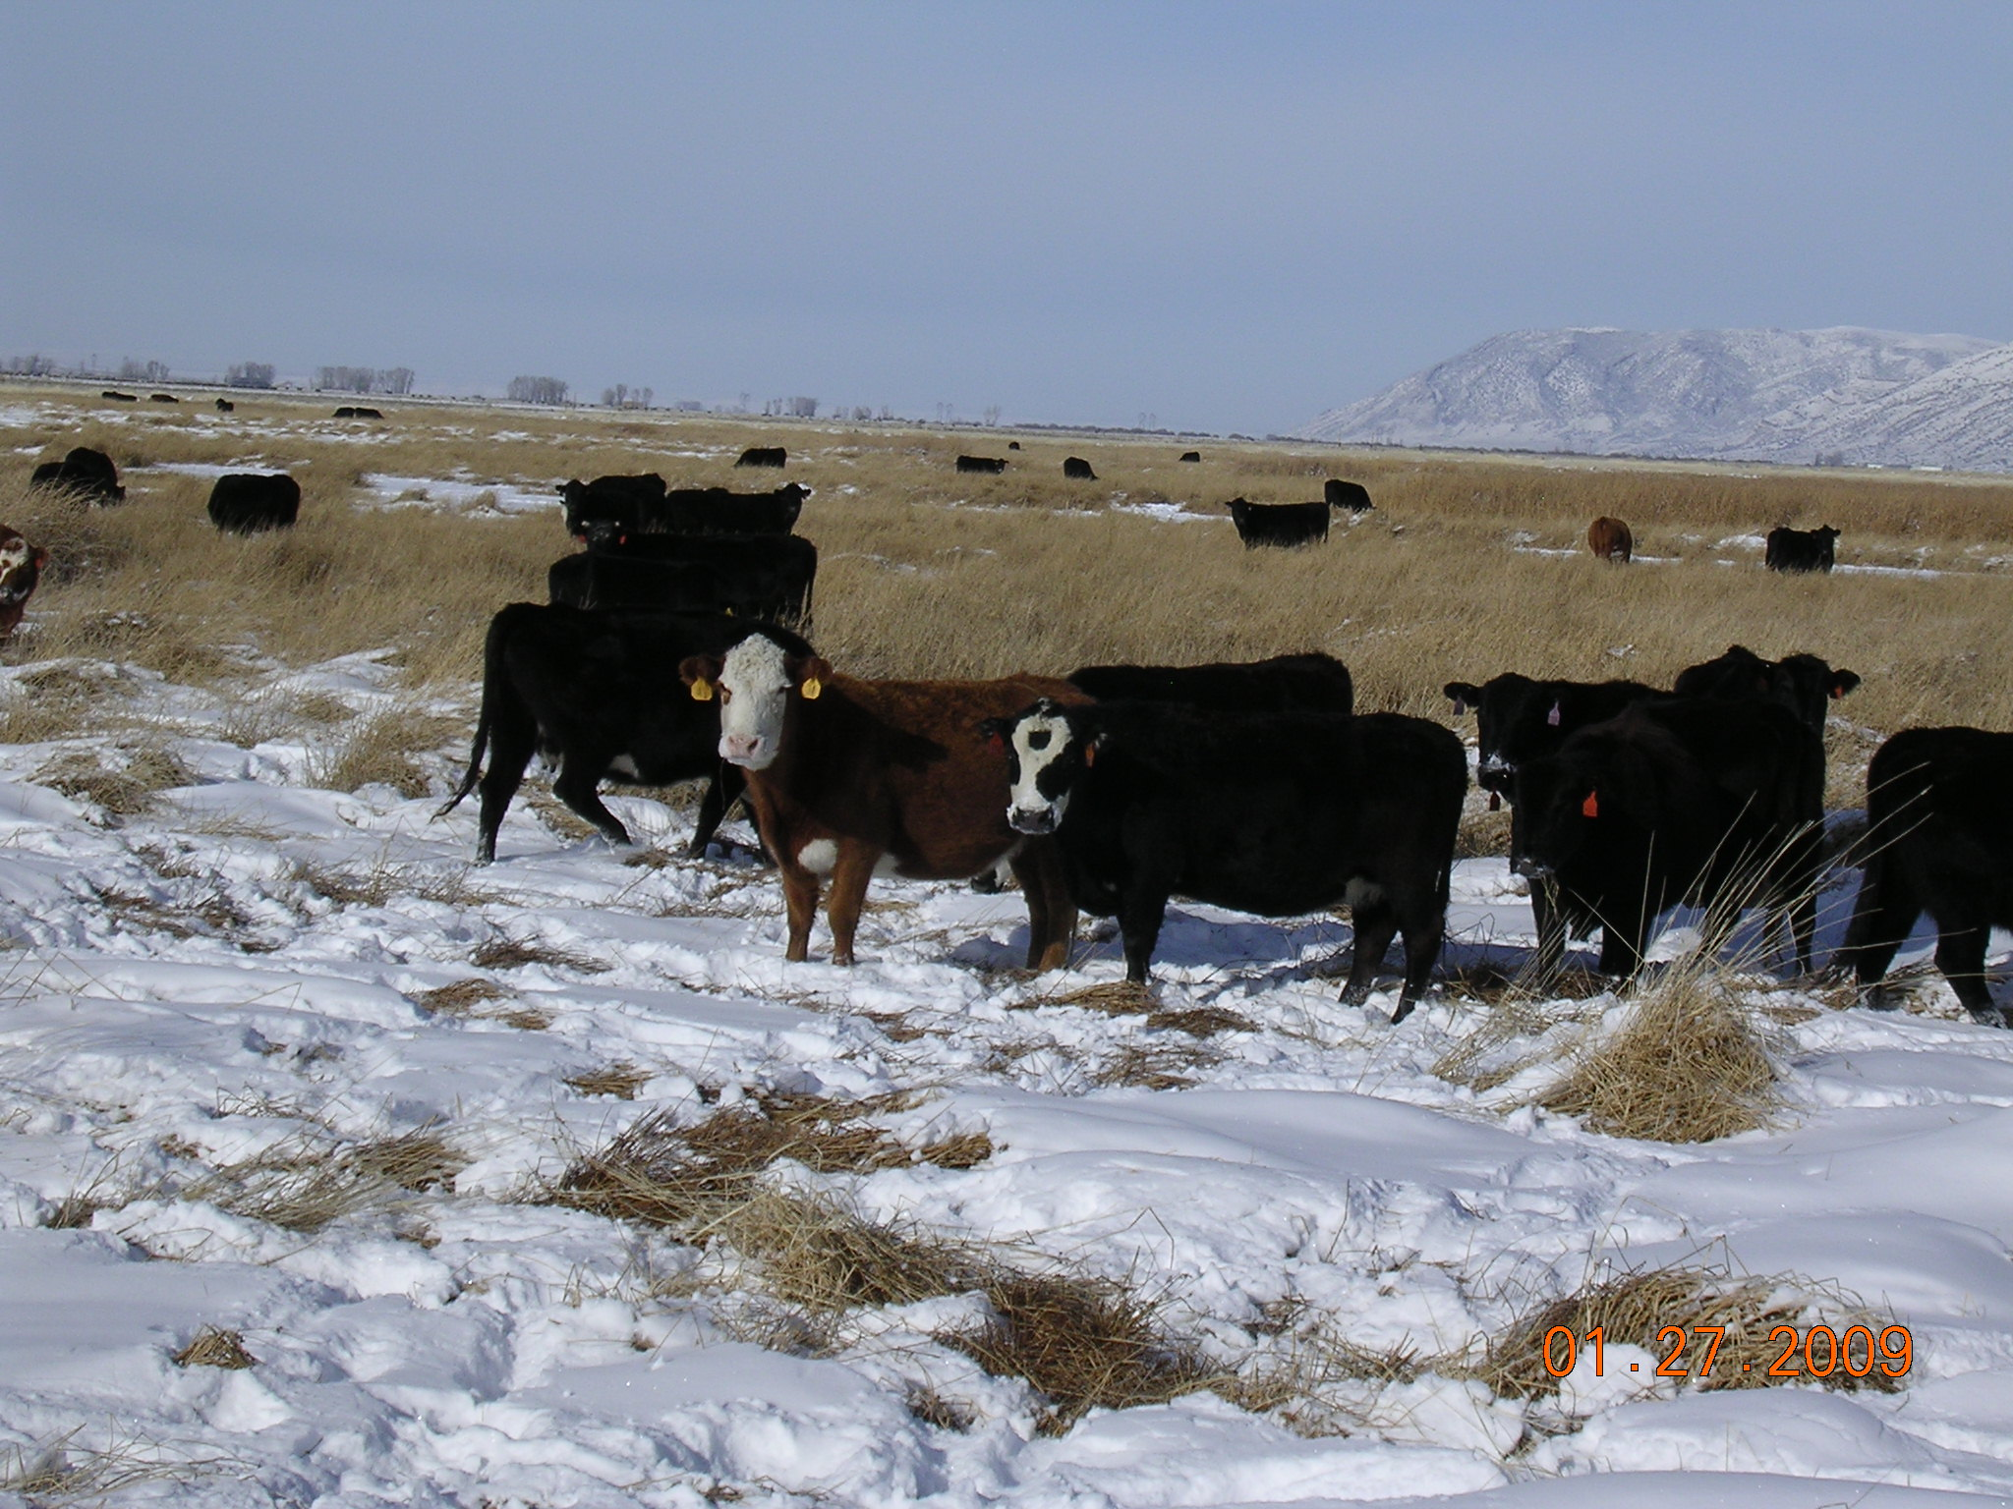
Cows selected for this!

Slide 35
Select the Right Bull
Mature Size—”Moderate” or Small
Milk—Most people have and want too much
Care Requirement—Do you have to feed them to keep them in condition? If so, do you want their heifer calves?

Slide 36
Cull the Right Cow
Open
Dry
Requires individual attention or help
Wild
Poor calf
Ugly (your definition)

Slide 37
Continuous Improvement of
People
Begins with understanding the
Manager’s Job

Slide 38
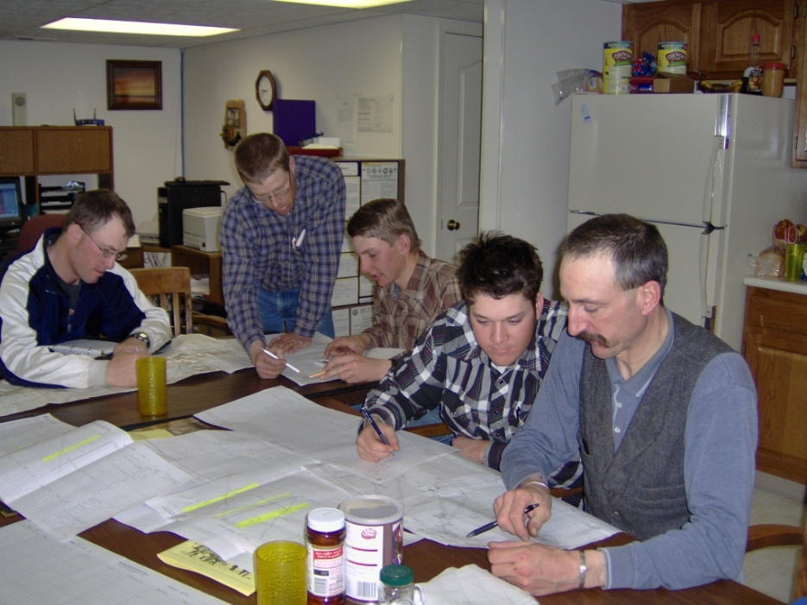
Manager’s Job – to create an environment in which people want to excel and then provide the tools, training and freedom to do it.

Slide 39
Empowerment
Can I empower anyone? No!
Then what can I do?
  I can encourage.
  I can facilitate.
  I can reward
But, empowerment is a personal thing. One must want to and work at becoming empowered.

Slide 40
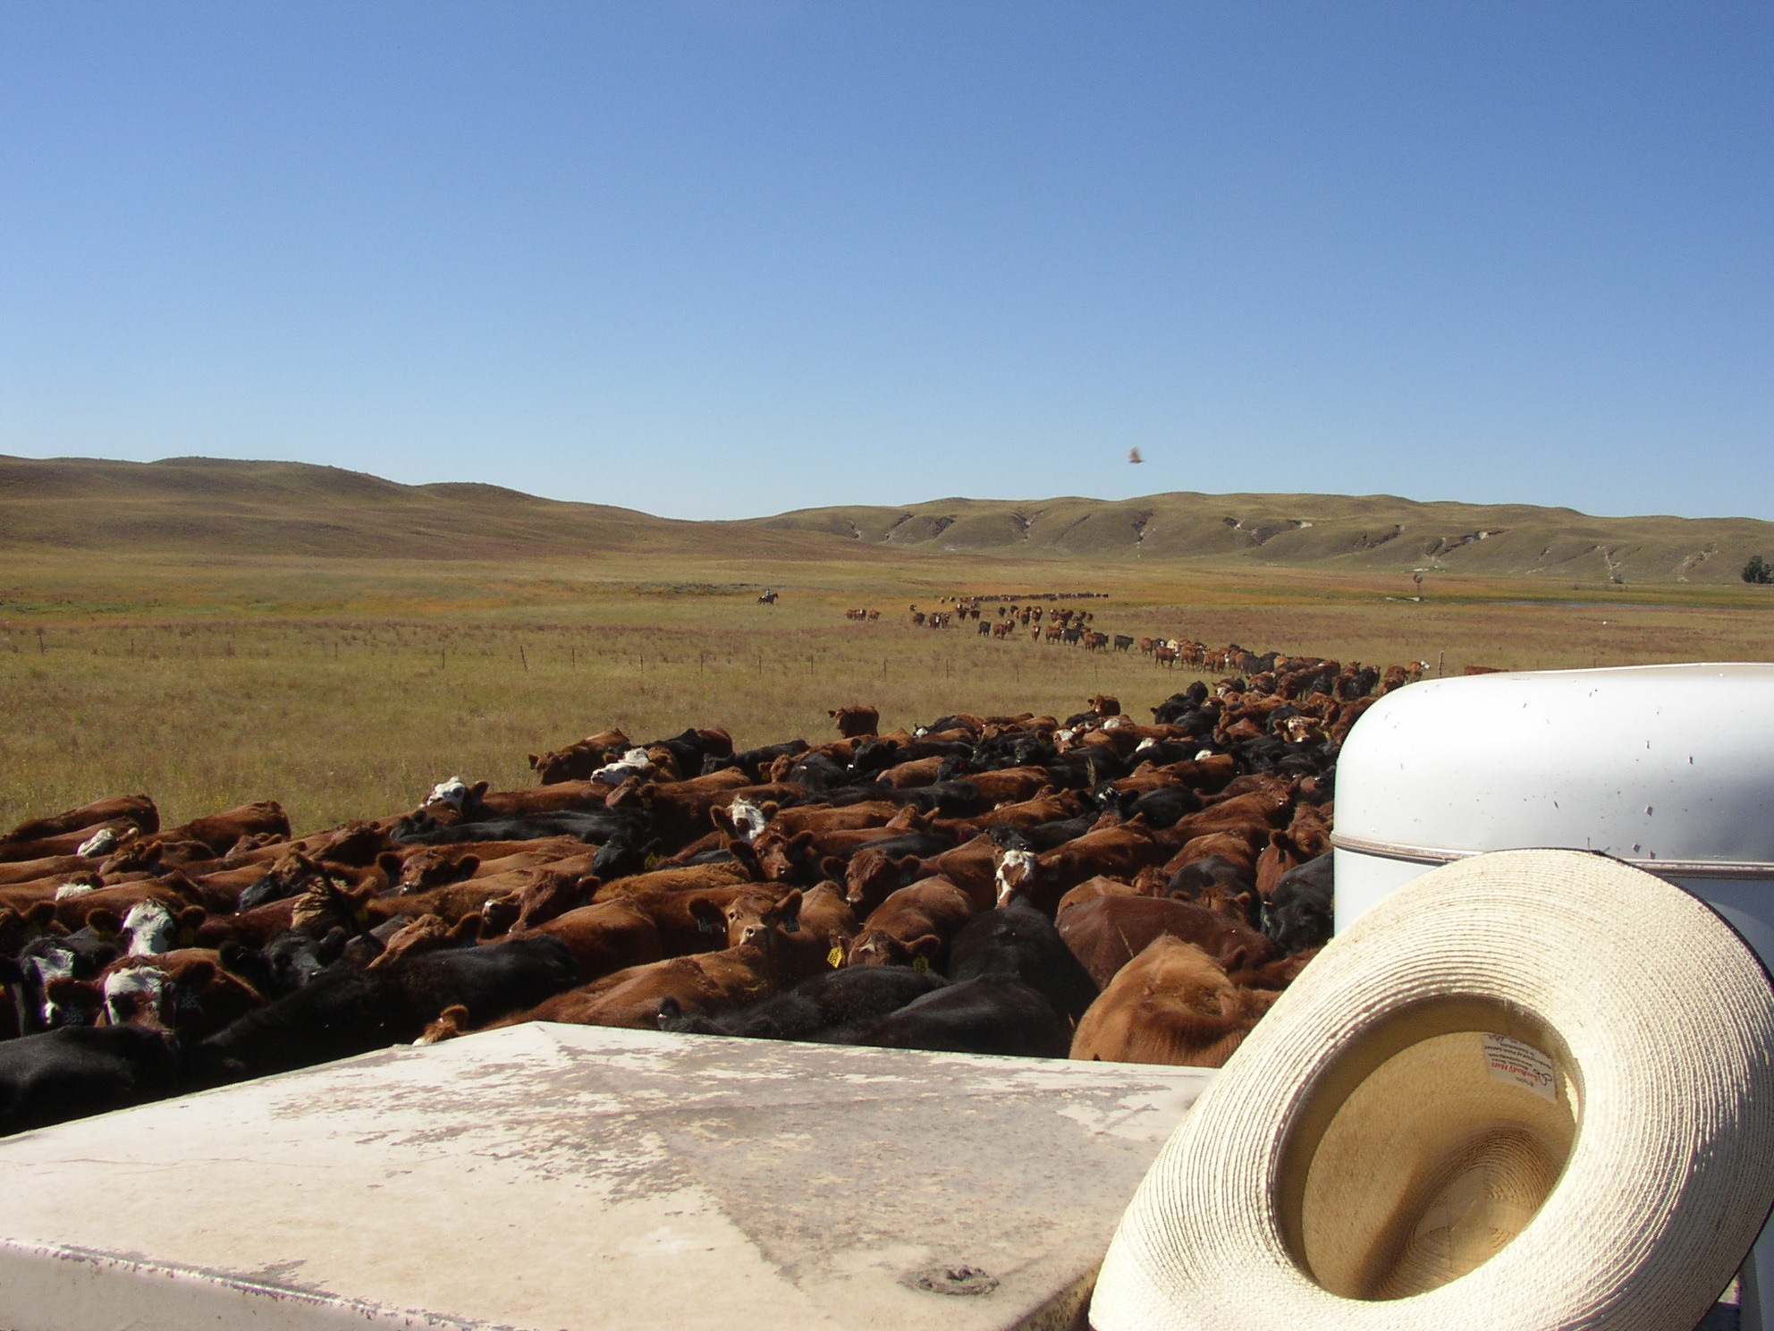
Leadership is best gauged by the response of those being led.
VOLUNTARY

Slide 41
Five Essentials for Successful Ranch Management
3. Use of good Planning and Decision Making tools

Slide 42
Must Have
Good financial records.
  Enterprise accounting by cost category.
  A good separation of Direct and Overhead costs.
  A good record of all sales listed separately
Good production records.
  Weaned calf crop percentage
  Pregnancy rates
  Weaning weights and yearling gain
  Death loss

Slide 43
Computers, Tablets, Smart Phones facilitate:
Data collection, storage and retrieval.
Analysis of past performance.
Analysis of future possibilities.
Budgeting

Slide 44
A Foreman with his cowboys and student interns doing grazing planning.

Slide 45
Annual Cattle Flow is the foundation for a good budget

Slide 46
Planning by Key Result Areas
Feed Production
Livestock Production
Wildlife Production
Range Production
Cost/Quality Control
Marketing

Slide 47
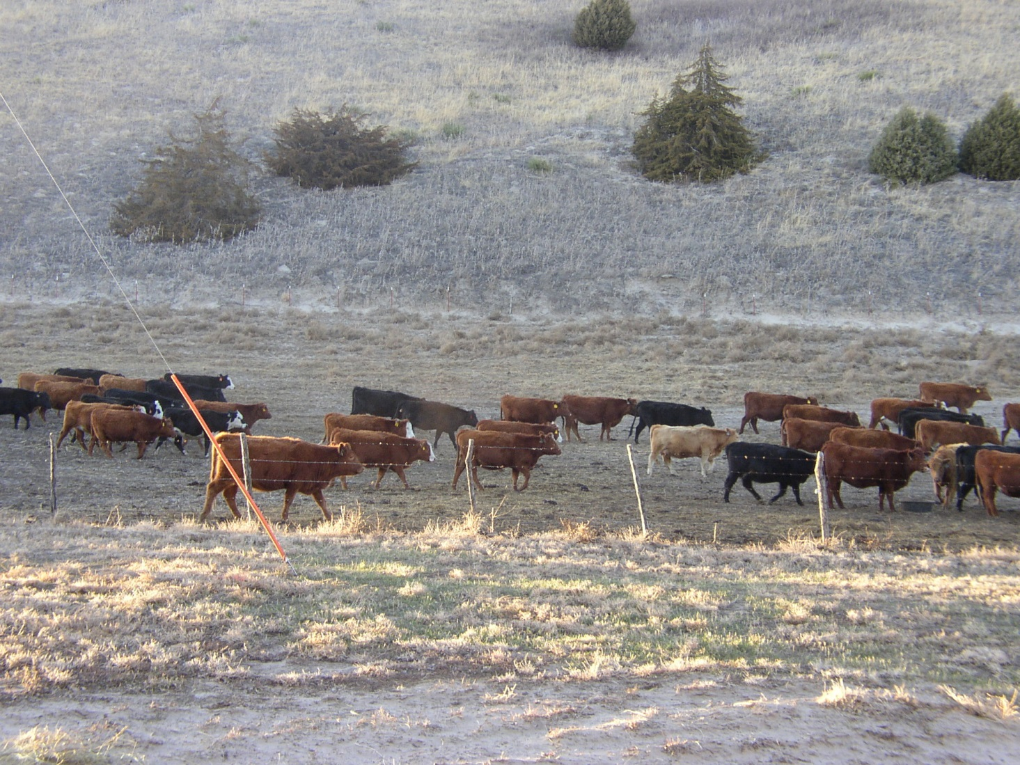
Drought Plan
Heavy snow plan

Slide 48
Five Essentials of Ranch Management
Five Essentials for Successful Ranch Management
The approach must be both integrative and holistic
Continuous improvement of the key resources – Land, Livestock, People
Use of good planning and Decision making tools
War on cost
Emphasis on marketing
4. War on cost

Slide 49
Reducing the ratio of fed feed to grazed feed has tremendous economic significance!

Slide 50
Calving in sync with nature is a good way to reduce fed feed.

Slide 51
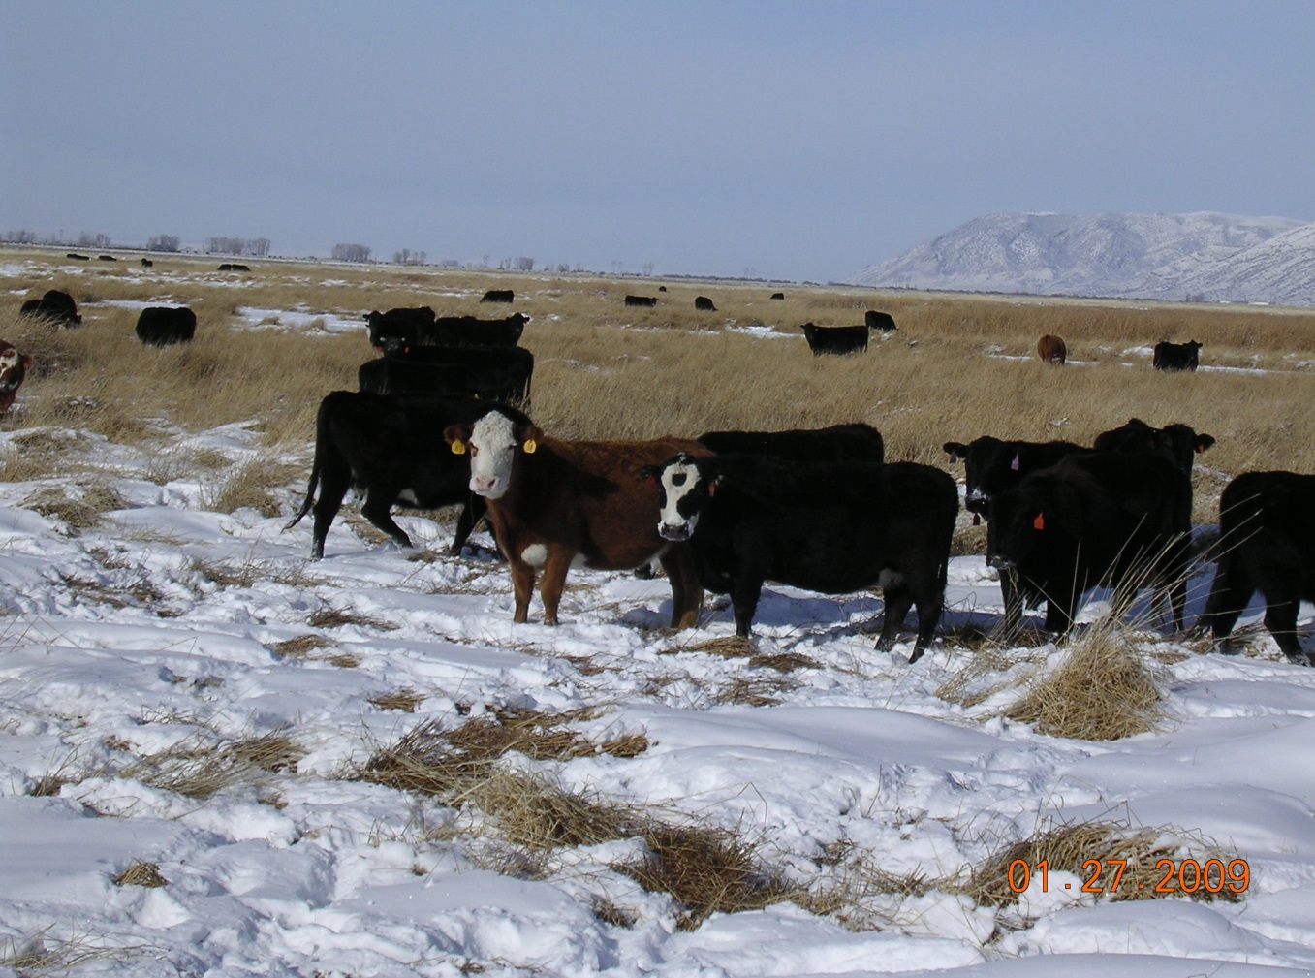
Grazing Management can
Increase grazing days and Reduce feeding days.

Slide 52
You might eliminate or reduce the requirement for hay.
Would you still need all that haying equipment?
What about the manpower to run it?
Could you buy what hay you might need and thereby increase your carrying capacity which would reduce acres per cow and increase turnover.

Slide 53
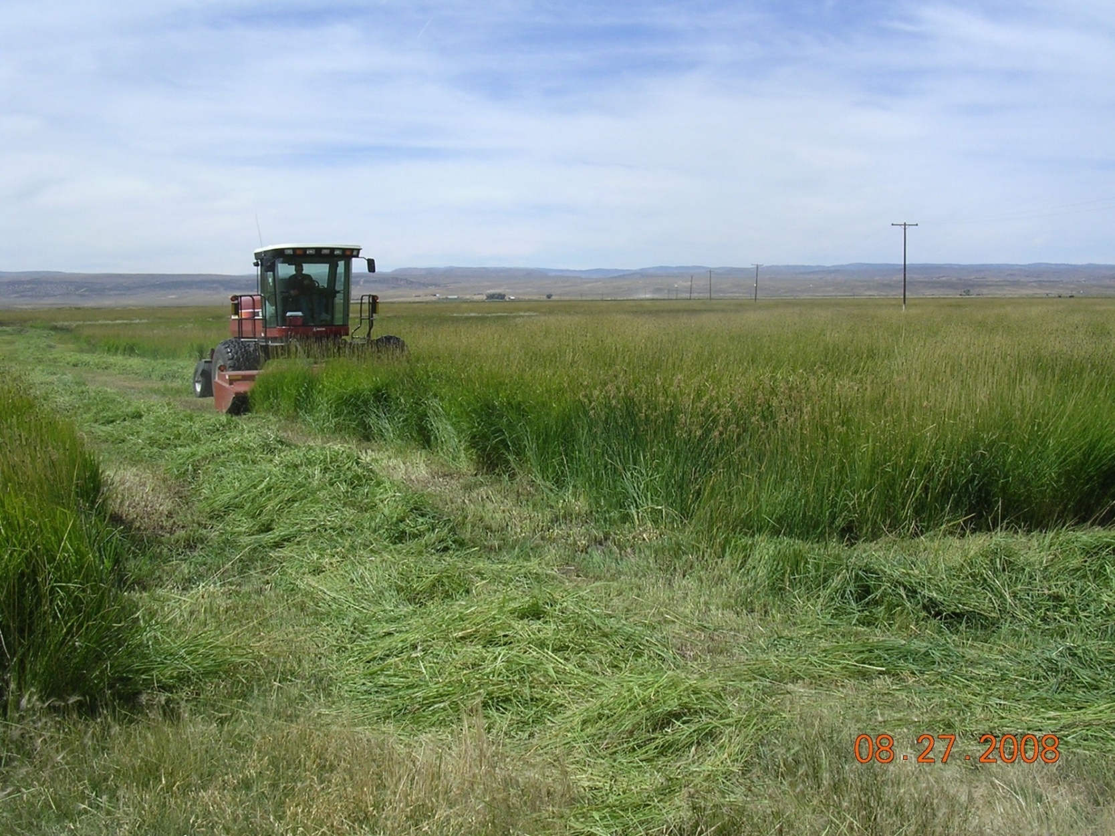
This isn’t Grazing!
Why do we do this? It’s expensive!

Slide 54
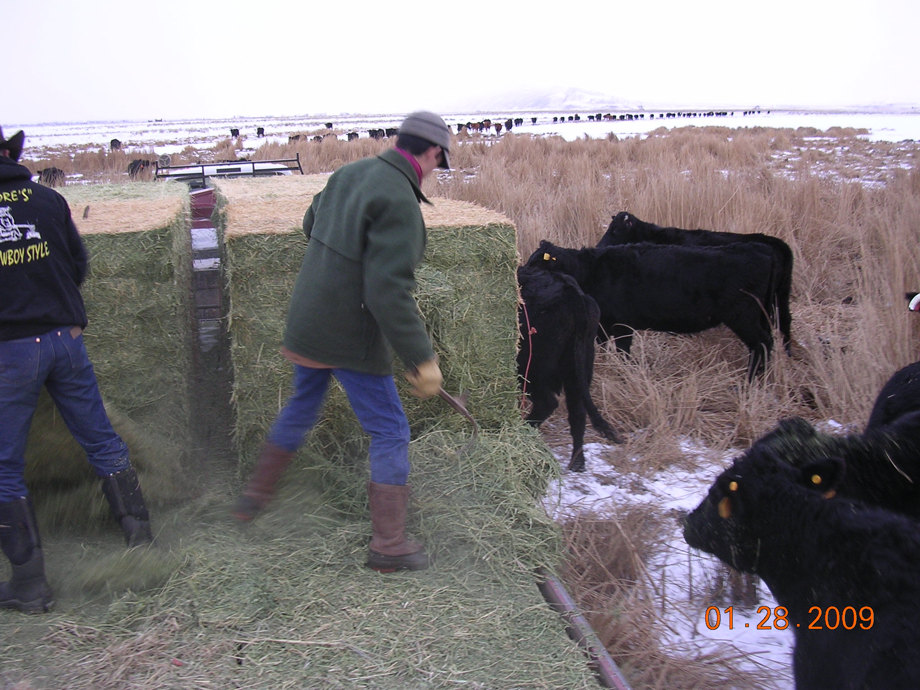

Slide 55
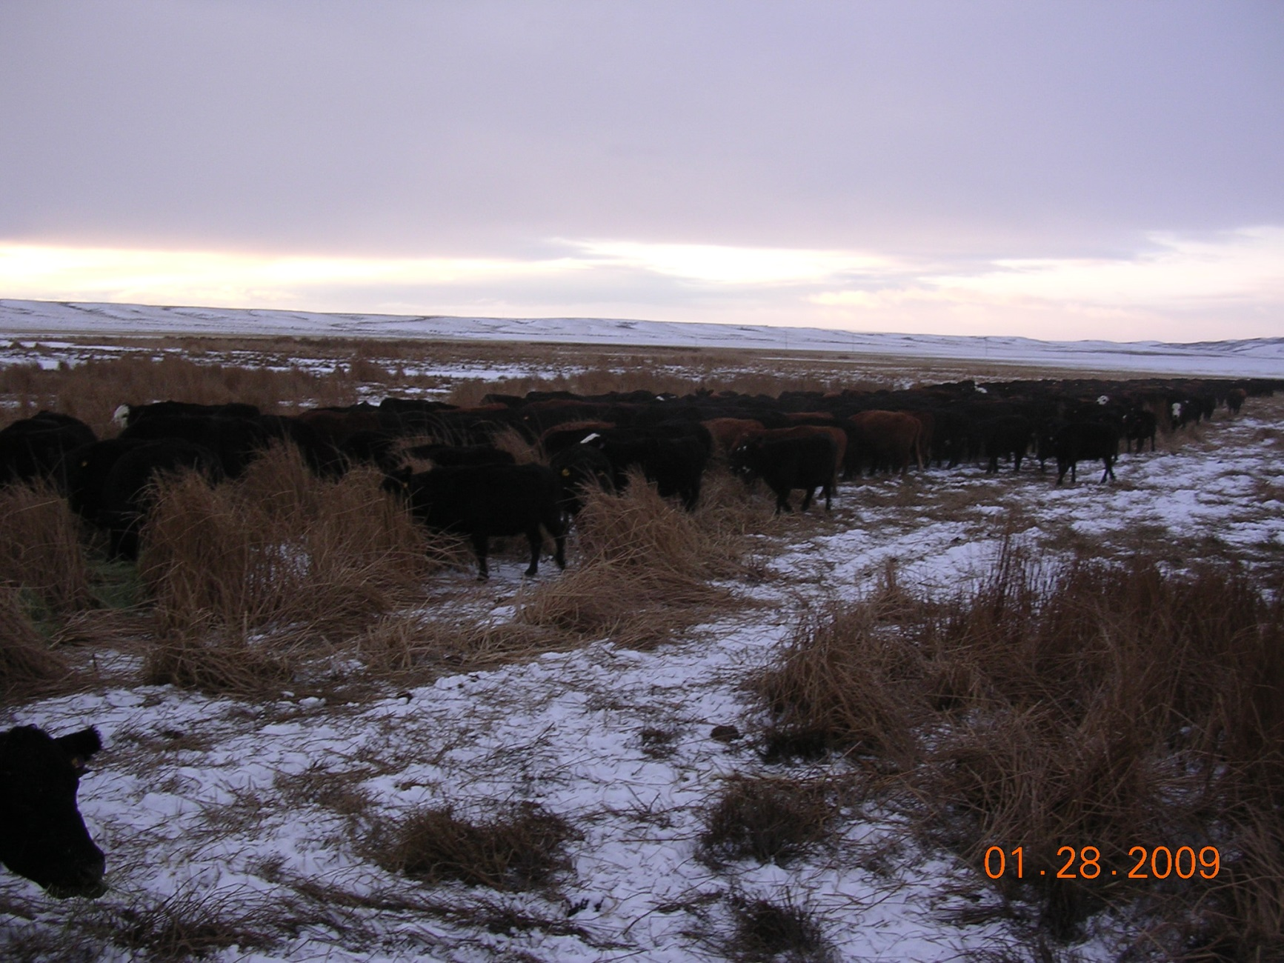
A little hay and a lot of cured grass

Slide 56
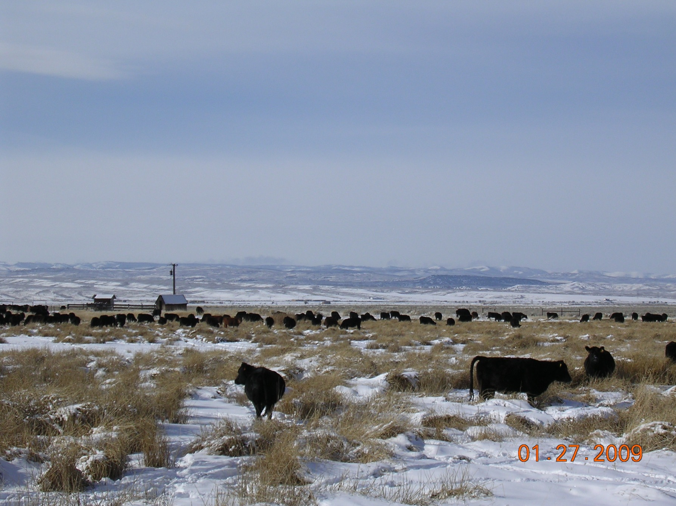
They really will eat it.

Slide 57
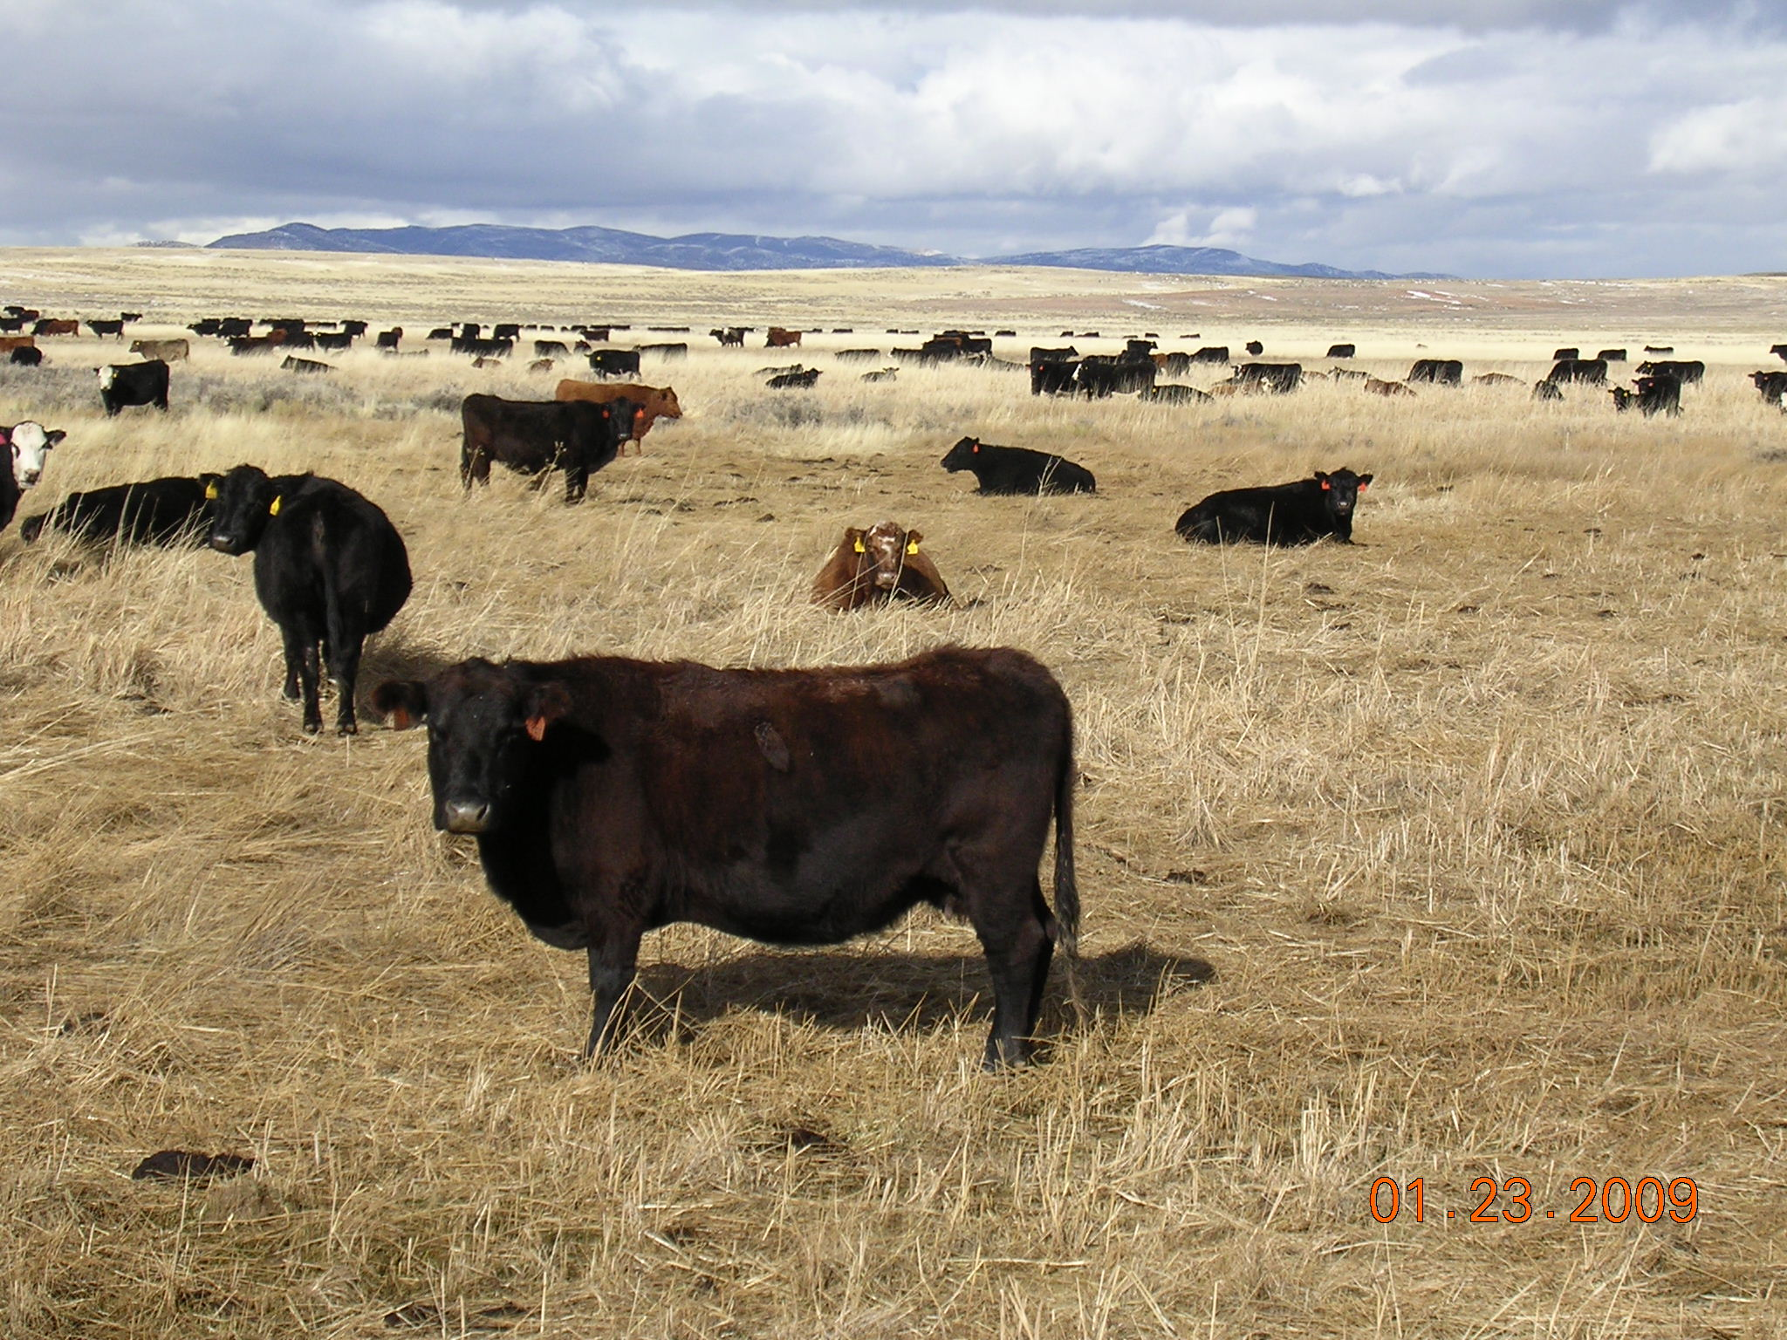
A riparian area in the middle of a dry spring range.

Slide 58
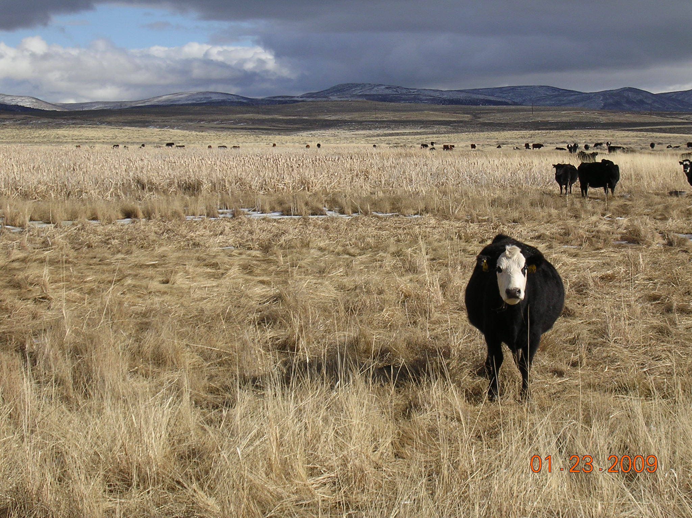
Same riparian area—even has wire grass and cattails.

Slide 59
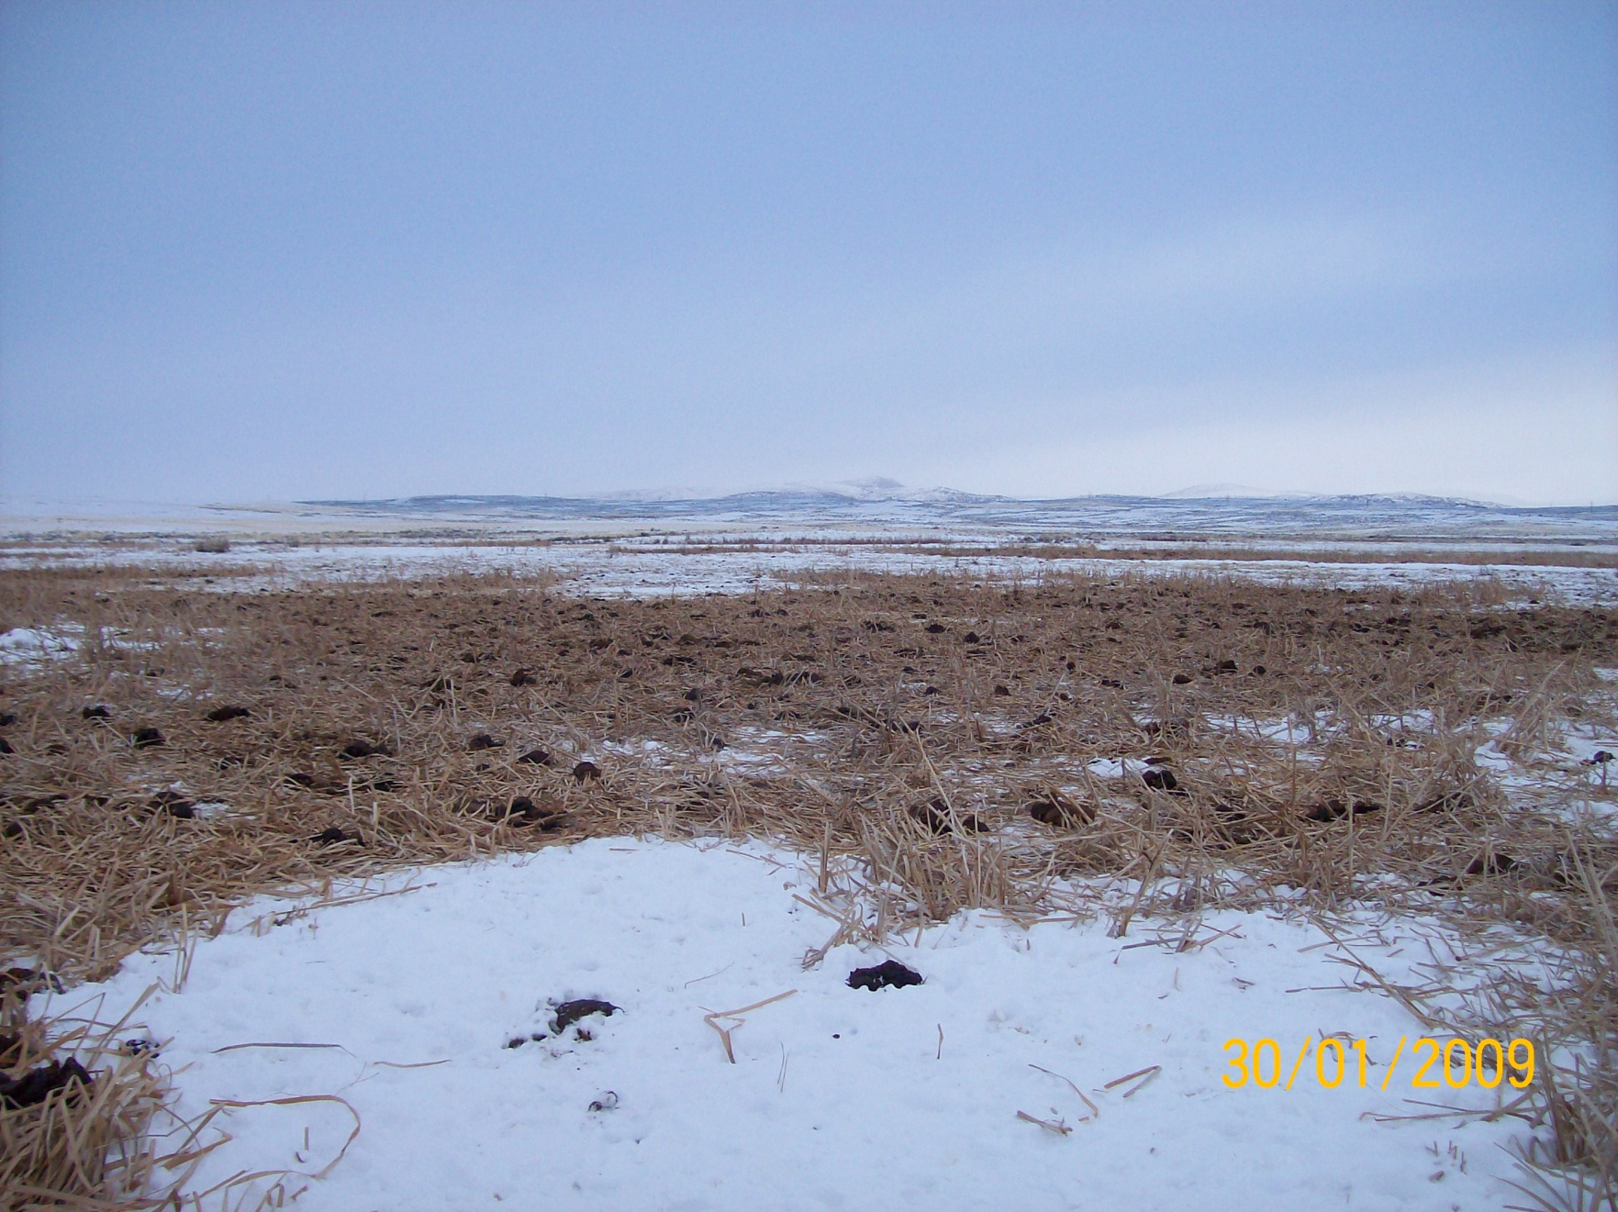
They ate it all!

Slide 60
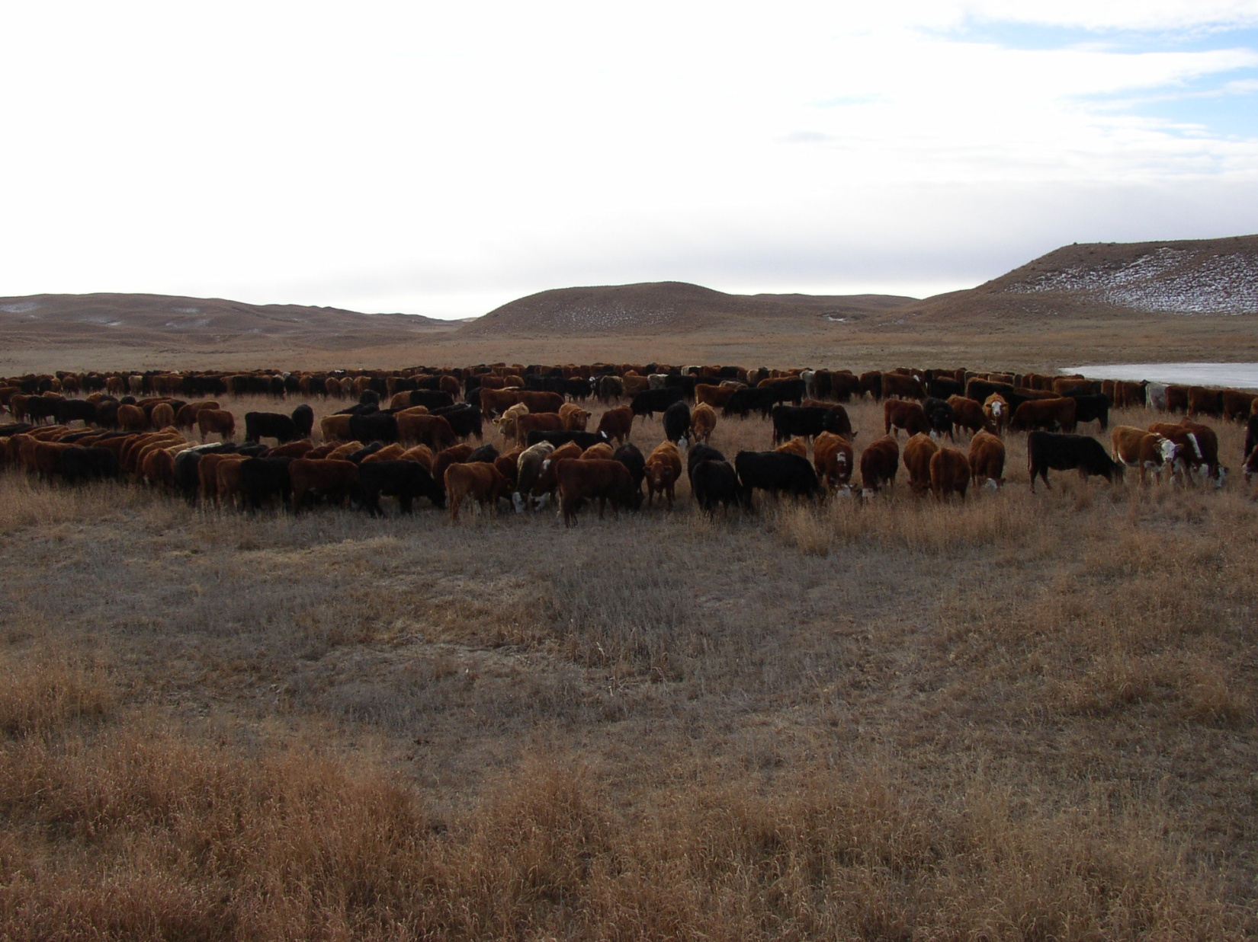

Minimal Development of Replacement Heifers

Slide 61
With good grazing management the following are typical results:
Fewer herds to reduce need for fence.
Increased herd size.
Livestock occupying a very small portion of the ranch at any given time.
Which leads to--

Slide 62
Less requirement for labor.
Higher cows per person ratio.

Slide 63
Increasing the size and reducing the number of herds
Reducing or eliminating the need for hay
Eliminating the need for haying equipment, labor and fuel
Guess What?

Slide 64
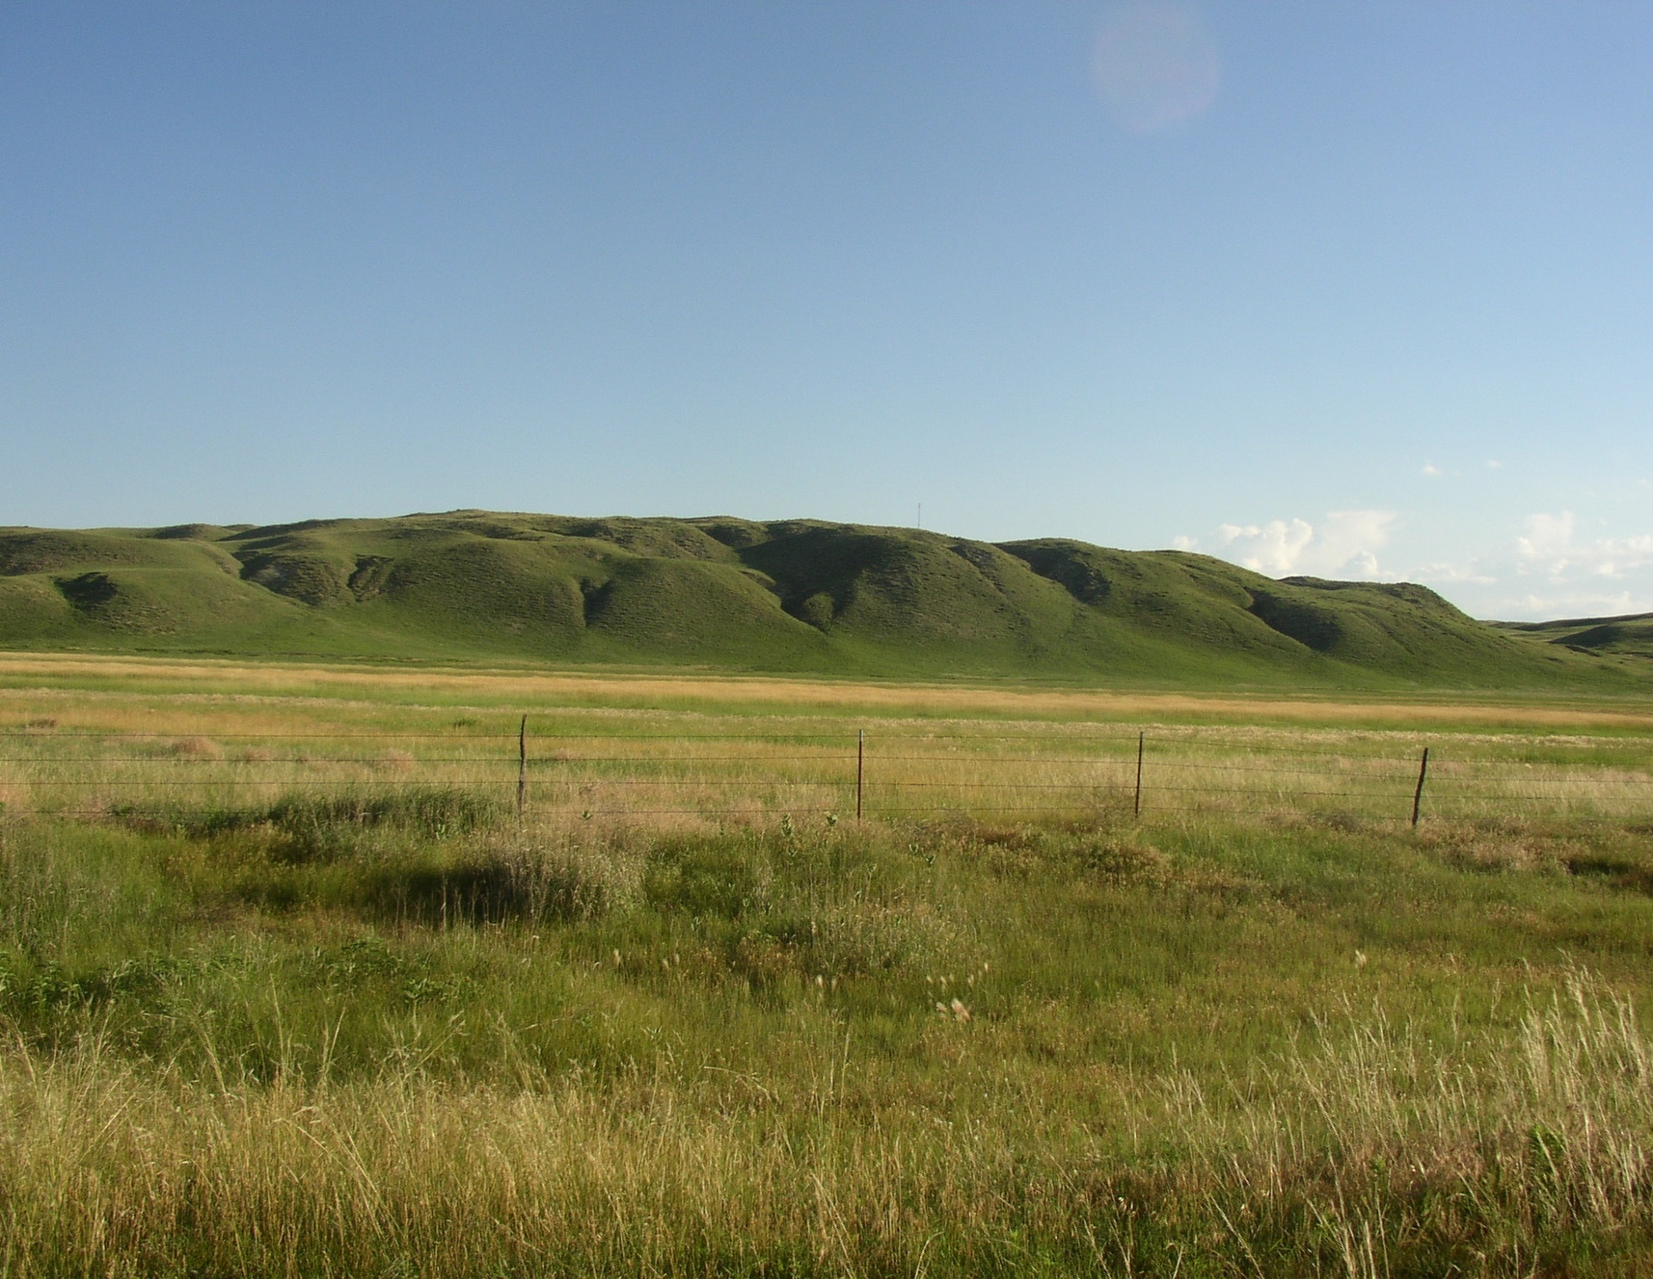
You increase gross margin and greatly reduce the need for people and equipment.

Slide 65
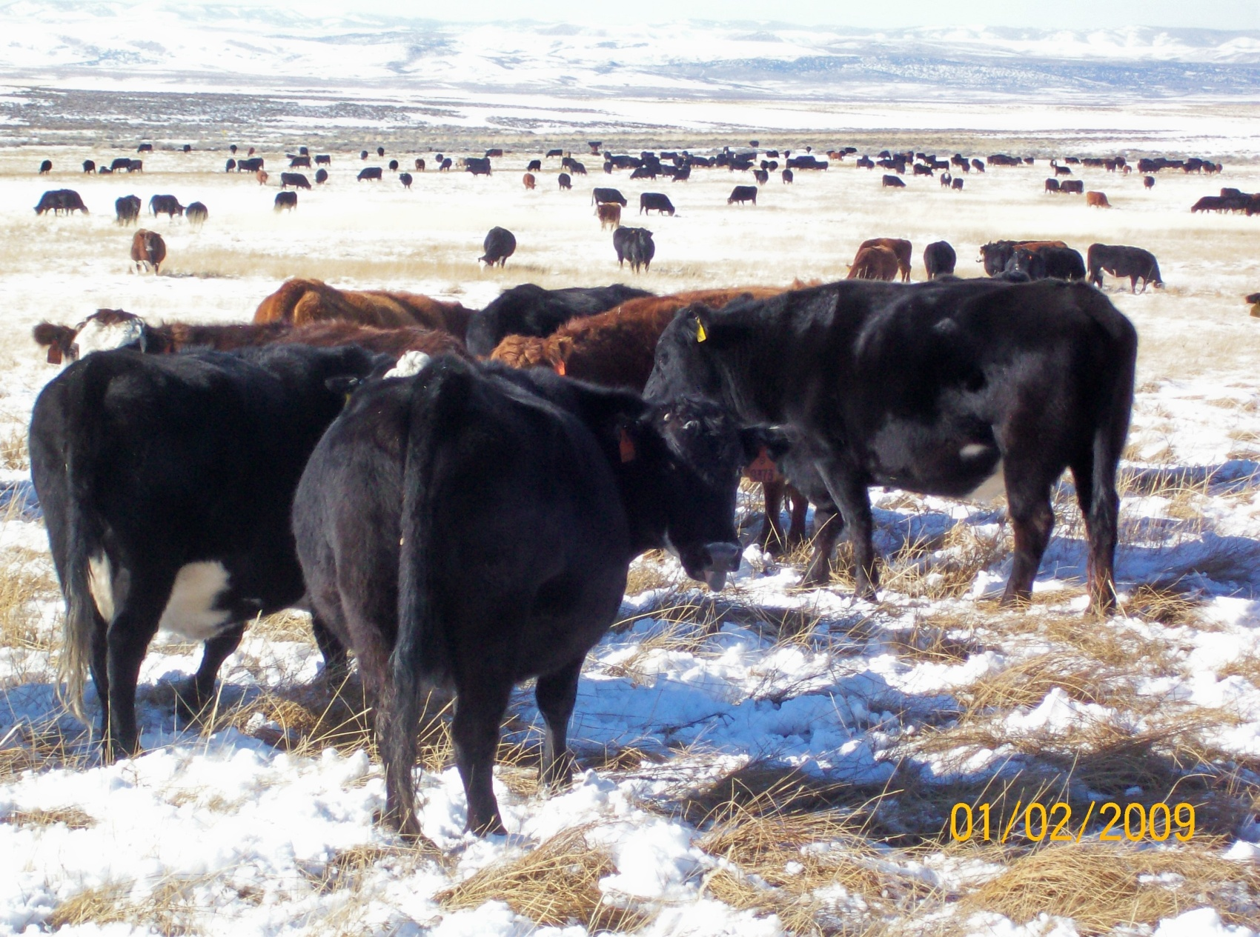
How do I get to Efficient?

Slide 66
-------
Buy small replacement cows that fit my environment, OR
Raise replacement heifers from bulls and cows that fit my environment.
Cut inputs and then-------”cull the right cow.”
Longevity is result of fertility and fertility is a result of environment fit.

Slide 67
Five Essentials for Successful Ranch Management
5. Emphasis on marketing

Slide 68
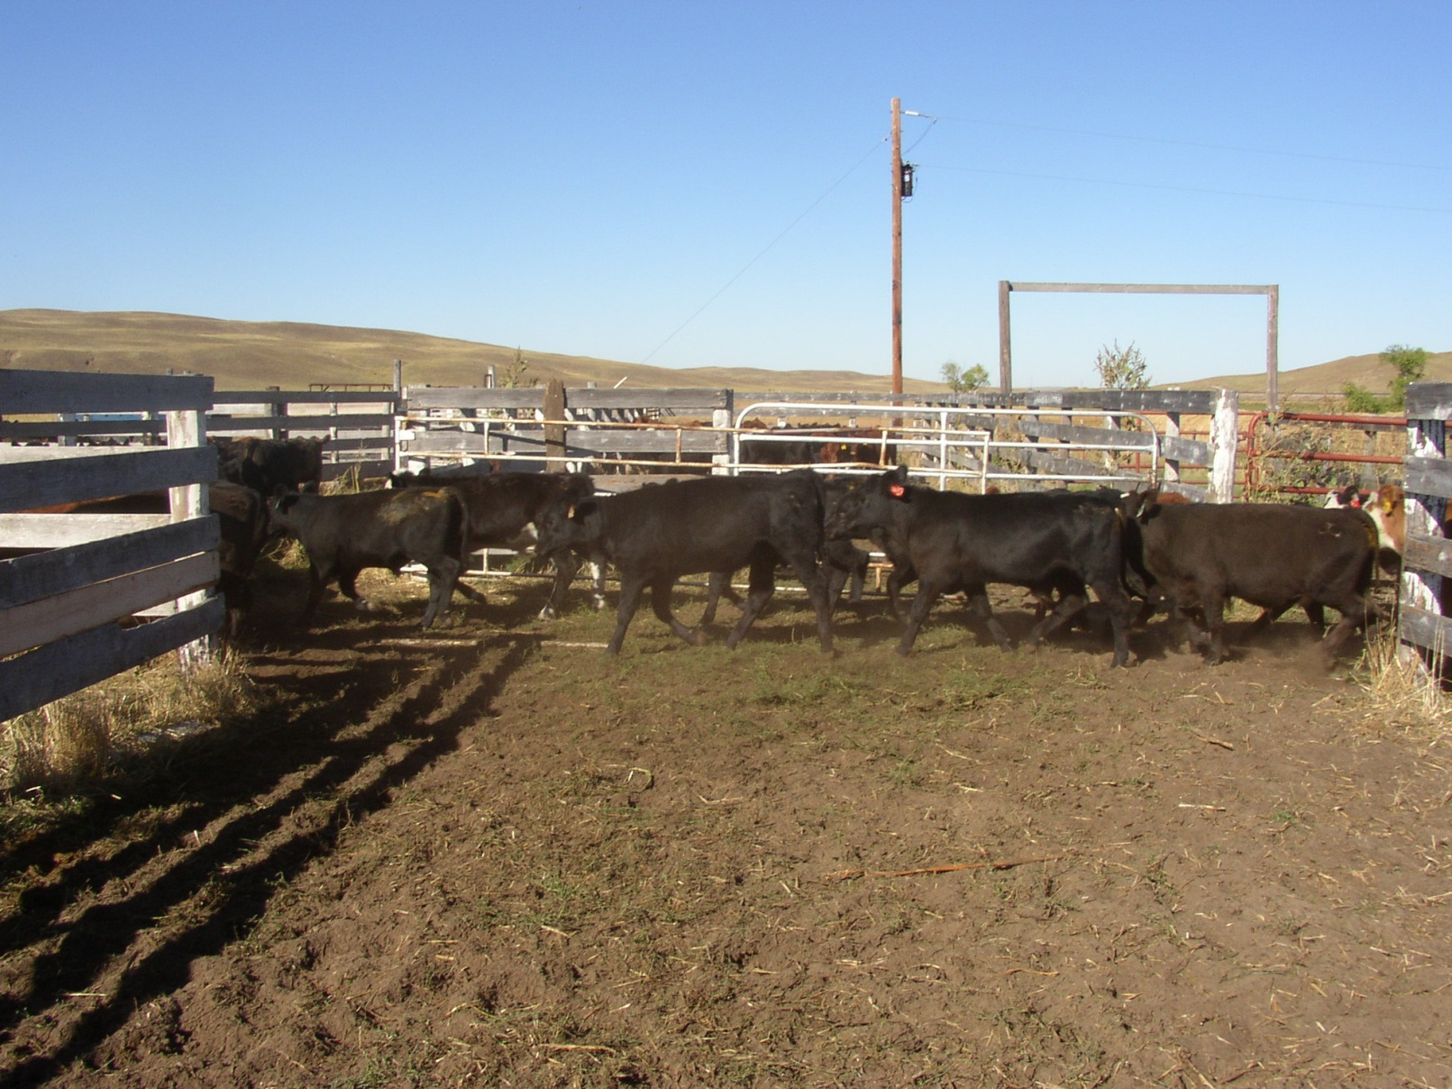
Production Fits into the Marketing Plan

Slide 69
Two Ideas after cutting inputs.
Heifers:
Short exposure—lots of heifers
  Opens make good feeders
  Pregnants make good cows
Cows:
Short calving season
  Long breeding season. What?

Slide 70
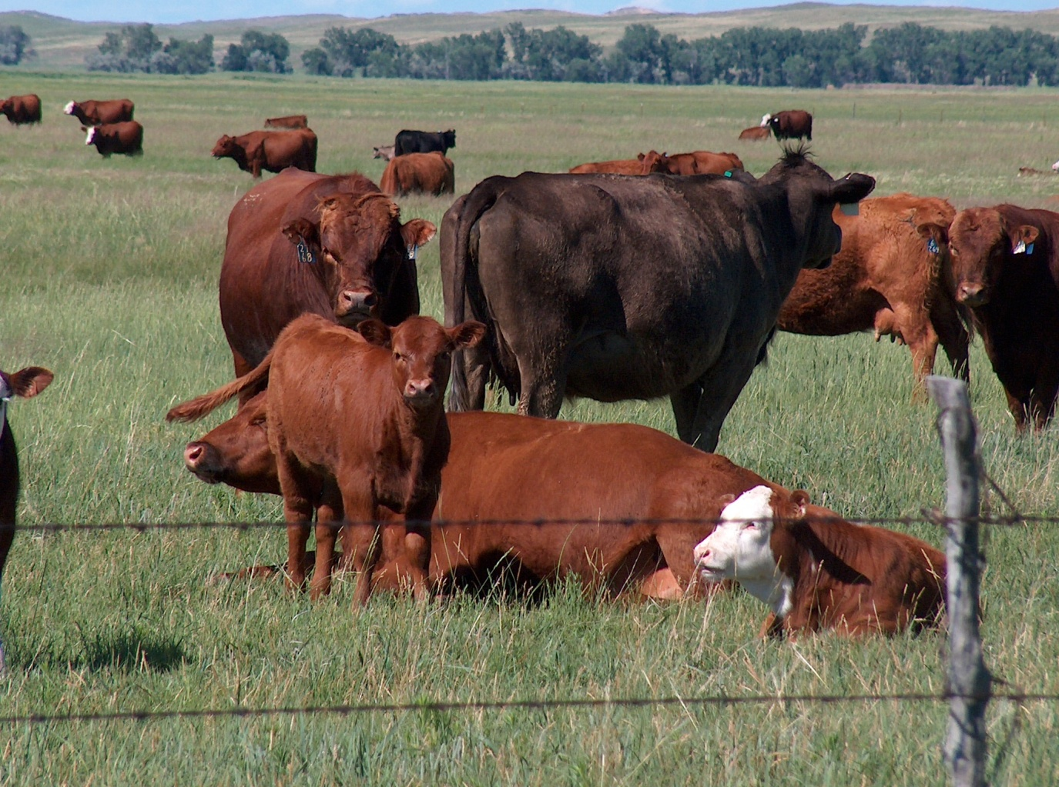
Short Calving Season
Leave bulls in cows until
preg check time

Slide 71
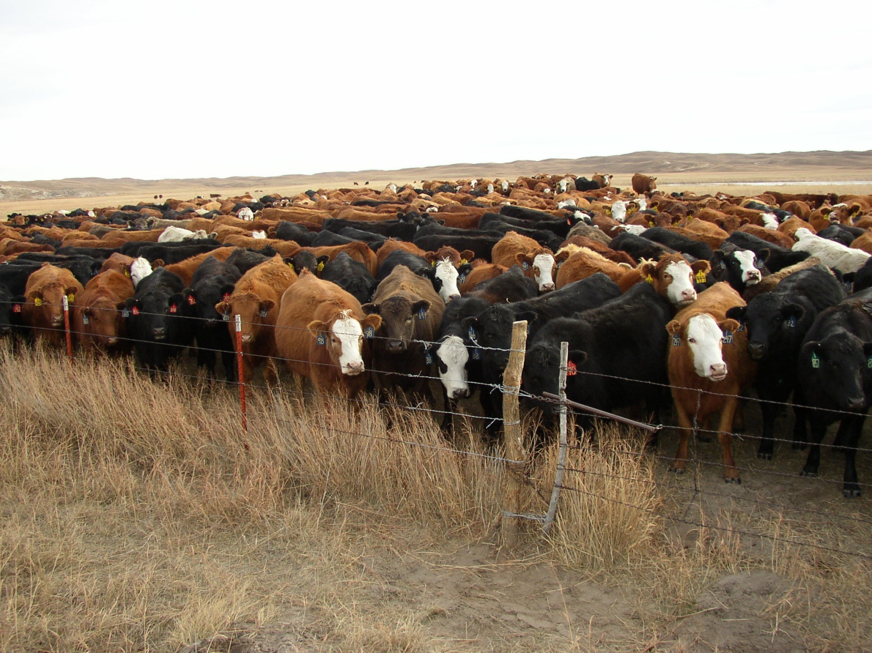
High Herd Turnover Rate

Slide 72
Five Essentials for Successful Ranch Management
The approach must be both integrative and holistic
Continuous improvement of the key resources – Land, Livestock, People
Use of good planning and Decision making tools
War on cost
Emphasis on marketing

Slide 73


Four Areas to Manage
Five Essentials for Successful Ranch Management
Production
Economics/Finance
Marketing
People
The approach must be both integrative and holistic
Continuous improvement of the key resources – Land, Livestock, People
Use of good planning and Decision making tools
War on cost
Emphasis on marketing
Three Ways to Improve Profit
Increase turnover
Decrease overheads
Improve gross margin
  Total returns – Direct costs

Slide 74
So
For Profitable Decision Making Become a Systems Thinker

Slide 75
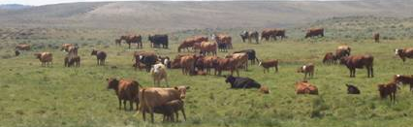
HOW? Planning, Planning, and---
Alignment of people, livestock, land
Large herds
Every man has his own herd (or herds)
Information feedback to know how your responsibility is progressing
High cows per man ratio

Slide 76
Careful coordination of reproduction, genetics, grazing and marketing
Short duration, adaptive grazing – with lengthy recovery
Increase grazing – Reduce fed feed
Take advantage of heterosis
Calve in sync with nature
Small or moderate cow size
Moderate milking ability

Slide 77
More Thoughts to Consider:
People first.
Put Strategy before Tactics.
Prioritize for Profit not Convenience.
Think Soil before Plants and Animals.
Think Return per Acre not per Cow.

Slide 78
With strategy in place - three very important tactical areas

Slide 79
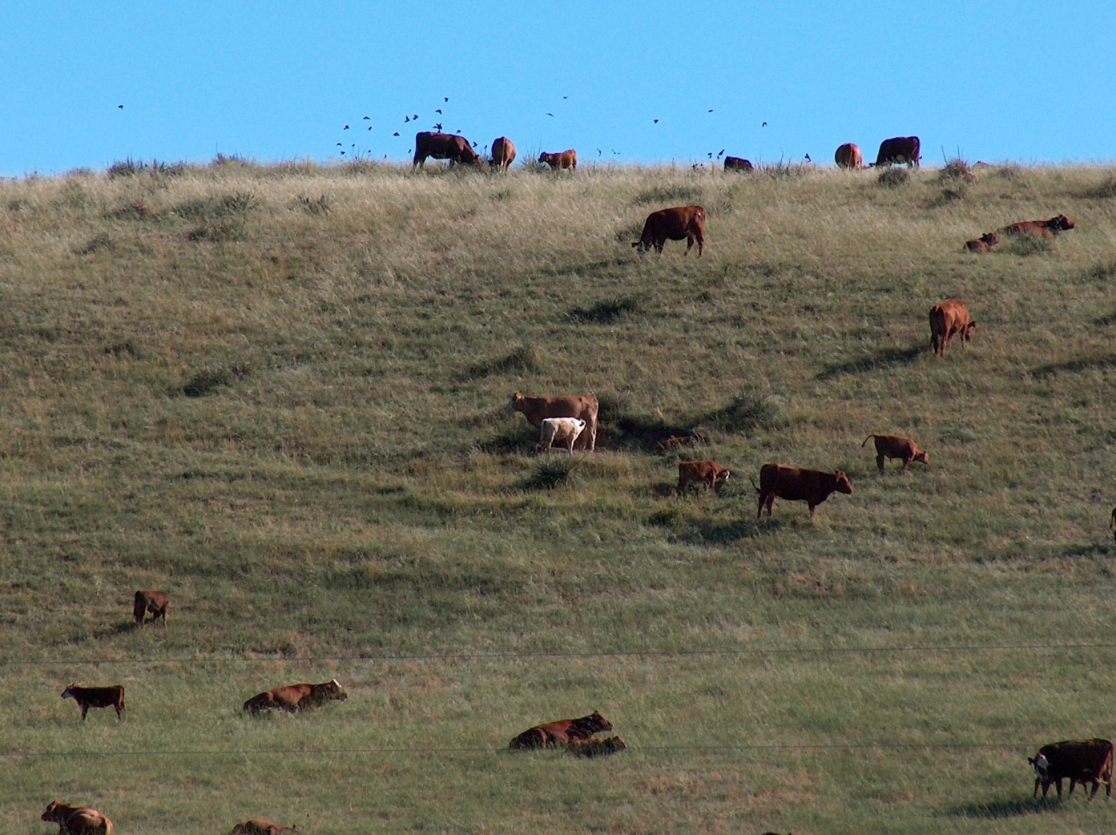
Graze Right
Daily effort preceded by good planning

Slide 80
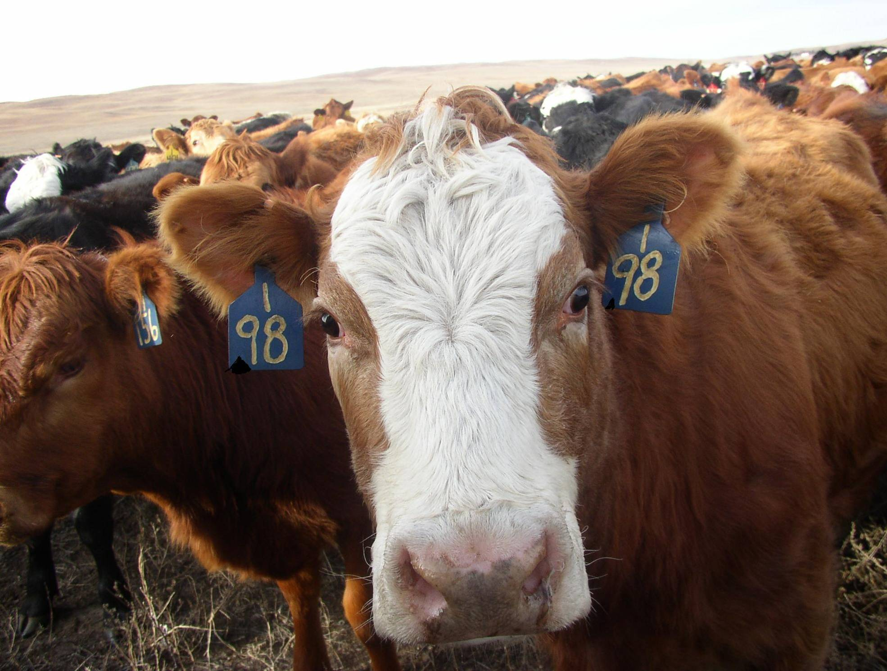

Cull the Right Cows
“notch the exceptions”

Slide 81
Cull the Right Cow
Open
Dry
Requires individual attention or help
Wild
Poor calf
Ugly (your definition—don’t be too hard on ‘em. You might cull some good ones.)

Slide 82
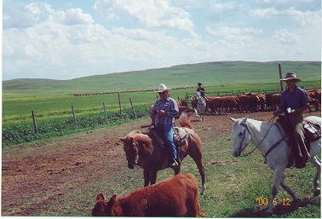
Low Stress Animal Handling Techniques
“You can never get too good”

Slide 83
Good Animal Handling
Better Performance
More efficient gathers and pasture moves
Less handler risk

