Slide 1

2018 Fall Cattle Marketing
Trent Milacek
NW Area Ag Econ Specialist
trent.milacek@okstate.edu
580-237-7677

Slide 2


Global and Macroeconomic Environment
Changes
  Political
  Policy
Uncertainty
  Global Economy
  U.S. Economy
  Trade
    Tariffs
    Exchange Rates
Volatility

Slide 3
Major Beef Market Factors
Cattle Inventory and Beef Production
Beef Demand
International Trade
Feed and Input Markets
Forage Conditions

Slide 4
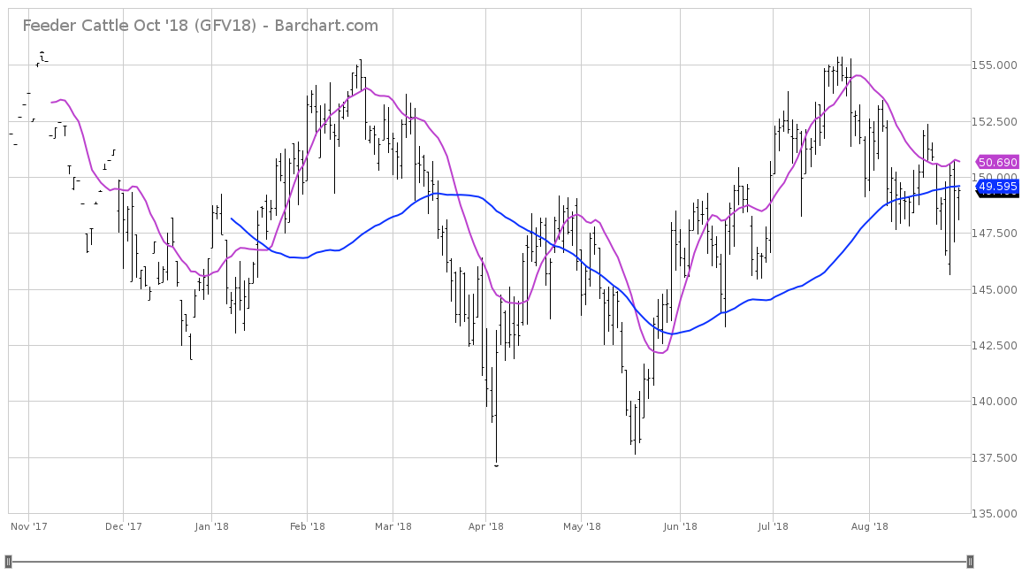
October Feeder Cattle

Slide 5
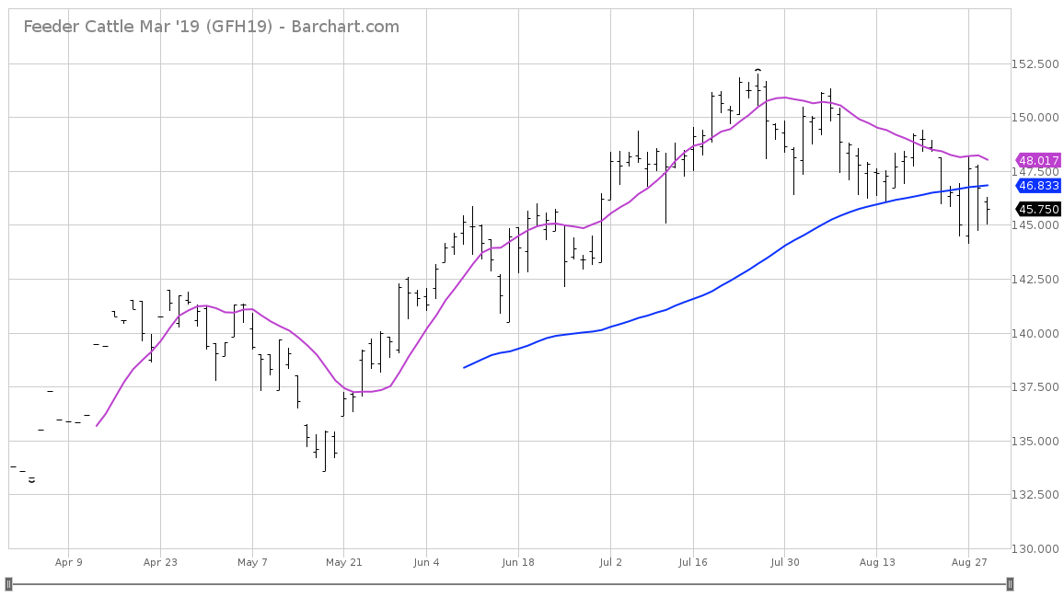
March Feeder Cattle

Slide 6
Data Source: USDA-AMS
Livestock Marketing Information Center

Slide 7
Data Source: USDA-AMS
Livestock Marketing Information Center

Slide 8
Data Source: USDA-AMS
Livestock Marketing Information Center

Slide 9
Data Source: USDA-AMS
Livestock Marketing Information Center

Slide 10
Data Source: USDA-AMS
Livestock Marketing Information Center

Slide 11
Data Source: USDA-AMS
Livestock Marketing Information Center

Slide 12
Data Source: USDA-AMS
Livestock Marketing Information Center

Slide 13
Data Source: USDA-NASS
Livestock Marketing Information Center 4.3%

Slide 14
Data Source: USDA-NASS
Livestock Marketing Information Center 1%

Slide 15
Data Source: USDA-NASS
Livestock Marketing Information Center 2.6%

Slide 16
Data Source: USDA-AMS & USDA-NASS
Livestock Marketing Information Center

Slide 17
2018 Meat Production and Consumption
 | Production |  |  |  |  | Consum. Change | Consum. Per Capita | Consum. Change
 | 2016 | 2017 | 2016-2017 | 2018 | 2017- 2018 | 2016-2017 | 2018 | 2017-2018
 | Million lbs. | Million lbs. | % Change | Million lbs. | % Change | % Change | Retail Lbs. | % Change
Beef | 25221 | 26187 | +3.8 | 27126 | +3.6 | +2.5 | 57.5 | +1.1
Pork | 24941 | 25584 | +2.6 | 26596 | +4.0 | +0.0 | 51.3 | +2.4
Broilers | 40261 | 41217 | +2.4 | 42089 | +2.1 | +1.3 | 91.9 | +1.2
Total | 97193 | 99739 | +2.6 | 102516 | +2.8 | +1.1 | 219.3 | +1.3
2018 forecast
LMIC, August 17, 2018

Slide 18
Marketing Programs

Slide 19
*Premiums calculated as difference in weighted average prices over non-preconditioned calves on same sale date.

Slide 22
Time for a decision…

Slide 23
Cash Contract
Simple and effective.
Known price at harvest by locking in basis.
Must deliver the cattle.

Slide 24
Futures Hedge
Relatively simple marketing strategy.
Take an offsetting position in the futures market.
Futures price is set but basis can move.
Requires margin.

Slide 25
Options
The right but not the obligation to enter into a futures contract.
Buying options requires no margin.
Selling options does.

Slide 26
Ready…Set…
Here we go!

Slide 27
Cattle Marketing
I need to market 500 calves that will average 500 lbs. per head in October
Local expected cash price is $169.45
Expected basis is at $18.53
Futures are trading for $150.925

Slide 28
What do I need to know?
Breakeven price
Risk exposure
Available capital

Slide 29
Cash contract
A cash contract on 80% of our expected production would give us $169.45 per cwt. cash price
Basis would be locked in at $18.53
100 calves are open to the market

Slide 30
Futures Hedge
We could hedge 4 contracts or 200,000 lbs. on the board at $150.925 per cwt.
Basis is open at $18.53 Expected cash price is $169.45 per cwt.
50,000 lbs. are open to the market

Slide 31
Options Contract
We could purchase 4 October put options to protect downside risk on 200,000 lbs.
Basis is open at $17.82
50,000 lbs. are open to the market

Slide 32
Which options contract?
We need a breakeven, spend some time calculating/thinking/guessing…

Slide 33
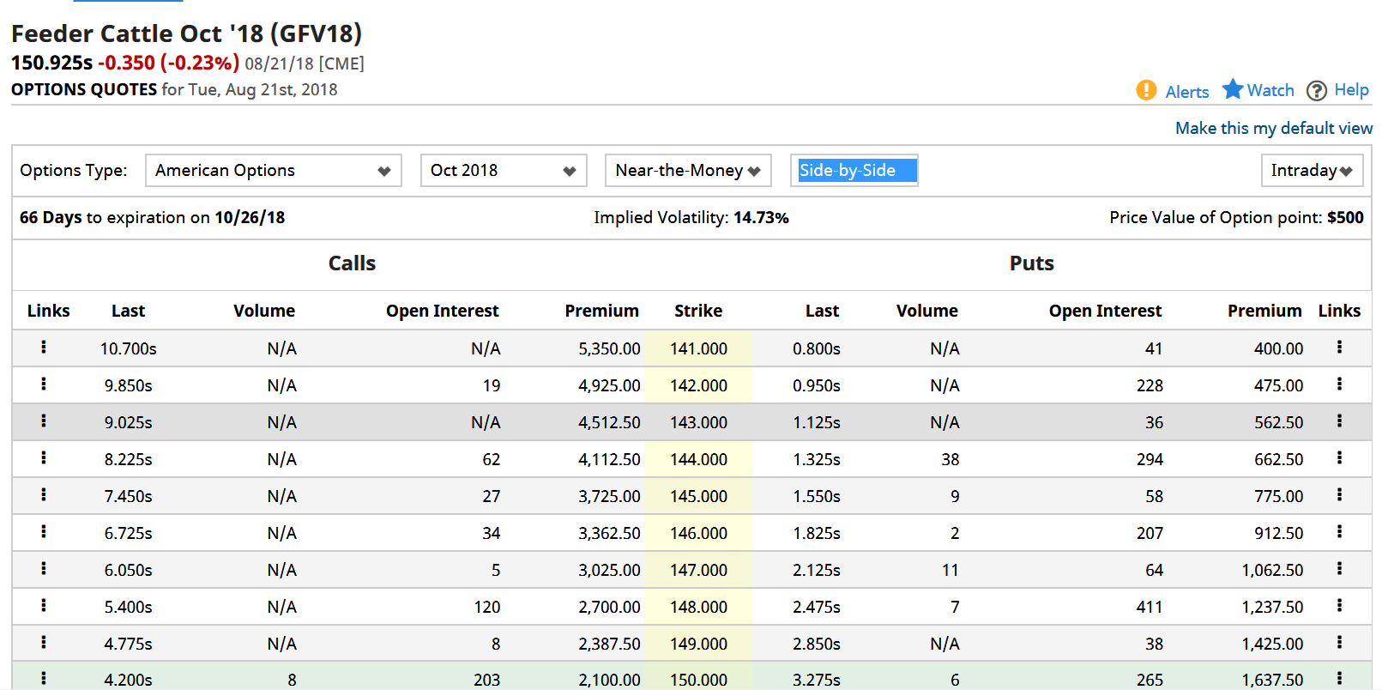
Now we choose.
http://www.barchart.com

Slide 34
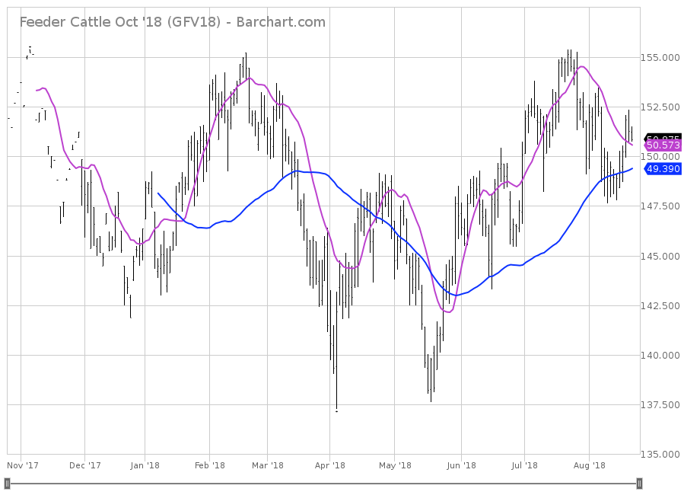
October Feeder Cattle

Slide 35
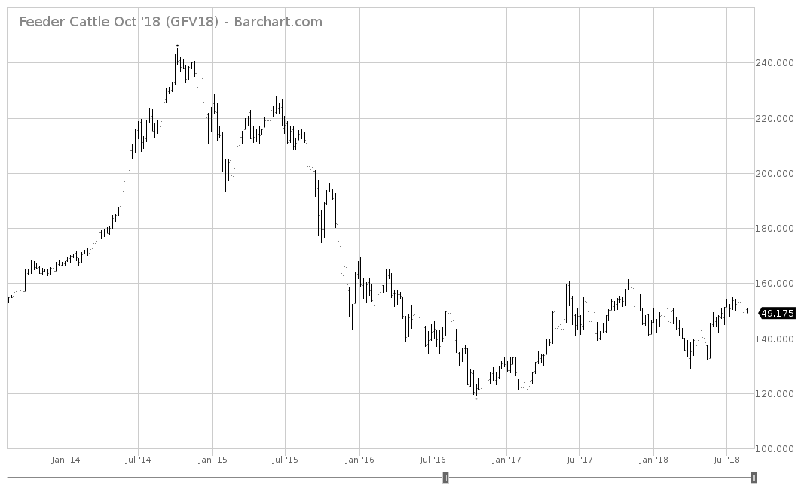
Nearby Feeder Cattle 5-yr

Slide 36
Options strike price
What strike price did you pick?
What was the premium?
What is your protected price?

Slide 37
Intermission…

Slide 38
Steer Price, Total Value and Value of Gain
August 10, 2018 7 Mkt. Ave., Oklahoma
Weight (lbs) | Average Price ($/cwt.) | Total Value ($/hd) | VOG 400 lb. Beg. Weight ($/lb.) | VOG 450 lb. Beg. Weight ($/lb | VOG 500 lb. Beg. Weight ($/lb.) | VOG 550 lb. Beg. Weight ($/lb.) | VOG 600 lb. Beg. Weight ($/lb.) | VOG 650 lb. Beg. Weight ($/lb.)
400 | $185.17 | $741
450 | $174.83 | $787 | $0.92
500 | $171.39 | $857 | $1.16 | $1.40
550 | $168.88 | $929 | $1.25 | $1.42 | $1.44
600 | $166.92 | $1,002 | $1.30 | $1.43 | $1.45 | $1.45
650 | $163.56 | $1,063 | $1.29 | $1.38 | $1.37 | $1.34 | $1.23
700 | $157.22 | $1,101 | $1.20 | $1.26 | $1.22 | $1.14 | $0.99 | $0.75
750 | $152.58 | $1,144 | $1.15 | $1.19 | $1.15 | $1.08 | $0.95 | $0.81
800 | $148.86 | $1,191 | $1.13 | $1.15 | $1.11 | $1.05 | $0.95 | $0.85
850 | $145.44 | $1,236 | $1.10 | $1.12 | $1.08 | $1.02 | $0.94 | $0.87
900 | $140.37 | $1,263 | $1.05 | $1.06 | $1.02 | $0.96 | $0.87 | $0.80

Slide 39
What is the expected Value of Gain?
500lb. calves in October are expected to bring $168.74/cwt. from previous example.
750lb. calves at the end of February are expected to bring $150.54/cwt. with an expected basis of $1.54/cwt.
Value of Gain sits at $1.14

Slide 40
Example
You are a producer in Woods County Oklahoma. Your principal crop is stocker calves and you farm 1,000 acres. The average stocking rate on your farm is 1 500 lb. animal per 2 acres. This will give you 500 750lb. calves to market in Feb. You expect that your breakeven price is $145 per cwt. Fill out the following tables using this information in order to market your cattle.

Slide 41
Example
Grower Information
Acres Farmed | 1,000
Animals Raised | 500
Harvest Month | February
Expected Production | 375,000 lbs.
Expected Breakeven Price/Cwt. | $145/cwt.

Slide 42
Example
In this example, it is a good year and you are likely to produce 100% of your expected production. The current cash price for 750 lb. calves is $150.54 per cwt. Market economists expect prices to fall so you are interested in using a futures hedge a portion of your cattle before harvest. March feeder futures are trading for $149 per cwt. Basis is expected to be $1.54/cwt.

Slide 43
Example
Hedging Example #1A
Date | Cash | Futures | # of Contracts | Basis
Oct. | $150.54 | $149 | 4 | $1.54

Slide 44
Example
It is now February. Prices have fallen and now March feeder futures are trading for $140 per cwt. Basis has performed as expected and is $1.54/cwt.

Slide 45
Example
Hedging Example #1B
Date | Cash | Futures | # of Contracts | Basis
Oct. | $150.54 | $149 | 7 | $1.54
Exp. Feb. | $141.54 | $140 | 7 | $1.54
Results | ($9.00) | $9.00
What price did you receive for your cattle? ____________________

Slide 46
Example
Using the same information from the previous example, use options to market your cattle. You expect that your breakeven cash price is $145 per cwt. There are several put options you can choose from:

Slide 47
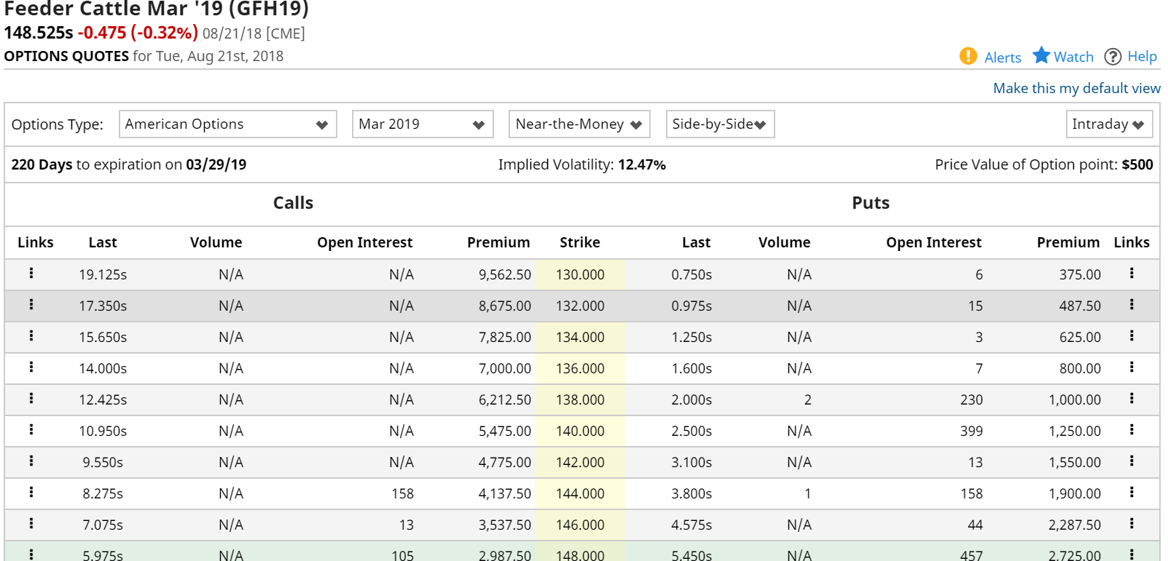
Example

Slide 48
Example
Hedging Example #2A
Date | Cash | Futures Price | Put Strike Price | Premium | Basis
Oct. | $150.54 | $149 |  |  | $1.54

Slide 49
Example
Futures prices have fallen to $140 and now your put is in the money. How much is your put worth?

Slide 50
Example
Hedging Example #2B
Date | Cash | Futures Price | Put Strike Price | Premium | Basis
Oct. | $150.54 | $149 |  |  | $1.54
Feb. | $141.54 | $140 |  |  | $1.54
Results | ($9.00)
What price did you receive for your cattle? ____________________

Slide 51
Marketing-It requires a plan!
Trent Milacek
NW Area Ag Econ Specialist
trent.milacek@okstate.edu
580-237-7677

