Slide 1
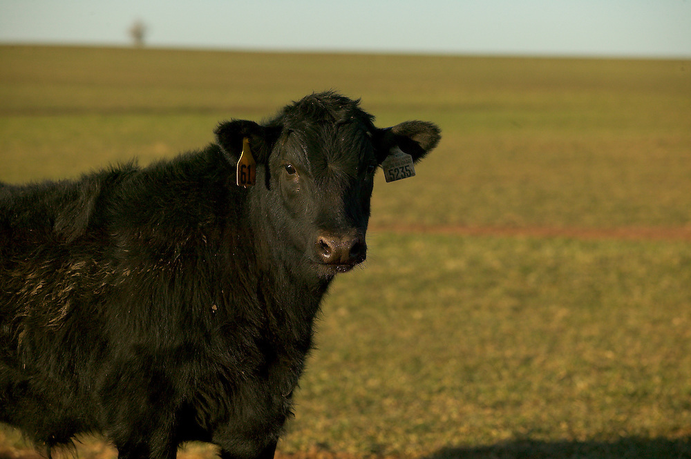
Dart Gun Use for Livestock
Importance of Handling & Safety
Dana Zook, Tommy Puffinbarger,
Gant Mourer

Slide 2
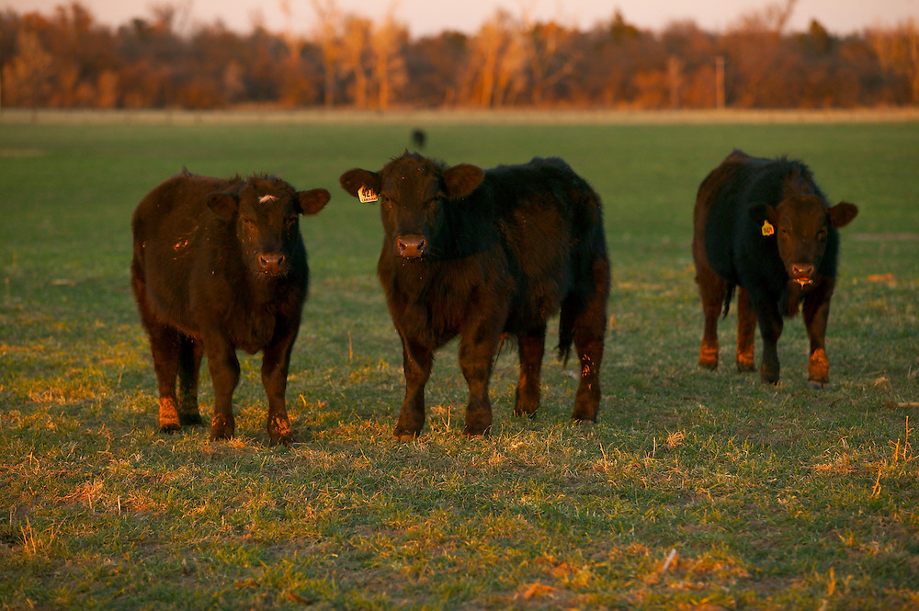
Dart Gun Use
Remote Drug Delivery (RDD)

Slide 3
Intro
Utilizing a dart gun requires responsibility
  delivery device
  medication
  consumers
Maintain a relationship with your veterinarian
Follow BQA Guidelines
Notes:
As many of you know, remote delivery of mediation to livestock is a controversial topic
1.) on one hand, the practice generates legitimate concerns over drug efficacy and safety
2.) on the other hand, RDD can allow immediate treatment for animals in remote areas with out easy access to processing facilities.
You a producer puts medication in a dart gun for the purpose of treating an animal – they have the same responsibility to deliver that antibiotic as if they were chute side.
It is crucial to understand that while using a RDD may make things easier on our end, there is quite a bit more risk in the delivery of that medication.
Many more things come into play
Vet will provide guidance on dart use and the medications they suggest work best for remote deliver – veterinary oversight
It is my goal today to not sway you one way or the other in dart gun use, but to help improve understanding of the device and how we can use it properly to ensure safety to ourselves and the animal.
Ask the audience how many have used dart guns in the past?

Slide 4
Determination for appropriate option
Facilities
Stress on the animal
  Weather
  Distance to treatment
Human safety
Speed of Treatment
No vaccinations

Slide 5
When Using Remote Delivery
Comply with BQA guidelines
  Injection site selection
  Routes of administration
  Needle selection
  Medication selection, volume
  Proper medication records
  Required action if needle is broken

Slide 6
Product Label
BQA
Indications: What the product is designed for
Dosage: How much to administer to the animal
Route of administration: How to give the product (IM, SQ)
Needle selection
Precautions/Withdrawal period: Prevent residues from entering the food supply = safety
Notes:
With all animal health products, it is important to first read the label. Attention to details while storing, handling, and administering animal health products can determine the outcomes of the herd health program.
The label will show the following:
Indications: What the product is designed for
Dosage: How much to administer to the animal
Route of administration: How to give the product (IM, IV, SC or SQ, PO, topical)
Precautions/Withdrawal period: It is highly important that withdrawal periods be followed to prevent violative residues from entering the food supply = safety.

Slide 7
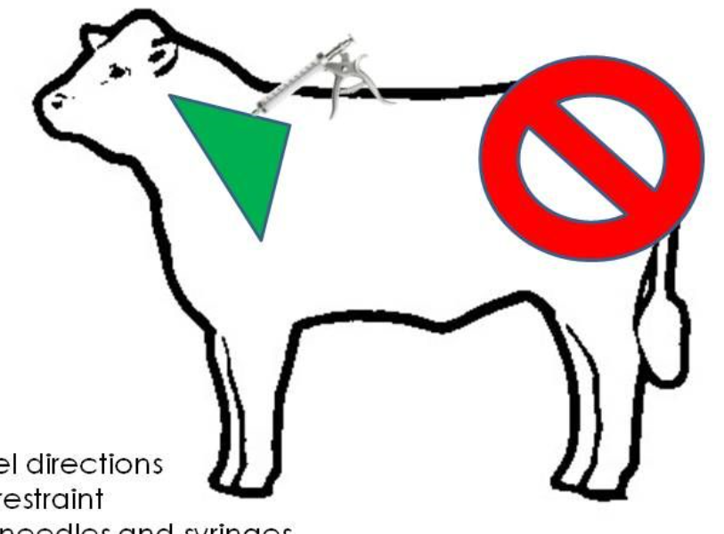
Proper Injection Site
Notes:
Tent the skin – alwa

Slide 8
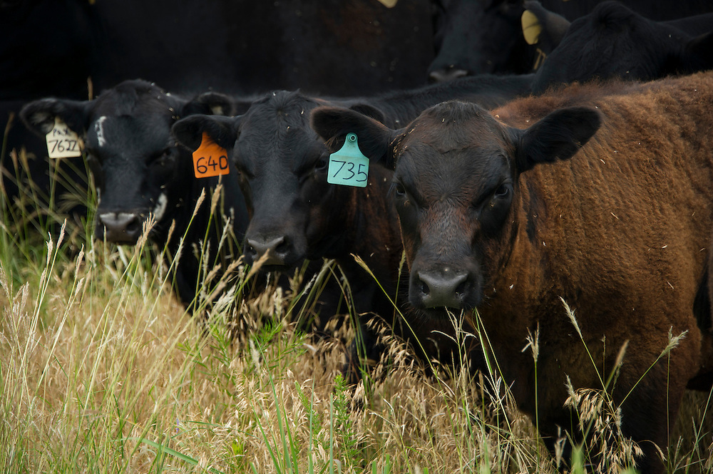
RDD Safety and Handling

Slide 9
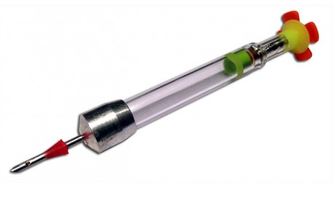
Anatomy of a Dart
Tail Piece
Spring
Firing Pin
Plunger
Percussion Cap
Gelatin Collar
Powder
Cannula
Nose Cone
Notes:
Cannula – part of the dart that engages the animal to deliver the medication.
Gelatin Collar – holds the device in position to ensure the prescribed dose is delivered
Drug containment chamber – transports medication
Activation system – includes firing pin, spring, percussion cap and powder - when activated, this propels the plunger forward to deliver the medication
Spring –prevents premature activation while in transport – sort of a shock absorber
When the dart is shot and comes in contact with the target, rapid deceleration causes the firing pin to spring forward and activate the activation system

Slide 10
Importance of Cleanliness/Upkeep
Clean Darts
Sterile needles to transfer medication
Abscesses/contamination
Gun
  How clean is your gun?
  Where/how was it stored?
  Accuracy

Slide 11
Loading the Dart
Sterile needle and syringe to pull medication from bottle
  Pulling from bottle –
    Example: 14-gauge needle
  Transferring to dart
    Example: 19 gauge needle
Device should be completely full
Notes:
Proper equipment to fill darts
Sterile needle and syringe to pull medication from bottle
– so that we don’t contaminate our very expensive bottle of medication
Dart should be completely full in order to travel properly
Device should be completely full otherwise flight pattern can be erratic

Slide 12
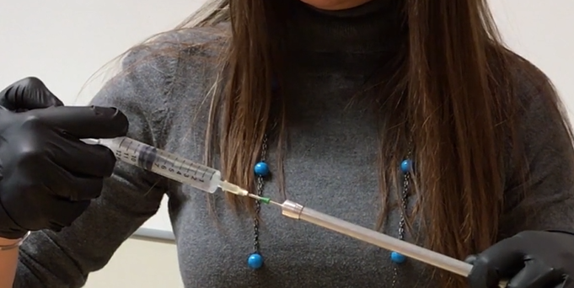
Loading the Dart
Pneu-Dart Website
http://www.pneudart.com/project/rdd-success-using-thick-viscosity-injectable-liquids/

Slide 13
Dart Delivery
Encourage 10-15 yards (30-45 feet)
Limit to 20 yards (60 feet)
Lowest powered delivery charge appropriate for the system – Green charge
Challenges:
  Over-power?
  Under-power?
Sight-in your gun!
Notes:
In order to accurately delivery medications properly through a remote delivery device

Slide 14
Dart Delivery
Flight predictability of device is reduced:
  higher charges
  larger doses
  longer distances
Avoid using an RDD when the animal is moving
  Realistic?
Notes:
In order to accurately delivery medications properly through a remote delivery device

Slide 15
Dart Delivery
Can we maintain that 6 inch injection site triangle on the neck?

Slide 16
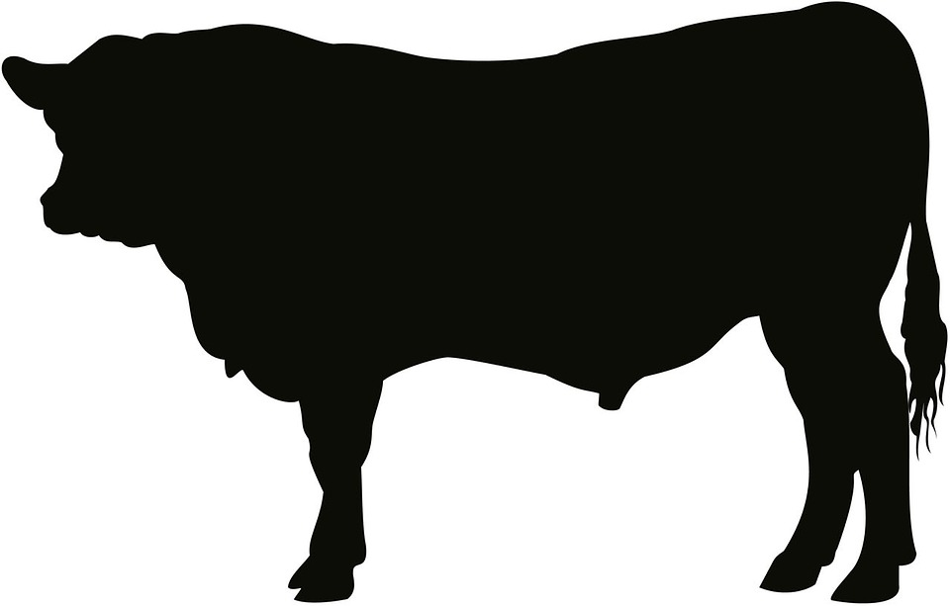
Proper charge
Proper fill of dart
Proper distance

Slide 17
Improper charge
Improper fill of dart
Improper distance
Larger variability?

Slide 18
Recovery of Devices
Always recover spent darts
  Risk of serious injury to other livestock/humans
Gelatin collar
Should fall out in 10-15 minutes
Cannula still attached?
Challenge
Gelatin Collar
Notes:
Gelatin collar meant to dissolve with animals body heat

Slide 19
Dart Storage
How do we store vaccines?
Internal structure of dart can degrade in heat
Storage according to label
Cool dry place
Do not refrigerate
Notes:
Keep away from children

Slide 20
Other Considerations
Sighting in device/gun
Appropriate charge for situation
Antibiotic Placement (IM or SQ)/Needle Length
Abide by all FDA regulations
Medication Compounding is strictly illegal
Record Keeping
Notes:
Sighting in device with the intended charge at the antipicated range –

Slide 21
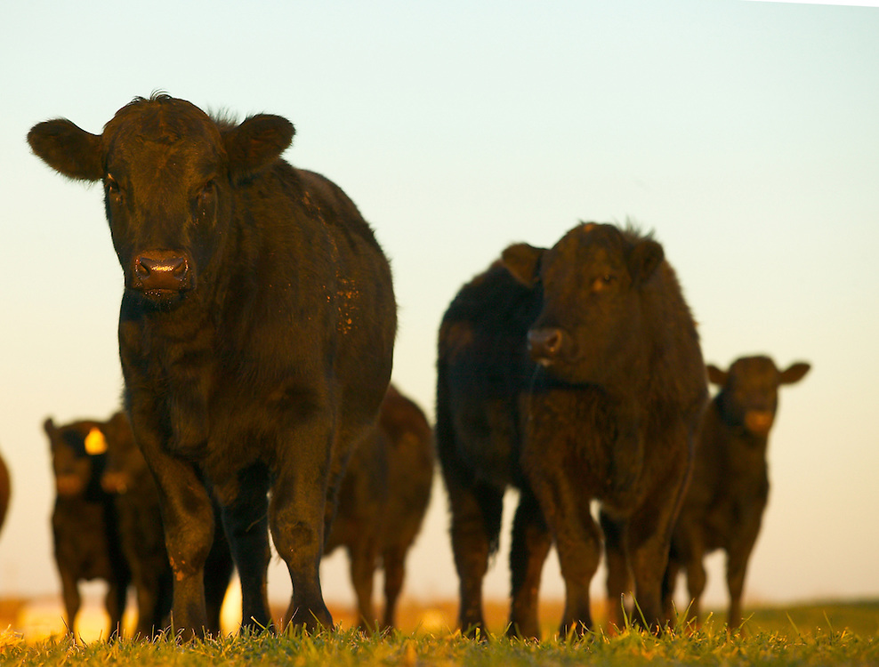

Slide 22
Questions for the Vet
What is your protocol for advising a producer on how to use a dart gun for the delivery of a medication?
How do you address the issue of administering medication through RDD without accurate knowledge of the animals weight?

Slide 23
Questions for the Vet
What drugs are labeled for use in a Dart Gun?
Are there any drugs you would discourage producers using in RDD?

Slide 24
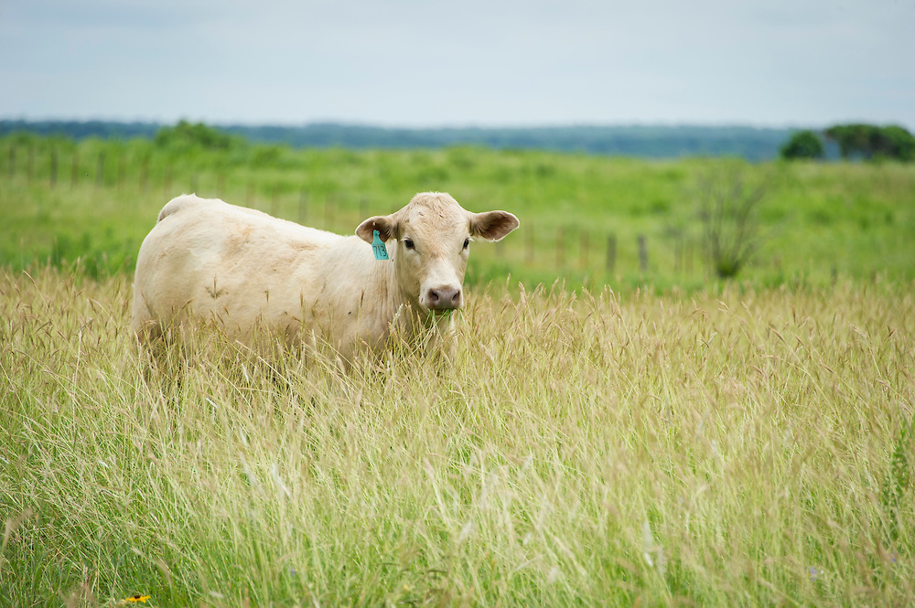
Any other questions?

Slide 25
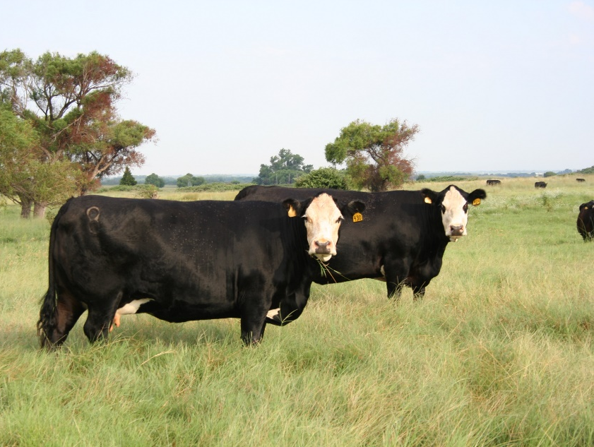
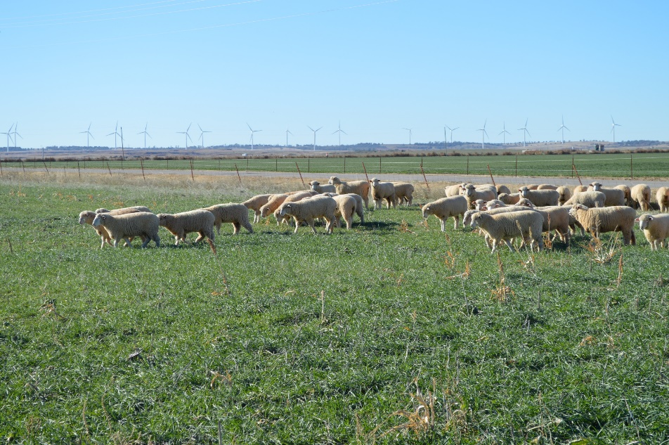
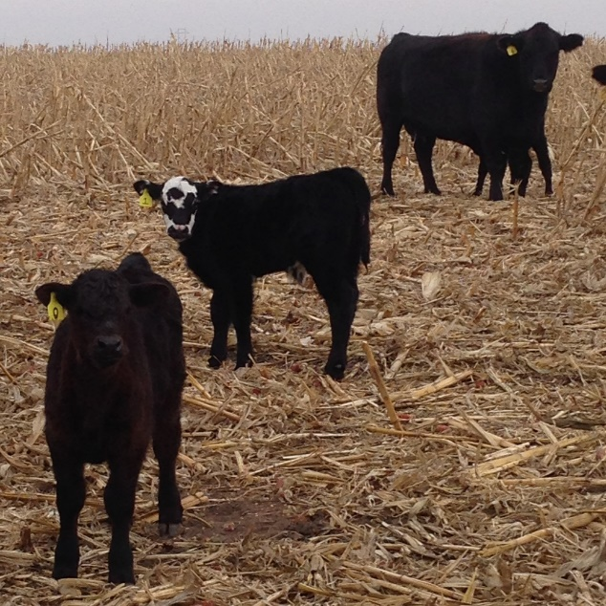
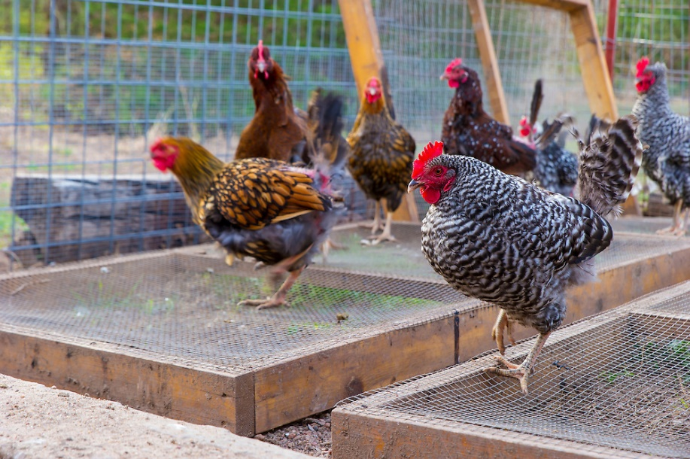
Thank you!
Dana Zook
Area Livestock Specialist
West District
Oklahoma Cooperative Extension

