Slide 1
Managing Uncertainty with LRP and Rainfall Insurance
Northwest Oklahoma Beef Conference
Dr. Monte Vandeveer, Kansas State University
August 2018

Slide 2
Two kinds of federally backed insurance
Livestock Risk Protection (LRP)
  Price insurance for feeder calves coming out of cow-calf operations
  Price insurance for finished cattle coming out of feedlots
Pasture, Rangeland, and Forage (PRF) coverage
  Rainfall-based insurance for pastures and perennial forages
Both are backed by USDA’s Risk Management Agency
Both products are sold by private crop insurance agents

Slide 3
Livestock Risk Protection: LRP
Available for both feeder calves and fed cattle
Price insurance: pay a premium for insurance which guarantees a minimum price
  Works a lot like a put option
Advantages:
  can adapt to your number of head, time periods, etc.
  Premium is subsidized
Does not insure other perils (weight gain, death loss, etc.)

Slide 4
LRP fact sheets available online
Risk Management Agency
  feeder cattle: https://www.rma.usda.gov/pubs/rme/lrp-feedercattle.pdf
  fed cattle: https://www.rma.usda.gov/pubs/rme/lrp-fedcattle.pdf
University of Nebraska-Lincoln
  feeder cattle: http://extensionpublications.unl.edu/assets/html/g1723/build/g1723.htm
  fed cattle: http://extensionpublications.unl.edu/assets/pdf/g2257.pdf
Kansas State University
  feeder cattle: https://www.coffey.k-state.edu/crops-livestock/livestock/Insurance%20for%20Feeder%20Cattle.pdf
  fed cattle: https://www.bookstore.ksre.k-state.edu/pubs/MF2706.pdf

Slide 5
Livestock Risk Protection: LRP
Price insurance: pay a premium for insurance which guarantees a minimum price
  If market price falls below guarantee, insurance pays the difference
  If market price stays above guarantee, no indemnity paid
  Allows the “up side” but protects the “down side”
The higher price guarantee you choose (= the smaller the deductible), the more it will cost
The longer the time horizon, the more it will cost

Slide 6
What price is insured?
LRP uses the CME Feeder Cattle Index
Does not insure local cash price; still subject to basis risk
    Insurance will only consider the change in the index price, not the local price
    For example, suppose local prices fall $4, but index falls only $3
Feeder cattle basis information for NW Oklahoma?

Slide 7
LRP details: sign-up
Work with a private crop insurance agent
One-time initial application
THEN each insured group of cattle must be signed up under its own Specific Coverage Endorsement (SCE)
Initial application can cover multiple SCE’s
Premium is paid at time of SCE sign-up

Slide 8
LRP details: number, weight, type of cattle
Annual limit: 2,000 head (July 1 to June 30)
Feeder cattle weight ranges (at end of insurance period)
under 600 lbs
600-900 lbs
Types: steers
heifers
Brahman
dairy

Slide 9
LRP details: length of coverage
Coverage periods: 13 weeks 34 weeks
17 weeks 39 weeks
21 weeks 43 weeks
26 weeks 47 weeks
30 weeks 52 weeks
Usually, length of coverage matches the expected sales date
Ownership may be retained past the end of the insurance period
Ownership must be maintained until at least 30 days prior to end of coverage date (if cattle are sold early, coverage can be transferred to new owner, otherwise forfeited)

Slide 10
LRP details: level of price coverage
Coverage Price = Expected Ending Value x Percent Coverage Level
Percent Coverage Level can range from 70% to 100% of EEV
Endorsement Length | Commodity | Type | Expected Ending Value | Coverage Price | Coverage Level | Rate | Cost Per CWT
13 weeks | Feeder cattle | Steers Weight 1 | $163.518 | $162.280 | 0.9924 | .030773 | $4.994
13 weeks | Feeder cattle | Steers Weight 1 | $163.518 | $155.680 | 0.9521 | .014025 | $2.183
13 weeks | Feeder cattle | Steers Weight 1 | $163.518 | $153.480 | 0.9386 | .010406 | $1.597
13 weeks | Feeder cattle | Steers Weight 1 | $163.518 | $149.080 | 0.9117 | .005276 | $0.787

Slide 11
LRP details: premium calculation example
Step 1: calculate the Insured Value
Step 2: calculate the Total Premium
Number of head (whole number) | X | Target weight at end date (CWT per head) | X | Coverage Price (as shown on actuarial document) | X | Insured Share | = | Insured Value (total dollars)
50 | x | 6.00 | x | $155.68 | x | 1.0 | = | $46,704
Insured Value (total dollars) | X | Rate | = | Total Premium (rounded, in dollars)
$46,704 | x | .014025 | = | $655

Slide 12
LRP details: premium calculation, cont’d.
Step 3: calculate the Premium Subsidy
Step 4: calculate the Producer Premium
Total Premium (total dollars) | X | Subsidy Rate | = | Rounded Subsidy (nearest dollar)
$655 | x | .130 | = | $85
Total Premium (total dollars) | - | Rounded Subsidy | = | Producer Premium (rounded, in dollars)
$655 | - | $85 | = | $570

Slide 13
LRP details: loss/indemnity calculation
Expected Ending Value $163.518
Coverage Price $155.68
Actual Ending Value $151.50
Did we have a loss? How much is the indemnity?

Slide 14
LRP details: indemnity calculation example
1. | Number of head | 50
2. | Target weight at end date (CWT per head) | 6.0
3. | Coverage Price (at insurance sign-up) | $155.68
4. | Actual ending value (price at end of period) | $151.50
5. | Coverage Price – Actual Ending Value = Line 3 – Line 4 | $4.18
6. | Insured Share | 1.0
7. | Total Indemnity = No. of head x Target Wt. X Price Diff x Ins. Share = Line 1 x Line 2 x Line 5 x Line 6 | $1,254

Slide 15
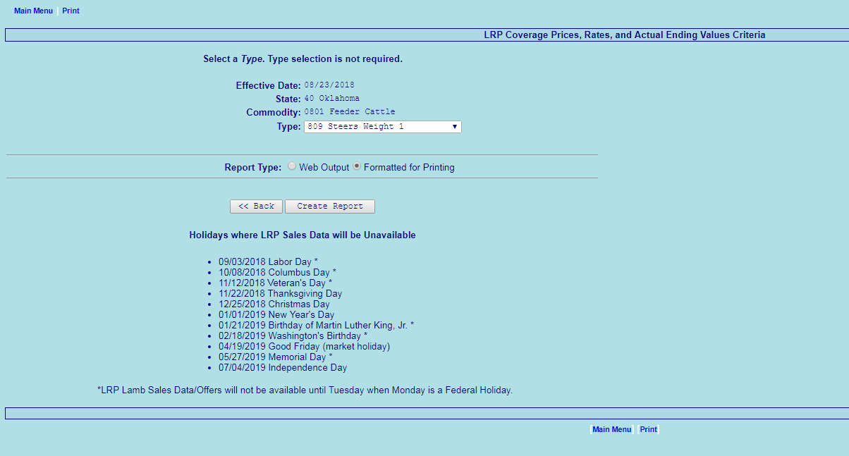
https://www3.rma.usda.gov/apps/livestock_reports/main.aspx

Slide 16
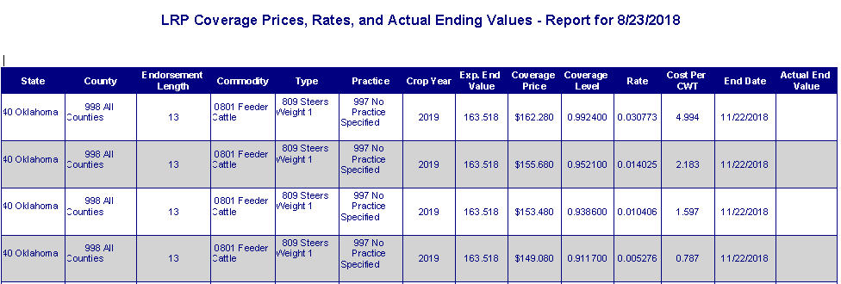

Slide 17
Using Livestock Risk Protection
Review fact sheets
Meet with a crop insurance agent
Visit the RMA website for LRP to check for prices, premiums, etc.
Compare with other marketing alternatives….
QUESTIONS ABOUT LRP?

Slide 18
Pasture, Rangeland, and Forage insurance: background
Program of Risk Management Agency (USDA)
Insures land for grazing or haying
    Established acreage of perennial forage
    Acreage must be suitable for intended use
    Intended to provide $$$ to purchase replacement feed
Started as a pilot program in 2007

Slide 19
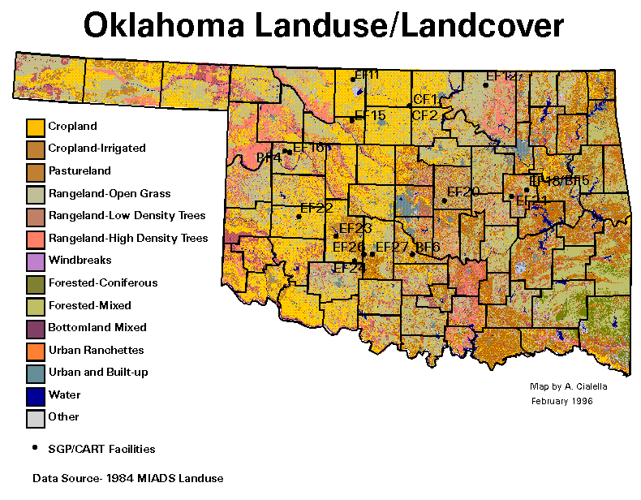
The PRF numbers for Oklahoma….
Oklahoma Farm and Ranch Land
34.4 million acres in farms
19.5 million acres in permanent
pasture or rangeland
11.3 million acres in cropland
2.7 million acres in hay
Source: 2012 Census of Agriculture

Slide 20
How much is 22 million acres?
Crop | Acres planted In 2017 | Acres insured In 2017 | % insured In 2017
Wheat | 4,349 K | 2,882 K | 66
Soybeans | 639 K | 525 K | 82
Cotton | 570 K | 511 K | 90
Corn | 331 K | 287 K | 93
Grain sorghum | 293 K | 234 K | 80
Rye | 179 K | 11 K | 6
Canola | 126 K | 115 K | 91
Top 7 crops | 6,487 | 4,565 | 70
Pasture & perennial forages | 22.2 million | 1.6 million | 7.2
Source: Risk Management Agency, USDA

Slide 21
PRF Insurance: more background
Sold by private insurance agents
Significant premium subsidy
    51-59% paid by USDA
Uses dollar coverage per acre
    varies by county, base value set by RMA
Uses rainfall index, area-based

Slide 22
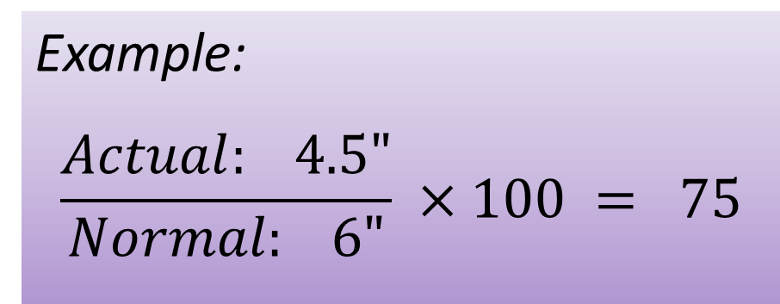

PRF uses a rainfall index
Index expresses ACTUAL as % of NORMAL:
If actual rainfall index falls below guaranteed level, the insurance pays an indemnity
Example:
$$\frac{Actual: 4.5"}{Normal: 6"} ×100 = 75$$
$$\frac{Actual precip}{Normal precip} × 100$$

Slide 23
But why insure precipitation?
PROBLEM: how can we insure forage production when we usually don’t measure pasture / forage output?
ANSWER: use another measure as a proxy for forage production
    “Meaningful” - will closely reflect forage production
    “Measureable” –feasible to obtain, understandable, even have “official” values

Slide 24
Whose rainfall?
Uses NOAA Climate Prediction Center data
    Minimum of 6,000 stations reporting daily, usually over 15,000 stations report daily across US
Uses multiple stations to calculate a composite precipitation value for each grid area
    4 closest reporting stations used
    Don’t rely on just 1 station
    NOAA performs grid calculations

Slide 25
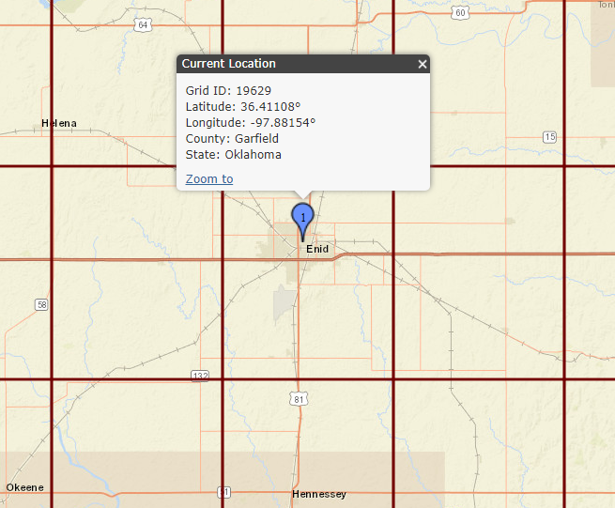
Area-based coverage: find your grid
0.25 degrees longitude x 0.25 degrees latitude
If your land lies in 2 adjacent grids, you can insure it in one or the other, or split it into both
Only one composite rainfall value for entire grid

Slide 26
Precipitation amount weighted by distance from grid center
Station 2
More distant stations get smaller weights
Your location in the grid doesn’t matter
Station 3
Station 1
Station 4

Slide 27
PRF Insurance: coverage features
Single peril: only insures precipitation
Other perils aren’t insured
    Fire • Hail
    Heat • Insects
    Disease • Plant vigor
Guarantee from 70% to 90% of normal precip
Area-based: uses a grid system

Slide 28
PRF Insurance: time periods
Policy runs January to December
Pick time periods you want to insure
    at least two 2-month intervals (no overlap)
    allocate $ coverage across selected intervals
    maximum allocation of 60%, minimum of 10%

Slide 29
PRF insurance decisions
Producers select / identify:
    intended use (grazing or haying)
    acres to insure, grid location
    rainfall index guarantee level (70% to 90%)
    dollars of protection (with Productivity Factor)
    time periods to insure
    allocation of coverage across time periods

Slide 30
Online resources
RMA info on PRF
www.rma.usda.gov/policies/pasturerangeforage/
Grid locator and Decision Support Tool
http://prodwebnlb.rma.usda.gov/apps/prf

Slide 31
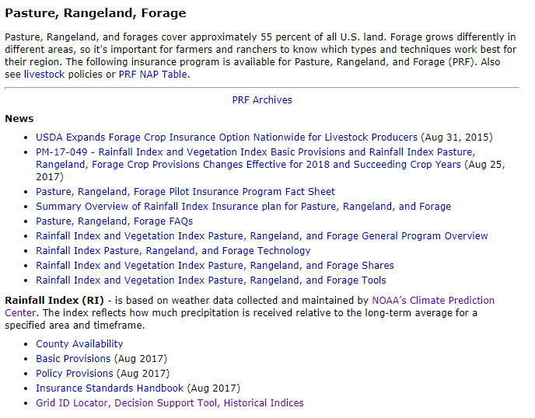

Slide 32
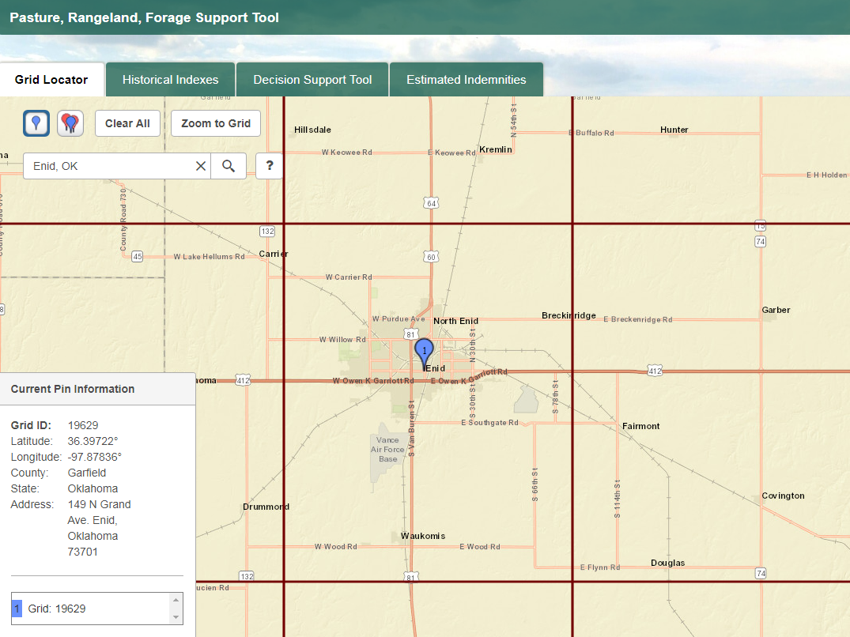

Slide 33
Use the Decision Support Tool to…
Compare index intervals and coverage allocations
Compare guarantee levels
Estimate premium costs
Evaluate PRF results for particular years

Slide 34
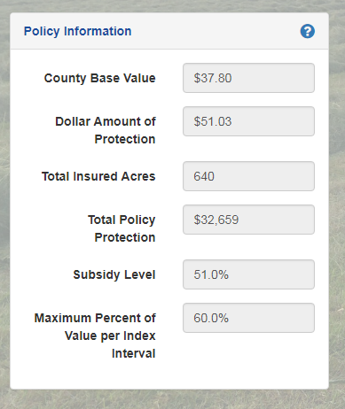
County Base Value
= base $ value of production per
acre; set by RMA
Dollar Amount of Protection
= County Base Value
x Productivity Factor %
x Guarantee Level %
Total Policy Protection
= Dollar Amount of Protection
x Total Insured Acres

Slide 35
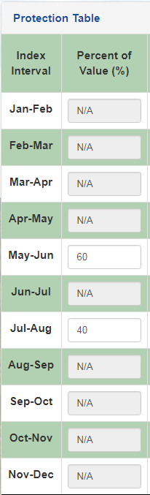
INDEX INTERVALS
Time periods for which
you insure rainfall
Must choose at least two
intervals
Must allocate % of
dollar coverage to each
(max 60%, min 10%)
Which periods? What allocation?

Slide 36
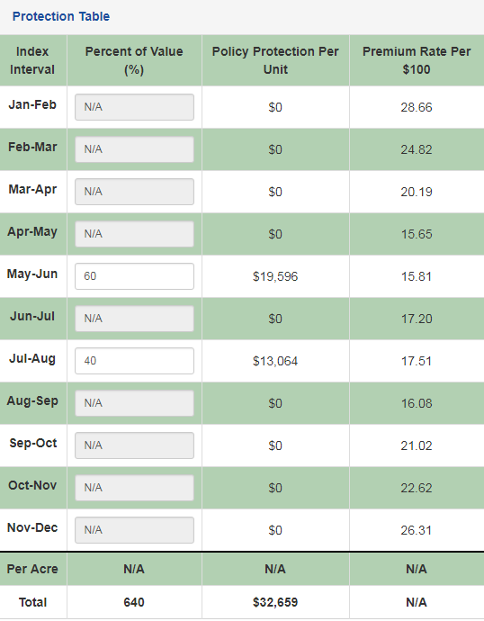
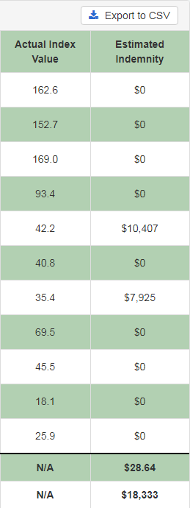
RESULTS FOR 2012
Coverage level = 90%
May-Jun:
Actual Index = 42.2
Payment Factor =
(90 – 42.2) = .5311
90
Indemnity =
Payment Factor
x $ Policy Protection
= .5311 x $19,596
= $10,407

Slide 37
Insuring Haying Lands
Perennial hay crops can be insured
    Alfalfa
    Grass hay meadows
    Much higher $$$ of protection per acre
Irrigated or non-irrigated
    Non-irrigated dollar coverage based on value of forage, like pasture
    Irrigated dollar coverage based on additional cost of pumping needed to obtain ordinary production

Slide 38
Should I use PRF?
How accurately do the PRF indices reflect actual drought in my location? (“Will PRF pay when I have a loss?”)
Which index intervals and coverage allocations should I use? Which guarantee level and dollar amount per acre?
Would PRF provide adequate funds to purchase replacement feed during bad years?

Slide 39
Index intervals? Allocation?
Precipitation during growing season is strongest predictor of forage output
Selecting more periods: reduces chances of collecting no indemnity
Premium cost
    Calculation: RATE x $ Coverage/A x (1 - subsidy rate)
    Which intervals have lower premiums?

Slide 40
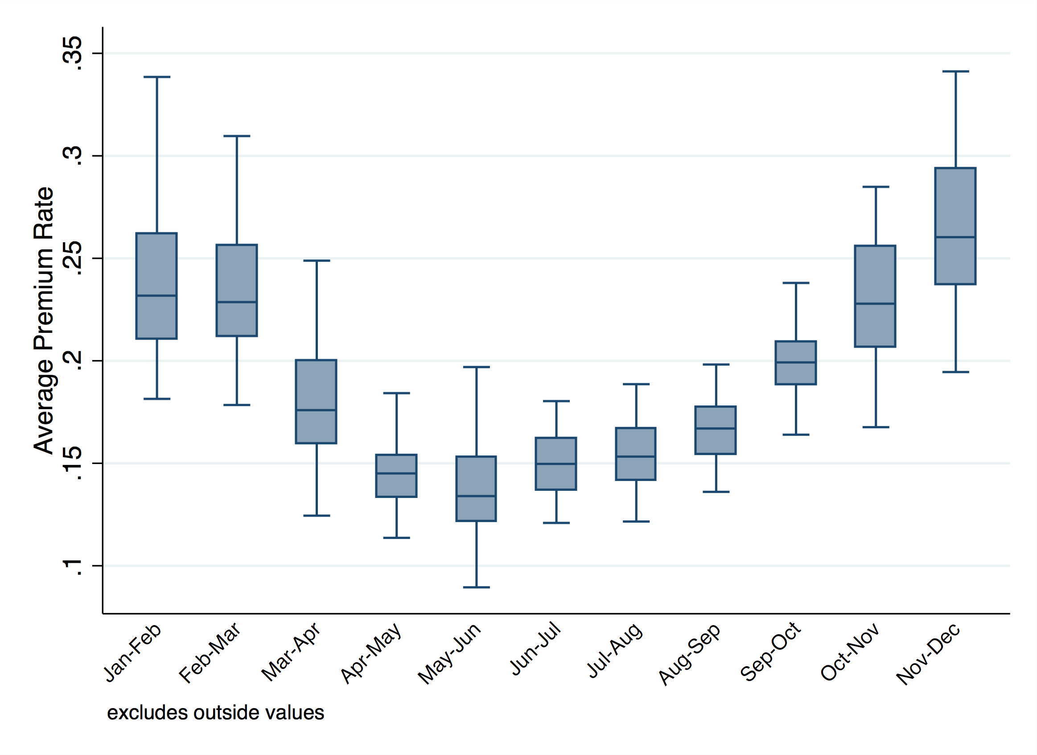
Premium rates, by index interval, 90% guarantee
Values across all KS and NE grids
Grid 19629 – Enid, OK

Slide 41
Premium rates vary by interval and coverage level
Grid 19629 – Enid, OK
Source: PRF Decision Support Tool, August 2018

Slide 42
Probability of loss, 1948 to 2017
Grid 19629 – Enid, OK
Source: PRF Decision Support Tool, August 2018

Slide 43
Strategies used….
“Cover the growing season”
  Use 2 or 3 intervals for the warmer months
  60-65% of participants
“Maximize chance of collecting”
  Put coverage in every period
  About 1/3 of participants
“Big money”
  Put most or all coverage in the winter months
  Best chance for collecting an indemnity
  About 5% of participants

Slide 44
How much feed could I buy?

Slide 45
Long-term perspective on PRF
Most OK locations will have good protection in widespread drought, may have hit-or-miss experience in spotty years
Will come out ahead in long run due to premium subsidy
    Most grids: about $1.50 - $2.00 back for every $1.00 paid in

Slide 46
Use the Decision Support Tool to evaluate your options
Compare your experience with the historical indices
Consider $$ needed for replacement feed
Compare coverage options
November 15 is sales deadline

Slide 47

Questions?
Comments?
Thank you!
Dr. Monte Vandeveer
KSU Extension Agricultural Economist
Email: montev@ksu.edu
Phone: 620-275-9164
K-State Research and Extension is a statewide network of educators sharing unbiased, research-based information and expertise on issues important to Kansas and the public in general. K-State Research and Extension is an equal opportunity provider and employer.

Slide 48
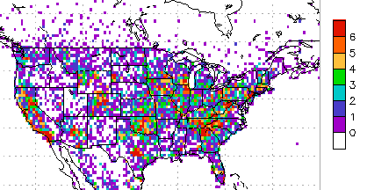
Location of reporting NOAA CPC weather stations
http://www.cpc.ncep.noaa.gov/products/Precip_Monitoring/Figures/NAMS/NAMS_curr.p.gnum.gif

