Slide 1
Vaccine Coolers
Dana Zook, Area Livestock Specialist
Oklahoma Cooperative Extension

Slide 2
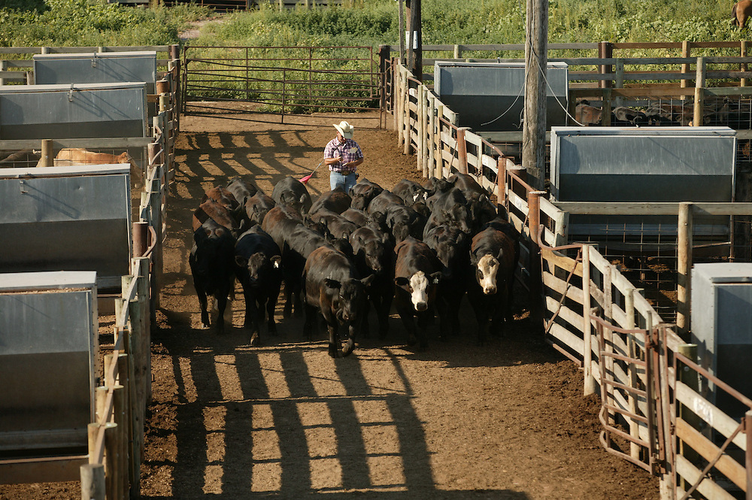
Vaccination Program
Bovine Respiratory Disease (BRD) in cattle costs the U.S. cattle industry over $2 billion annually (Powell, 2013)
Vaccination Program
Vaccine Costs - >$3/head
Notes:
There are steps we can take to reduce the incidence of diseases such as this
One such thing is a vaccination program

Slide 3
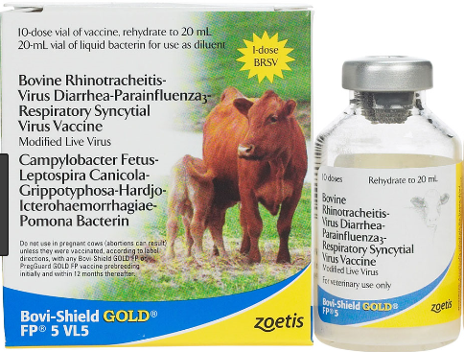
Vaccine Storage
Protection from cold and hot temperatures
Biological products should be stored 35-45°F (APHIS 2007)
Deviation from target temp
= reduced efficacy of vaccine
Notes:
Understanding the importance of vaccine storage and protection from both cold and hot temperatures
Biological products should be stored 35-45°F unless the label tells us otherwise

Slide 4
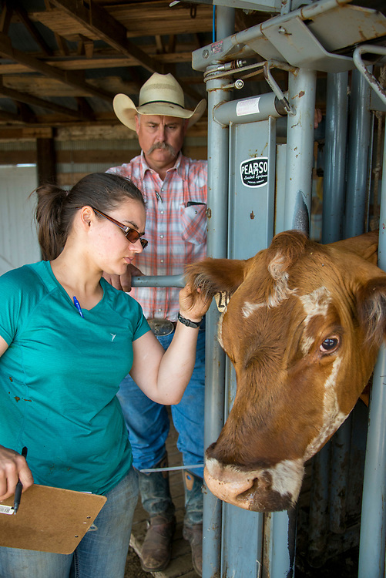
Where is vaccine storage overlooked?
Shipping?
On the way home from the vet?
Vehicle
Chute side

Slide 5
